Slide 2
Building Bridges from knowledge to impact Interactive discussion about the impact of the ONCA campaign and how to improve it
Rudi Crabbé & Marcel Smeets, co-chairs

Slide 3
Building Bridges from knowledge to impact
Building bridges from knowledge to impact – interesting examples
Green Deal in NL (bottom-up) and
Charte nationale pour une alimentation responsable et durable in France (top-down)
Create, tell and sell !
Discussion about the role ONCA can play in national campaigns and the role of national campaigns in ONCA

Slide 4
Building Bridges from knowledge to impact
[VIDEO]

Slide 5
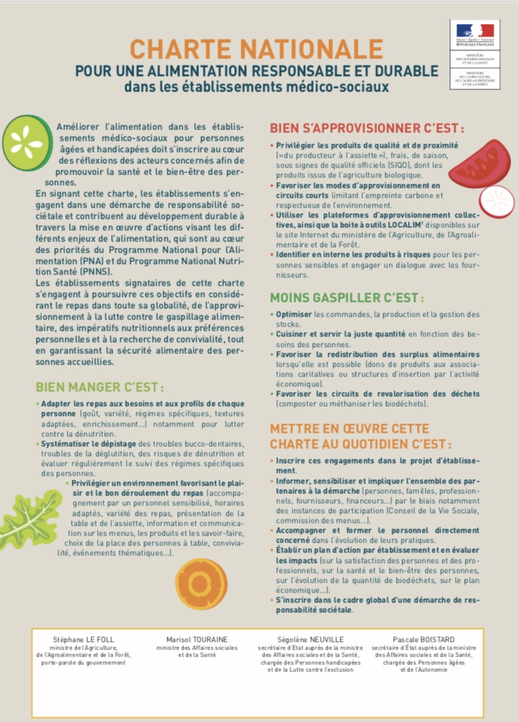
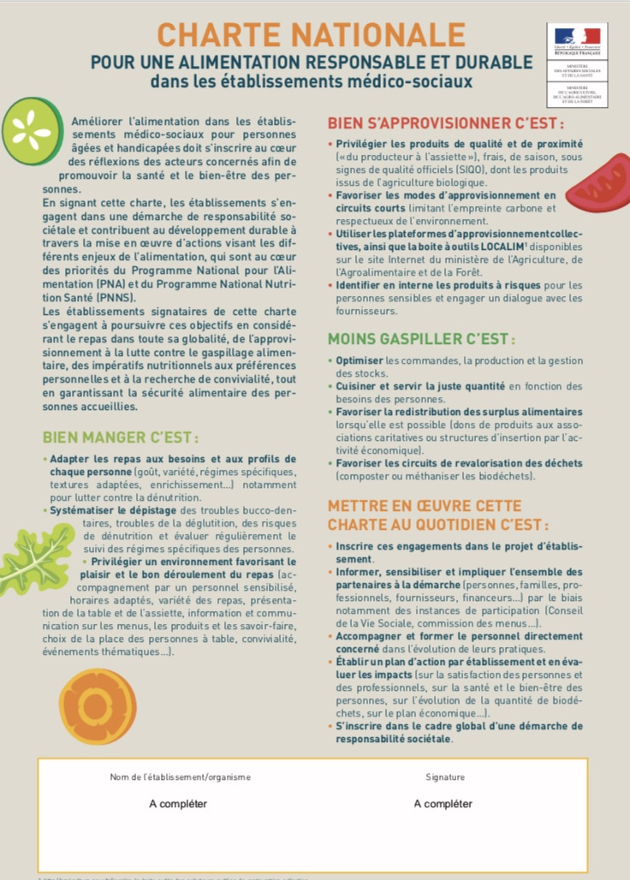
Building Bridges from knowledge to impact

Slide 6
Building Bridges from knowledge to impact
Origin
In FR, financial crisis, agri-industry policy
In NL, sustainability agenda
Initiatiator
IN FR, government, Ministries (AGRI & ECON, Health, Social)
In NL, 123 organisations: Local governments, 3 ministries Healthcare, Health Insurance, Banks, Patient organisations
Goals
In FR, stimulate local produce, reduce waste, tackle malnutrition
In NL, Sustainable healthcare for a healthy future

Slide 7
Building Bridges from knowledge to impact
Message
In FR, “La maison gourmande et responsable”
In NL, The Healthcare can positively influence to a healthy diet: “Health Potential”
Credibility
IN FR, research, best practices, chefs
In NL, patients and clients
Support
In FR, FNAQPA, ADEF, etc
In NL, good practices, patient and elderly organisations, knowledge organisations

Slide 8
Building Bridges from knowledge to impact
Discussion points
What could be done in other ONCA-countries ?
How could ONCA contribute to the national campaigns?
How could national campaigns contribute to ONCA ?

