Slide 1

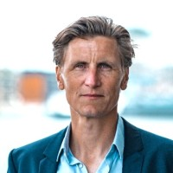
An indispensable part of multidisciplinary patient-centred cancer care
Joost Wesseling
Executive Director
The European Nutrition for Health Alliance
joost@european-nutrition.org
Notes:
Our proposal is to launch a Thematic Network on Integrated Nutrition Cancer Care – Which is an indispensable part of multidisciplinary patient-centred cancer care.
The initiators of this proposal collaborate other under the EU4Nutrition platform. The bottom line of this policy platform: If you are serious about health, you should be serious about nutrition.

Slide 2
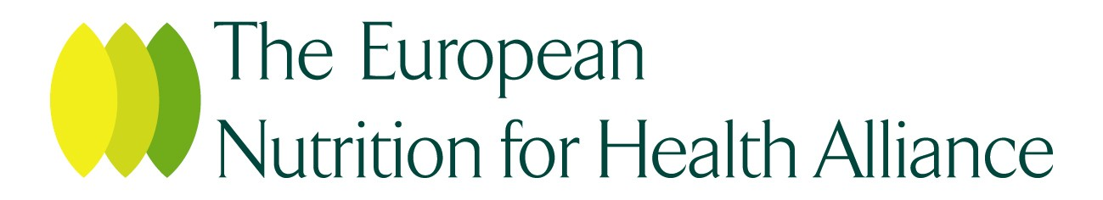
The protection of the nutritional state of a patient with cancer is critical for their treatment outcomes and quality of life, and it is a patient’s right to have access to high-quality nutrition cancer care.
Notes:
(30 sec)
I’d like to thank all speakers and panelist for their contribution to this important topic and let’s regard this as an important step for future collaborations.
So let me briefly touch upon European Nutrition for Health Alliance, ENHA
The ultimate aim of ENHA and its partners is to ensure that the protection of a person’s nutritional status is an integral part of high-quality care in aging and disease. A right of every European citizen.

Slide 3


The European Nutrition for Health Alliance
The purpose of the alliance is to ensure that the protection of a person’s nutritional status is an integral part of high-quality care in aging and disease.
Notes:
(30 sec)
I’d like to thank all speakers and panelist for their contribution to this important topic and let’s regard this as an important step for future collaborations.
So let me briefly touch upon European Nutrition for Health Alliance, ENHA
The ultimate aim of ENHA and its partners is to ensure that the protection of a person’s nutritional status is an integral part of high-quality care in aging and disease. A right of every European citizen.

Slide 4
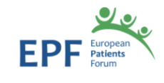
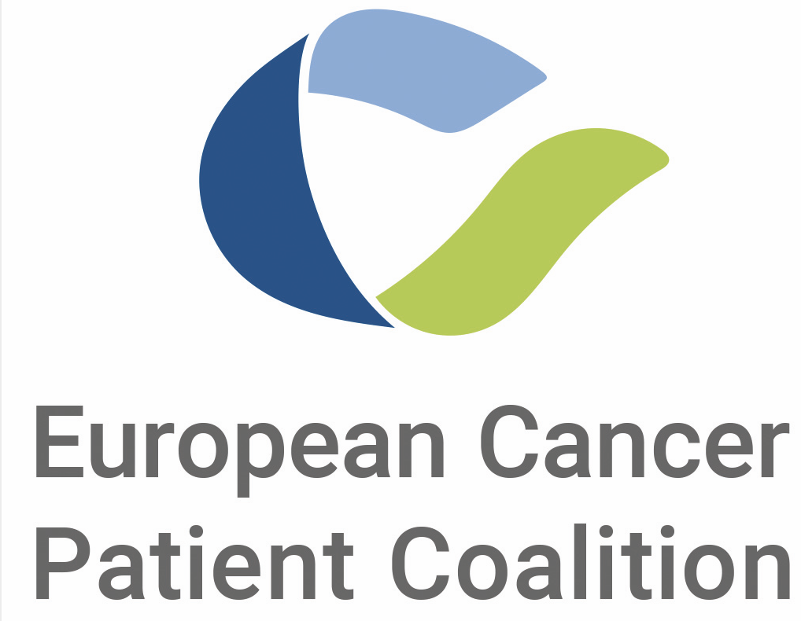
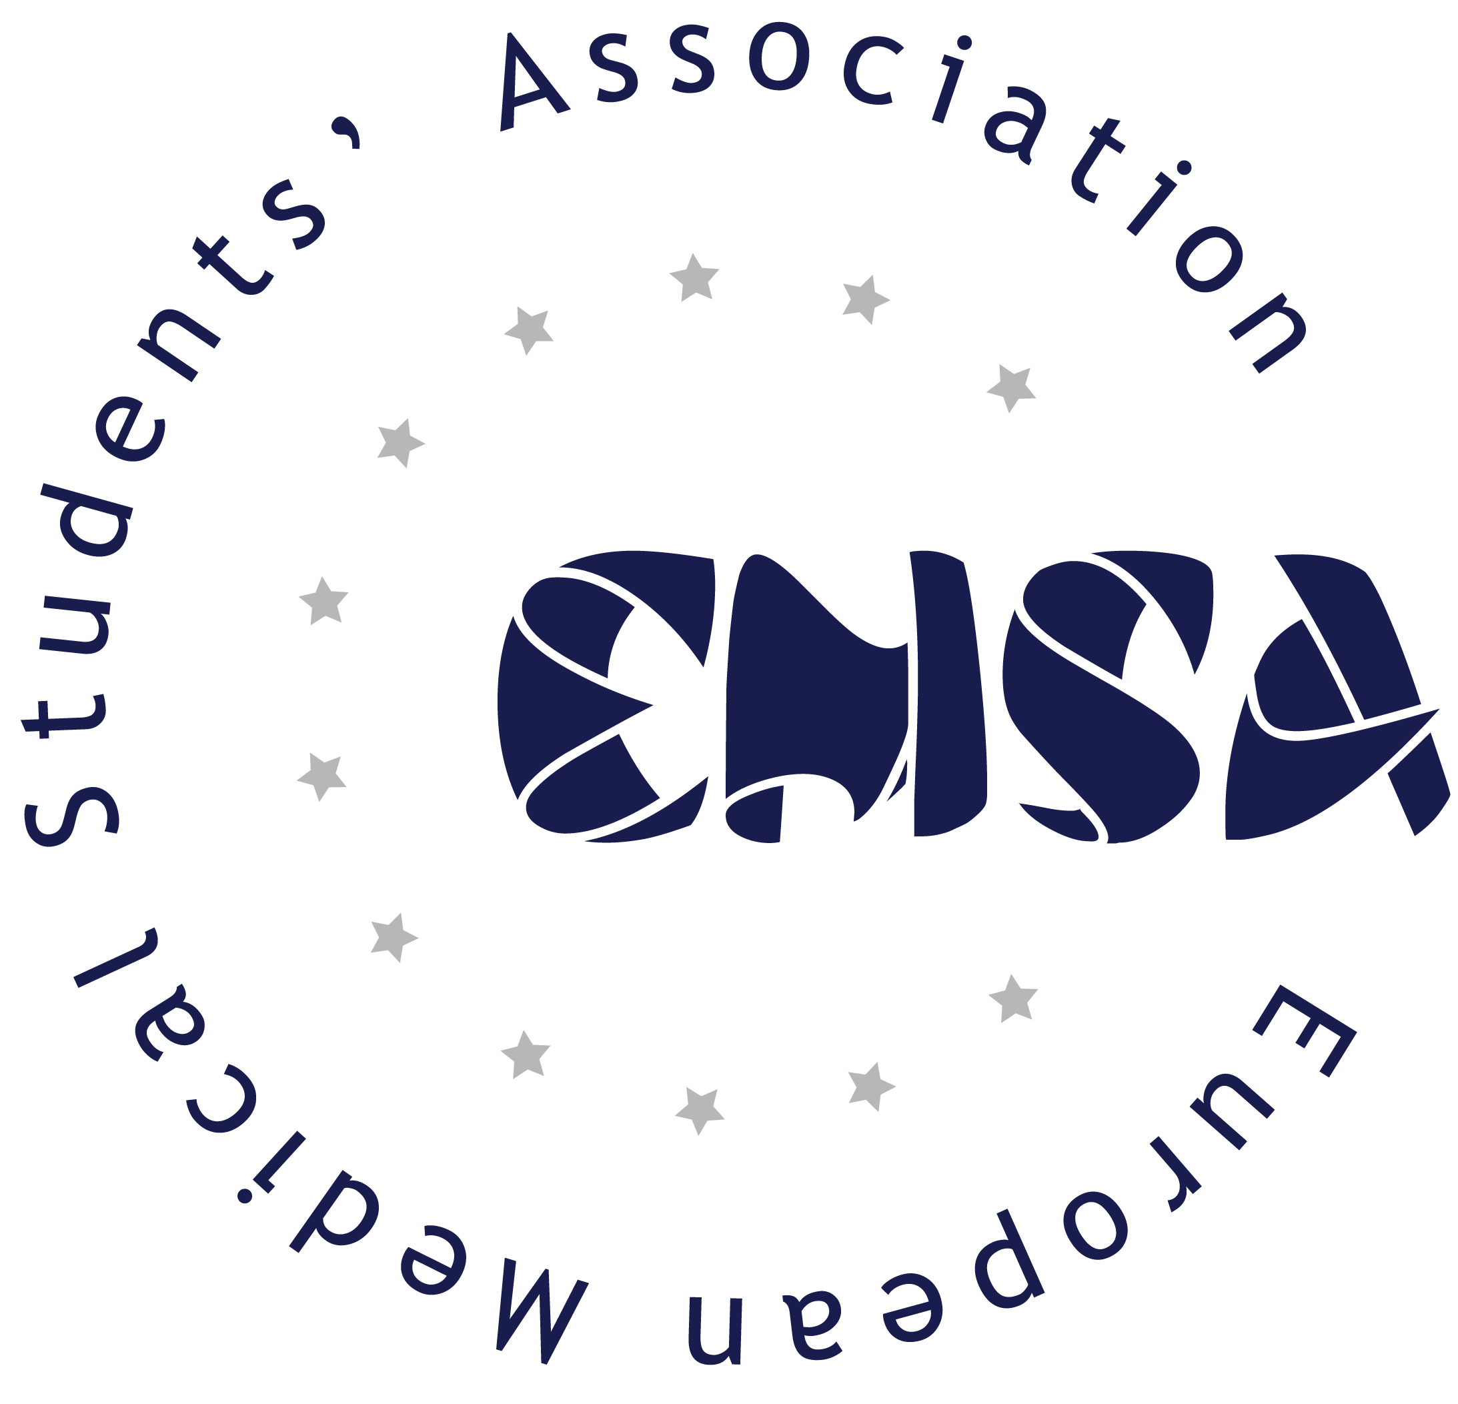
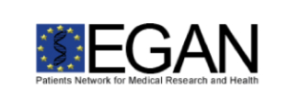

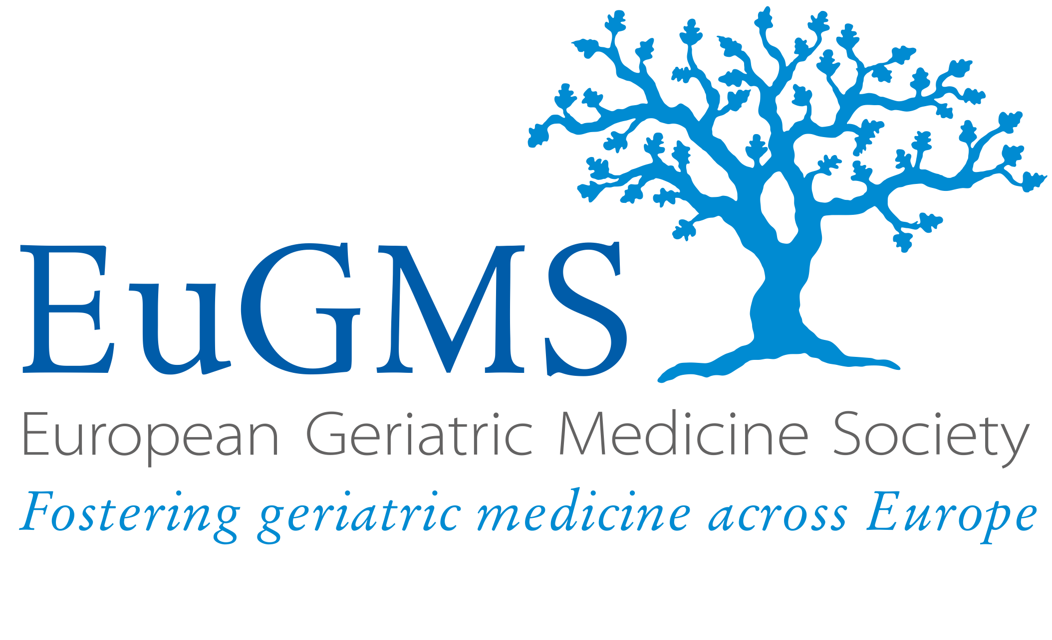
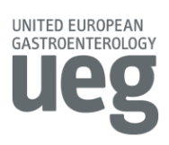

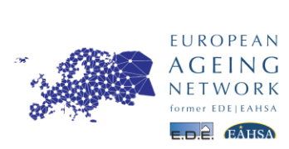

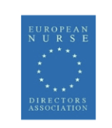
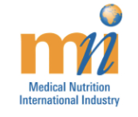
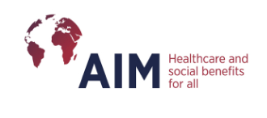
Shaping policy through multistakeholder collaboration
Notes:
(30 sec)
ENHA is a _Multistakeholder and _Multidisciplinary platform.
Its members are, among others, Europe’s leading professional societies, in clinical nutrition (ESPEN), geriatrics (EuGMS) and dietetics (EFAD) as well as European patient organisations: the European Patients’ Forum (EPF) and the European Cancer Patient Coalition (ECPC).

Slide 5

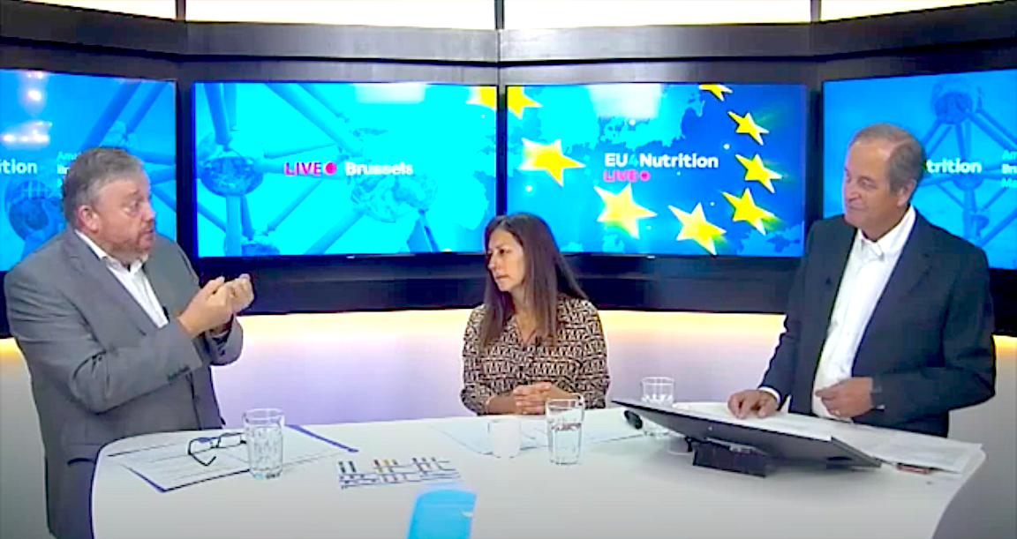
European and regional platforms
Notes:
(1 minute)
ENHA and its partners have collaborated to build EU level relationships with the Commission, Committees, Members of European Parliament and other stakeholders to further drive implementation of optimal nutritional care. We do this through EU4Nutrition, a policy advocacy platform that aims integrate nutrition in all EU programs AND EU recommendations for NATIONAL health policies such as Europe’s Beating Cancer plan. The EU has health high on the agenda, working towards a European Health Union. So what WE say is: ‘If you are serious about health, you should be serious about nutrition’. With Europe’s Beating Cancer plan, national policy makers now have an unrivalled opportunity to align their cancer programmes with best international practice for high quality cancer care. Which brings us to our national level campaign: Optimal Nutritional Care for all.
COVID-19 pandemic has severely impacted cancer care, disrupting prevention and treatment. The aim of Europe’s Beating Cancer Plan is to tackle the entire disease pathway. It is structured around four key action areas where the EU can add the most value: (1) prevention; (2) early detection; (3) diagnosis and treatment; and (4) quality of life of cancer patients and survivors.
ENHA and its partners have worked hard to include nutritional care in the cancer plan. And so we were very pleased to that _nutritional support has become part of the cancer plan, within a workforce 'Inter-specialty cancer training programme’. But we obviously strive for more. And, as Stella Kyriakides, European Commissioner for Health and Food Safety, stated: ‘The challenge of the plan lies in its implementation’,
ENHA recognises Europe’s Beating Cancer Plan as a major step forward in the bloc’s collective efforts to address inequities in the quality of cancer care across member states. With a €4.1billion budget aimed at supporting implementation of this ambitious programme, __national policy makers now have an unrivalled opportunity to align their cancer programmes with best international practice for high quality cancer care that carries the same hope of survival and quality of life. However, high quality cancer care cannot be delivered without addressing the gaps in workforce training, clinical pathways and dietetic services that leave many patients without timely access to information, dietary counselling or nutrition support needed to achieve their best possible outcome.
In her first State of the Union address, drawing lessons from the COVID-19 pandemic, European Commission President Ursula von der Leyen highlighted the need to build a stronger European Health Union and, with that, relaunched the idea of rethinking health competence, which is currently in member states’ hands. As you might know, the European Union is active on several health-related policy domains. However, health services and medical care being a competency of the members states, the EU’s impact on healthcare has been limited thus far. The focus being on complementing national policies. This has started to change, with the idea of a European Health Union, beginning with the launch of the Commission’s ambitious Europe’s Beating cancer plan of which treatment of cancer, and with that healthcare, is one of its four pillars.
One of the EU’s instruments to fund Europe’s Beating Cancer plan, is the EU4Health programme, which, in response to the COVID pandemic, has a 5 billion Euro budget, more than 10 times that of the previous health programmes. In the next seven years it will aim to reduce the burden of communicable and non-communicable diseases in the EU. EU4Health will provide funding to EU countries, health organisations and NGOs.

Slide 6
Did you know…
…malnutrition and undernutrition affect over 30 Million European citizens?
Ljungqvist O, van Gossum A, Sanz ML, de Man F. The European fight against
malnutrition. Clin Nutr 2010;vol. 29:149e50.
Notes:
Malnutrition and undernutrition affect over 30 Million European citizens and place an unacceptable burden on European citizens and health care budgets.

Slide 7
Did you know…
…one in two patients with cancer experience involuntary weight and muscle loss.
Arends J., et al. Klinische Ernährung in der OnkologieS3-Guideline of the German Society for Nutritional Medicine (DGEM) in Cooperation with the DGHO, the ASORS and the AKE. Clinical Nutrition in Oncology. Aktuel Ernahrungsmed 2015; 40: e1–e74
Martin L, Senesse P, Gioulbasanis I, et al. Diagnostic criteria for the classification of cancer-associated weight loss. J Clin Oncol. 2015 Jan 1;33(1)
Notes:
One in two patients with cancer experience involuntary weight and muscle loss, (including patients with obesity) that undermine the effectiveness of treatments, increase risks of side effects, increase length of hospital stay, reduce quality of life and increase cost.

Slide 8
Did you know…
…the deaths of 10-20% of patients with cancer can be attributed to malnutrition rather than to the malignancy itself?
Arends J., et al. Klinische Ernährung in der OnkologieS3-Guideline of the German Society for Nutritional Medicine (DGEM) in Cooperation with the DGHO, the ASORS and the AKE. Clinical Nutrition in Oncology. Aktuel Ernahrungsmed 2015; 40: e1–e74
Notes:
It is estimated that the deaths of 10-20% of patients with cancer can be attributed to malnutrition rather than to the malignancy itself.

Slide 9
Did you know…
…that only 30%-60% of patients with cancer who were at risk of malnutrition actually receive nutritional support?
Arends J., et al. Klinische Ernährung in der OnkologieS3-Guideline of the German Society for Nutritional Medicine (DGEM) in Cooperation with the DGHO, the ASORS and the AKE. Clinical Nutrition in Oncology. Aktuel Ernahrungsmed 2015; 40: e1–e74
Maschke J,et al. Nutritional care of cancer patients: a survey on patients' needs and medical care in reality. Int J Clin Oncol. 2017
Notes:
Research within European hospitals found that only 30%-60% of patients with cancer who were at risk of malnutrition actually received nutritional support.

Slide 10

A Patient’s Right
It is a patient’s right to have access to high-quality nutrition cancer care.

Slide 11

What does the science say?
1) The protection of the nutritional state of a patient with cancer is critical for their treatment outcomes and quality of life.
2) optimizing nutritional care is a very (cost-) effective measure in both disease prevention and treatment
Thorne JL, Moore JB, Corfe BM. Nutrition and cancer: evidence gaps and opportunities for improving knowledge. Proc Nutr Soc. 2020 Aug;79(3):367-372.
Scholte, R. The Value of Dietetics for Malnourished Hospital Patients. No. 2015-04. Commissioned by the Dutch Association of Dietitians SEO Economic Research. Amsterdam, April 2015

Slide 12
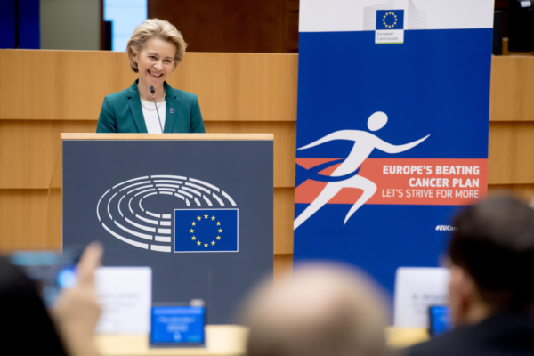
Europe’s Beating Cancer plan
‘Europe’s Beating Cancer Plan will ultimately ensure that patients across the EU can benefit from better care and treatment’.
Notes:
Europe’s Beating Cancer Plan carries a strong commitment to giving all patients in the EU the same access to high-quality care.
We were very pleased that nutrition support has become part of the cancer plan, but we also strive for more. And, as Stella Kyriakides, European Commissioner for Health and Food Safety, stated: ‘The challenge of the plan lies in its implementation’, Nutrition is part of every step of the cancer care pathway, and Integrated Nutritional Cancer Care requires a well thought out implementation.

Slide 13
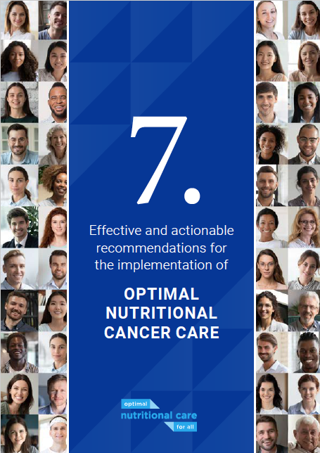
What needs to be done?
Cancer plan implementation
7 actionable recommendations
Adapt to local situation
Addressing existing gaps
www.european-nutrition.org/recommendations
Notes:
Overwhelming scientific evidence supports that weight, body composition, and nutrition intake play an essential role in all stages of cancer treatment and the risk of developing certain cancers. Despite being the single most frequent, serious complication in cancer, malnutrition continues to receive unacceptably low priority in some national cancer care policies and the concept of integrated nutritional care in healthcare systems is not yet well established in every European country, increasing inequality.
National policy makers now have an unrivalled opportunity to align their cancer programmes with best international practice for high quality cancer care that carries the same hope of survival and quality of life. However, high quality cancer care cannot be delivered without addressing the gaps in workforce training, clinical pathways and dietetic services that leave many patients without timely access to information, dietary counselling or nutrition support needed to achieve their best possible outcome.
Recognising the need for every member state to take coordinated actions for Beating Cancer Plan implementation, a this joint ‘call to action’ is being developed which includes 7 key recommendations designed to ensure the protection of nutritional status in cancer in national health policies.
High-quality cancer prevention and care cannot be delivered without addressing the existing gaps in healthcare: workforce training, clinical pathways and dietetic services are often not available, leaving many patients without timely access to information, dietary counselling or nutrition support needed to achieve their best possible outcome.
To influence EU programmes and to support national initiatives, together with our partners we have developed this joint call to action with 7 actionable recommendations designed to ensure the protection of nutritional status in cancer in national health policies.
The CTA is a template that can be tailored to your country’s or region’s specific situation and needs. And we can help you to do that and reach out to reach out to politicians and media or support the organisation of a policy seminar.
You can read and download the call to action at European-nutrition.org/recommendations.

Slide 14
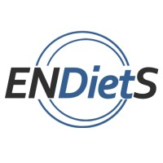
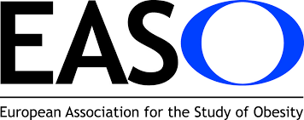
Europe’s Nutrition & Cancer experts
Notes:
The proposal is led by ECPC (450 members), EFAD (35L dietitians), EASO (15K leaders in obesity research) and ESPEN 65 member societies covering the whole of the EU.
The European Nutrition for Health Alliance is a multistakeholder and multidisciplinary platform that aims to accelerate the implementation of optimal nutritional care in Europe and beyond.

Slide 15
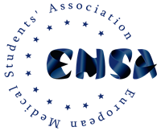
It starts with education

Slide 16
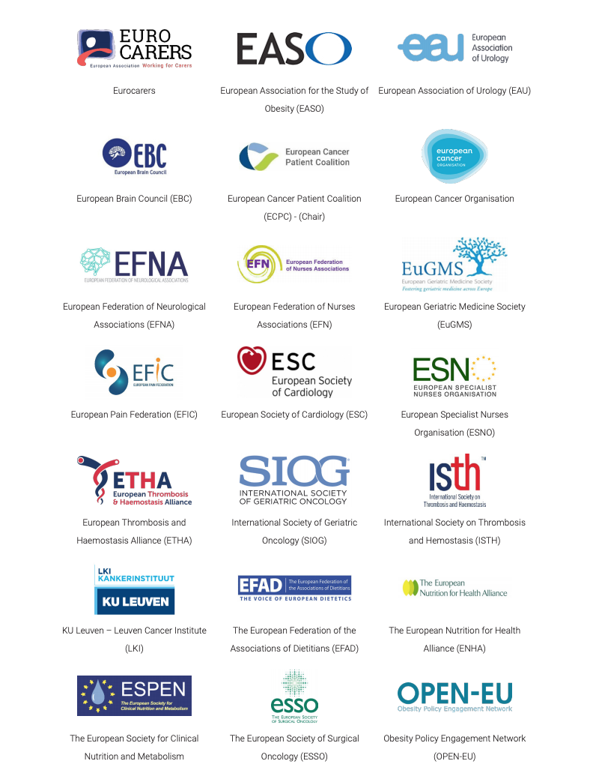

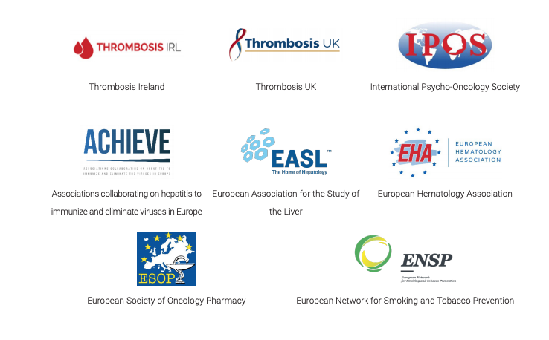
Cancer-related comorbidities initiative

Slide 17
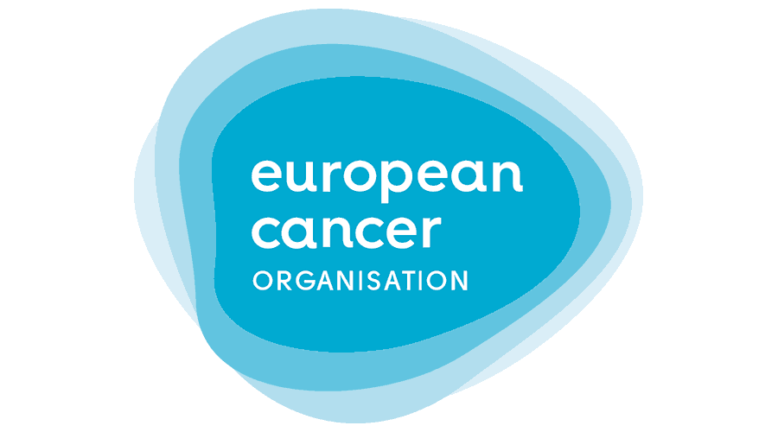
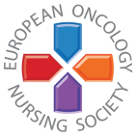
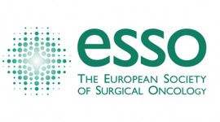

Engaging with Europe’s Cancer experts

Slide 18
Secure patient centredness

Slide 19
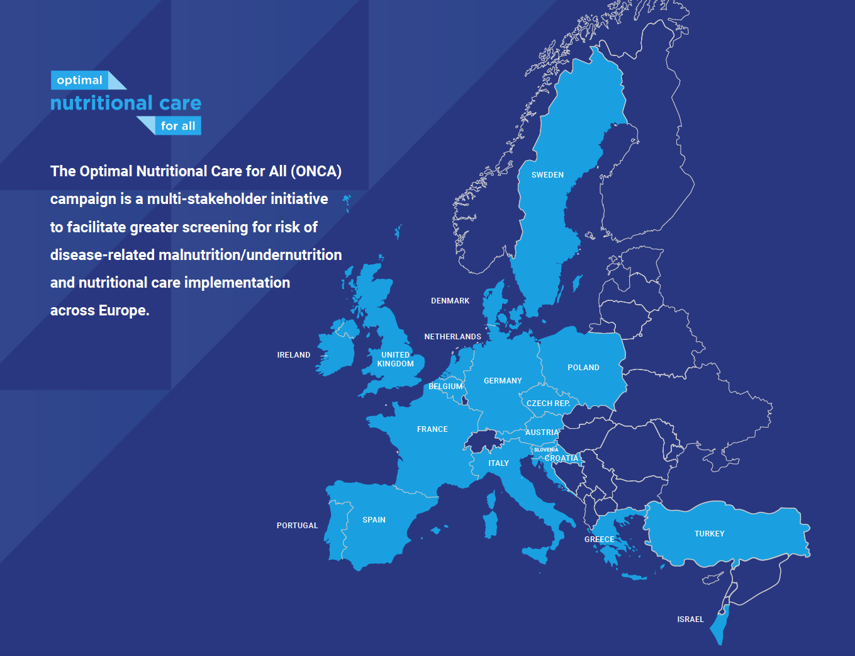
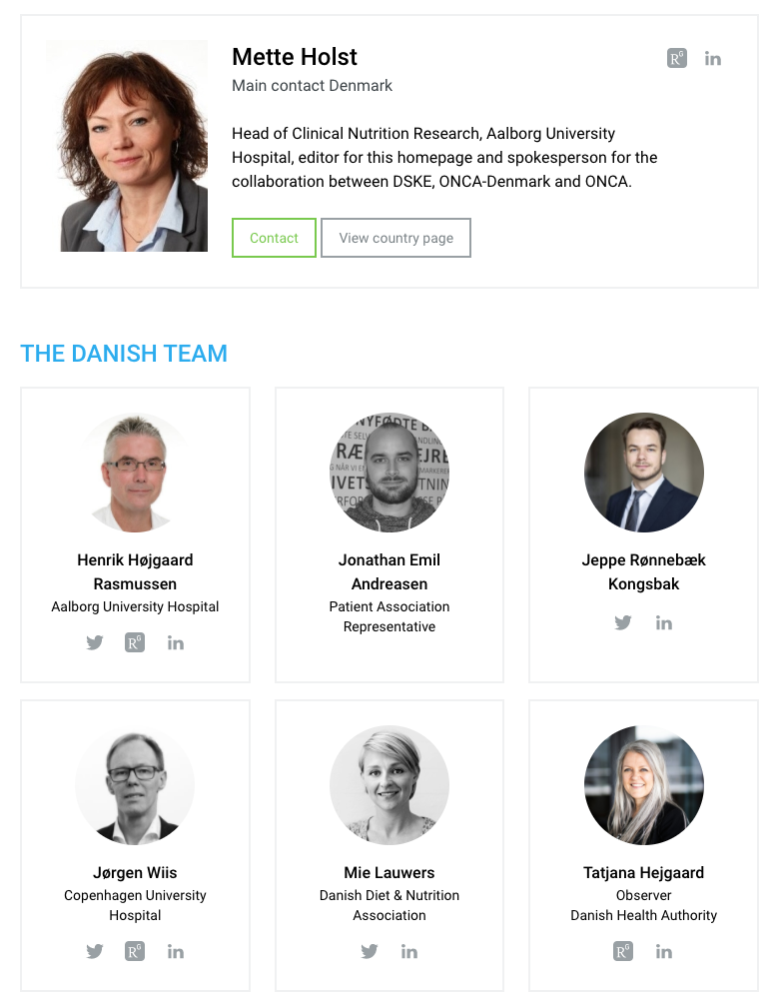
National Focus Group
Notes:
(1 min)
National, multidisciplinary alliances in 19 countries, we call them ‘ONCA teams’, bring together health care professionals, patients’ groups, Ministries of Health and other key stakeholders. They work together to implement national nutritional care programs
The next International ONCA conference will be hosted by the Danish team in May 22 and you are more than welcome.
MAW drives ongoing awareness and advocating for nutritional care and will be held in some 10 ONCA countries this year.
Last but not least , especially in the contect of today’s session: ONCA organises national policy seminars, that include politicians and policymakers. Last March in Portugal and coming up in other ONCA countries such as Denmark, Slovenia and Italy.
It remains an ongoing challenge to engage with national authorities and it is therefore one of our key objectives to create opportunities through these policy seminars, utilizing our European network to support national implementation. This is why we launch our call to action today.

Slide 20

Our proposal
A truly integrative approach
Drives sharing of Good Practices
Builds on existing science, guidelines and recommendations
Is actionable!
Follow up activities
Notes:
To develop a truly integrative approach, the composition of the network partners ensure cross-border, regional, multidisciplinary and multistakeholder input;
Stakeholders will include patients, healthcare professionals and health authorities;
The Joint Statement and Thematic Network will drive sharing of Good Practices and will build on existing science, guidelines and recommendations

Slide 21

Activities
Kick off meeting network
Workshop EU/national policies
HPP online
Webinar(s), promotion
Dissemination, template
Post HPP network
Notes:
To develop a truly integrative approach, the composition of the network partners ensure cross-border, regional, multidisciplinary and multistakeholder input;
Stakeholders will include patients, healthcare professionals and health authorities;
The Joint Statement and Thematic Network will drive sharing of Good Practices and will build on existing science, guidelines and recommendations

Slide 22
Results
Actionable guide for EU and regional policymakers
Leveraged by the country level ‘Optimal Nutritional Care for All’ campaign
Integrated in EU/national policies
Notes:
The joint statement will result in an actionable guide for both EU and regional policymakers, pointing them in the right direction
Leveraging the joint statement through the EU wide ‘Optimal Nutritional Care for All’ campaign to support implementations at country level

Slide 23
Question:
What is the role of the commission in implementing/leveraging the output of the networks?
integrate in existing programmes/structures
use the content as input for new policies
including at member state level
Notes:
The joint statement will result in an actionable guide for both EU and regional policymakers, pointing them in the right direction
Leveraging the joint statement through the EU wide ‘Optimal Nutritional Care for All’ campaign to support implementations at country level

Slide 24
An indispensable part of multidisciplinary patient-centred cancer care
secretariat@european-nutrition.org
Notes:
Our proposal is to launch a Thematic Network on Integrated Nutrition Cancer Care – Which is an indispensable part of multidisciplinary patient-centred cancer care.
The initiators of this proposal collaborate other under the EU4Nutrition platform. The bottom line of this policy platform: If you are serious about health, you should be serious about nutrition.

