Slide 1




Slide 2

Making the economic case for reimbursement
of dietetic care in Greece
Panousopoulou Maria, PhD
HR & Administrative Manager, EOPYY
Member of the EU CG-HTA Medical Devices
Vice President of Institute of Health and Technology Promotion

Slide 3
Since 2012, in the Greek Health Care System the National Organization for the Provision of Healthcare Services (EOPYY), is the one major Organization that provides health services to beneficiaries.
EOPYY Competences
Healthcare Services Purchase
Health Technology Assessment
Contracts
Negotiatons
The purchase of health services for insured persons, pensioners, and for the protected members of their families
01
Establishing rules on design, quality, development, evaluation, safety and efficiency of the health services market, managing and controlling funding, and making rational use of available resources.
02
03
The definition of contractual criteria and conditions for the procurement of health services with public and private sector bodies and contracting physicians
04
Negotiating with all contractors their remuneration, the terms of the Agency's contracts, the prices of medical devices and medicines

Slide 4
EOPYY in numbers
105
1.600
37.000
11 m.
€ 7,5 b.
Service Points
Employees
Providers
Citizens
Annual Budget

Slide 5
FSMPs are reimbursed by EOPYY
Nutrition plays a crucial role in maintaining our overall health and well-being. However, for people with specific medical conditions or nutritional needs, standard diets may not be sufficient. This is where Food for Special Medical Purposes (FSMPs) come into play, which are intended for the dietary management of various medical conditions.
EOPYY, as the major National healthcare provider, reimburses FSMPs following good practices and ensuring the maintenance of patients' health.

Slide 6
FSMPs are reimbursed for specific diseases, ie;
Inherited Metabolic Diseases
Coeliac Disease
Malabsorption due to a) Inflammatory bowel disease (Ulcerative Colitis, Crohn's disease) b) Short bowel syndrome, resection of the ileum, c) Partial gastrectomy with gastrojejunostomy (Billroth II), or total gastrectomy d) Eosinophilic gastroenteritis, e) Radiation enteritis and radiation oesophagitis
Fistulis gastric, gastroduodenal, ileocolic
Cystic fibrosis
Feeding through gastrostomy and / or jejunostomy. Nasogastric feeding for children
Children with Cow’s Milk Allergy and Eosinophilic gastroenteritis
Premature and underweight infants and infants with necrotizing enterocolitis or short bowel syndrome
Children with solid organ transplantation and with renal failure or liver failure

Slide 7
The past situation of reimbursement
Facts;
By 2016 the total expenditure of FSMPs reimbursement was more than 45.000.000€.
The procedure of FSMPs prescription was not digital.
Cases of fraud prescription were revealed.
Patients gave out of pocket money and then payed off by EOPYY after 2-3 months.
There was a great need for expenditure reductions.
All the above created a situation where policy decisions were necessary.

Slide 8
The Registry Project
In order to make decisions to create reimbursement policy, there must be data. EOPYY had data in paper and not centralized and organized. But more data needed in about;
  Number of patients receiving FSMPs
  Number of patient per ICD
  Number of FSMP for ICD
  FSMP and providers
  FSMPs reimbursed
  Doctors who prescribe FSMPs
So, the EOPYY’s Registry for Reimbursed MD and FSMPs, as a sophisticated digital tool, was designed and implemented by late 2016-early 2017 (Founded by law).

Slide 9
The Registry Project
The Registry
FSMP pricing monitoring
FSMP Registry
Manufacturers Registry
Traceability
Authorized Representatives Registry
  End-to-end traceability
  Price monitoring and policy enforcement
  Product Evaluation
  Medical effectiveness feedback

Slide 10
The Registry Project
  In order for a product to be reimbursed;
  its manufacturer or importer or distributor should make an application through the Registry
  EOPYY, after the assessment of the product, sets the reimbursement price
  the provider (manufacturer or importer or distributor) should have a contract with EOPYY.

Slide 11
The Expenditure
  With the implementation of the Registry and the contracts with the providers, the expenditure boundaries of the FSMPs’ reimbursement were set into global budget.
  The use of global budgeting serves to control the expenditures. The mechanisms of Rebate (RB) and ClawBack (CB) help the expenditure containment into boundaries.
  FSMP Expenditure

Slide 12
The next step
  Although the use of global budget and the mechanisms of RB and CB helped EOPYY to hold the expenditure, another problem arose. The providers were burdened with very high percentage of haircuts.
  So, EOPYY had to plan new policies to overcome this situation. At that point, a lot of data was available to help us towards the right decisions.
Policy Decisions
Registry Data
Expenditure
Number of patients
Diseases

Slide 13
Policies implemented in 2019-2022
Set the monthly reimbursed amount of each product (volume ceilings) according to ICD
Connect each FSMP to ICDs
Set reimbursement price per energy or protein content to specific Registry categories.
Implementation of the virtual barcodes
Connect each ICD to doctor specialization
Real Time Approval of prescriptions
Split the budget for adult and children.

Slide 14
Volume ceilings / ICD
ICD-10 |  | ΤΕΜΑΧΙΑ
ICD-10 | ΤΙΤΛΟΣ ΙCD-10 | 0-1 ετών | 1-2 ετών | 2-8 ετών | 8-14 ετών | 14-18 ετών | > 18 ετών
Ε72 | Άλλες διαταραχες του μεταβολισμου των αμινοξεων | 6 | 3 | 4 | 5 | 6 | 6
Ε71.1 | Άλλες διαταραχες του μεταβολισμου των αμινοξεων με διακλαδιζομενες αλυσους | 6 | 3 | 4 | 5 | 6 | 6
Ε74 | Άλλες διαταραχες του μεταβολισμου των υδατανθρακων | 6 | 3 | 4 | 5 | 6 | 6
Ε72.8 | Άλλες καθορισμενες διαταραχες του μεταβολισμου των αμινοξεων | 6 | 3 | 4 | 5 | 6 | 6
D80 | Ανοσοανεπαρκειες που οφειλονται σε διαταραχες των αντισωματων | 6 | 3 | 4 | 5 | 6 | 6

Slide 15
Volume ceilings / ICD
 |  |  | ΠΙΝΑΚΑΣ 2
ICD-10 |  |  |  | ΠΑΘΗΣΕΙΣ ΕΚΠΥ | ΤΕΜΑΧΙΑ
1o ΠΕΔΙΟ |  | 2ο ΠΕΔΙΟ
K51.0 | Ελκώδης (χρόνια) εντεροκολίτιδα | Κ90 | Εντερική δυσαπορρόφηση | ΕΛΚΩΔΗ ΚΟΛΙΤΙΔΑ | 60
K51.1 | Ελκώδης (χρόνια) εντεροκολίτιδα | Κ90 | Εντερική δυσαπορρόφηση | ΕΛΚΩΔΗ ΚΟΛΙΤΙΔΑ | 60
K51.9 | Διάφορες μορφές ελκώδους κολίτιδας | Κ90 | Εντερική δυσαπορρόφηση | ΕΛΚΩΔΗ ΚΟΛΙΤΙΔΑ | 60
K50.0 | Νόσος του Crohn του λεπτού εντέρου | Κ90 | Εντερική δυσαπορρόφηση | ΝΟΣΟΣ Crohn | 60
K50.1 | Νόσος του Crohn του παχέως εντέρου | Κ90 | Εντερική δυσαπορρόφηση | ΝΟΣΟΣ Crohn | 60
K50.8 | Άλλες μορφές νόσου Crohn | Κ90 | Εντερική δυσαπορρόφηση | ΝΟΣΟΣ Crohn | 60
Κ91.2 | Μετεγχειρητική δυσαπορρόφηση, που δεν ταξινομείται αλλού |  |  | ΣΥΝΔΡΟΜΟ ΒΡΑΧΕΩΣ ΕΝΤΕΡΟΥ | 60
Κ91.2 | Μετεγχειρητική δυσαπορρόφηση, που δεν ταξινομείται αλλού |  |  | ΕΚΤΟΜΗ ΕΙΛΕΟΥ | 60
Ζ90.3 | Επίκτητη απουσία τμήματος του στομάχου |  |  | ΥΦΟΛΙΚΗ (ΜΕΡΙΚΗ) ΓΑΣΤΡΕΚΤΟΜΗ ΜΕ ΓΑΣΤΡΟΝΗΣΤΙΔΟΑΝΑΣΤΟΜΩΣΗ | 60

Slide 16
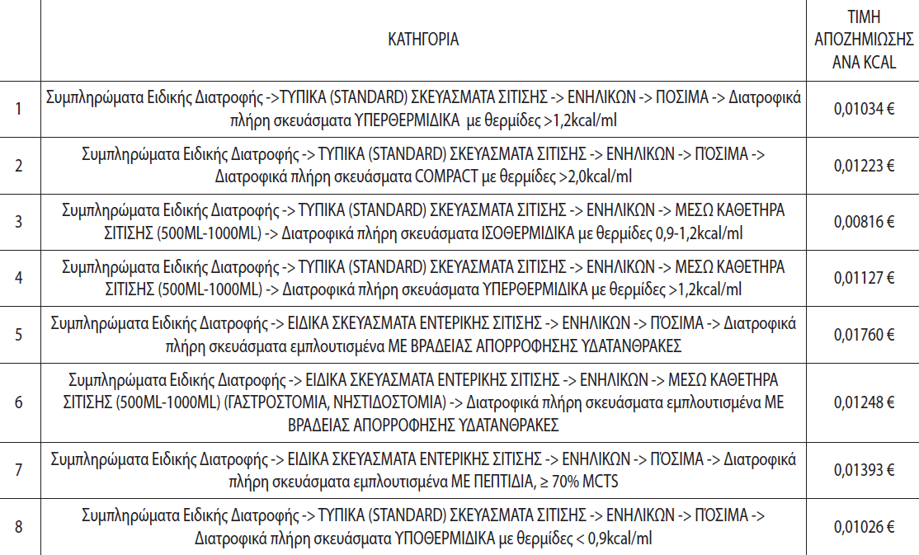
Pricing per kcal or (gr) of protein content

Slide 17
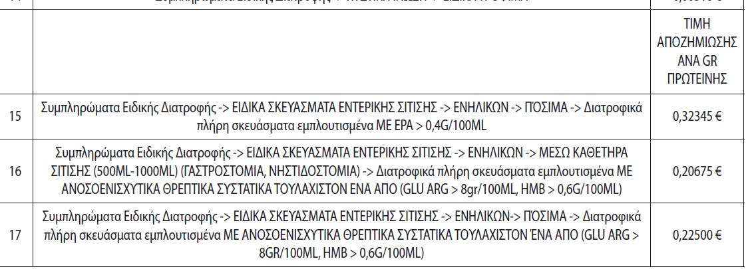
Pricing per kcal or (gr) of protein content

Slide 18

Real Time Approval
Prescription
(Doctor)
Real Time/AYS Approval
(auditor)
Acceptance of prescription
(Provider)
SMS notice
The purpose of the Real Time System is;
To simplify the process of the approval without bureaucracy
To protect the reimbursement against fraud
To collect data, in a personalized manner, so to develop statistical indicators in order to support the decision making at the organization level

Slide 19
In Summary
EOPYY Digital Transformation & FSMPs Reimbursement Reform 2017-2021
E-registry of products
E-prescription system
Virtual barcodes
Real time approval
ICD 10s
Reference pricing
Closed budget
Volume ceilings
Better expenditure control
Enhanced access to healthcare data
Improved quality of products and services

Slide 20


Next Steps
Leverage healthcare data to identify patients' unmet needs
Re-evaluate list of reimbursed diseases
Re-evaluate list of reimbursed FSMPs-Set criteria
Give access to quality nutritional care
Re-evaluate the global budget
Expand patient registries across new therapeutic areas
Negotiate reimbursement of FSMPs
Promote education about the dietary care and the need to reimburse FSMPs
Improved patient-centered services

Slide 21

Thank you for your attention!
Panousopoulou Maria, PhD
Email; mpanousopoulou@eopyy.gov.gr
Tel; +302106871704

