Slide 1




Slide 2

A joint approach to nutrition care in Europe
Grigoris Risvas,
Dr. RD, Vice-President of European Federation of the Associations
of Dietitians (EFAD)
Christina Cuerda,
M.D., General Secretary of European Society for Clinical Nutrition
and Metabolism (ESPEN)

Slide 3


Notes:
EFAD aims for
A Europe where every citizen enjoys optimal nutritional health through universal access to evidence-based dietary care, delivered by Registered Dietitians who are recognised as the leading authorities in nutrition.
in collaboration with our members and stakeholders
As European Federation of dietitians we represent over 35000 dietitians and 9000 students across 30 countries in Europe.

Slide 4
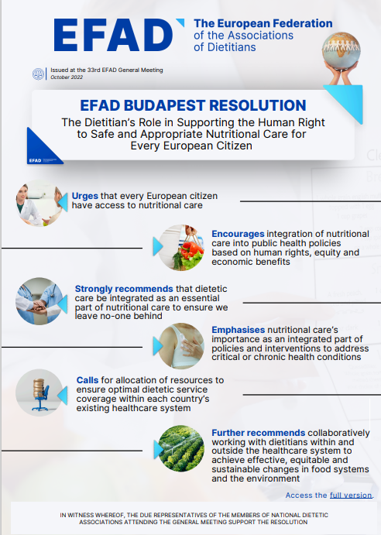
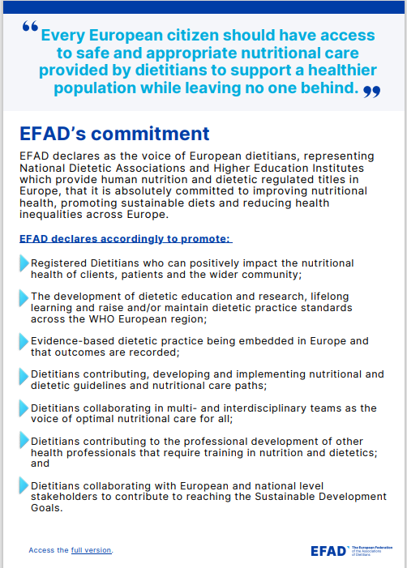
Notes:
Our commitment as dietitians to strive appropriate Nutritional Care for all, is clearly stated in the Resolution we issued in 2023.
In this so called EFAD Budapest Resolution we
emphasises the importance of nutritional care as integrated part of policies and interventions to address critical and chronic health diseases.
Guidelines should include relevant nutritional interventions
and it should be clear how nutritional care is implemented in the patient care pathway, from screening to diagnosis to treatment, With the aim to maintain, reduce risk to, or restore health, as well as alleviate discomfort in palliative care.
A multidisciplinary approach or even interdisciplinary approach is important, because there are many aspects which should be covered realizing appropriate nutritional care for patients.
(clinical) Dietitians being part of these multidisciplinary teams, could take the responsibility for nutritional assessment with a holistic approach, the individual nutrition and dietary counselling,
And being the coordinator, contact and source of information regarding nutrition.

Slide 5
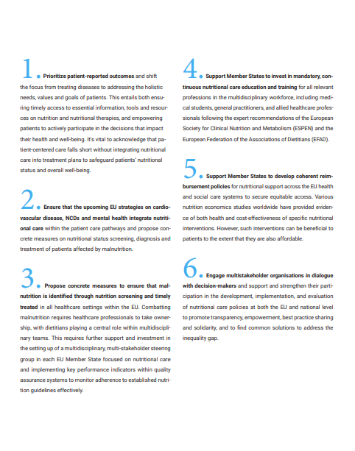
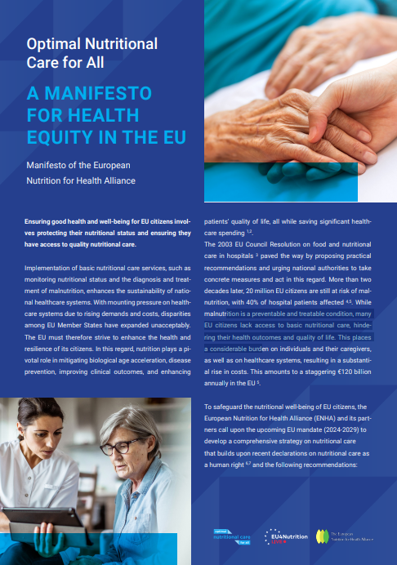
Notes:
Our EFAD resolution on safe and appropriate nutritional Care for European citizens perfectly fits with the Manifesto for Health Equity in Europe from ENHA.
Which also reflects the importance of integrated care and multistakeholder approach both on policy level as in daily health care to impact patients' health and wellbeing.
EFAD is therefor a proud partner of ENHA and is happy to collaborate with various stakeholders.
This manifesto is an example of Launching and coordinating a Parliamentary Interest Group on Nutrition within the European Parliament policy to ensure "Nutrition in All Policies" through policy debate and cross-committee collaboration. Other activities are: policy papers, briefings, events, policy roundtables, and support for nutrition-related amendments in relevant EU legislation.

Slide 6
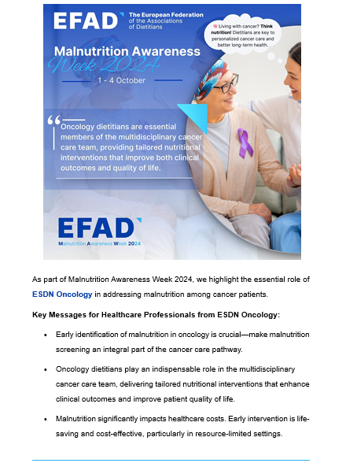

Notes:
One of the activities we paid attention to, together with ENHA is the Malnutrition Awareness Week.
European Malnutrition Awareness Week is An annual campaign to raise awareness of disease-related malnutrition and its impact on healthcare systems, recovery, and quality of life.
•Activities are Pan-European campaigns, national activations, media partnerships, and EU wide policy stakeholder outreach.
• With the Goal to position malnutrition as a public health issue that deserves systemic attention across policies.
We informed our members about it and encouraged them to post too. And we made several posts during the malnutrition awareness week.
Our dietetic network on oncology translated it into concrete key messages showing the essential role of nutrition among cancer patients.

Slide 7





…and many more
Notes:
As said, collaboration with stakeholders and other healthcare professionals is important for us.
ESPEN, EASO, EFPC are examples of some of our important collaborating partners.
Also, our position as a Non-State Actor in WHO-Europe is essential and allows us to work together with WHO and other partners on important nutritional issues.
To conclude my presentation, I want to showcase briefly some examples we are currently working on

Slide 8
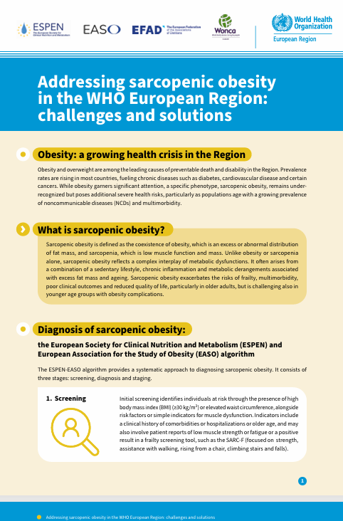
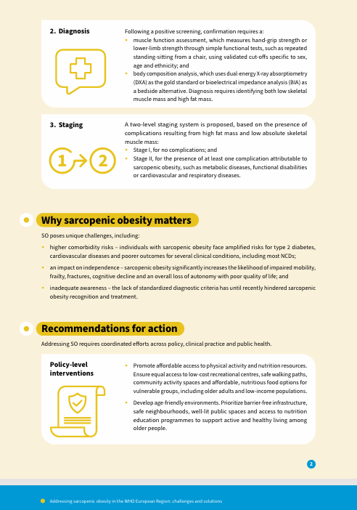
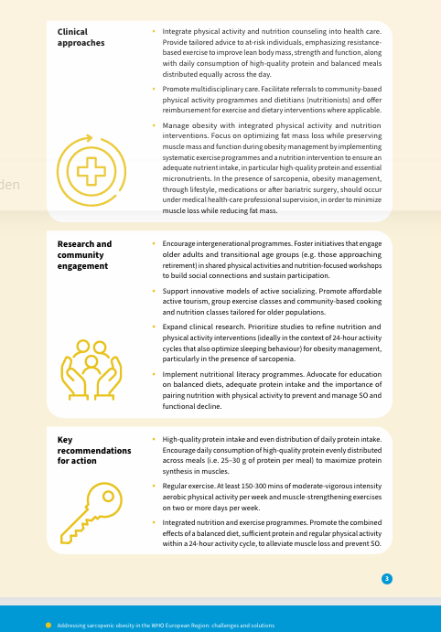
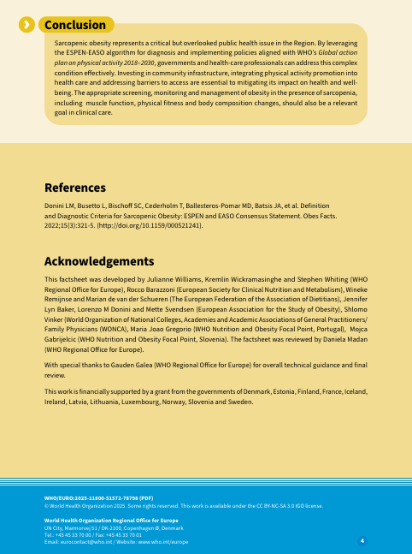
Notes:
In April a factsheet was launched on Sarcopenic Obesity. This is the first step in creating awareness of this critical but overlooked health issue.
More activities will follow to help governments and health-care professionals to address this complex condition effectively.
You can think of the appropriate screening, monitoring and management of obesity in the presence of sarcopenia, including muscle function, physical fitness and body composition changes, being relevant goals in clinical care.

Slide 9

Dietetic addendum to the ESPEN original scientific guidelines
Notes:
ESPEN provides valuable, evidence-based recommendations for clinical nutrition. An addendum specifically tailored for dietitians may help to bridge the gap between these established guidelines and routine clinical dietetic practice.
Such addition may enhance the accessibility, clinical applicability, and relevance of the guidelines for dietitians in everyday practice.
EFAD has recently conducted a survey about the needs for such an addendum and we hope to present the outcomes at ESPEN congress.
Following this we will develop such an addendum
Beside such addendum EFAD proposes/delivers experienced dietitians who participate in the development and revision of ESPEN guidelines.

Slide 10
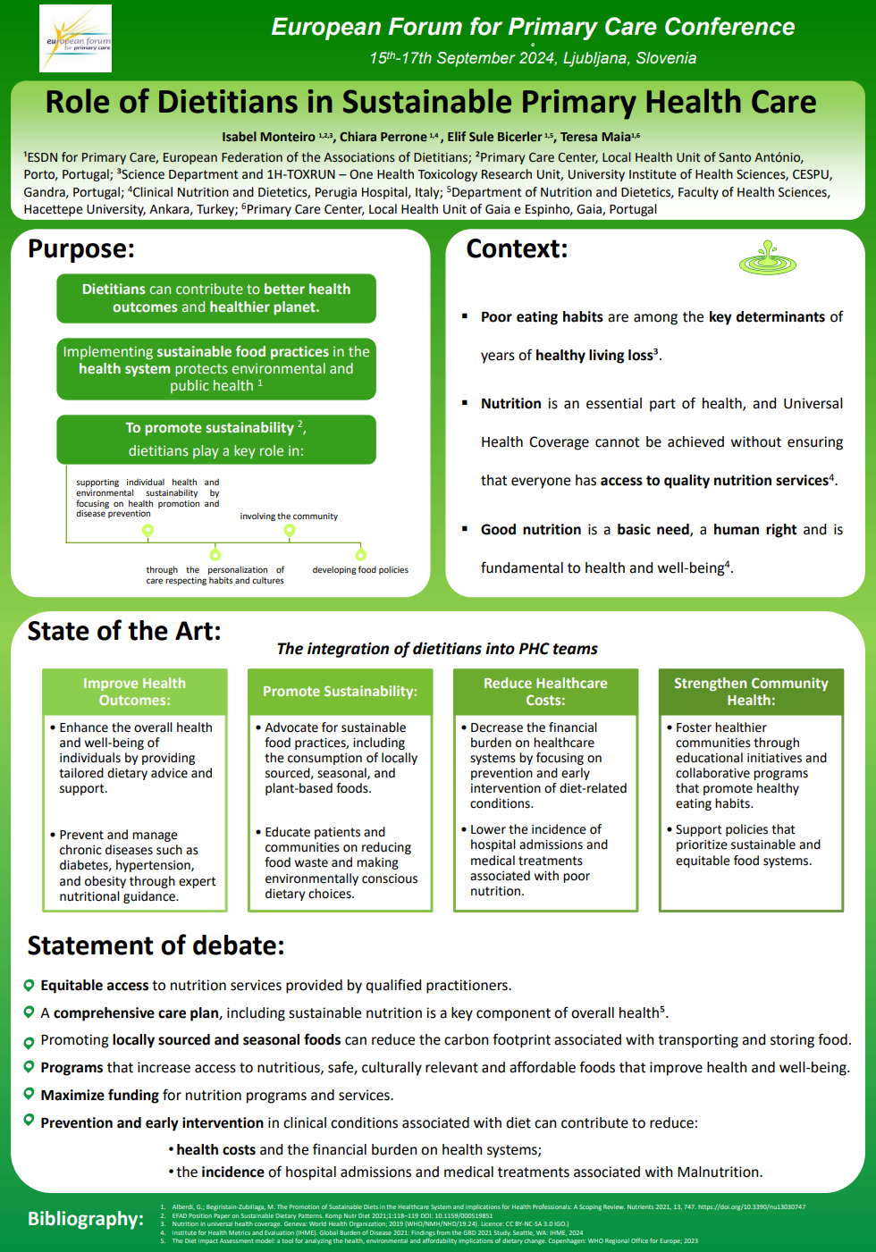
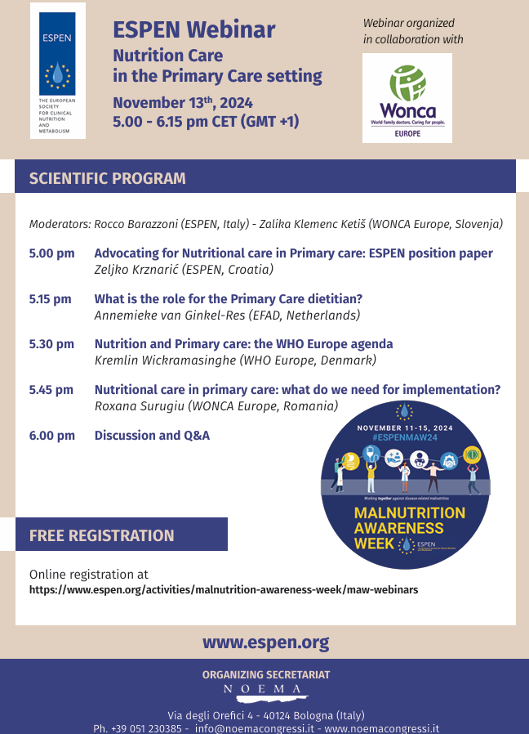
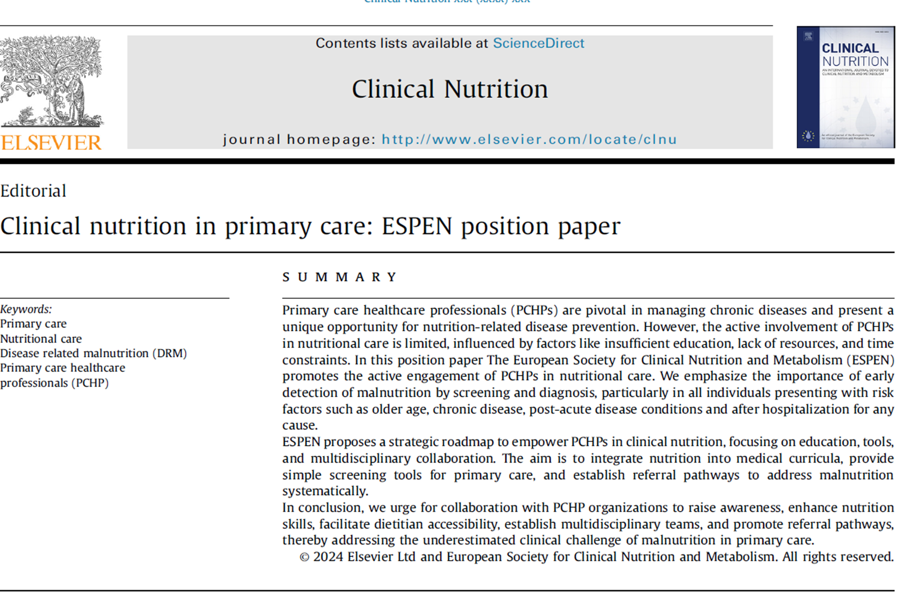
Notes:
The last example I briefly want to adress is the collaborative work on enhancing nutritional care in Primary health systems.
Primary care is well-positioned to address malnutrition and food insecurity through early detection and timely intervention or referral. Leveraging this potential can yield significant health benefits and reduce social and health inequalities.
Nutrition-competent teams, including dietitians, are essential but often absent. Their integration into primary care can bridge service gaps and enhance care quality.
Dietitians are uniquely qualified to deliver person-centred, evidence-based nutritional care. They ensure diet quality and food security across the lifespan. And they support and educate other health professionals.
Our policy Recommendations for Primary care but it also applies to all health care systems:
Integrate dietitians into all primary care teams.
Provide nutrition training for primary care staff.
Prioritize screening for malnutrition and food insecurity.
Thank you for your attention.

