Slide 1




Slide 2


The role of patient advocates
on nutrition in Europe, self-efficacy
Katerina Nikitara,
Dietitian – Nutritionist, MSc, PhDc
Head of EU Programs
Hellenic Cancer Federation (ELLOK)

Slide 3
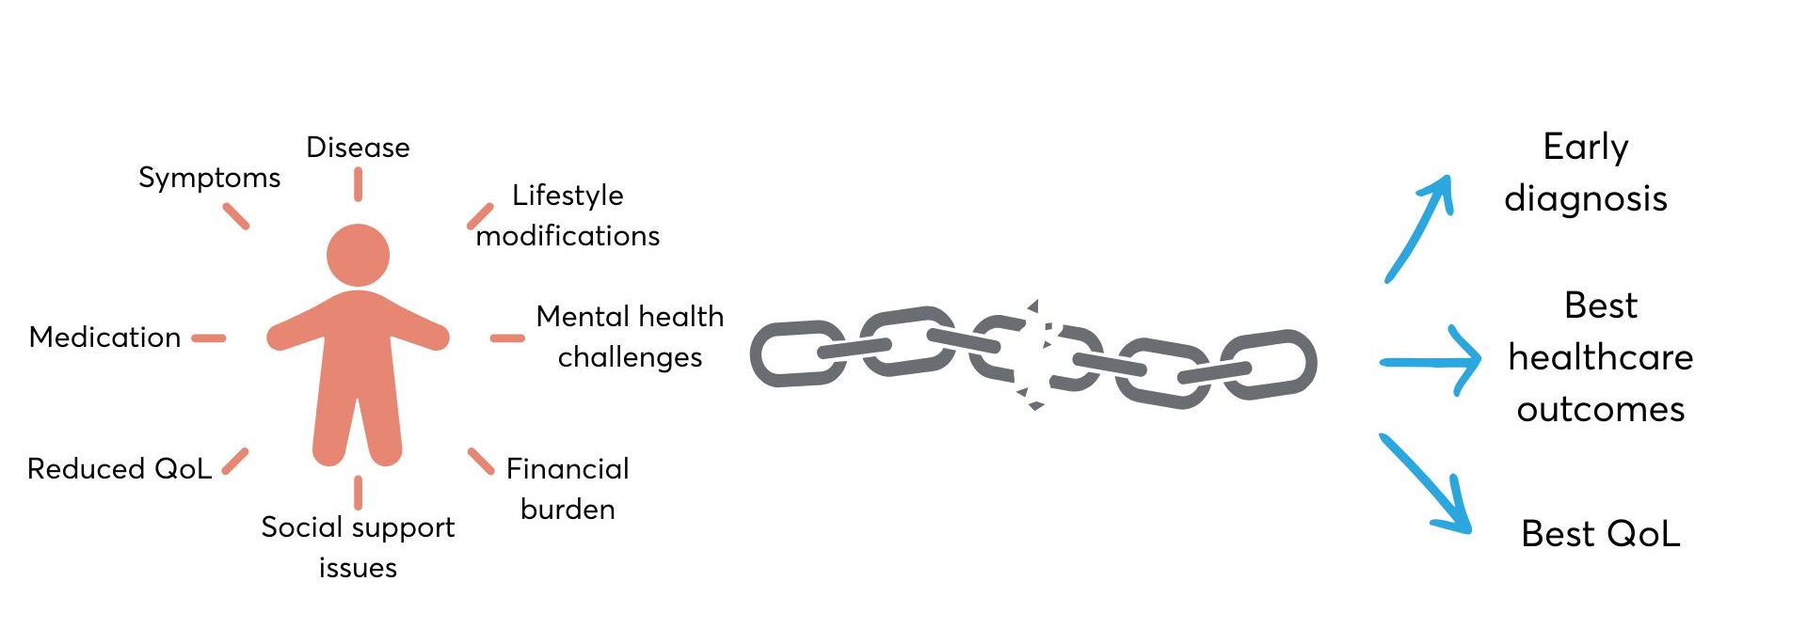
Setting the scene…,ygLow self-efficacy
PATIENT
IDEAL SCENARIO

Slide 4
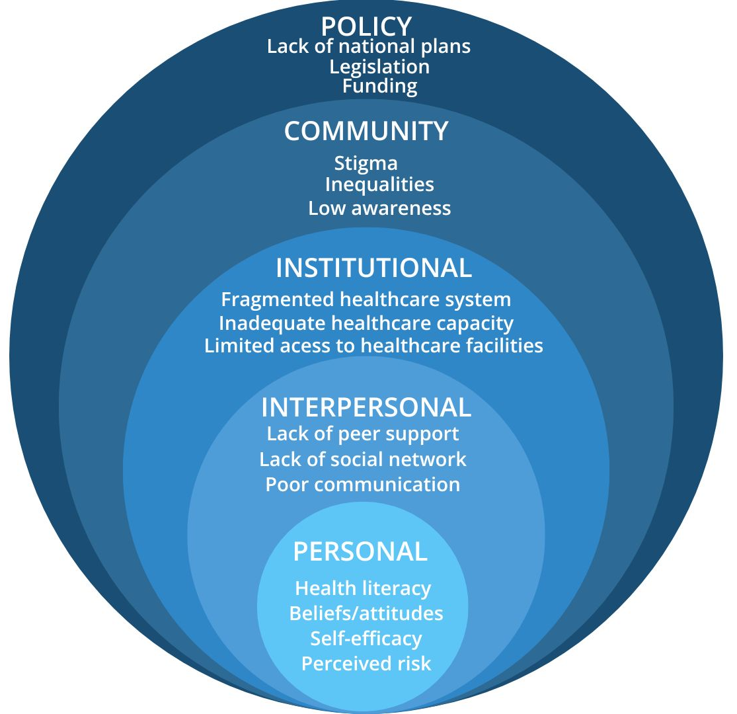
Ecological Model
Quadruple-helix Model
Community
Academia
Policy makers
Industry

Slide 5
Role of Patient Advocates: Bridging Barriers for an Optimal Healthcare
Patient advocates play a vital role in representing patients' needs, securing their rights, influencing systems, and bridging gaps across all levels of health and society
Their involvement addresses the barriers listed across the ecological model and interacts dynamically with the Quadruple Helix actors
Who can become a patient advocate?
      Patients - caregivers
      Healthcare professionals
      Social workers
      Nonprofit and civil society leaders
      Researchers and academics

Slide 6
Patient Advocates in the Community
Empowering patients through community-based support
  Educate patients on their disease
  Promote self-advocacy and independence among patients
  Establish peer-led support groups
Bridging gaps between patients and services
  Facilitate access to healthcare services
  Develop and implement services to address unmet needs
Raising community awareness
Conduct awareness campaigns on prevention and early detection
Organise community events to reduce stigma and increase visibility of patient needs

Slide 7

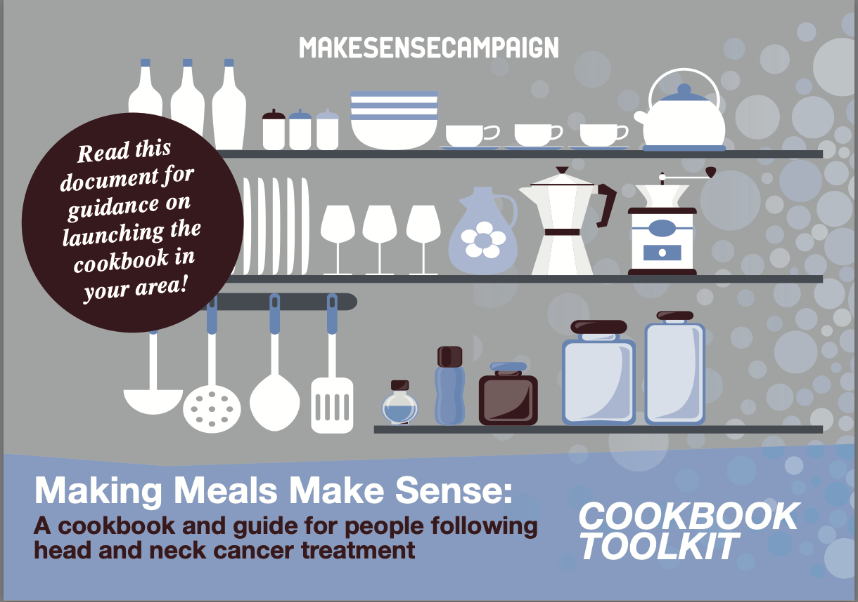



Patient Advocates in the Community – Empowering Patients

Slide 8


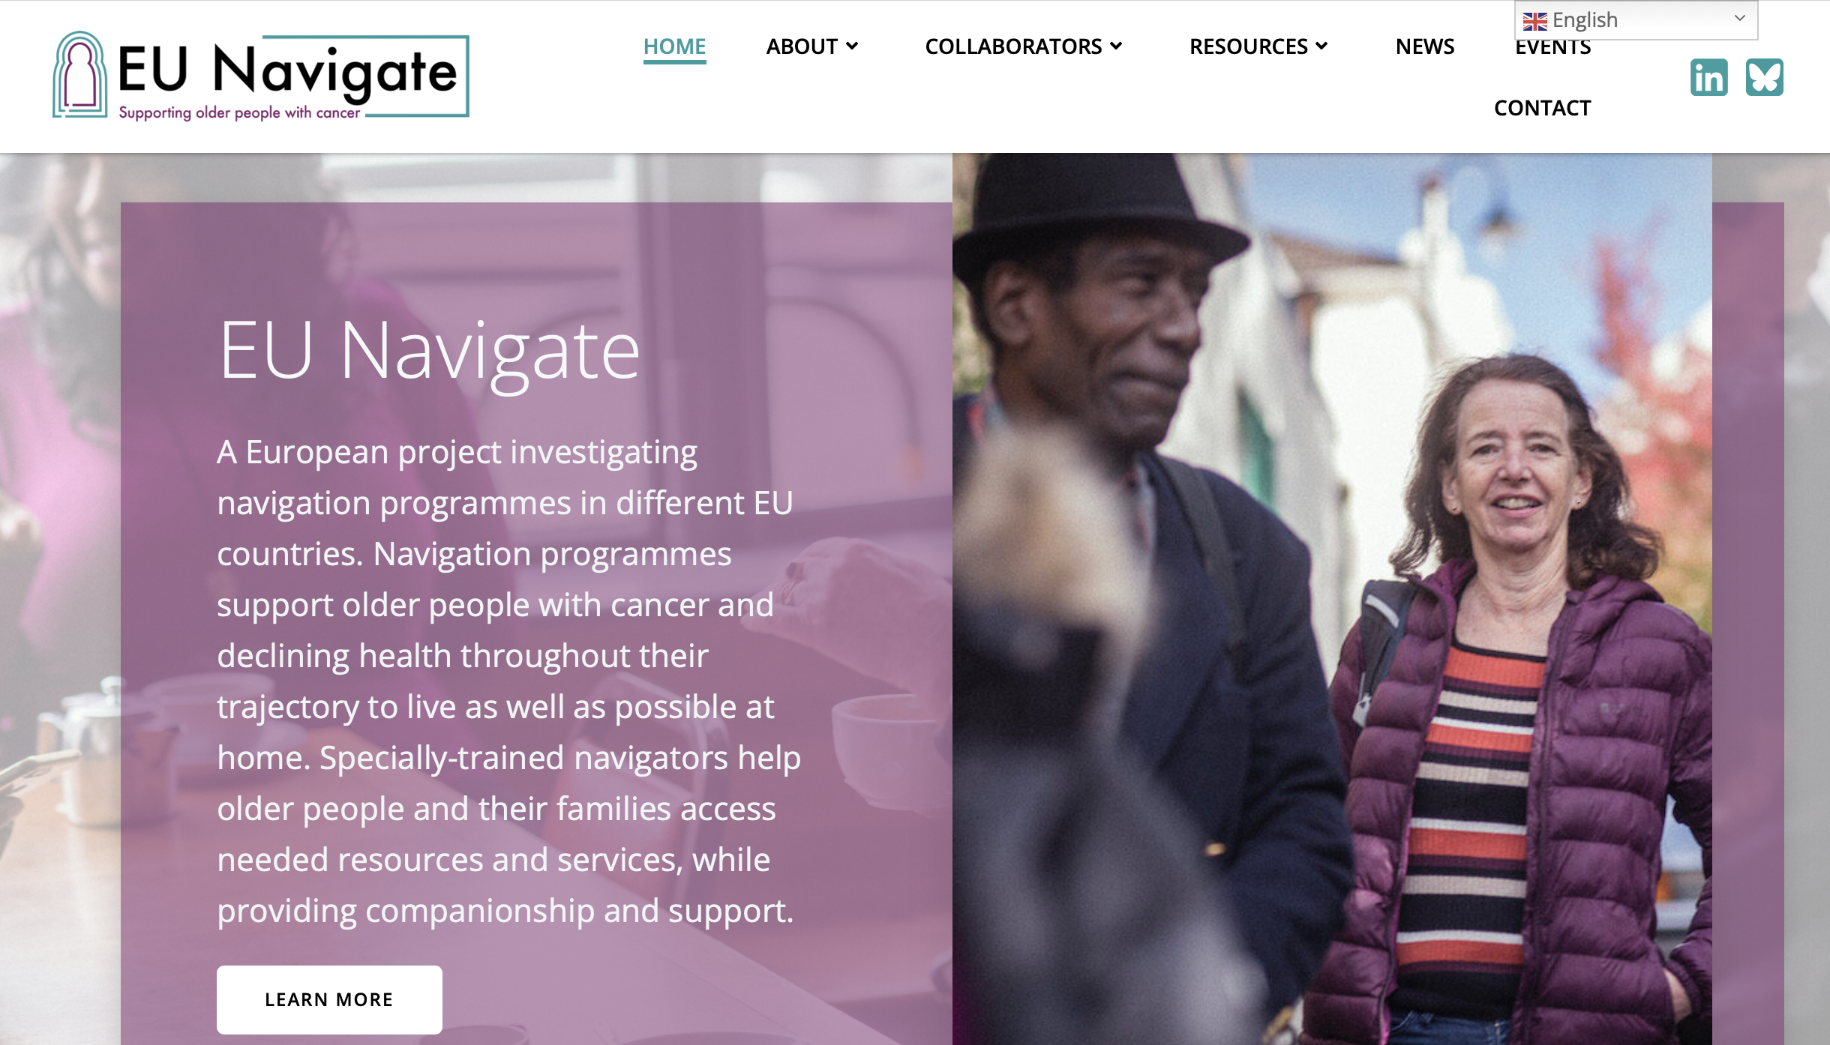

Patient Advocates in the Community – Bridging Gaps Between Patients and Services

Slide 9
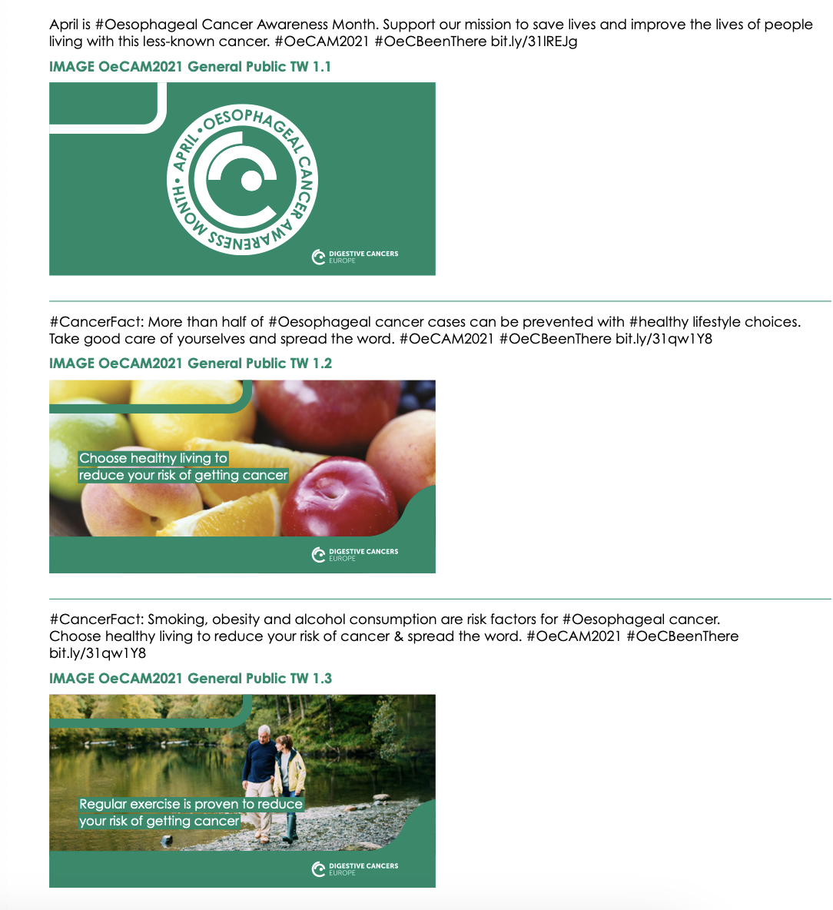
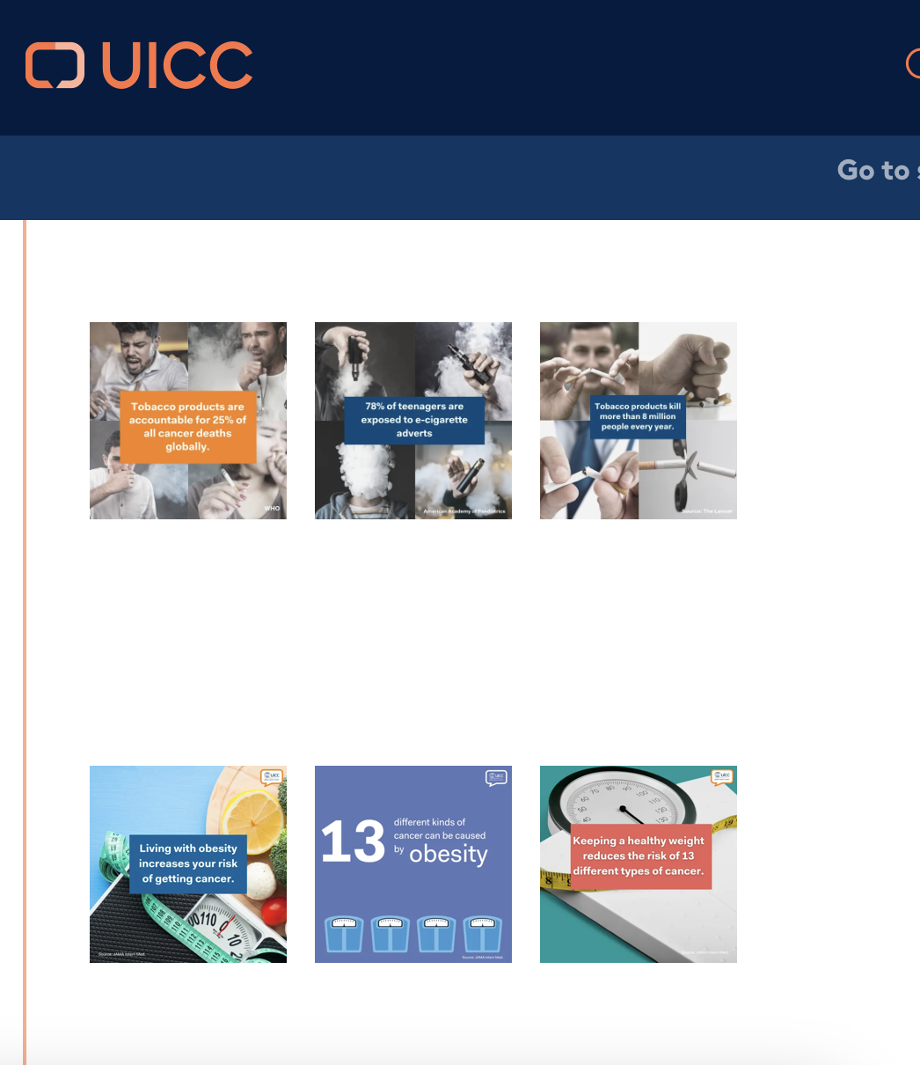

Patient Advocates in the Community – Raising Awareness

Slide 10
Patient Advocates in Policymaking
Contribute to informed, evidence-based decisions on legislation
  Participation in advisory boards, consultations, policy roundtables
  Publication of policy recommendations, statements, manifestos..
  Track implementation of patient-centered policies
Connect policymakers with other stakeholders
  Organisation of events with key actors
Mobilise public support and media for policy changes
Build capacity among patient organisations for advocacy and engagement at the political level

Slide 11
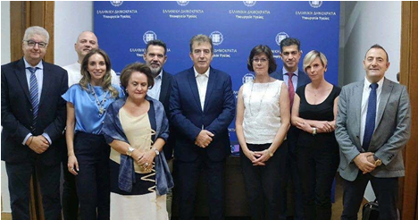

Patient Advocates in Policymaking - Key Actions in Greece
Working meeting with the Minister of Health, Mr Michalis Chrysochoidis, and the Secretary General of Health Services, Ms Lilian Vildiridi on the next steps to be implemented to advance the National Cancer Action Plan, the National Cancer Council, and the National Cancer Registry
Meeting with the Minister of National Economy and Finance, Mr. Kostis Hatzidakis. on the need to enact legislative regulations to ensure the "Right to Be Forgotten" for individuals with a history of cancer

Slide 12


Patient Advocates in Policymaking - Publications

Slide 13

Patient Advocates in Policymaking - Events

Slide 14
Patient Advocates in Academia
Participatory research
  Participation of patients as partners in the key stages of research design, development, and implementation
  Multidisciplinary team —> patients possess expertise through experience
  Prioritisation of research questions based on patients' needs
  Aims at the practical application of the knowledge produced, to improve patient care and quality of life

Slide 15

Patient Advocates in Academia – Living Labs
ELLOK is currently collaborating with the “Thessaloniki Action for Health & Well-Being Living Lab (Thess-AHALL)”, under the governance of the AUTH School of Medicine, Lab of Medical Physics & Digital Innovation to establish:
the first Living Lab in Greece led by patients
culture of mutual collaboration between cancer patients/representatives, researchers, and healthcare professionals

Slide 16
Patient Advocates in Industry
Provide insights into patient needs, preferences, and experiences
  Development of new solutions
Participatory research
  Co-design of clinical trials
Co-creation of educational and awareness initiatives
Collaboration to influence policy and regulatory decisions
Funding opportunities
Codes of conduct that promote transparency, independence, and ethical collaboration are important!!

Slide 17


