Slide 1




Slide 2

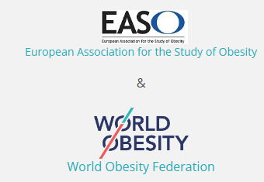

Next Steps in Nutritional Policies by Greek Societies
Member of:
Main objectives of HMAO are:
Education and training of health care professionals in obesity and metabolic diseases (physicians, nutritionists, pharmacists, nurses, psychologists, sports trainers etc.)
Provision of information to citizens and increasing awareness about the varied effects of obesity and treatment options of the disease
Research in the scientific area of obesity
Publications

Slide 3




Actions of HMAO
Annual panhellenic obesity conference
Participation in scientific conferences of affiliated scientific societies
Annual training seminar for healthcare professionals in obesity
Alliance with the municipalities’ network of “Healthy cities”
Participation in the Alliance for Obesity Tackling
Regular educational events for health professionals and citizens throughout Greece concerning obesity effects and treatment options

Slide 4
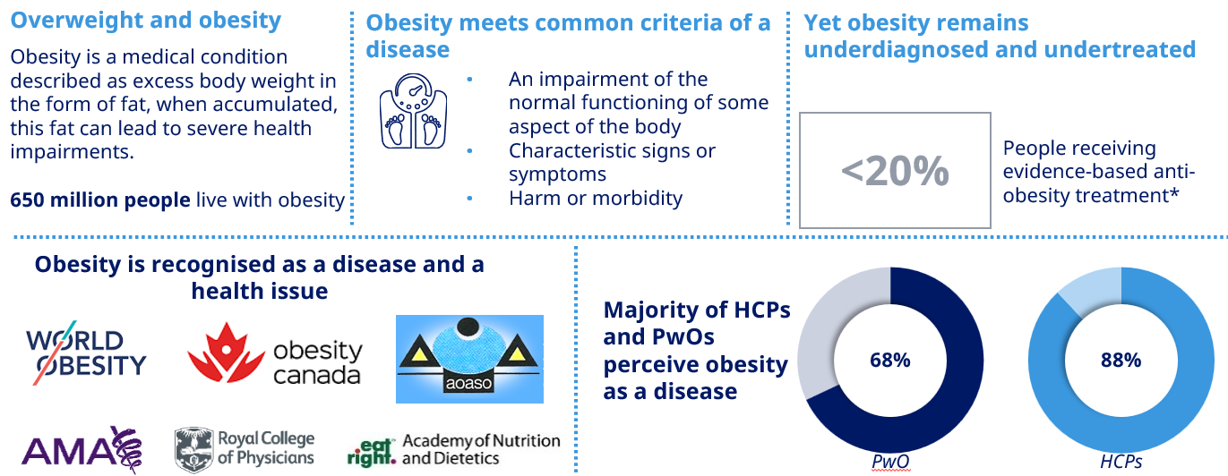
Obesity as a chronic disease

Slide 5
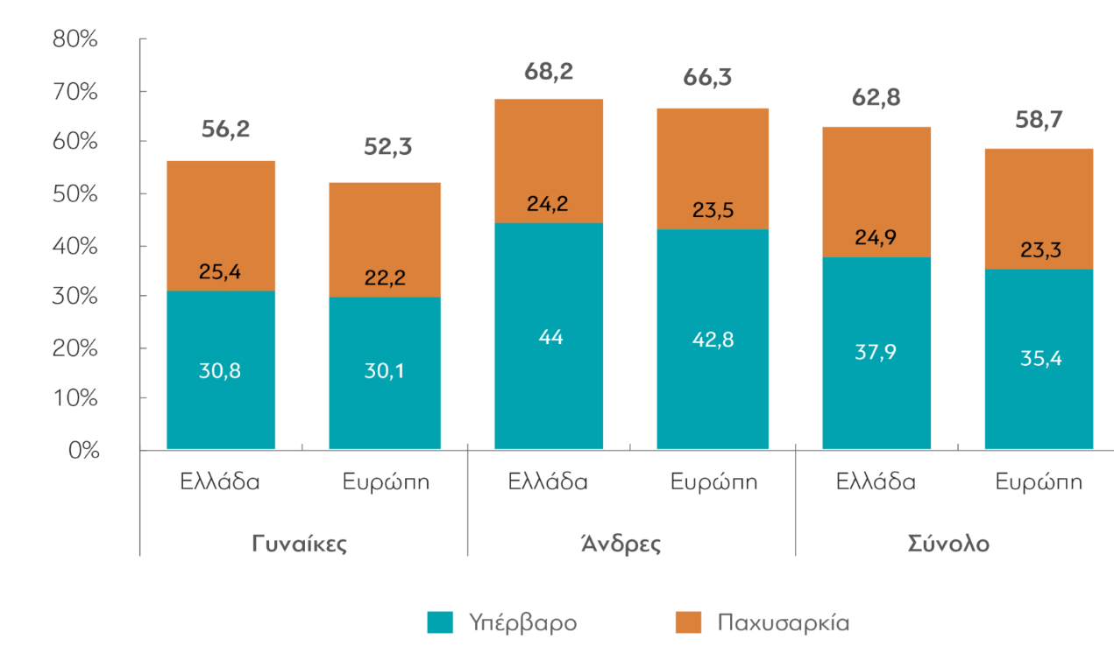
Obesity prevalence in Greek adults
WHO. Age-standardized prevalence of obesity (defined as BMI ≥ 30 kg/m2) in people aged 18 years and over (WHO estimates), Obesity, Health 2019

Slide 6
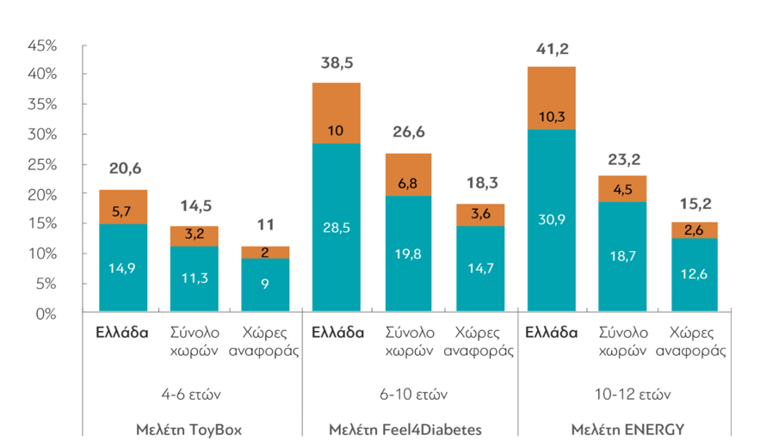
Obesity prevalence in Greek children
www.dianeosis.org/2022

Slide 7
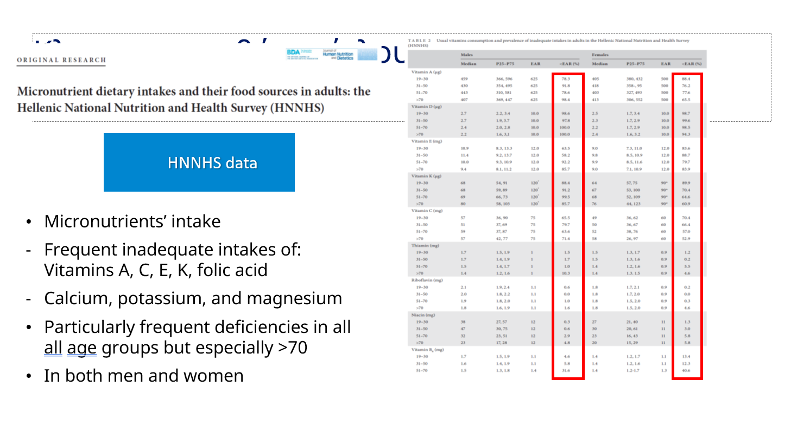
High rates of inadequate intake of: Vitamins A, C, E, K, folic acid
Calcium, potassium, and magnesium
Frequent deficiencies in all age groups but especially >70 years
- In both men and women
Mitsopoulou et al. J Hum Nutr Diet (2021)

Slide 8
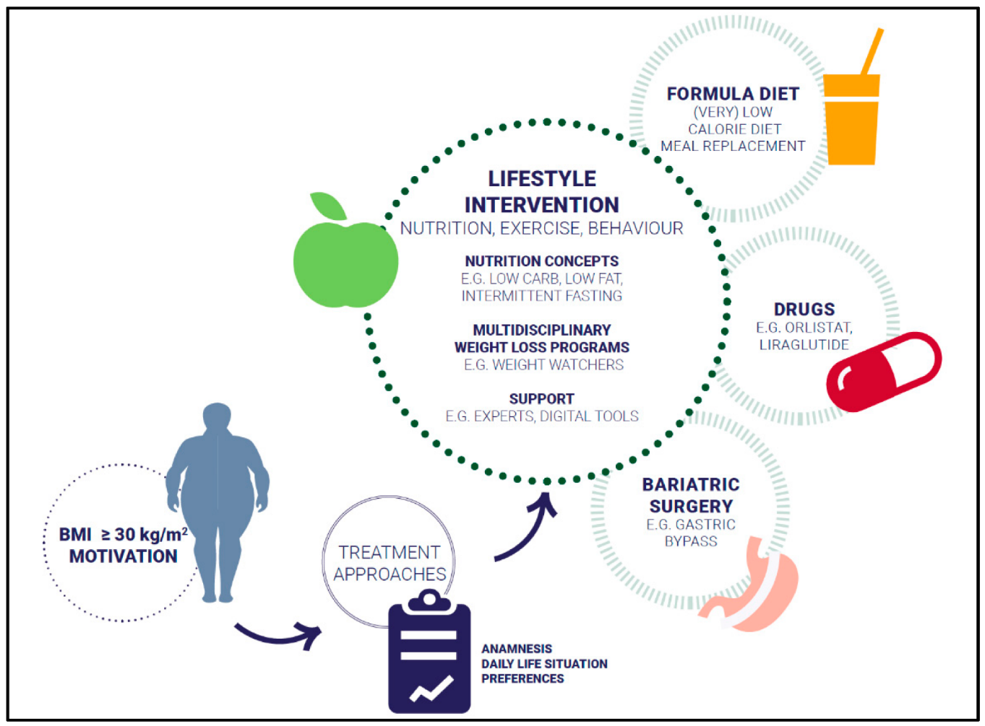
The contemporary approach of obesity treatment as a chronic disease
Obesity treatment should be no different from other chronic diseases
Personalized intervention
Lifestyle changes (diet, exercise) aiming at weight reduction, but also at treating comorbidities
Pharmacotherapy or Metabolic bariatric surgery
Continuous follow-up (treatment and maintenance)
Apovian et al. J Clin Endocrinol Metab (2015)
Wiechert et al. Nutrients (2022)
Weintraub et al. J Clin Endocr Metab (2023)

Slide 9
Obesity Management – Medical Nutrition Therapy
Weight control/Weight loss vs. Obesity management
Obesity management: The term “obesity management” is used to describe health-related improvements beyond weight-loss outcomes alone. If weight loss occurred as a result of the intervention, this should not be the focus over the health and quality of life (QoL) improvements.
“Medical Nutrition Therapy: Medical nutrition therapy (MNT) is an evidence-based approach used in the nutrition care process of treating and/or managing chronic diseases, often used in clinical and community settings, that focuses on nutrition assessment, diagnostics, therapy and counselling. MNT is often implemented and monitored by a registered dietitian and/or in collaboration with physicians and regulated nutrition professionals.”

Slide 10
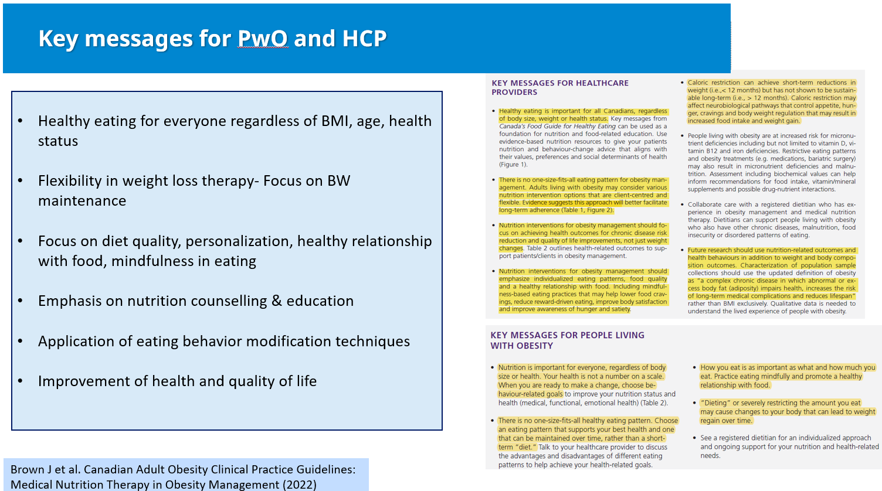
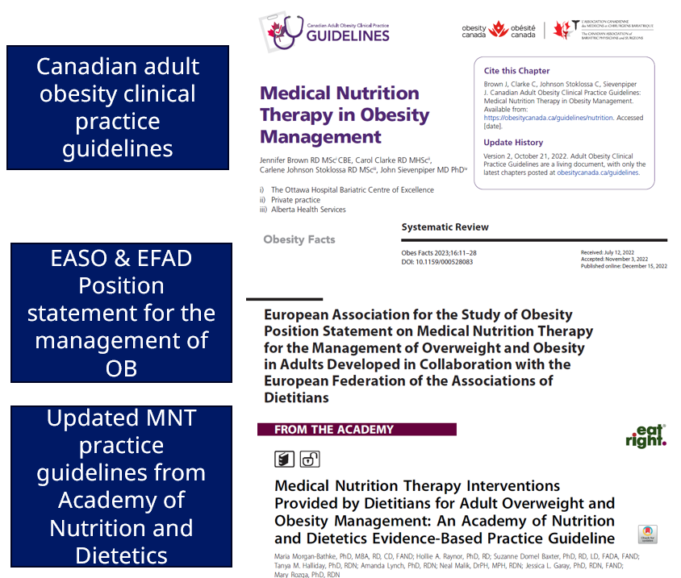

Slide 11
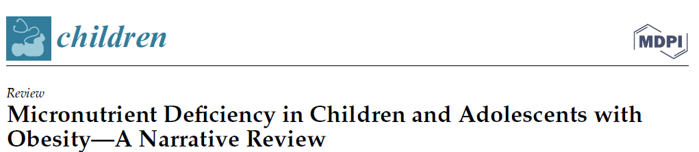
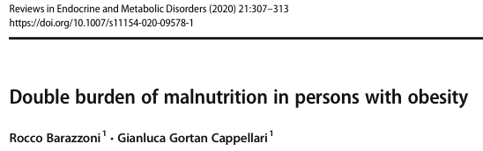
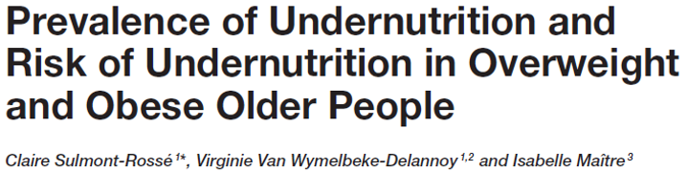
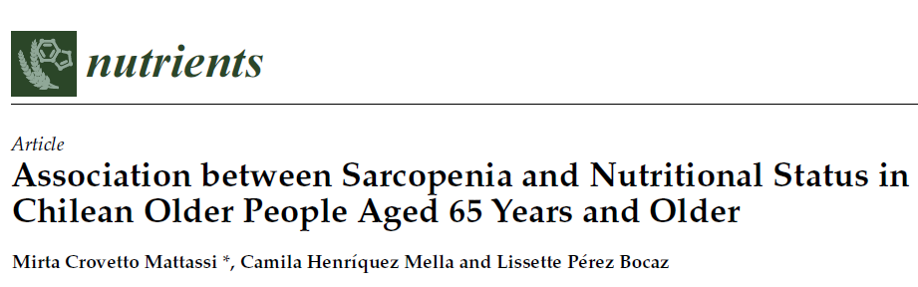
Malnutrition & undernutrition in patients with OB
It is important to highlight that obesity and fat accumulation may induce nutritional imbalances, both directly through metabolic and body composition changes and indirectly through acute and chronic diseases with negative impact on nutritional status
Malnutrition/undernutrition is observed in patients with OW/OB with several forms:
Micronutrient deficiencies (intake, absorption, metabolism)
Skeletal muscle loss and dysfunction-Sarcopenic Obesity
Other disease related to obesity malnutrition

Slide 12

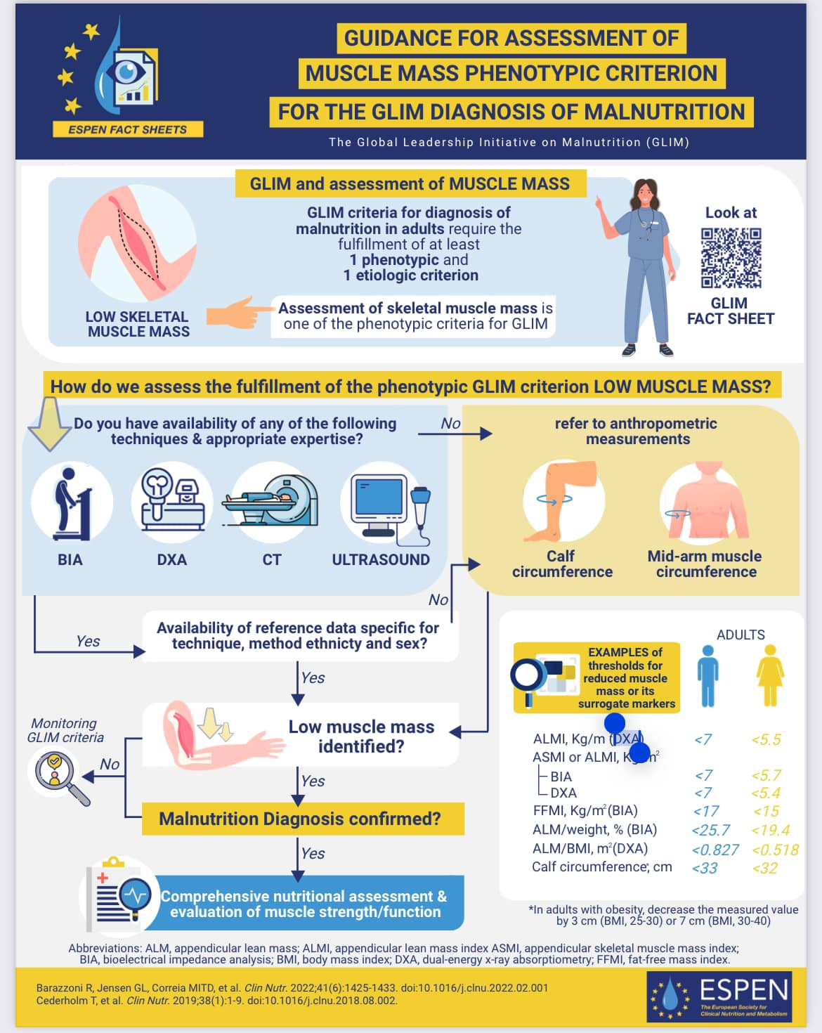
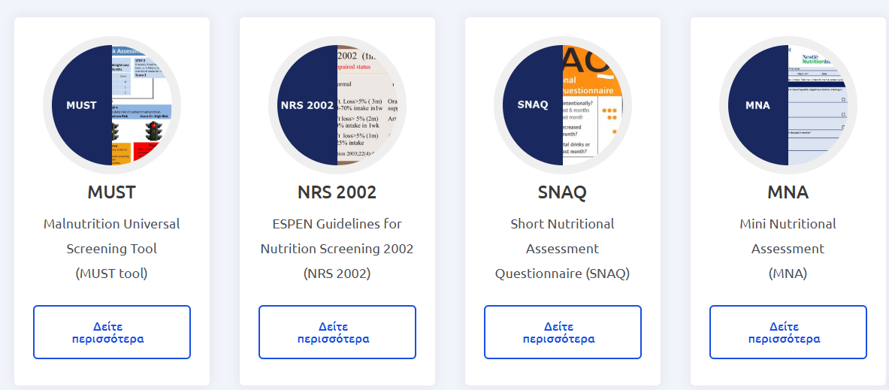
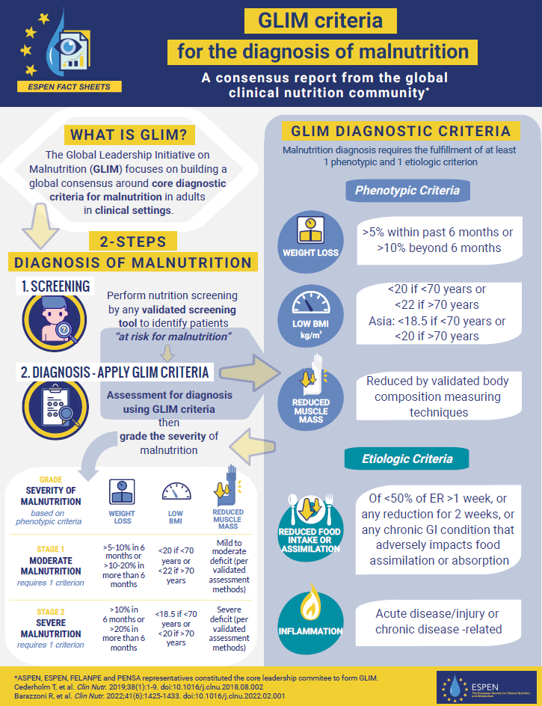
Malnutrition screening and diagnosis in patients with OB
Malnutrition screening and diagnosis in patients with OB is not easy, since most tools assess BMI level and % weight loss
Therefore, it is crucial to evaluate and assess muscle mass with available reference data
Evaluation of muscle strength/function
Conduct a detailed dietary screening to assess diet quality and nutritional status
Continuous assessment of patients with OB during therapy
Holistic approach in obesity management
Continuous training of health care professionals
Careful decision of the appropriate therapy and adjustments
Interdisciplinary cooperation

Slide 13
Thank you for your attendance
Paul Farajian, MSc, PhD
Hellenic Medical Association for Obesity

