Slide 1

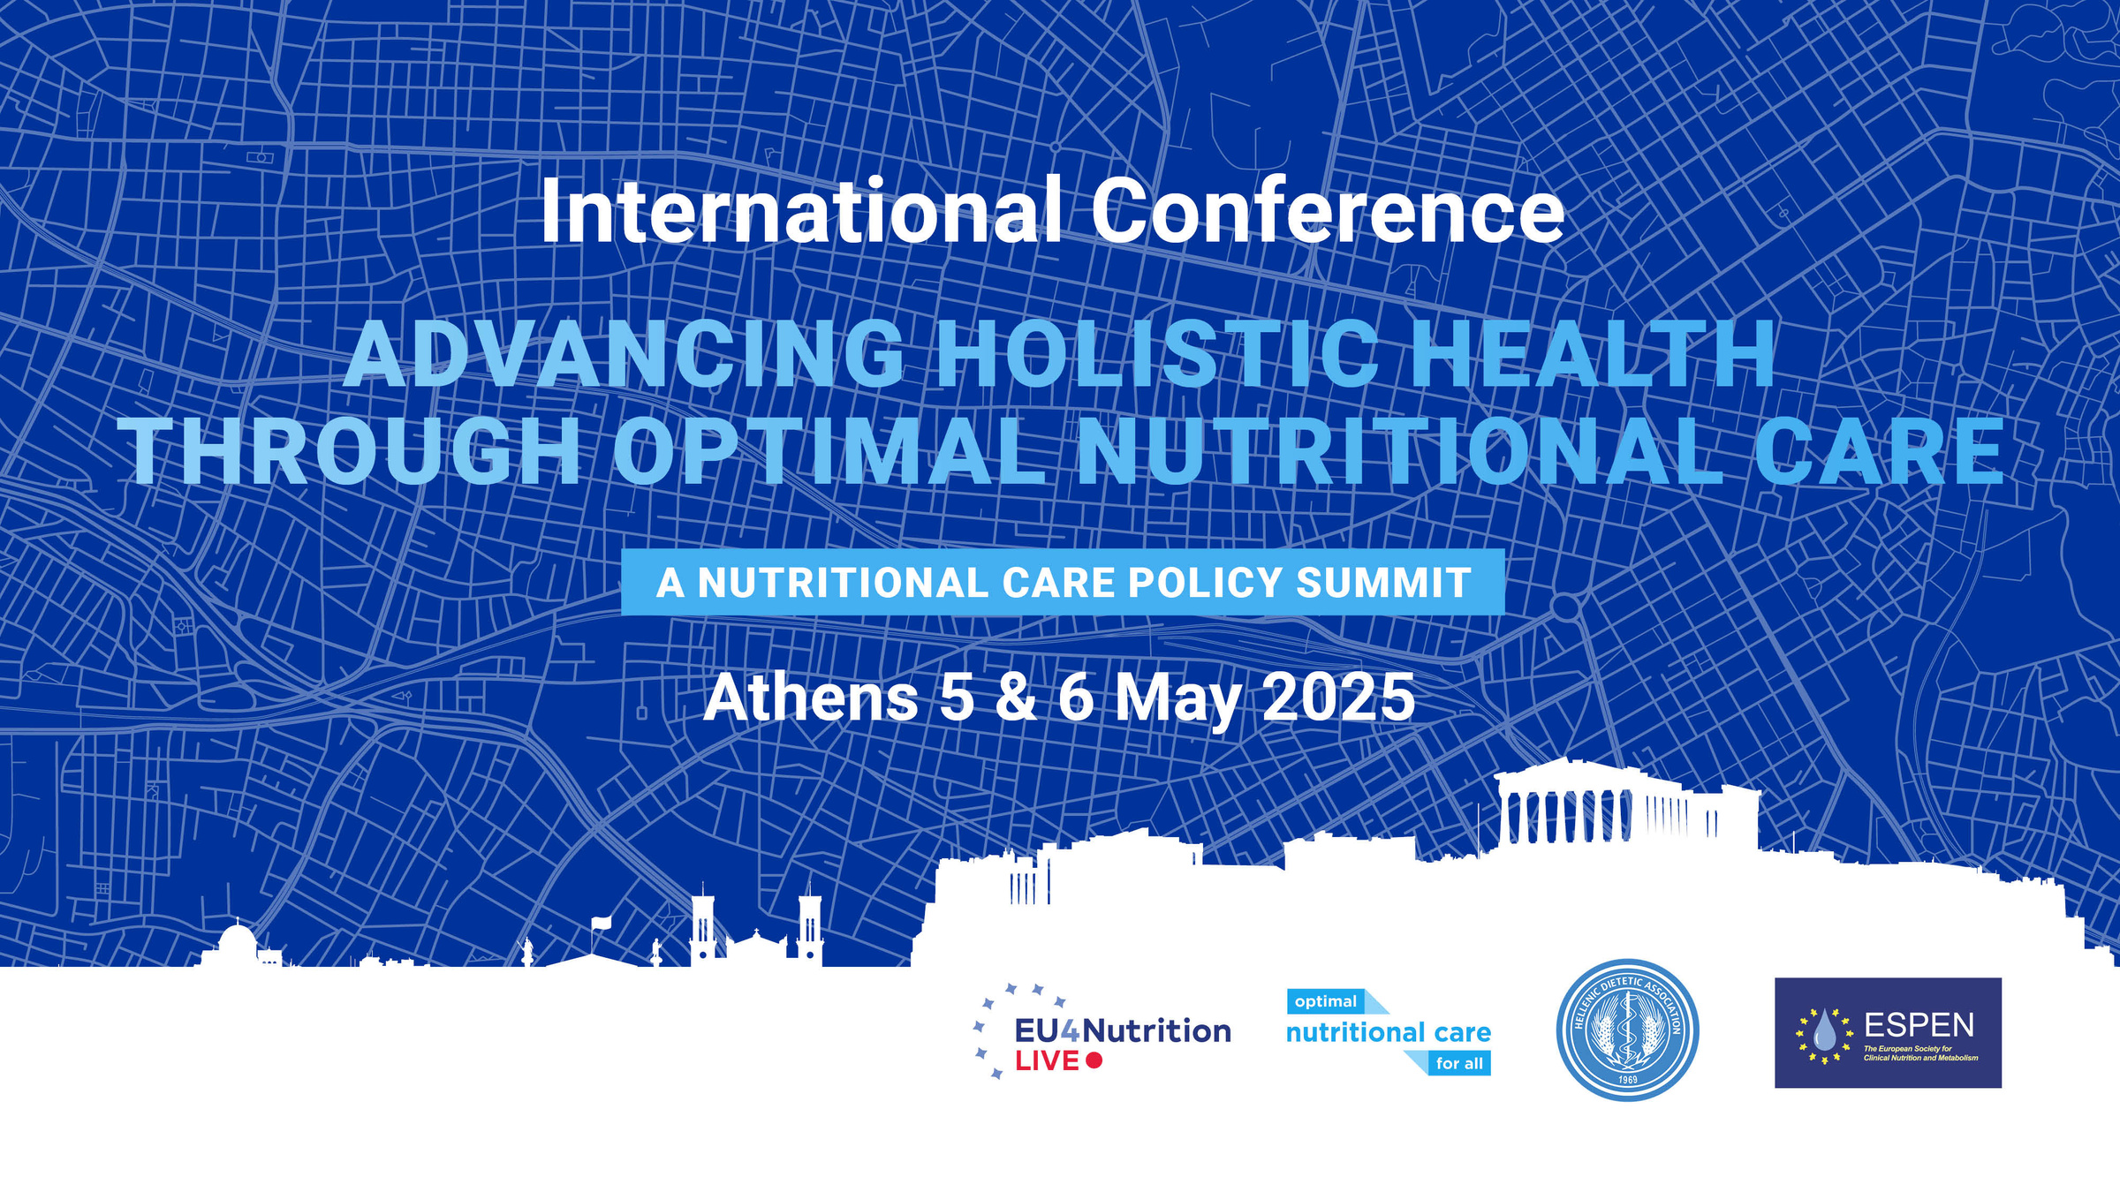
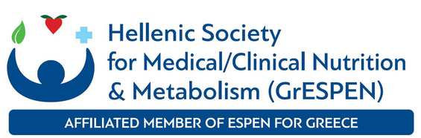

Slide 2
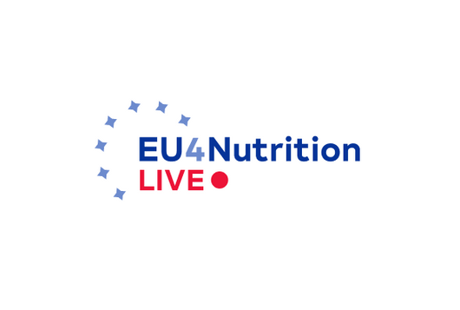
A Holistic Approach on Nutritional Care and Quality of Life
Vasiliki - Rafaela Vakouftsi
President, Greek Patients’ Association

Slide 3
Why Nutrition Matters to Patients
Nutrition is more than food
Nutrition is at the heart of recovery, management and quality of life
Chronic illness often brings dietary restrictions and deficiencies
The relationship between diet, symptoms and overall well-being is often overlooked in care models
Poor nutrition = Poor outcomes (disease flare-ups, hospitalizations etc.)

Slide 4
The Impact on Quality of Life
Malnutrition and restricted diets affect:
Physical energy and strength
Mental health
Social life and daily functioning
The stigma of “eating differently” or “not being able to eat normal foods”
Quality of life is not just surviving - it’s living well!

Slide 5
Gaps in Current Nutritional Care
Nutritional care is often:
Fragmented or reactive
Not personalized
Lacking psychological support
Dietitians may not be part of the care team in every healthcare setting

Slide 6
What Patients Want
Access to:
Dietitians trained in our health condition
Emotional support
Practical, real-life solutions
Education and resources about their disease and nutrition
We want to be partners, not passive recipients

Slide 7
Holistic Nutritional Care
Holistic nutritional care includes:
Clinical nutrition
Personal goals

Slide 8
Interdisciplinary Care Model
Ideal team includes:
Physician
Dietitian
Psychologist
Social Worker
Patient as equal voice
Holistic care is about treating the whole person, not just the disease

Slide 9
The Role of Patient Advocacy
Advocacy helps:
Raise awareness of hidden burdens
Co-design care pathways and guidelines
Ensure inclusivity in nutritional trials
Patient organizations can offer peer support and education

Slide 10
Empowering Patients Through Education and Support
Teach patients how to make informed food choices based on their condition
Help patients understand the relationship between diet and disease progression
Offer workshops, resources and access to support networks for patients

Slide 11
Call to Action
For healthcare professionals:
Involve us early and listen to our lived expertise
Integrate dietitians into every care plan
For policymakers:
Reimburse dietetic care
Support funding for nutrition-related research
For industry and researchers:
Include QoL and nutrition in metrics
For patients:
Take an active role in learning and managing your nutrition

Slide 12
Final Thoughts
Nutrition is a right, not a privilege
Nutrition is key to managing chronic illness and maintaining a good quality of life
Holistic care improves health outcomes, emotional well-being and dignity
We deserve holistic care that nourishes both body and soul
A holistic approach empowers patients to live fully

Slide 13
Thank you!

