Slide 1




Slide 2

Hellenic Society of Internal Medicine
Rapid Interview Panel Session: Next Steps in Nutritional Policies by Greek Societies
Dr Haris Dimosthenopoulos MMedSci.PhD
Chief Dietitian - Biologist
Dietetic Dept of General Hospital of Athens "Laiko"
Vice President of Empakan-Board member of IDF Europe
Scientific Secretary of Diabetes Nutrition Study Group (DNSG)

Slide 3



Next Steps in Nutritional Policies by Greek Societies
Despite the increased emphasis on obesity and diet-related diseases, nutrition education is lacking in many internal medicine training programs.
Hellenic Society of Internal Medicine provides the opportunity to doctors-members of the society- to learn more about nutrition and nutritional care by including at least a Round Table by clinical dietitians on basic nutritional issues (dietary treatment of metabolic diseases and disease prevention), in the official program of EEEP’s Annual Conference

Slide 4



Next Steps in Nutritional Policies by Greek Societies
Hellenic Society of Internal Medicine (ΗSIM-EEEP) participates with sessions (round tables or lectures) in conferences of related medical bodies such as the Hellenic Diabetes Association, the Hellenic Atherosclerosis Society, the Hellenic Medical Society of Obesity, including lectures on nutritional therapy of metabolic diseases
Hellenic Diabetes Association, which is a strong partner of EEEP, is producing dietary guidelines and books for people on T1DM and T2DM and organizes webinars on nutritional sessions
Dietitians are very often board members of EDE or EIEP contributing in the promotion of healthy eating, and of the therapeutic value of diet in obesity, diabetes, giving lectures in schools and associations etc.

Slide 5



Next Steps in Nutritional Policies by Greek Societies
ΗSIM in cooperation with “Εxercise is medicine” is promoting a more active lifestyle
Hellenic Society of Internal Medicine has representatives in the Working Group "Diabetes & Obesity Group" of EFIM (European Federation of Internal Medicine)
The objectives of the Diabetes and Obesity Clinical Working Group is to promote the awareness of diabetes among European Internists and to promote common European strategies for prevention, diagnosis, and therapy of patients with diabetes and/or obesity.

Slide 6


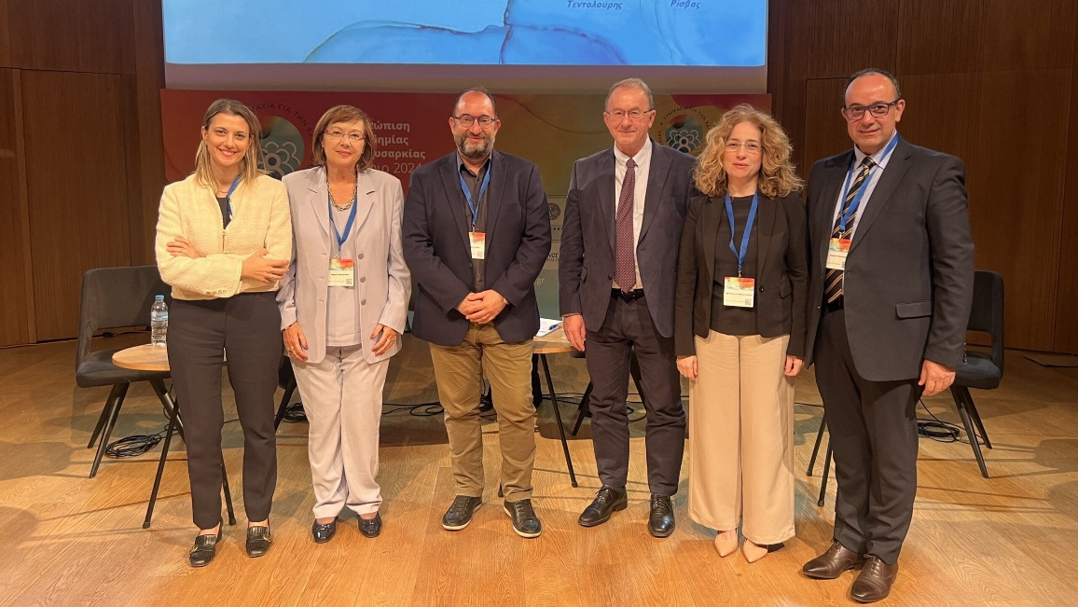
Next Steps in Nutritional Policies by Greek Societies
Hellenic Society of Internal Medicine is also a founding member of the ALLIANCE TO COMBAT OBESITY (Action4Obesity), through which events are held on nutrition issues, prevention and treatment of Obesity for health professionals and the community.
Action4Obesity will produce the new “National Medical and Dietary Guidelines for Obesity”, in association with many medical and dietetic Associations

Slide 7

Next Steps in Nutritional Policies by Greek Societies
Hellenic Society of Internal Medicine participates in scientific events and events for the public on the benefits of the Mediterranean diet, dietary treatment and other nutritional issues
Strong cooperation with ELODI and POSSASDIA (the two national associations of people on diabetes)
“DIABETES Magazine – Hellenic Diabetes Federation (ELODI)
The Hellenic Diabetes Federation is addressed to doctors and health professionals as well as to ordinary, aware citizens.
The editorial team of the magazine consists of doctors and dietitians in the field of diabetes.
The articles published in each issue are selected with great care, with a view to providing complete and valid information on scientific issues of diabetes, the new technologies that are or will be available to people with diabetes, as well as everyday issues and dietary topics that concern people on DM and their caregivers.

Slide 8
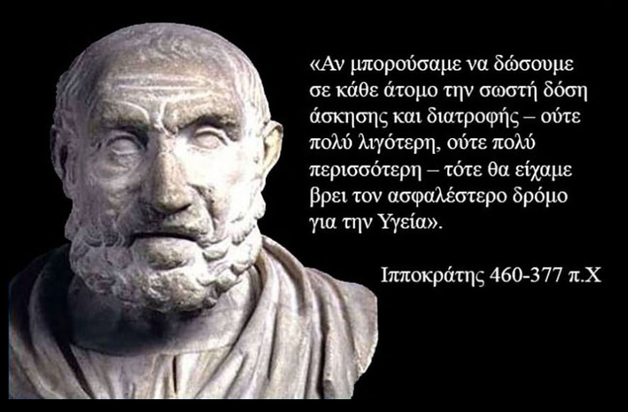
Next Steps in Nutritional Policies by Greek Societies
Members of the Hellenic Society of Internal Medicine participate in authorities on the national nutritional policy, the requirements for metabolic surgeries, the creation of therapeutic protocols for the treatment of obesity and the reimbursement of obesity drugs

Slide 9
Thank you for your attention
Dr Haris Dimosthenopoulos MMedSci.PhD
Chief Dietitian - Biologist
Dietetic Dept of General Hospital of Athens "Laiko"
Vice President of Empakan-Board member of IDF Europe
Scientific Secretary of Diabetes Nutrition Study Group (DNSG)

