Slide 1




Slide 2

European Strategies for Advancing Nutritional Care Policies and Implementation
A joint approach to nutrition care in Europe
Annemieke van Ginkel-Res, President European Federation of the Associations of Dietitians (EFAD)
Cristina Cuerda, M.D., General Secretary of European Society for Clinical Nutrition and Metabolism (ESPEN)

Slide 3

ESPEN
ESPEN is a scientific society dedicated to all issues relevant to the field of clinical nutrition and metabolism and promotes:
basic and clinical research
basic and advanced education
organization of consensus statements about clinical care and care quality control
Multiprofessional, multidisciplinary, international

Slide 4
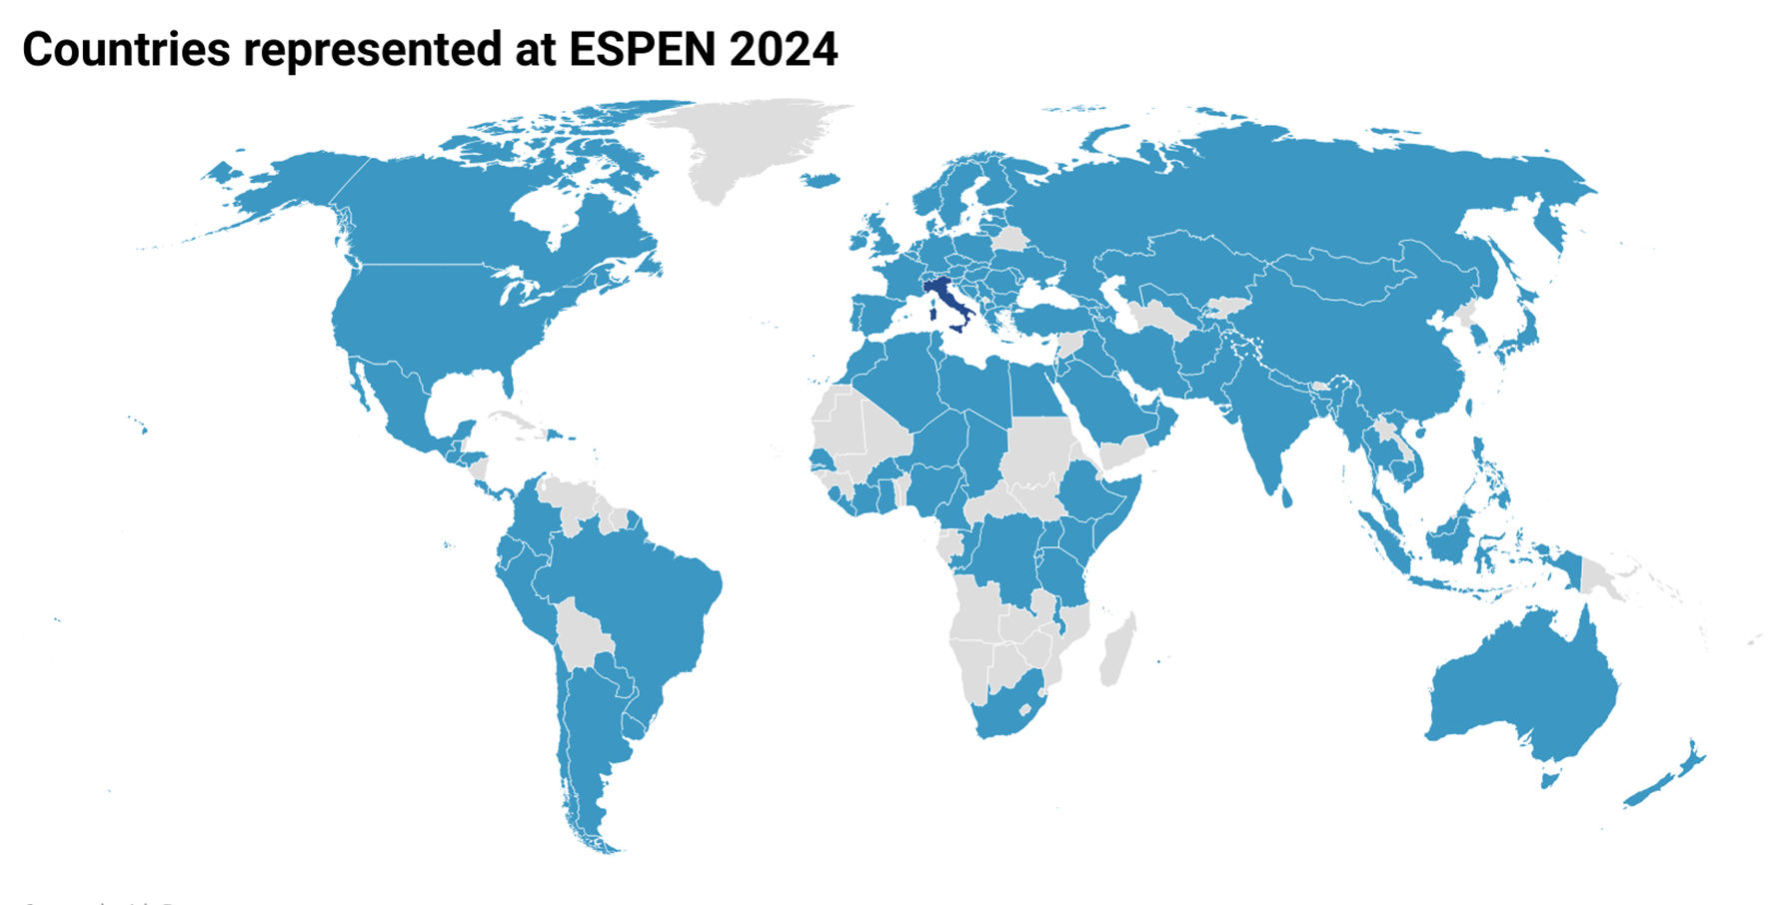
ESPEN in figures
ESPEN is the most important clinical nutrition society in the world
It is composed by more than 3200 members and includes 70 PEN societies in its council
The ESPEN congress attracts more than 4800 delegates from 128 countries

Slide 5
ESPEN organization
Executive Committee
C
ECPC
Scientific Committee
Basic course
Workshops
LLL program
Guidelines
Educational grants
Congress
Symposium
Advance course
Research grants
Broaden your Horizon grants
Special Interest Groups
Early Career Faculty
Congress
Journals
IT
nDay
CIF- action day
Chargés de mission
Cancer Task Force NEMS MAW GLIM WHO EU projects
Notes:
ESPEN is clinical: our main interests are to promote basic and clinical research, education at all the levels. But we are also interested in networking with other soiceties and organizations to make visible our work in the field of clinical nutrition. We have published 19 clinical guidelines + ethics + terminology papers.

Slide 6
ESPEN ES
ESPEN networking
Global initiatives
GLIM, GLIS
Human Rights
Scientific societies
EFAD
Non-related to nutrition (UEG, ECO, EASO, ERA, WONCA, EuGMS, ERAS…)
PEN societies
ESPEN Council
Continental- regional societies
ENHA-ONCA network
ICD, IDDSI
International organizations WHO, EU

Slide 7
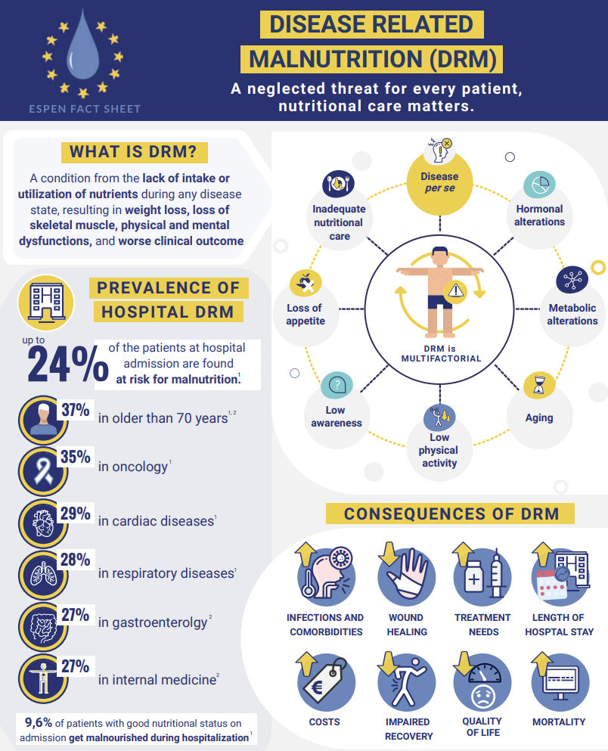

Slide 8
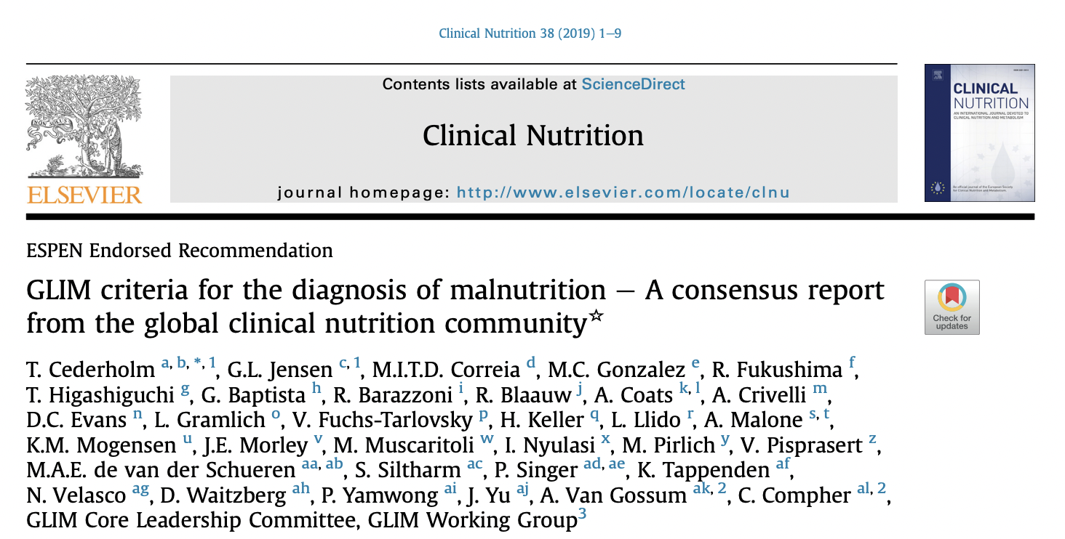
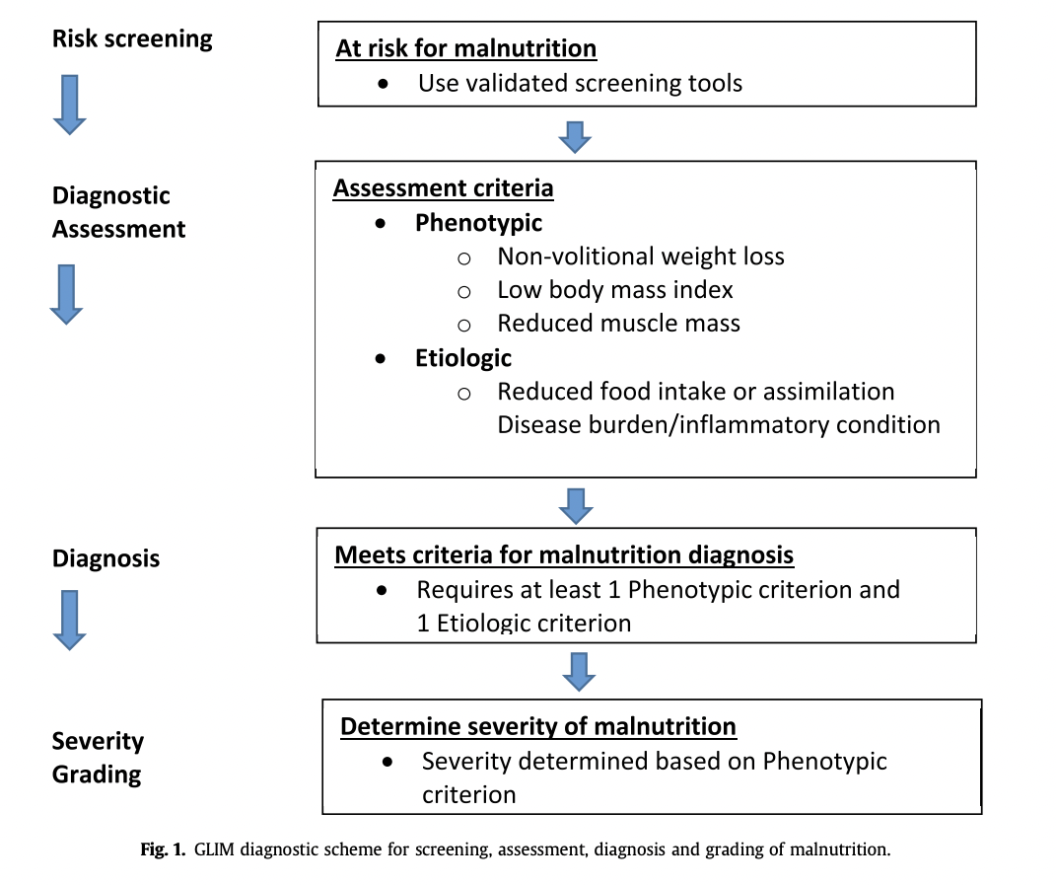

Slide 9
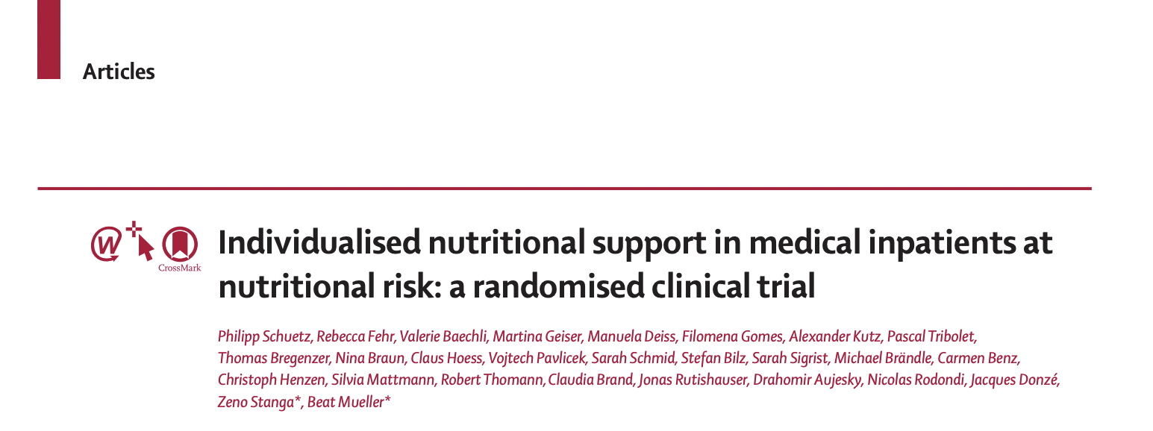


Slide 10
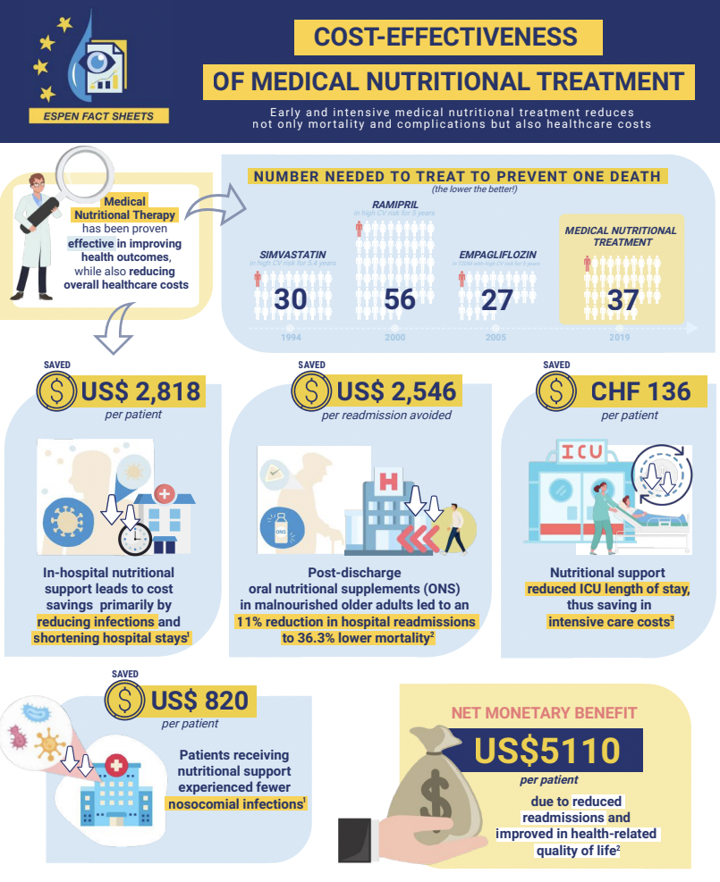
Prelimin
Preliminary draft

Slide 11
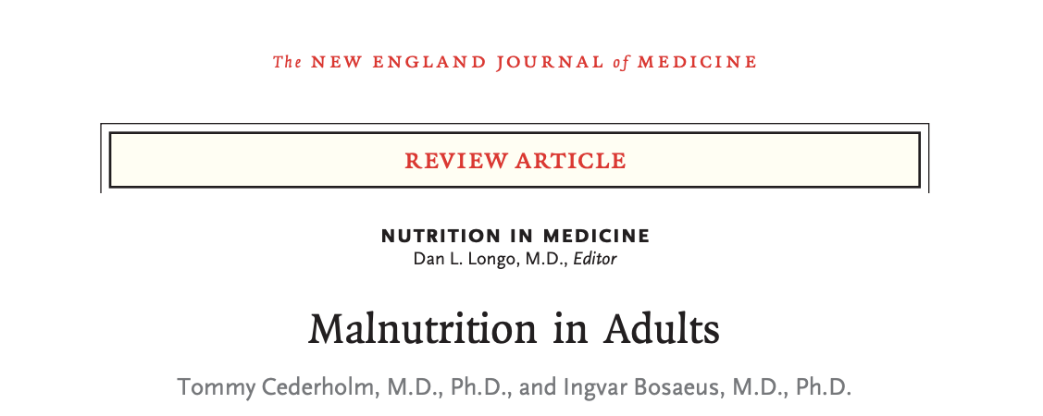

Slide 12
Networking with scientific societies

Slide 13
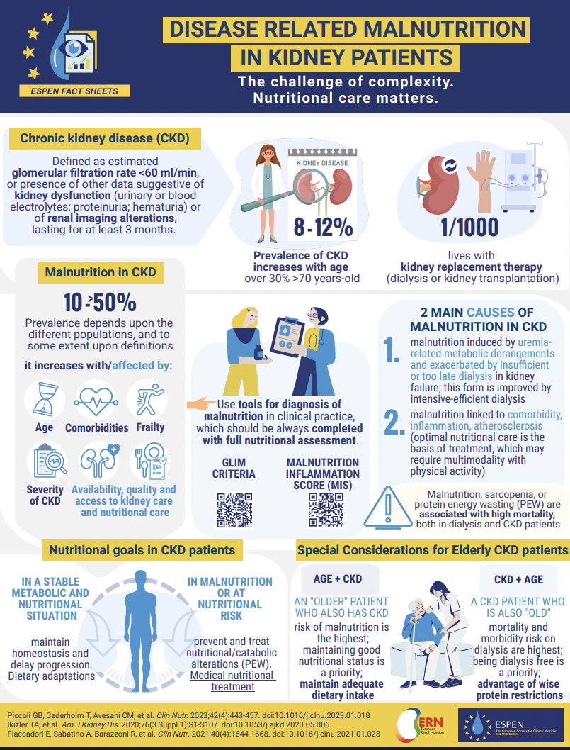
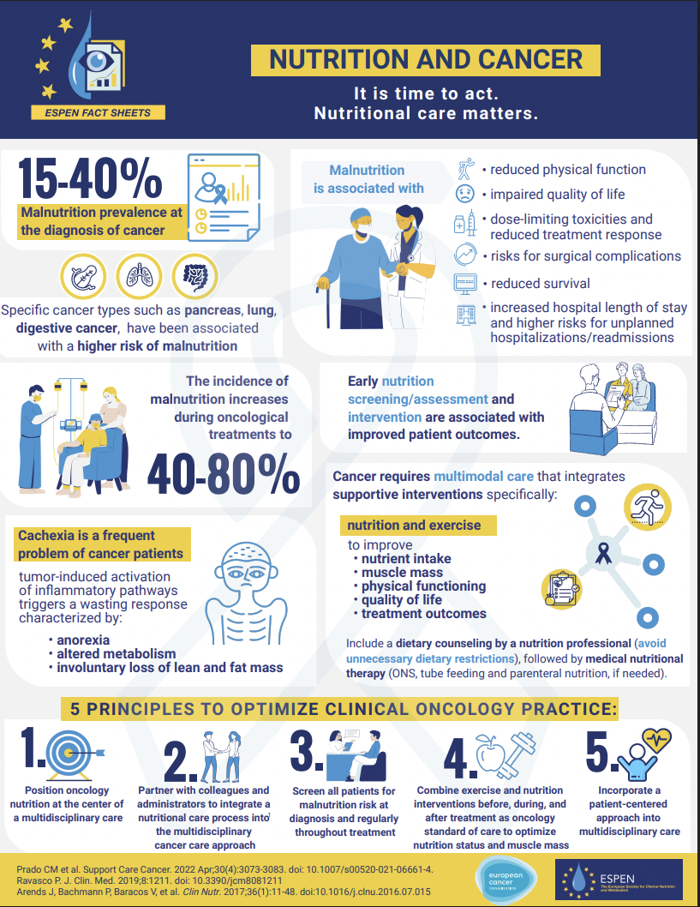
E
ERA
ECO

Slide 14
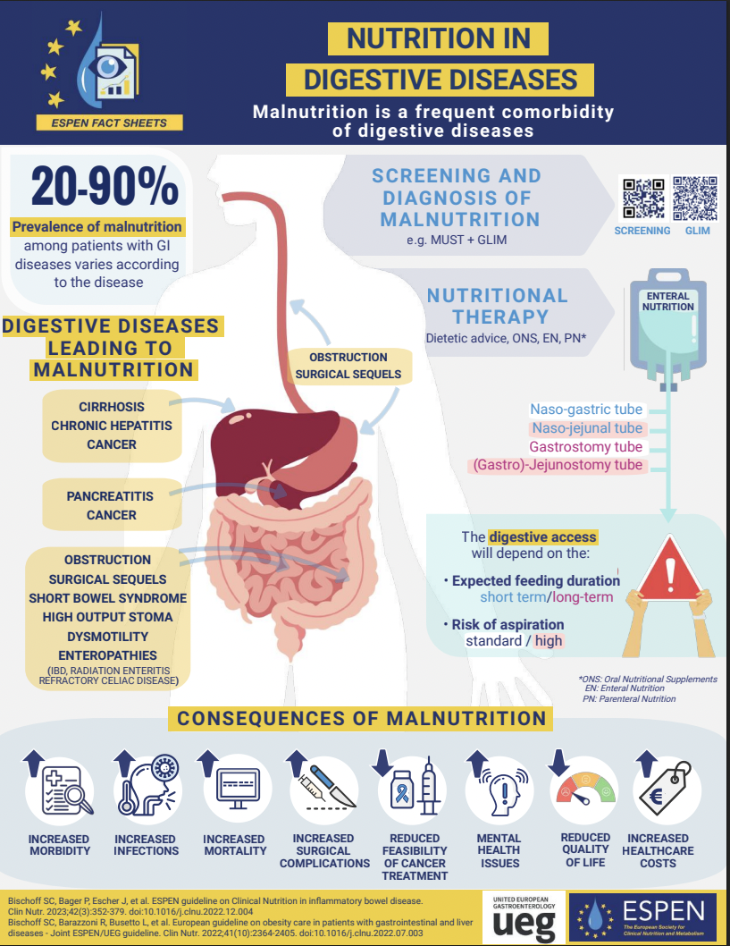
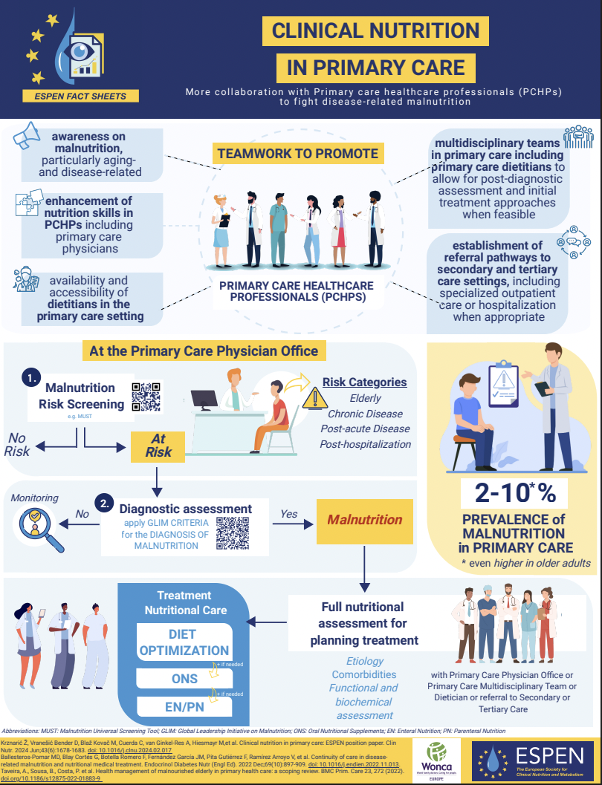
UEG
WONCA

Slide 15
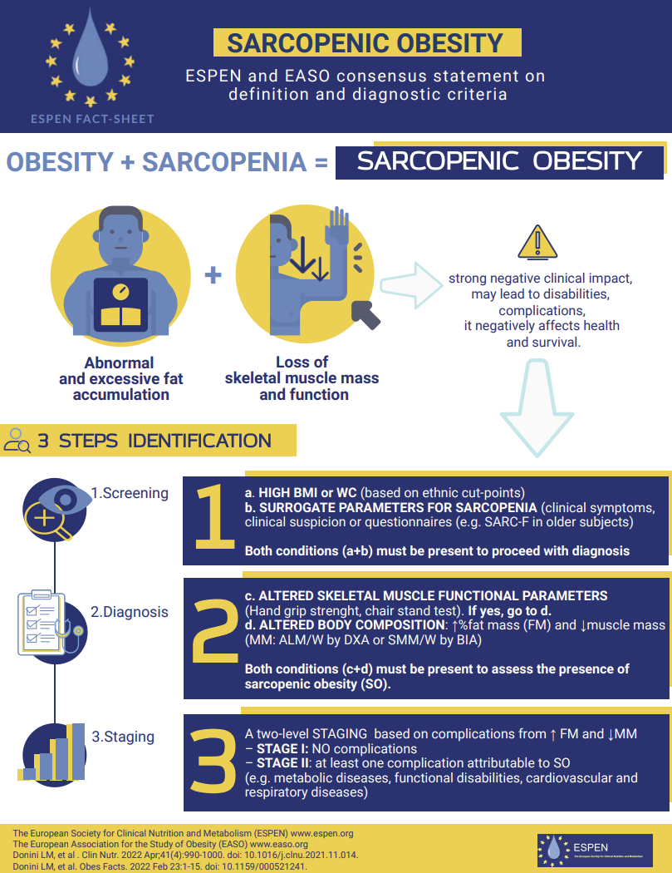
EASO

Slide 16
ENHA-ONCA network
International organizations: EU, WHO

Slide 17


ES
More collaboration and involvement in ENHA:
ESPEN Political arm
Collaboration in the MAW
Policy papers, manifestos

Slide 18

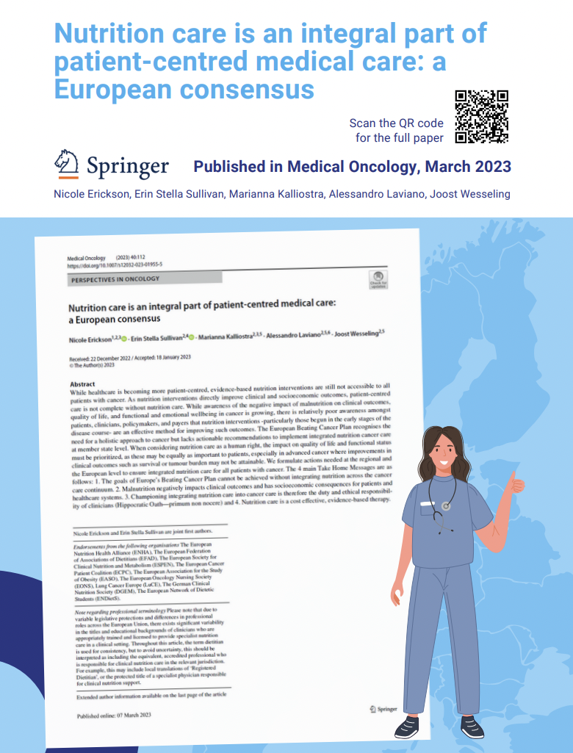
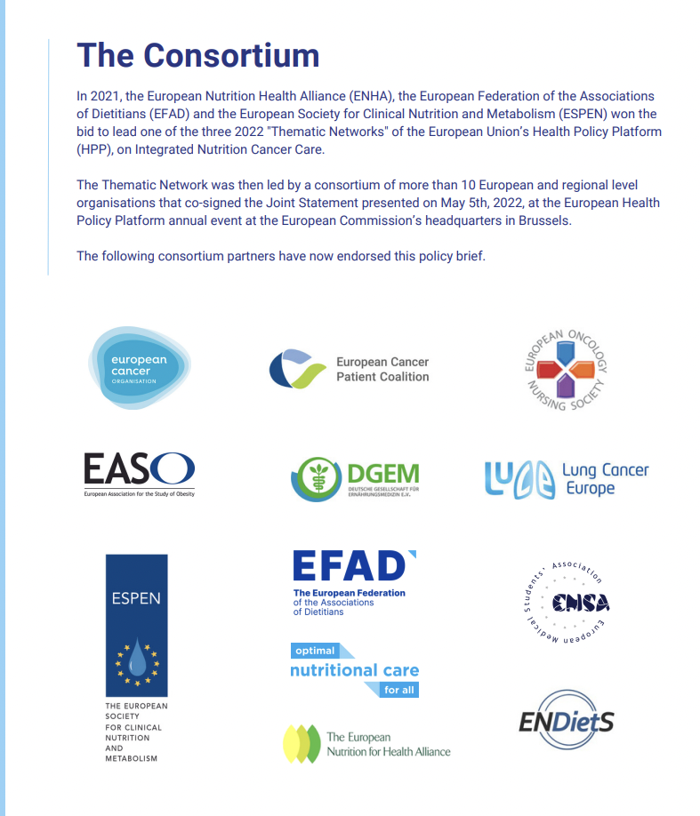

Slide 19
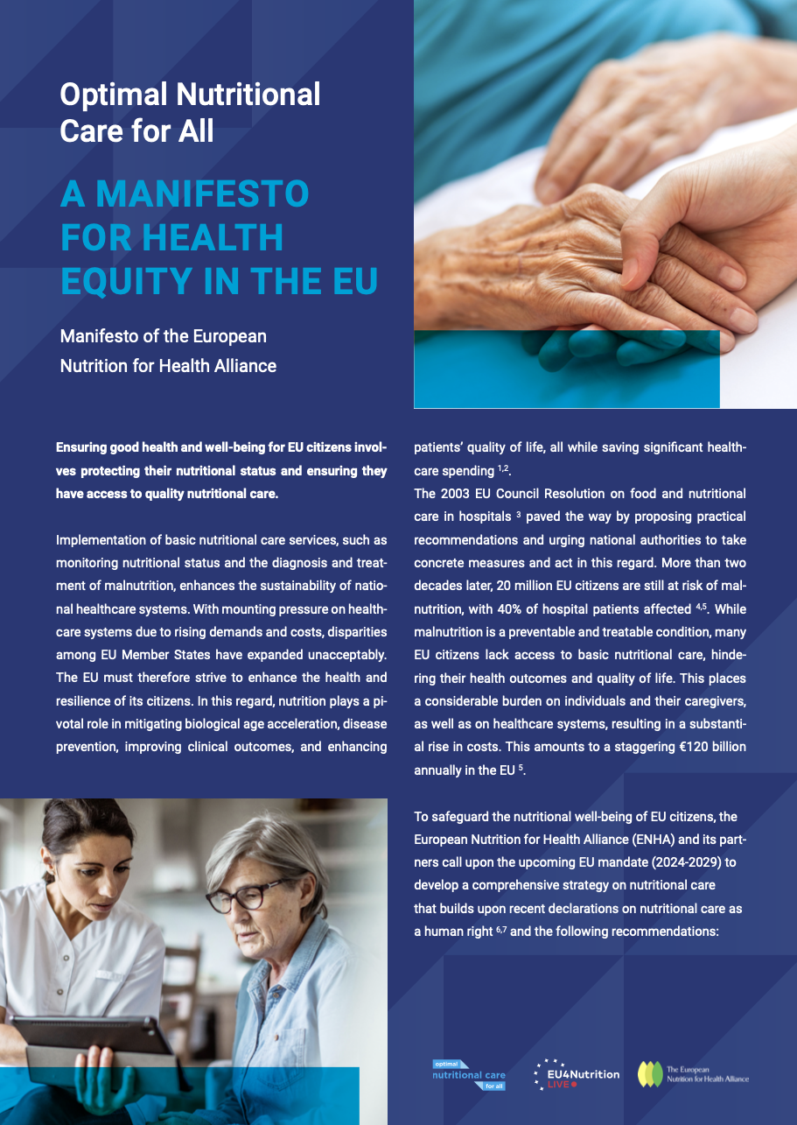
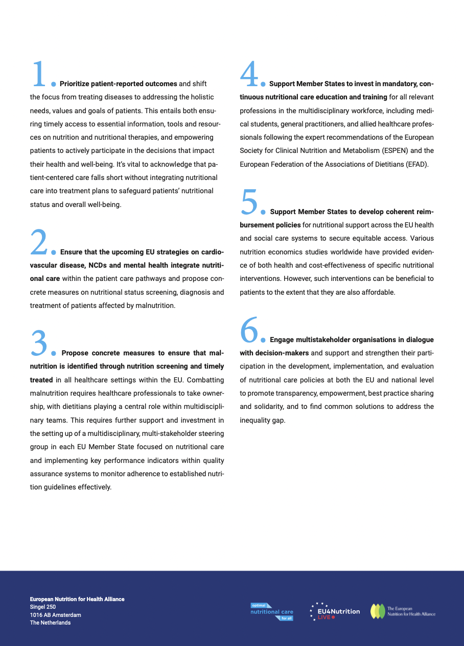
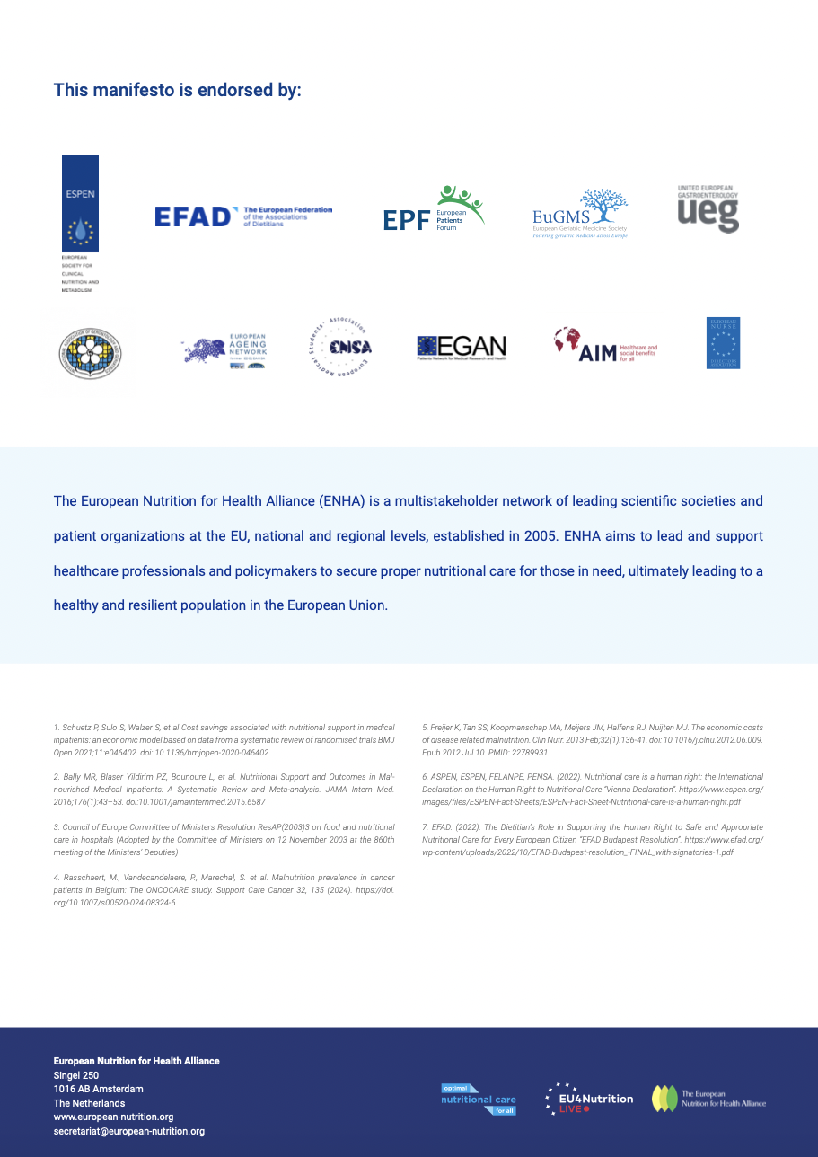

Slide 20

WHO - EUROPE
GROWING collaborative platform
  Nutritional care on the AGENDA!!
  Policy-awareness

Slide 21
WHO
ESPEN started a collaboration with WHO in 2019
ESPEN is a non-state actor of WHO since 2022
Participation to WHO Europe Regional Committee Session 72-74
Regular meetings with WHO Europe representatives
Joint ESPEN-WHO session during the ESPEN congress (Nutrition in emergency, nutrition in primary care, policy to implement nutritional care)
Particiaption of WHO speakers at ESPEN simposia (nutrition in older adults, home nutrition)
Participation of ESPEN speakers at WHO webinars
Collaboration and networking opportunities with other NSA

Slide 22



WHO - EUROPE
Tel Aviv, Israel, September 2022
Astana, Kazakhstan, October 2023
Copenhage, Denmark, October 2024

Slide 23



WHO - EUROPE
October 2023
  ESPEN participation
  Political network to propose DRM inclusion as WHO healthcare priority

Slide 24
Disease-relatred malnutrition
D Cardenas, R Barazzoni
WHO Fact sheet 2023

Slide 25
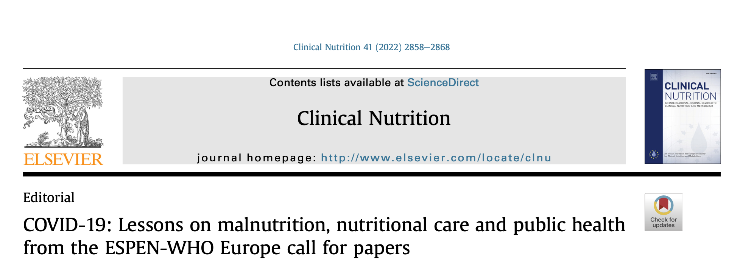
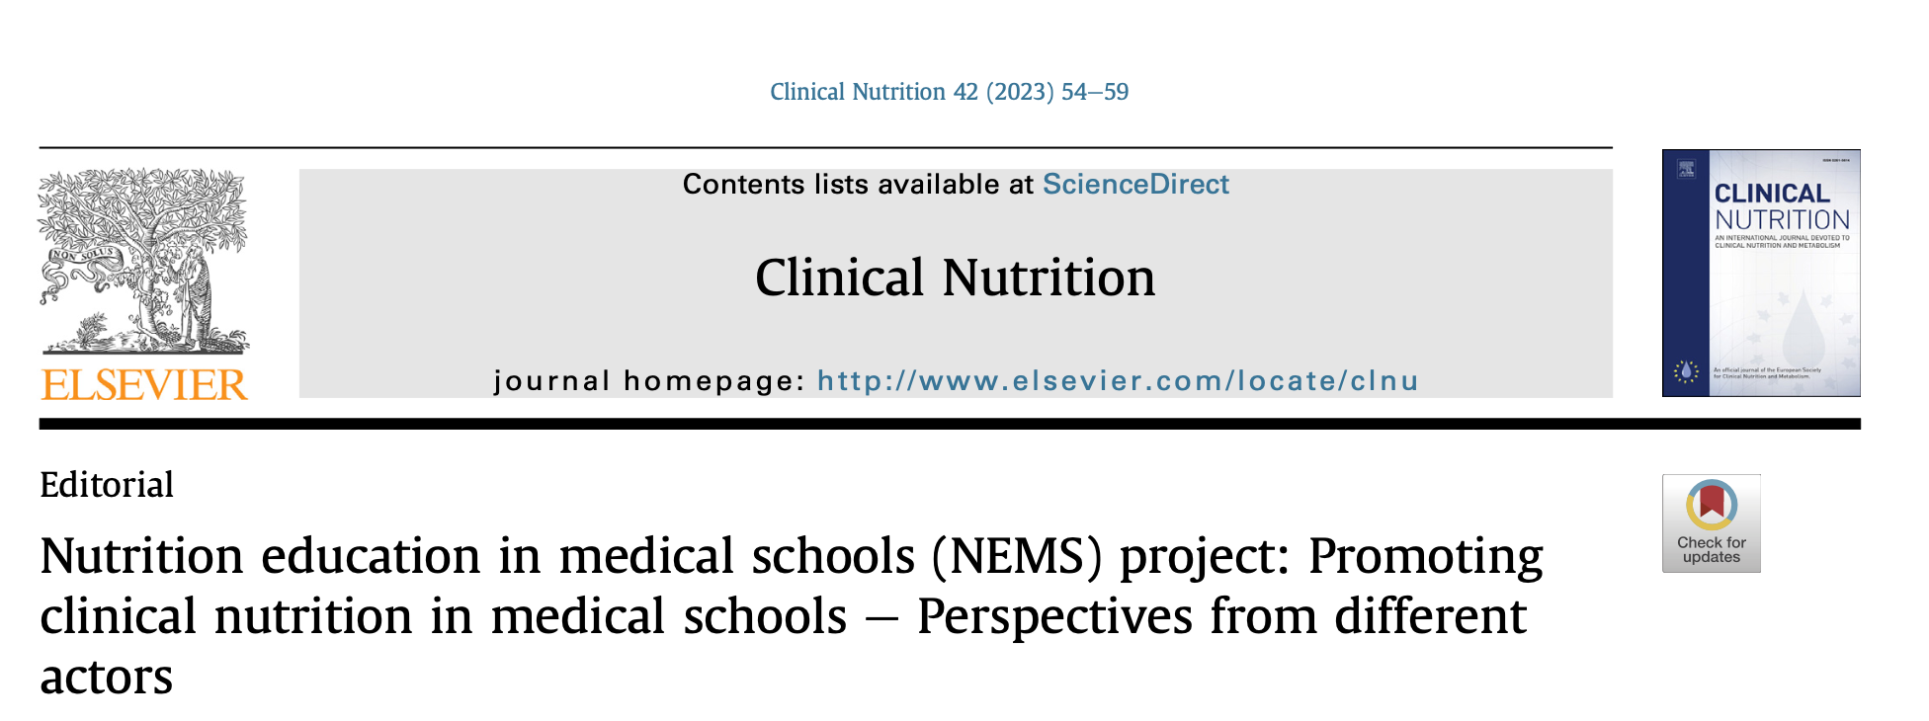
COVID
Education

Slide 26
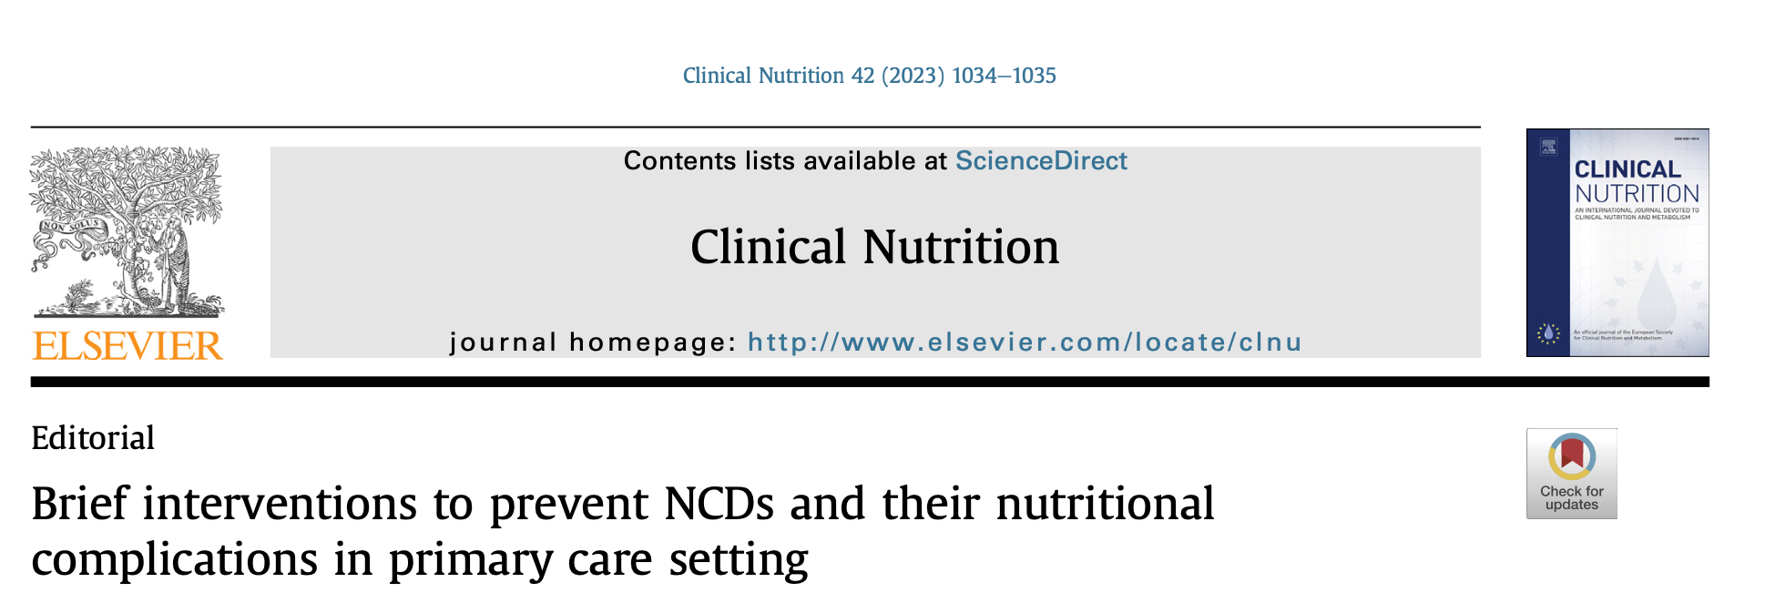
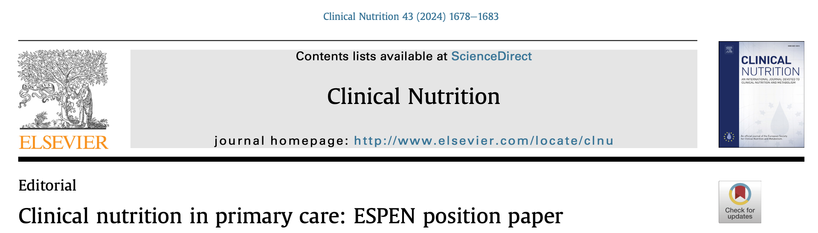
Primary Care

Slide 27
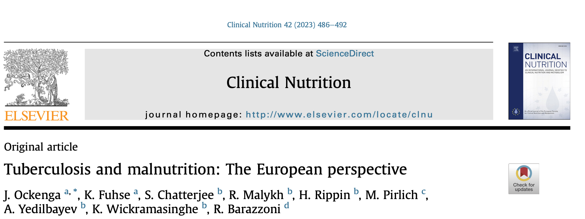
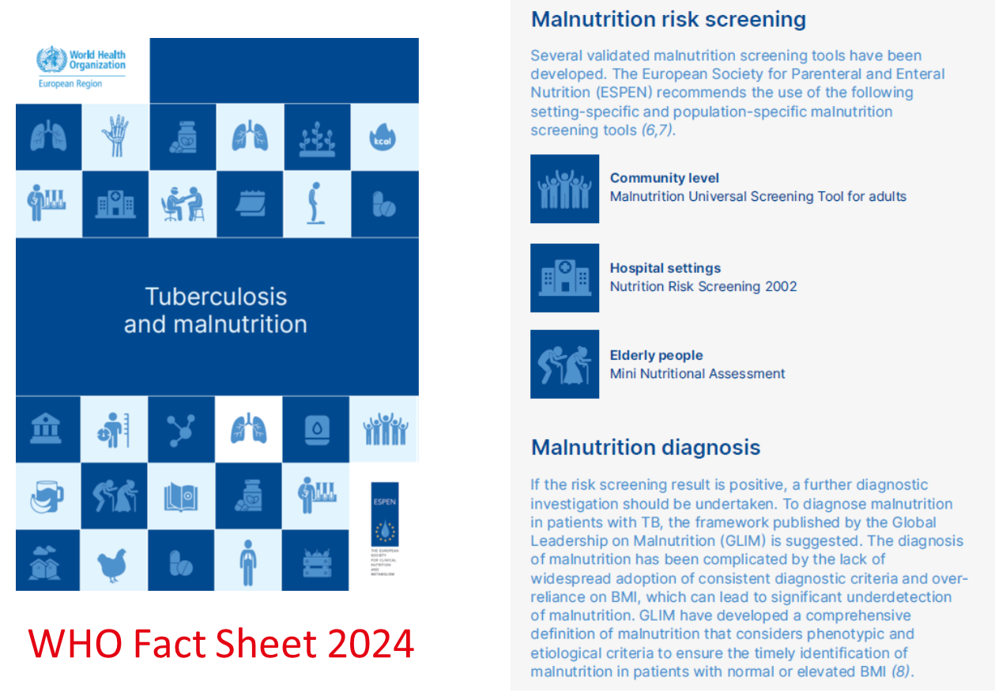
Tuberculosis

Slide 28
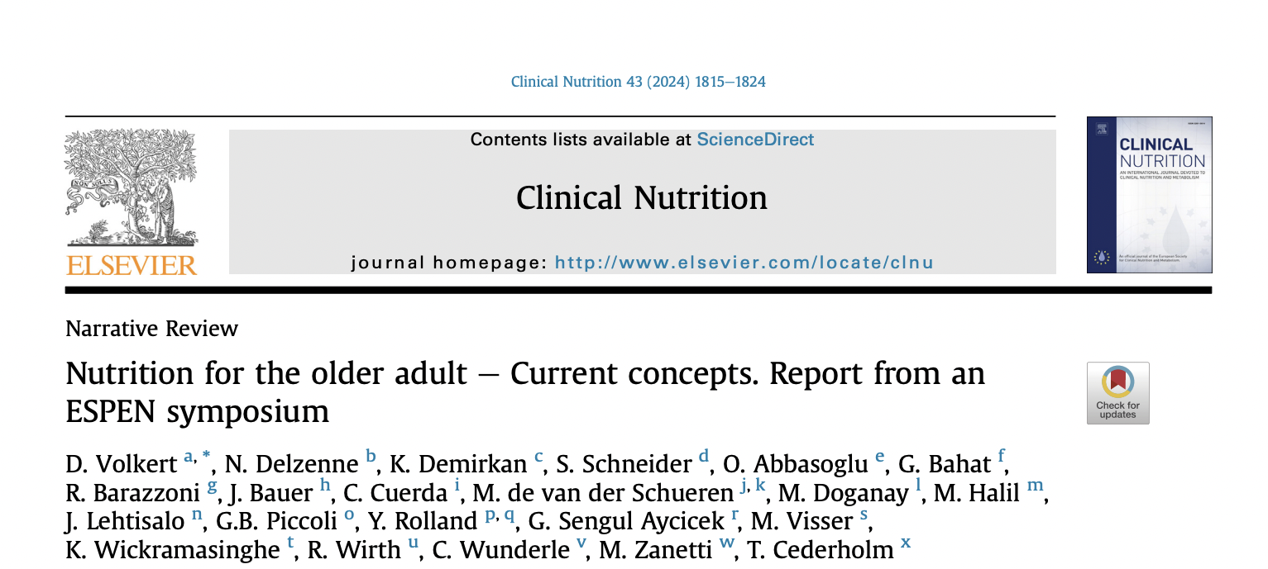
Nutrition in older adults

Slide 29

WHO Fact sheet 2025
Sarcopenic Obesity

Slide 30
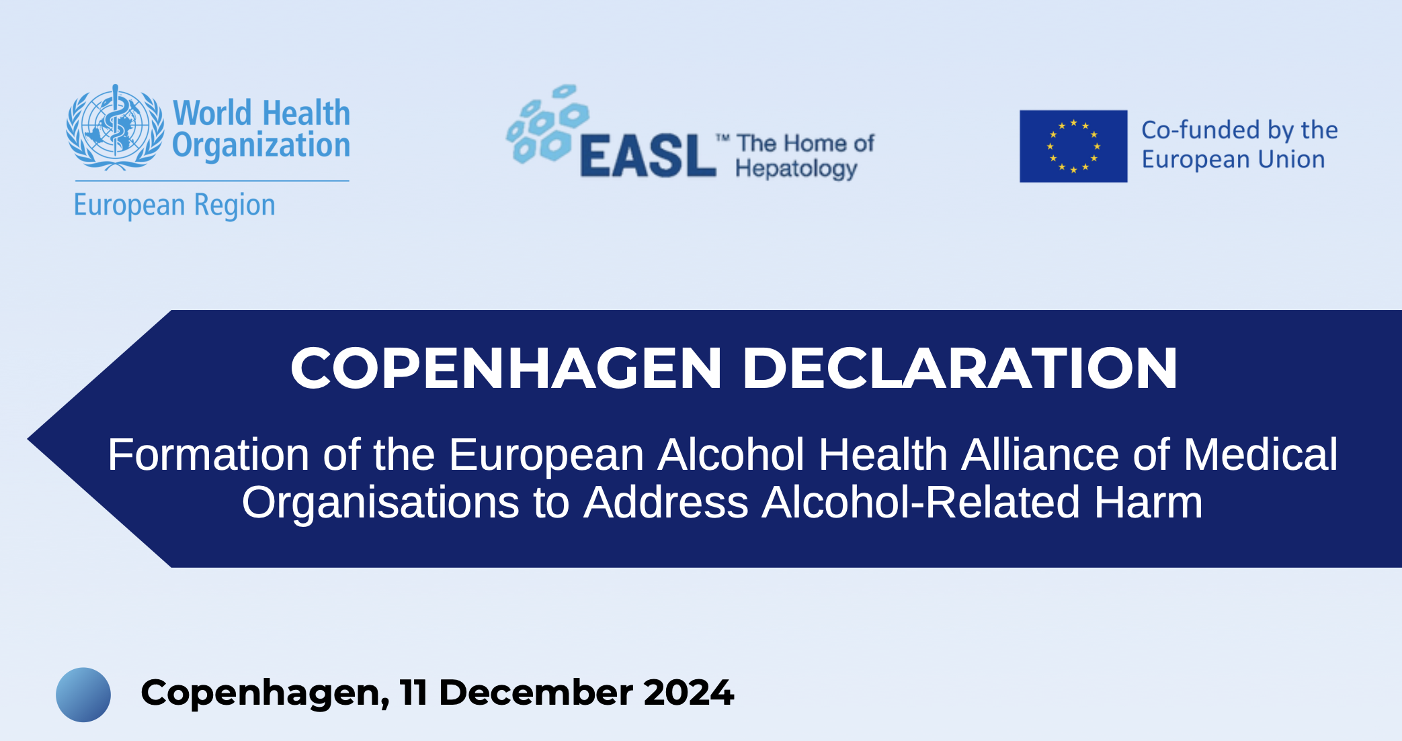
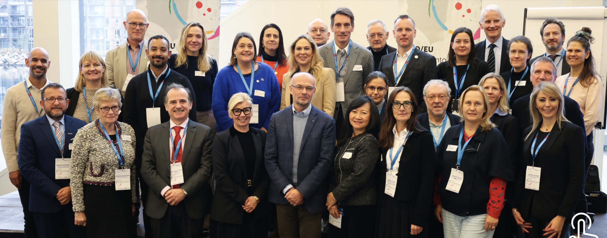
Nutrition and alcohol

Slide 31
Global initiatives

Slide 32
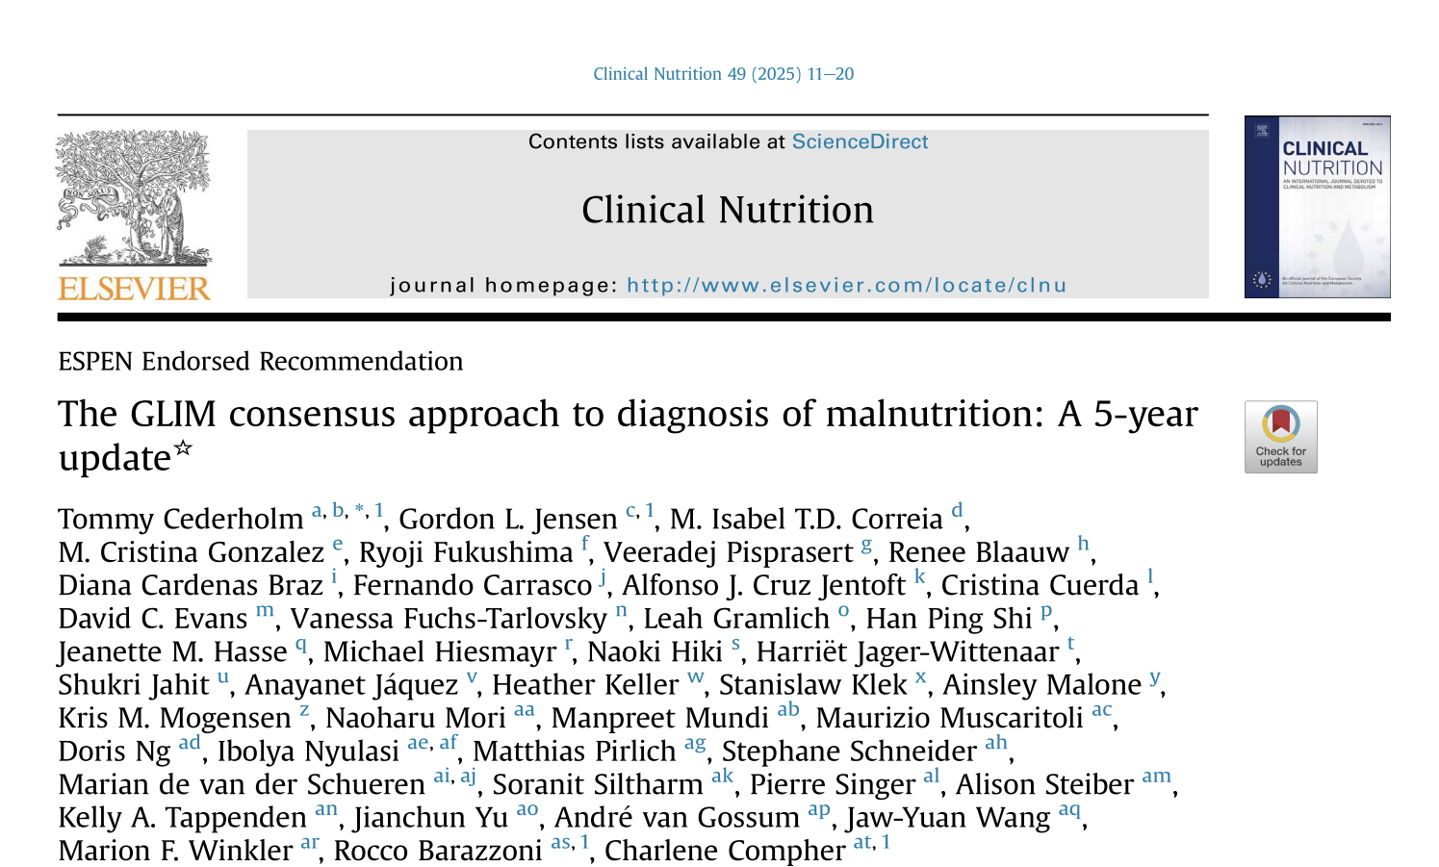


Slide 33
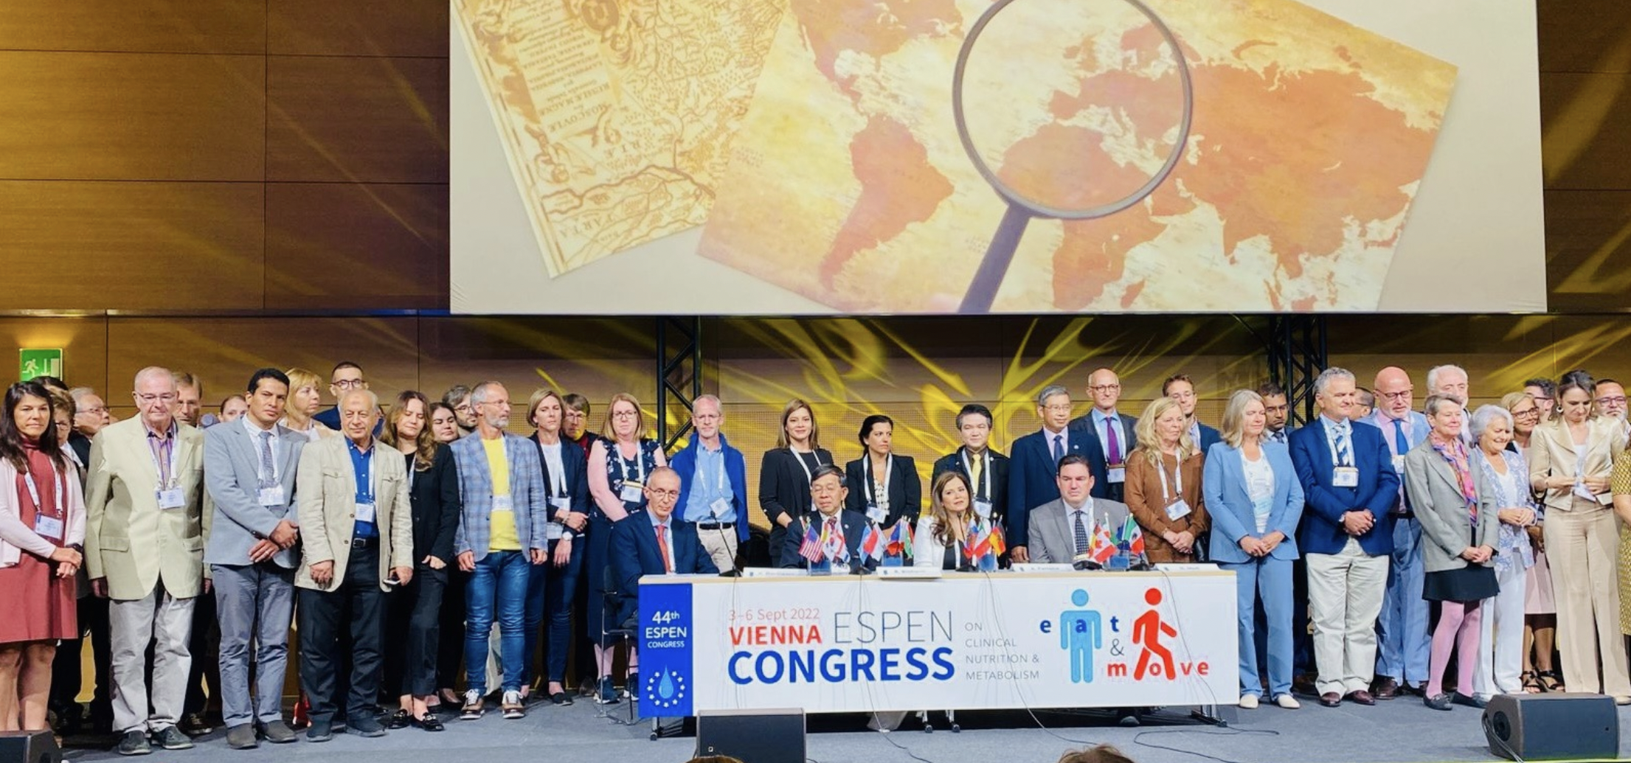
V
Signed by more than 70 PEN societies (including ESPEN, ASPEN, FELANPE and PENSA)
Vienna Declaration. Nutritional care is a human right

Slide 34
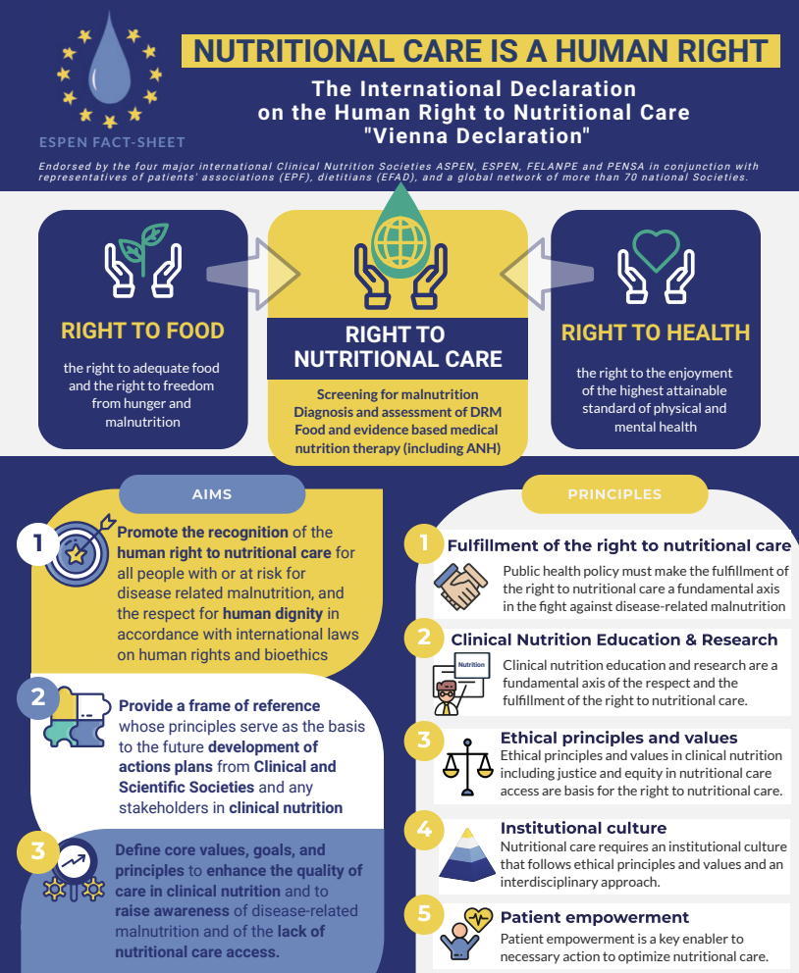

Tackling disease-related malnutrition in resource-limited settings: an international position paper

Slide 35
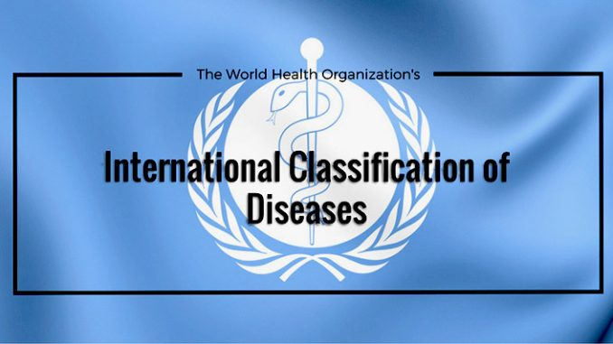
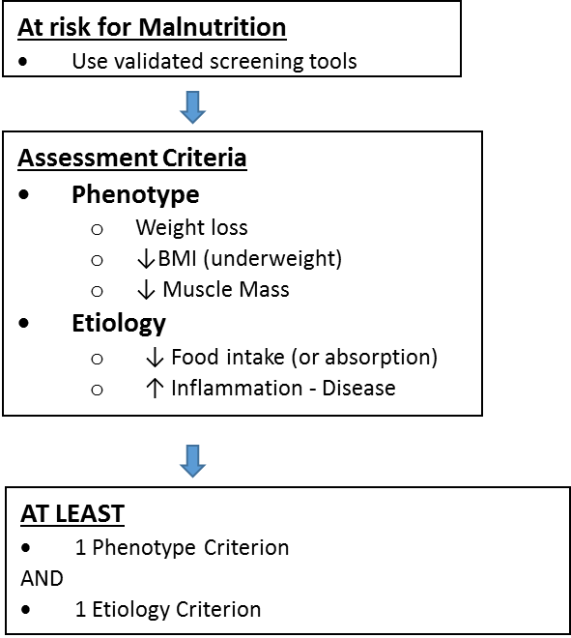
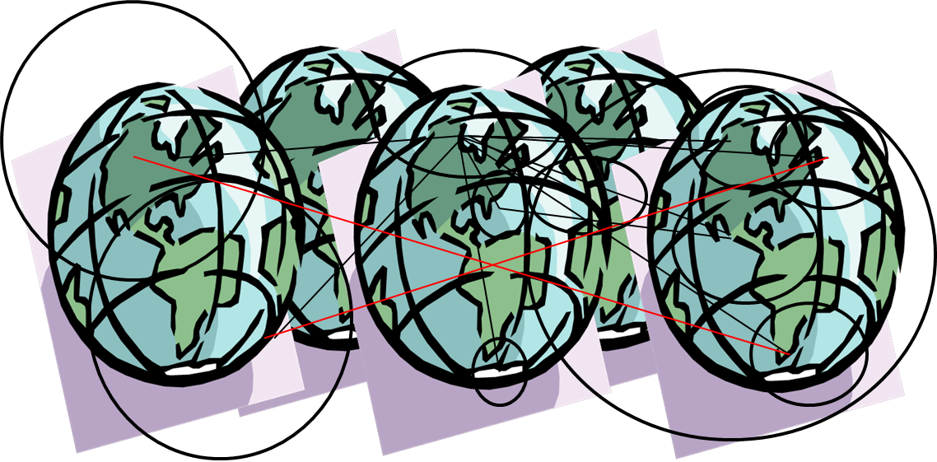
Malnutrition:
BMI<18,5 (!)
Kwashiorkor
Marasmus
> 40 Societies WORLDWIDE!
WHO Europe FORMAL support
Progress expected Fall 2025
Notes:
That is exactly what I/we found 2019-2020 when we browsed the new ICD-11 website to see where the GLIM concept could fit in. To our astonishment, the new ICD-11 coding system only had/has one code related to malnutrition/undernutrition in adults and that is “5B54 Underweight in adults”.
For that reason the GLIM Core Committee (ESPEN and ASPEN representatives), with the support of the Swedish National Board of Health and Welfare/Classification and Terminology team (headed by Dr Magdalena Fresk), and with the help of the SWESPEN chairperson Elisabet Rothenberg, provided the WHO ICD group with a proposal for complementary ICD-11 codes. These codes are/were in line with the GLIM concept, but also relevant for any undernutrition diagnostic procedure.
As Rocco indicate, and as you probably remember, we raised the support from altogether 40 international societies when the proposal was submitted to WHO in November 2020. The sender was Dr Magdalena Fresk, Swedish National Board of Health and Welfare/classification and terminology. I know that Stéphane has posted a positive remark on the ICD website (during the public digital exhibition of new ICD code proposals :)).
Since then, Magdalena, I, Elisabet, Rocco, Gordon, Charlene, and in the end also Harriët Jager (representing EFAD) have had sporadic, but sometimes quite intense communication with the WHO people (their ICD and their Nutrition group). We have learned that the WHO bureaucracy is thorough and slow! We also published a paper to call for a new ICD-coding (attached). Dr. Kremlin Wickramasinghe, at the European WHO Office, has also kept his eyes/hand over this procedure.
Now, about five years later this process may near a successful end. Coincidentally, just today, Dr. Magdalena Fresk on behalf of the Swedish National Board of Health and Welfare, submitted the final edition of the proposal (after several critical rounds with WHO experts). This proposal (attached, look for 5B72, 5B72.0-5B72.2) will now be considered and processed by WHO.
In best case there will be a positive decision on this proposal in October, and if accepted the new codes will be incorporated in ICD-11 from January 2026.
In the meantime, we have to use the old ICD-10 codes, i.e. the ones that Stanislaw just mentioned.
Let’s cross our fingers for a successful procedure at WHO.

Slide 36
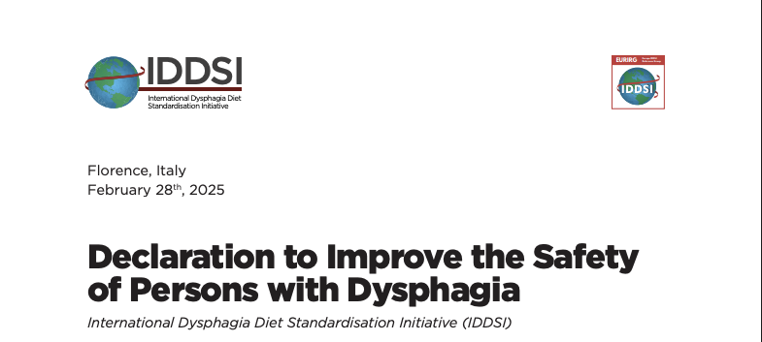
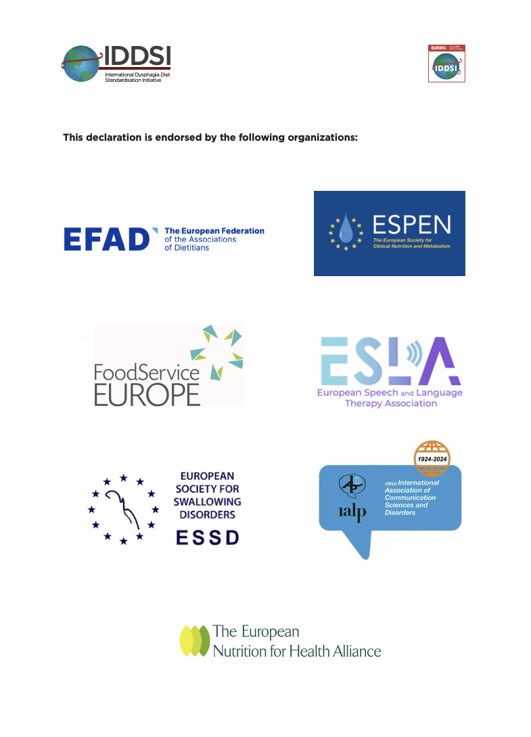
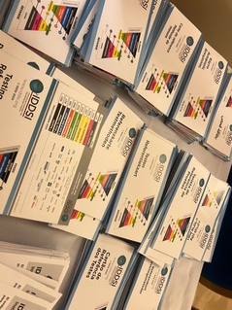

Slide 37


Slide 38
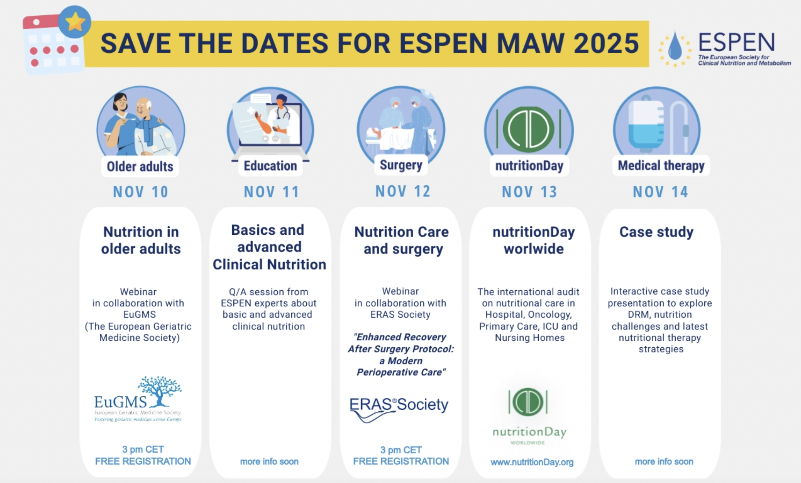

Slide 39


