Slide 1



Nutritional Care, Quality and Disease Prevention
In the WHO European Region
Alison Bate
Consultant
WHO Athens Office on Quality of Care and Patient Safety
CPS Division, WHO/EURO

Slide 2






1 | The WHO Office on Quality of Care and Patient Safety
COUNTRY TECHNICAL SUPPORT on national strategies and frameworks to scale up successful interventions
INNOVATION & KNOWLEDGE on quality of care and patient safety
POLICY ANALYSIS on of quality of care and patient safety
NETWORK building, alliances and stakeholder engagement
Notes:
Sit within the WHO Regional Office for Europe:
Serves the WHO European Region, which comprises 53 countries, covering a vast geographical region from the Atlantic to the Pacific oceans.
Strategy for the Region set by the Second European Programme of Work: United action for better health
Health systems of the future
Ageing
Climate change
Health Security
NCDs and Mental Health
Special Initiative on Violence Against Women and Girls
Primary Health Care

Slide 3

2 | Quality of care
1 Effective
2 Safe
Evidence-based health care services for those who need them
Avoiding harm to people for whom the care is intended
3 People-centred
Providing care that responds to individual preferences, needs and values.
Lower risk and error
Reduce avoidable harm
Reduce impact of harm when It does occur.

Slide 4

2 | Health Service
Timely
Equitable
reducing waiting times + harmful delays
gender, ethnicity,
geographical location or socioeconomic status
Integrated
Efficient
interdisciplinary-based care that makes available the full range of health services at all ages
maximizing available resources and avoiding waste

Slide 5
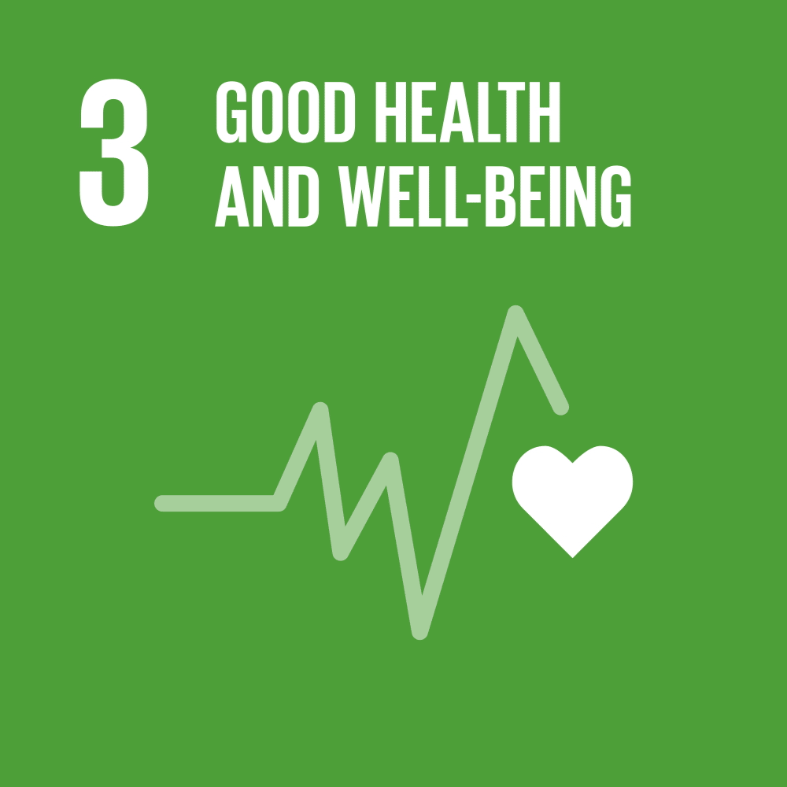
2 |Quality of care
Why?
There is no universal health coverage without quality of care.
Notes:
Good health and wellbeing for all
Achieving UHC is one of the targets the nations of the world set when they adopted the 2030 Sustainable Development Goals (SDGs) in 2015.
UHC = All people have access to the full range of quality health services they need, when and where they need them, without financial hardship. It covers the full continuum of essential health services, from health promotion to prevention, treatment, rehabilitation and palliative care across the life course.
UHC is firmly based on the 1948 WHO Constitution, which declares health a fundamental human right and commits to ensuring the highest attainable level of health for all.
As a foundation for UHC, WHO recommends reorienting health systems towards primary health care (PHC). In countries with fragile health systems, WHO focuses on technical assistance to build national institutions and service delivery to fill critical gaps in emergencies. In more robust health system settings, WHO drives public health impact towards health coverage for all through policy dialogue for the systems of the future and strategic support to improve performance.
But WHO is not alone: WHO works with many different partners in different situations and for different purposes to advance UHC around the world.

Slide 6
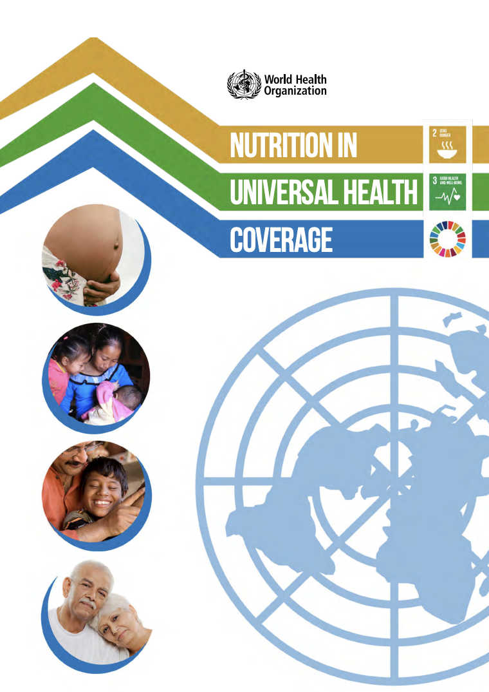
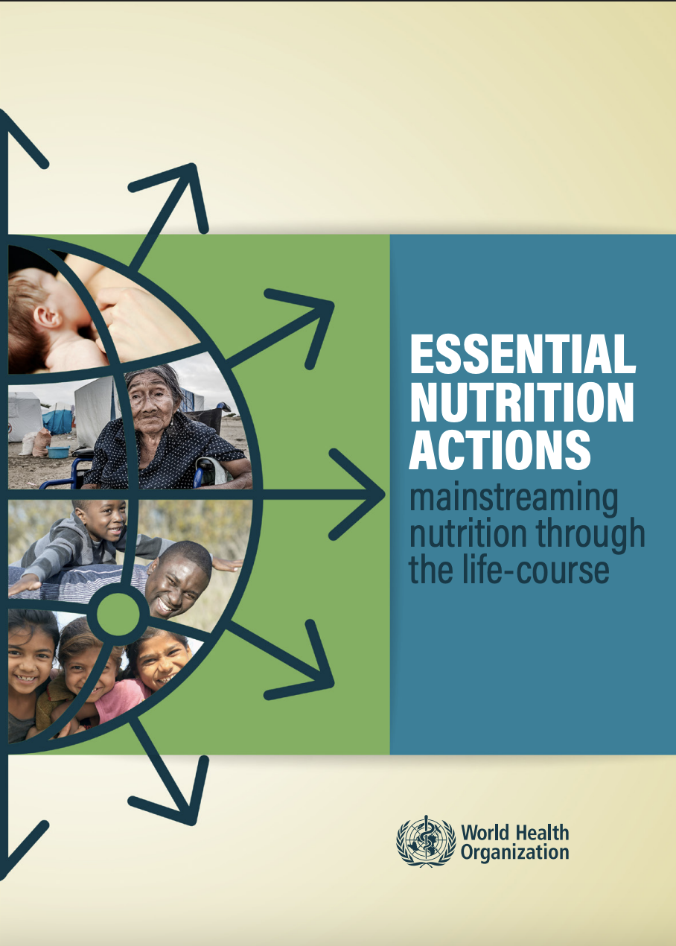
3 | Nutrition for UHC
“No country can achieve universal health coverage (UHC) without investing in essential nutrition actions, and good nutrition for all cannot be achieved without UHC.”
– Nutrition in UHC (WHO, 2019)
“Stronger focus on nutrition within health services could save 3.7 million lives by 2025.”
– Essential Nutrition Actions (WHO, 2019)
Notes:
Nutrition in UHC, Key messages:
Malnutrition in all its forms increases risk of disease and death
Addressing malnutrition and nutrition-related diseases is cost-effective
Essential nutrition actions benefit the poorest, most vulnerable and marginalised

Slide 7
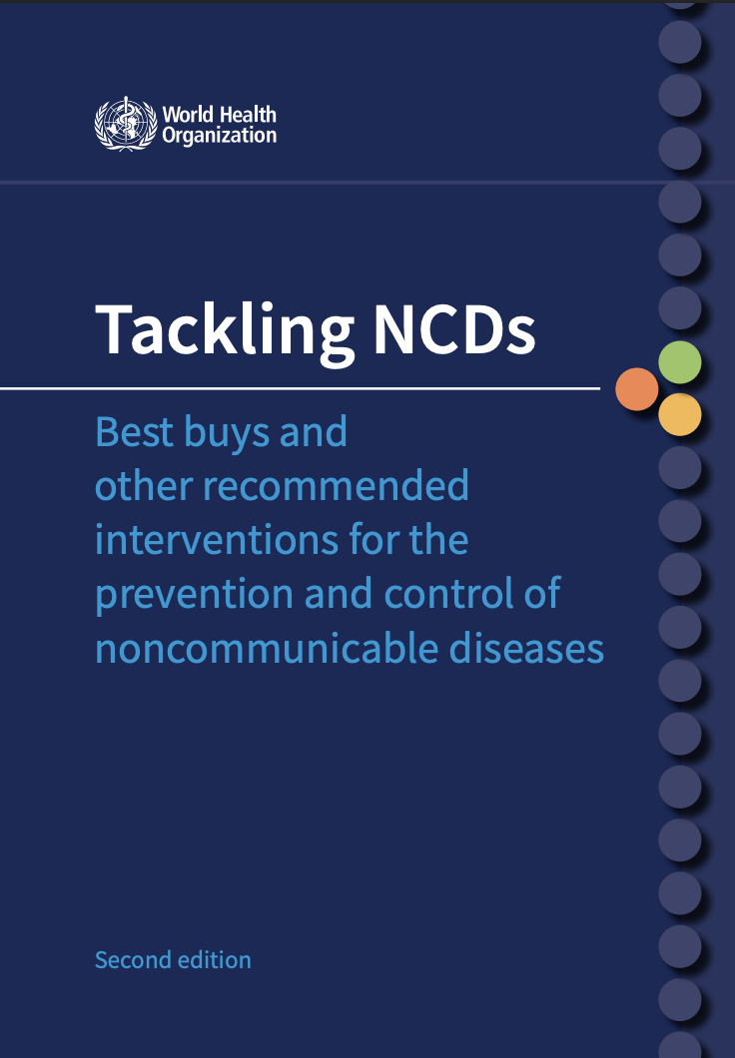
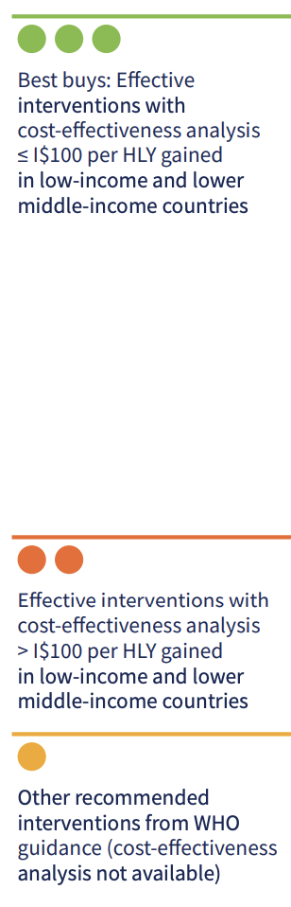
4 | Nutrition impact through prevention
NCDs are responsible for almost 3 quarters of all deaths worldwide.
WHO recommendations on alcohol reduction and dietary patterns offer “best buys”:
Reformulation on HFSS foods
Public food procurement & service policies
Behaviour change communications & mass media
Food marketing restrictions
Protecting optimal breastfeeding practices
WHO (2024): https://iris.who.int/bitstream/handle/10665/376624/9789240091078-eng.pdf?sequence=1
Notes:
Those essential nutrition actions are highlighted in this recent WHO publication, Tackling NCDs which highlights best buys for really driving down NCDs and deaths from NCDs.
I.e. effective and cost-effective interventions
And these are largely lifestyle based, a lot of which are related to nutrition/diet

Slide 8

5 | Clinical Nutrition
& Quality of Care
Integration of evidence-based practices and innovative solutions enhances effectiveness, safety and equity of care delivery, minimizing errors and variability in outcomes.
Literacy and engagement empower individuals to become informed partners, strengthening the patient– provider relationship and ensuring that care is personalized, respectful and responsive to individual needs and preferences.
Notes:
On the other side of the spectrum we’ve got clinical nutrition.
When we think about what providing a high quality of care means, we can see how it applies in nutrition and dietetics.
This is relevant from primary care (eg weight mx, BP mx, diabetes mx) through to secondary and tertiary care (eg surgical patients).

Slide 9
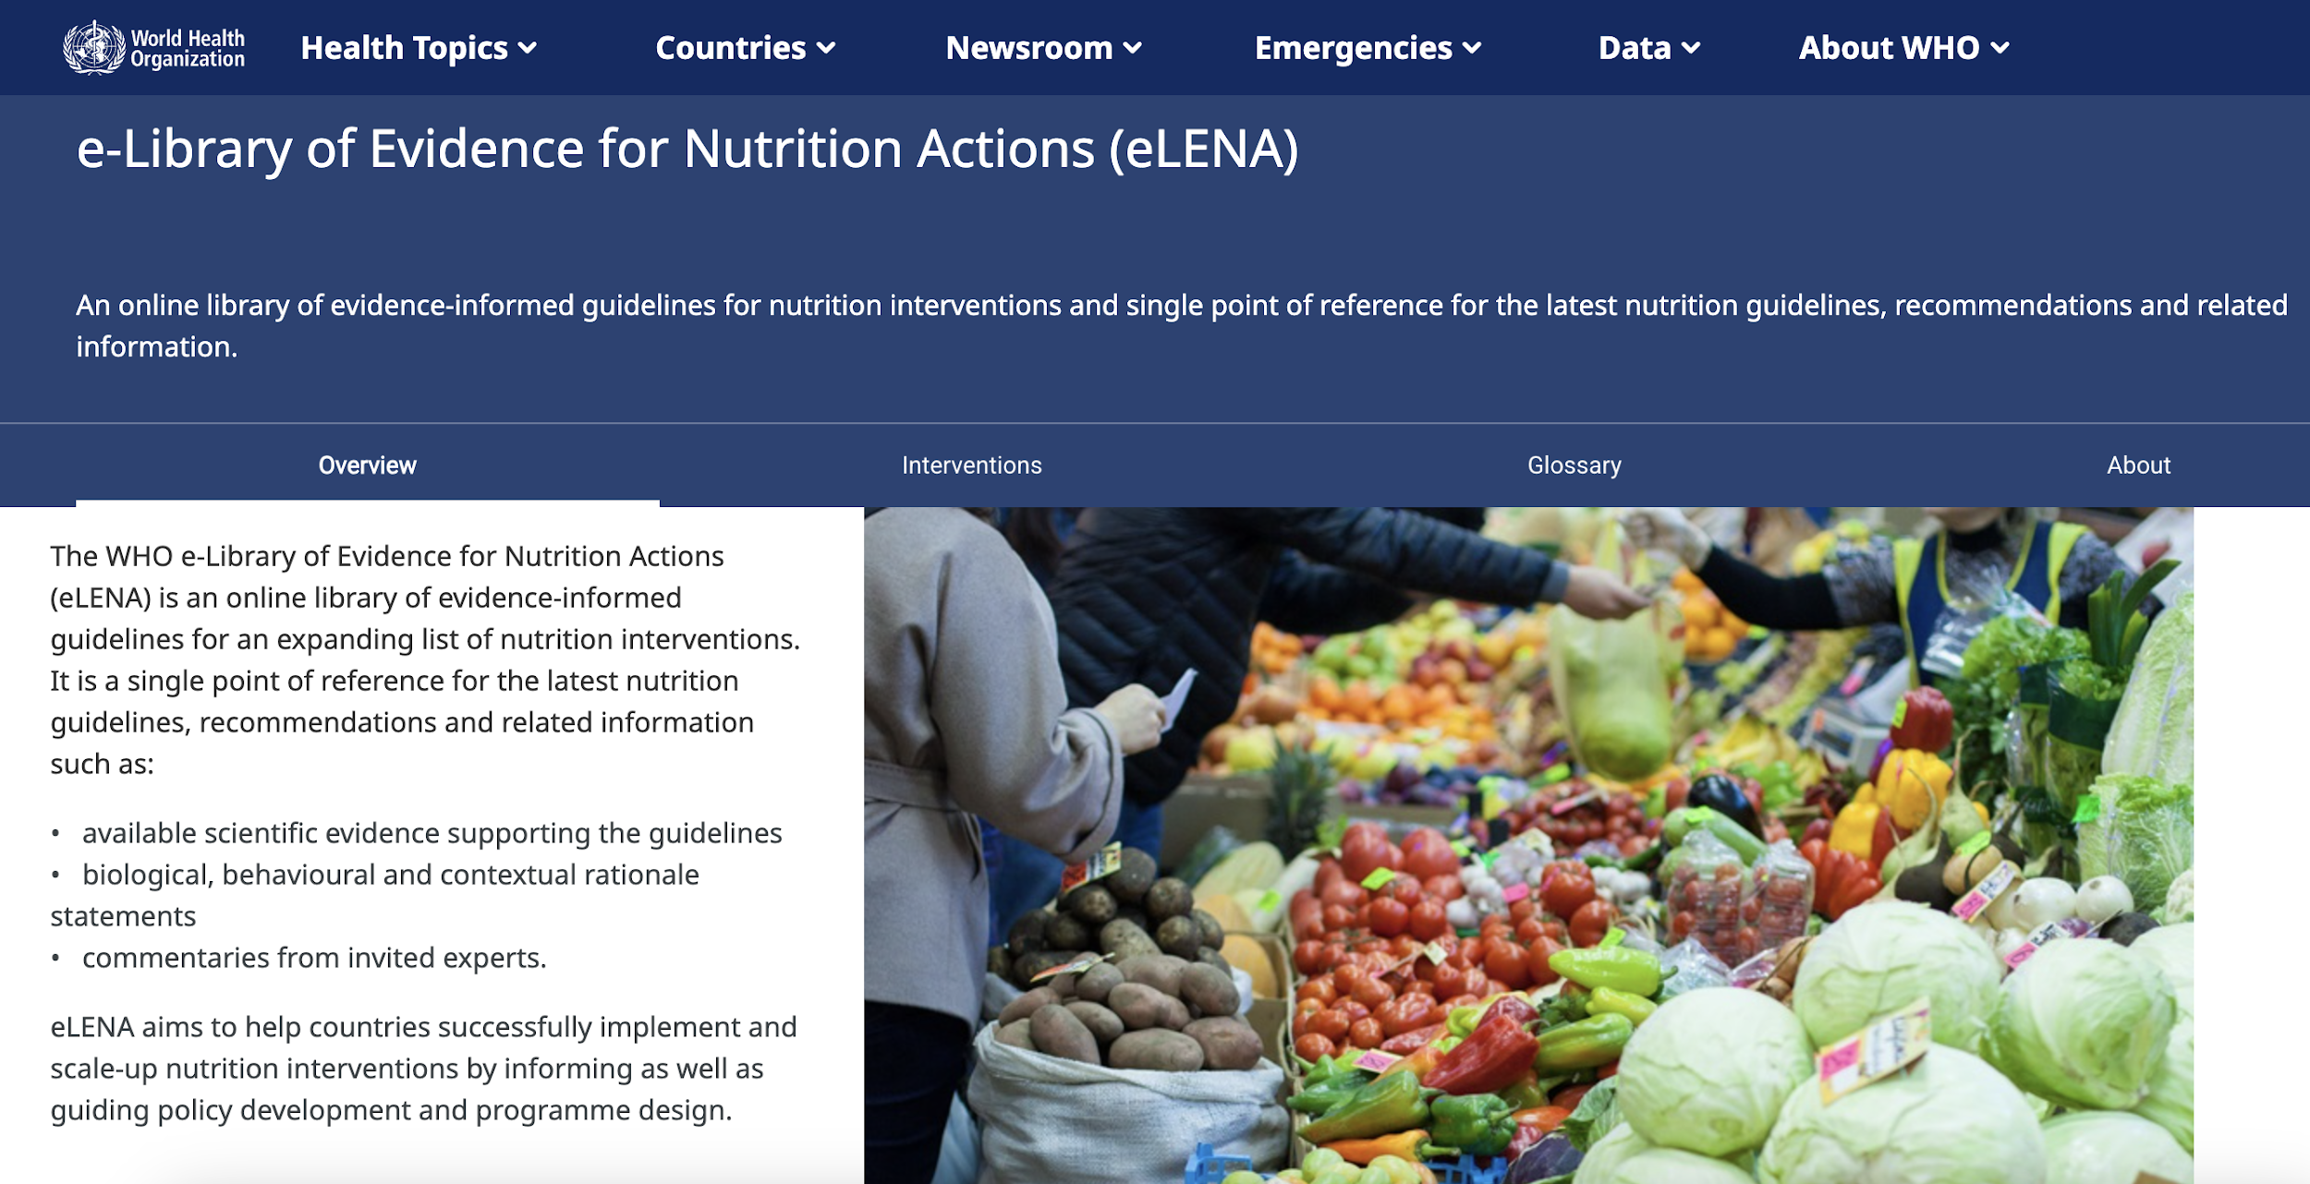
5 |WHO e-Library of Evidence for Nutrition Actions (eLENA)
Notes:
An example of the relevance of WHO QoC work in nutrition – An online library of evidence-informed guidelines for nutrition interventions and single point of reference for the latest nutrition guidelines, recommendations and related information.
Each page covering a nutrition intervention contains the following features:
Narrative text
WHO recommendations
WHO documents
Evidence
Cost-effectiveness
Category of intervention
Intervention pages may also contain:
Biological, behavourial and contextual (BBC) statement
Commentary
Systematic review summary

Slide 10
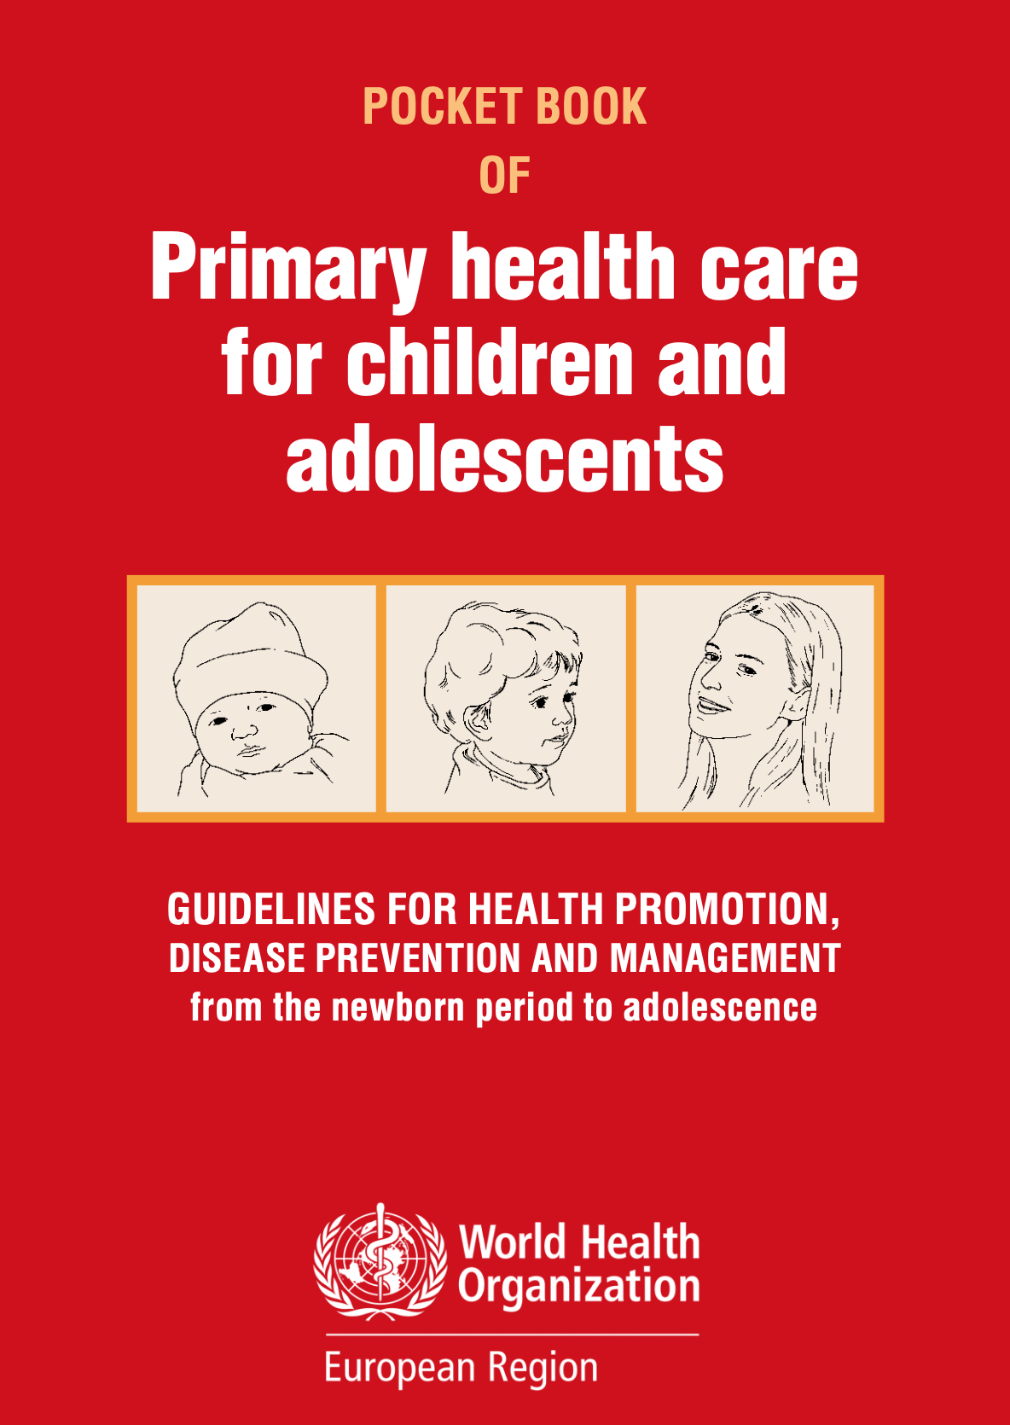

5 |Pocket Book of Primary Health
Care for children and adolescents
Launched on the 21st of March 2022
Target
PHC providers treating children from 0 to 18 years.
Applicable across the WHO European Region.
Evidence-based
WHO and other evidence-based guidelines.
Practical and pocket-sized
Job-aid to be carried during daily work.
Notes:
An example of the relevance of QoC work in nutrition – Primary care paediatric guidelines produced by WHO for the European Region. Acts as a practical guide but also a set of quality standards.

Slide 11
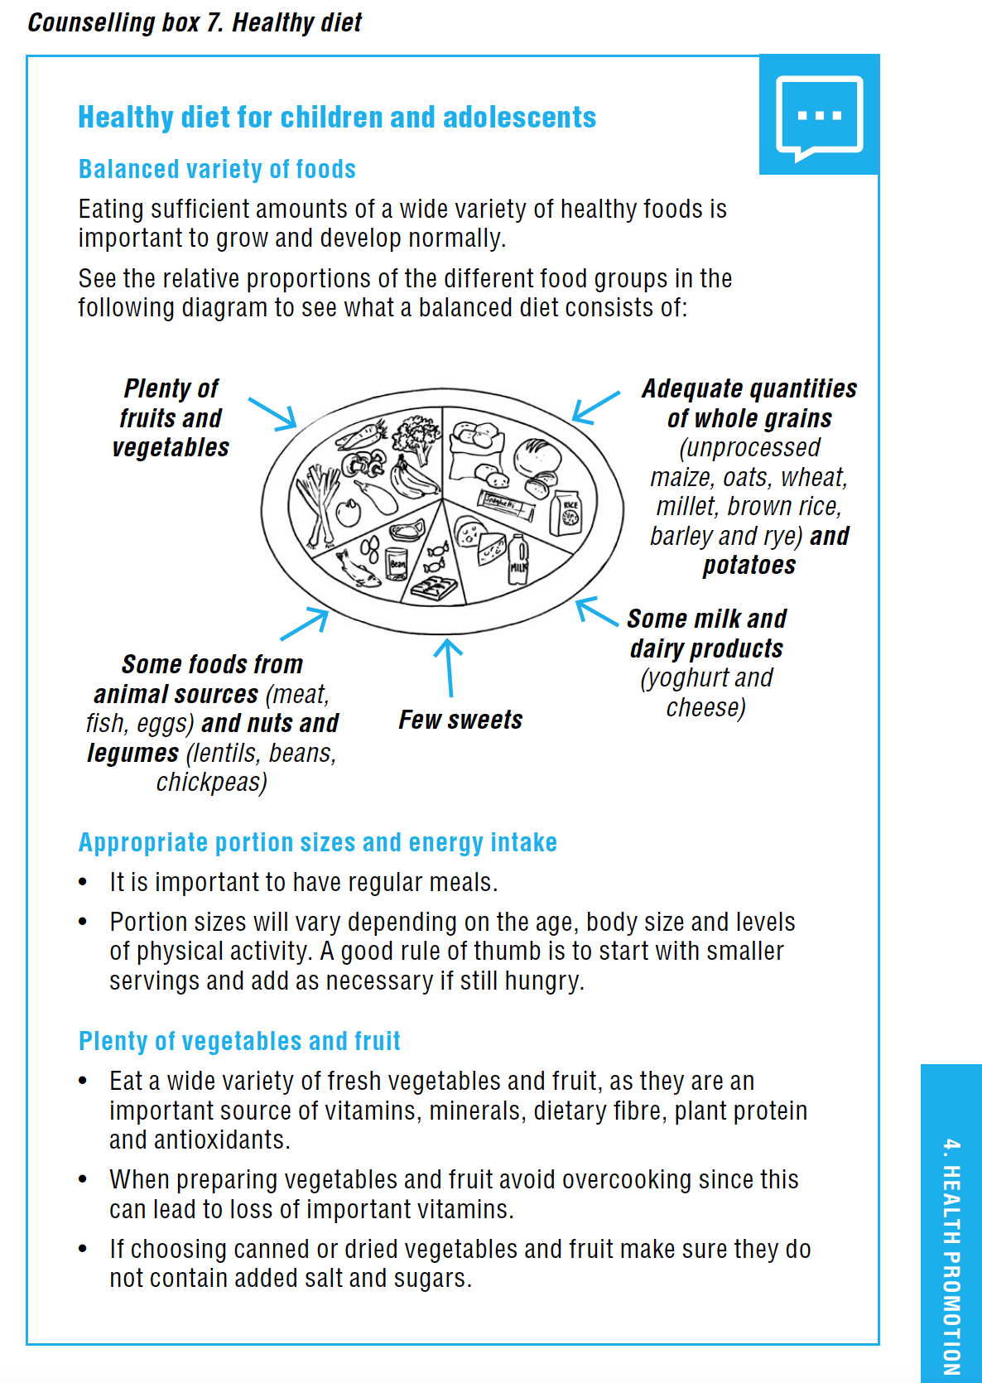
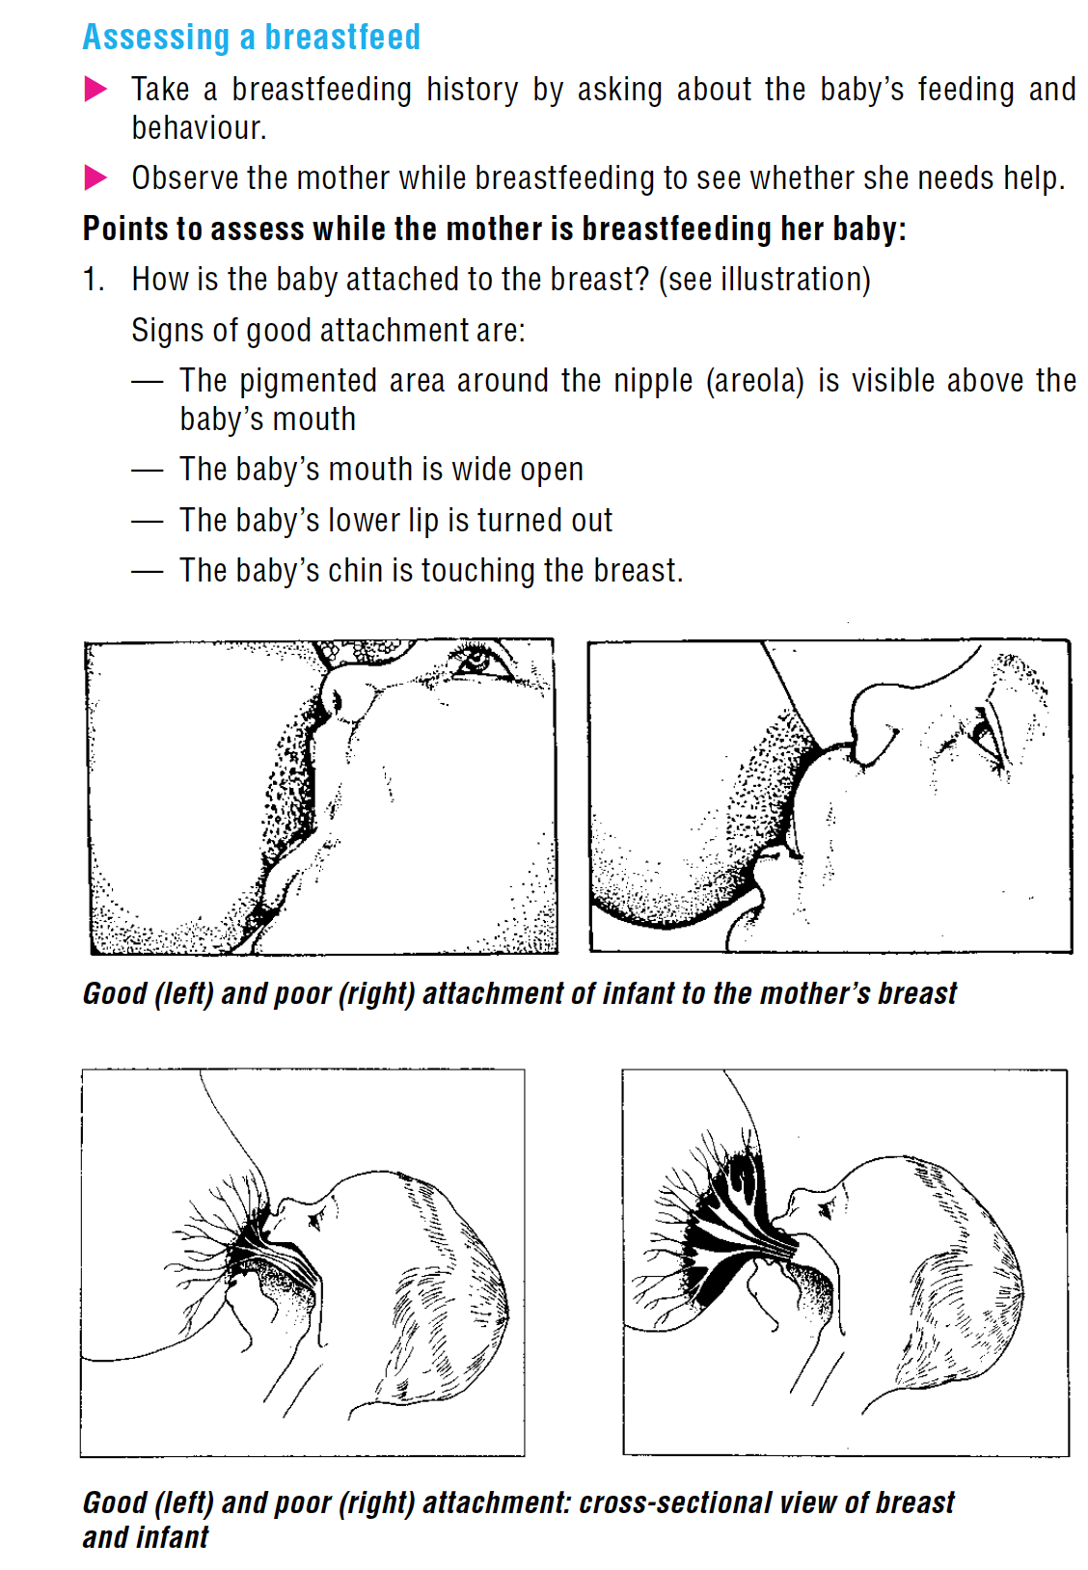
5 | Pocket Book of Primary Health
Care for children and adolescents
Nutritional and feeding recommendations;
Healthy diet and physical activity to decrease risk of overweight, obesity and other NCDs;
Monitor growth and BMI;
Screen for nutritional problems;
Manage overweight, obesity, malnutrition and eating disorders;
Review dietary and physical activity history - NCDs family history and intrauterine growth restriction;
Promote family adherence to healthy behaviours.
Notes:
And these guidelines include nutrition and feeding recormmendations

Slide 12

6 |HEALTH-IQ Project
The HEALTH-IQ project “Development and implementation of a framework for quality care” (2023 – 2025), assesses the full spectrum of HC services, public health access and prevention procedures for NCDs and mental health.
Key objectives:
A guide for recording and measuring key quality performance indicators;
A system to collect and evaluate patient feedback;
An online and human-centred HS with equitable access to quality health services;
Health quality standards among EU Member States facing similar challenges.
Notes:
We work with countries in the European region to address QoC throughout this spectrum; from prevention through to treatment
Health IQ project = a framework for QoC: a robust methodological guide for measuring and improving quality in health care.
Inspired by the WHO European Programme of Work, 2020–2025 – “United Action for Better Health”, and the WHO Regional Director for Europe’s vision of leaving no one behind, WHO/Europe identified the need to support countries in their efforts to create high-quality health-care systems.
In alignment with this vision, WHO/Europe is collaborating with Greece within the framework of the Hellenic Republic's National Development Programme (NDP) for 2021–2025. A key objective of the NDP is the restructuring of Greece's national health system. To this end, it is essential to adopt a systematic approach to assess and enhance the quality of health care and services, which is why the collaborative HEALTH-IQ project has been established.
Places a strong emphasis on patient-centred services in various health-care contexts, including primary care, hospital care, long-term care, access to public health; prevention procedures for noncommunicable diseases (cancer, cardiovascular disease, diabetes, obesity and chronic respiratory diseases), and mental health. Includes establishing a framework for health-care institutions to measure their quality performance and patient feedback, facilitating ongoing improvements in service delivery
Naturally this bears relevance to nutrition, right through from prevention and public health nutrition to quality of care in clinical settings (eg quality performance indicators related to nutrition).
A model to be rolled out across WHO European region: “While the project is primarily focused on the Greek health-care landscape, it is designed to disseminate health quality standards and best practices to other countries encountering similar challenges in the WHO European Region.”
Research*
Strengthening Health Management Capacity*
The WHO Office on QoC and Patient Safety in Athens, with support from the Health Workforce and Service Delivery team, hosted the 2nd Train-the-Trainer session, in collaboration with the Greek AQAH and the NOVA National School of Public Health.

Slide 13
Thank you for your attention

