Slide 1


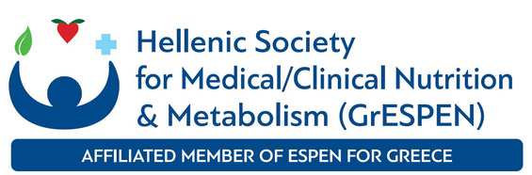
Dr. Theodora E. (Dorina) Sialvera, MSc, PhD, Post-Doc
ONCA Delegate, HDA, Greece

Slide 2
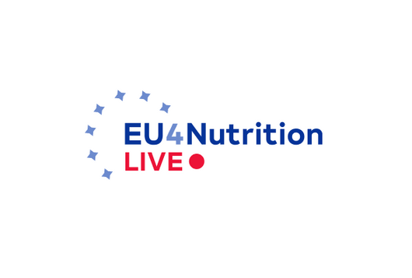
Next Steps in Nutritional Policies by Hellenic Dietetic Association (HDA)
The Hellenic Dietetic Association (H.D.A.) was established in 1969. It has served as the official representative body of Dietitians – Nutritionists in Greece since 1969 and for the past 50 years.
Μember of the European Federation of the Associations of Dietitians (EFAD) since 1982.
Member of the International Confederation of Dietetic Associations (ICDA) since 1984.
HDA became the 19th member of the ONCA, following the coordinated efforts of the Hellenic Dietetic Association and GrESPEN, 2020.
HDA was officially recognized as a Public Legal Entity (Legal Entity under Public Law), April 2025.

Slide 3
Why are we concerned about malnutrition, as Hellenic Dietetic Association (HDA) – THE VITAL ROLE OF DIETITIANS
Malnutrition can significantly affect both individuals (inpatients and out patients) and public health systems.
For the individual, it may result in:
  the loss of muscle mass and strength,
  reduced mobility
  increased risk of falls and fractures.
  impair immune function, heighten susceptibility to infections,
  deteriorate quality of life due to diminished self-care ability and negative impacts on mental health.
For the state, malnutrition imposes a substantial burden on the healthcare system. It is associated with:
  increased hospitalization rates,
  higher risk of post-operative complications,
  longer hospital stays—thereby increasing the use of healthcare resources and financial costs.
Notes:
This is why the role of dietitians in healthcare systems is VITAL— as advocates, experts, and leaders in delivering optimal nutrition care to all who need it.

Slide 4
What is the current reality regarding malnutrition in Greece
Unfortunately, in Greece, malnutrition is often underdiagnosed and not adequately or promptly treated.
Individuals often receive support only after their nutritional status has significantly deteriorated.
HDA through Malnutrition Awareness Week aimes to raise awareness for malnutrition, among policymakers, healthcare professionals, and the public about its importance.
GOOD NEWS: New law for Mandatory Nutritional Screening at Hospital Admission, August 2024

Slide 5
Next Steps in Nutritional Policies. A Strategic Initiative by the Hellenic Dietetic Association (H.D.A.)
Policy Proposals for Addressing Malnutrition in Healthcare Settings
Integration of Mandatory Nutritional Screening at Hospital Admission. Implement mandatory nutritional screening within the first 48 hours of admission in at least 50% of public and private hospitals, with the ultimate goal of universal implementation across all healthcare institutions.
Promotion of National Policy for Universal Nutrition Screening. Advocate for a national policy mandating the systematic use of validated nutrition screening tools in all hospitals—public and private—within 48 hours of patient admission, to ensure early identification of those at nutritional risk.
Healthcare Professional Training in Malnutrition Recognition & Management. Develop and deliver training programs for healthcare professionals on the recognition, assessment, and management of malnutrition. Educational materials will be created by the Hellenic Dietetic Association (H.D.A.) in collaboration with relevant scientific and medical bodies.

Slide 6
Next Steps in Nutritional Policies by Hellenic Dietetic Association (HDA)
Policy Proposals for Addressing Malnutrition in Healthcare Settings
4. Public Awareness Campaign on Malnutrition and Its Consequences.
Launch a nationwide public information campaign focused on educating the general population about malnutrition, its causes, warning signs, and health consequences. The campaign should include multimedia content (a short film), social media outreach, and public engagement initiatives.
5. Establishment of a National Malnutrition Registry.
Develop and implement a national registry to record cases of malnutrition identified within hospital settings. The registry will provide data to support evidence-based policy decisions and enable the evaluation of nutritional care interventions.
6. Institutional Adoption of Nutritional Care Protocols.
Submit a formal proposal to the Ministry of Health and to the Legal Entity for the institutional adoption of clinical nutrition protocols and guidelines. These protocols should align with established European standards for the nutritional support of patients in clinical settings.
Notes:
6. FOR EXAMPLE >>Ensuring adequate inpatient nutrition through the institutional protection of mealtimes, the systematic provision of snacks, and the availability of supplementary meals in cases of missed regular meals due to diagnostic procedures or other clinical reasons. Additional measures include offering patients the ability to select from a range of menu options and implementing structured support mechanisms for individuals unable to feed themselves, such as the allocation of additional nursing staff, engagement of trained volunteers, and the early identification of patients requiring assisted feeding

Slide 7
Next Steps in Nutritional Policies by Hellenic Dietetic Association (HDA)
Call to Action
Engage policymakers and healthcare administrators
Increase in the number of dietitians in primary and secondary healthcare
Expansion of reimbursement cases for Medical Nutrition supplements/ formulations, amendment of the relevant legislation.
Dr. Theodora E. (Dorina) Sialvera, MSc, PhD, Post-Doc
Clinical Dietitian – Nutritionist, Head of the Department of Dietetics and Nutrition, General Hospital for Chest Diseases of Athens “Sotiria”
Former President of the Hellenic Dietitians and Nutritionists Association (HDA)
ONCA delegate HDA
Thank you!

