Slide 1
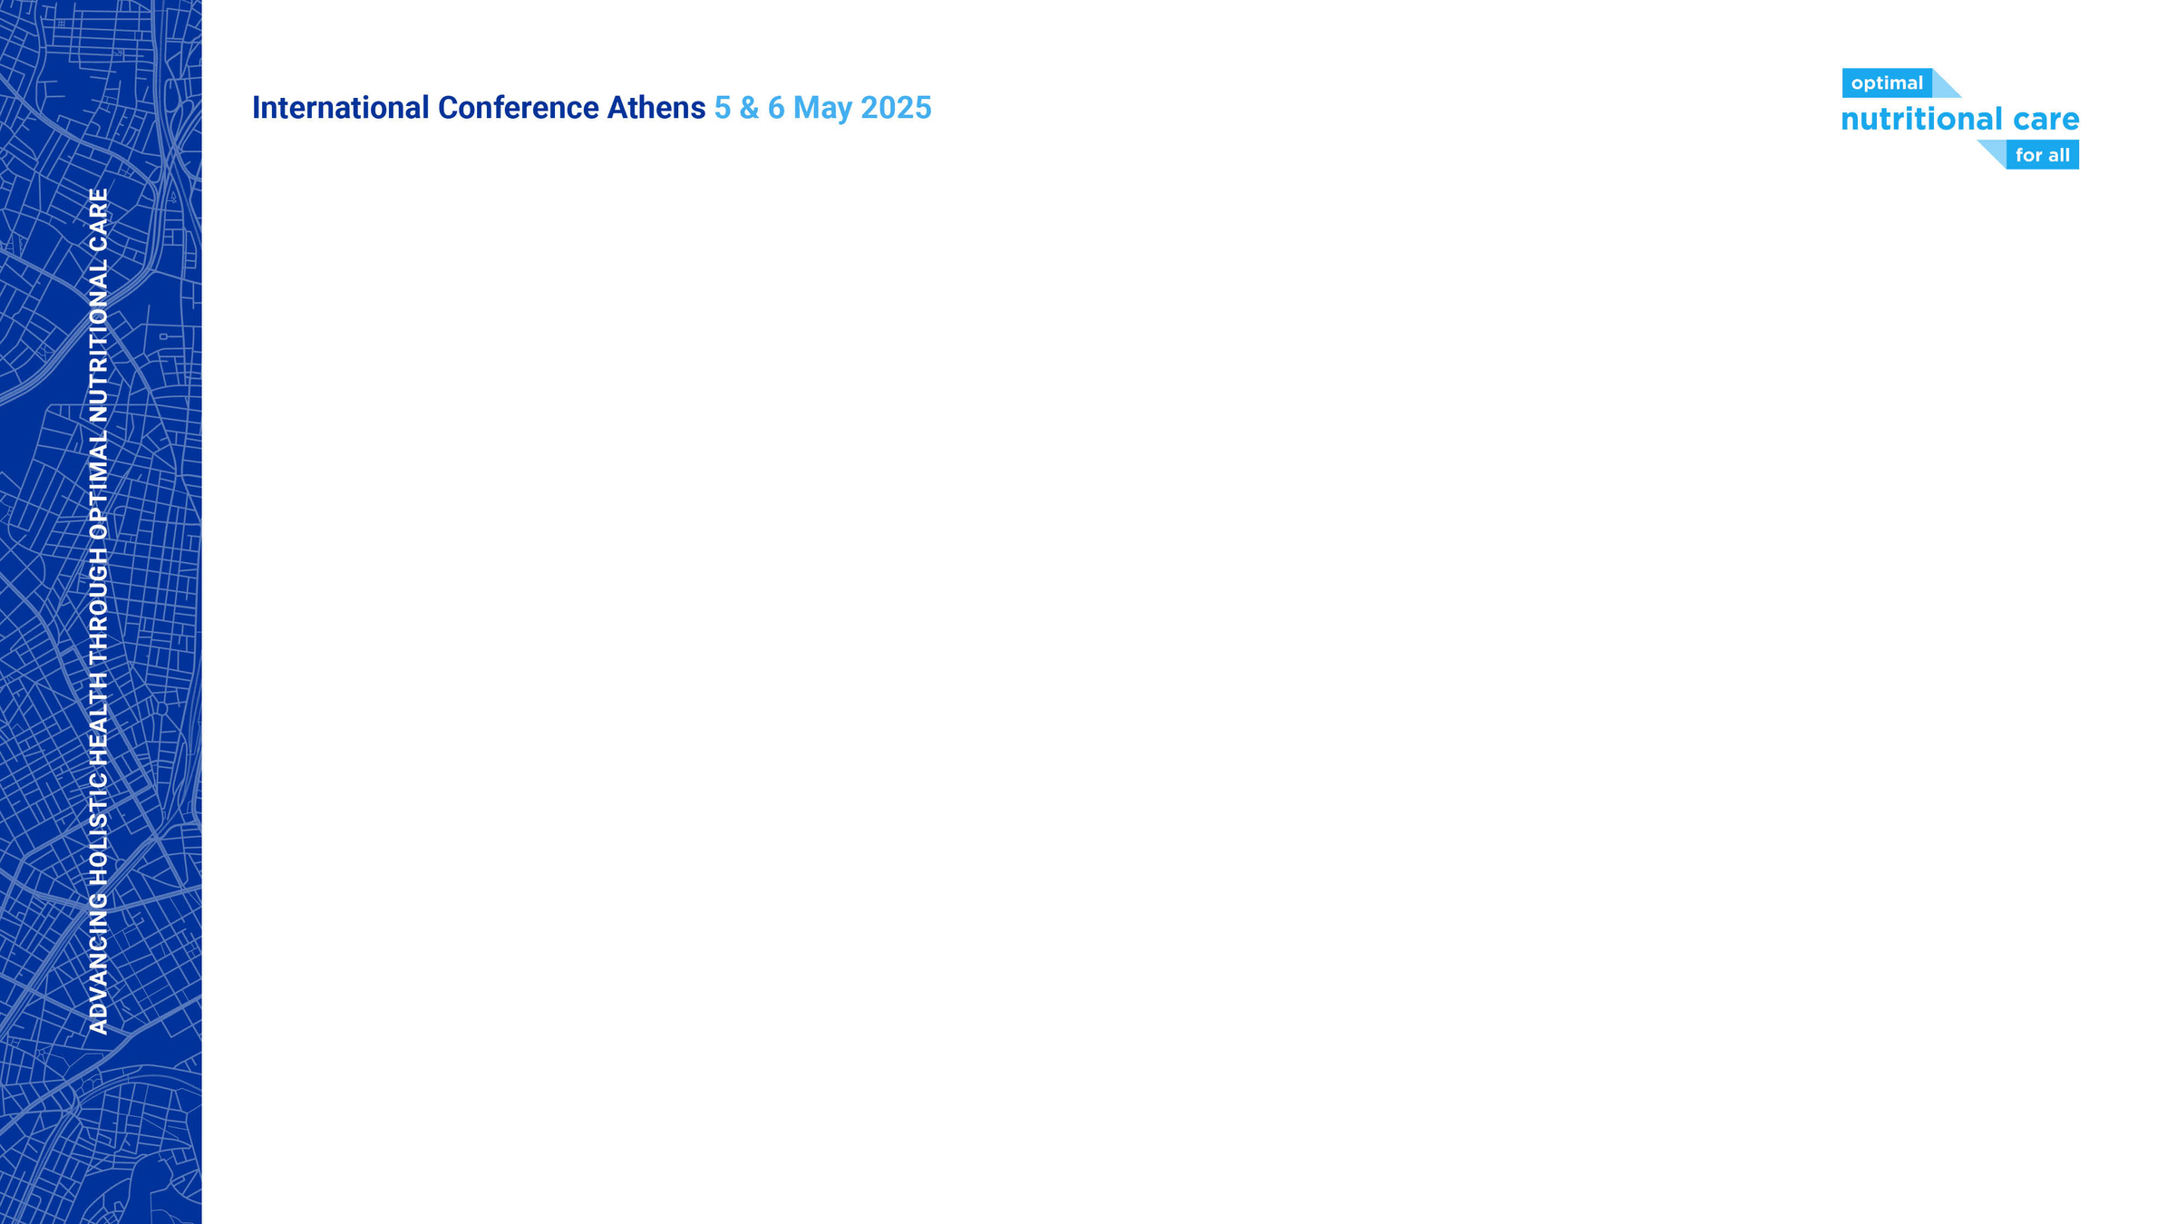
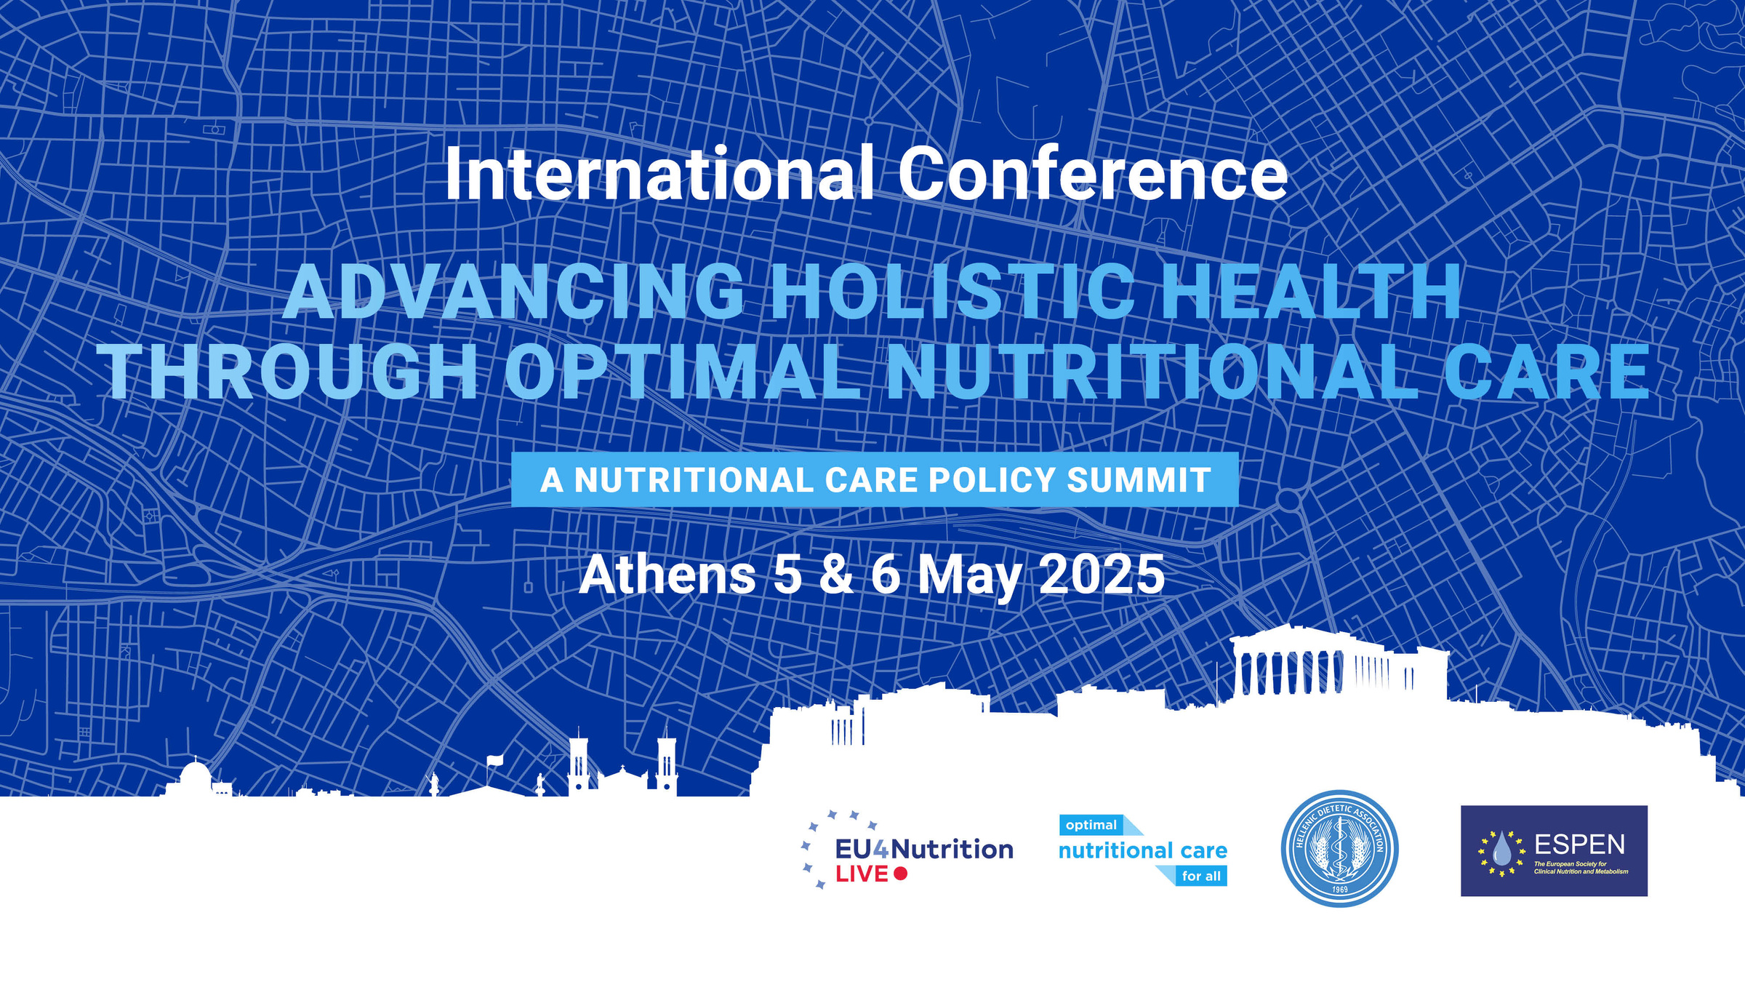


Slide 2


Primary care in the nutritional care patient pathway:
a European policy perspective
Prof. Radost Asenova, MD, PhD, DSc
Dept of Urology and General Practice
Vice-Dean of Quality and Accreditation, Faculty of Medicine, Medical University of Plovdiv, Bulgaria

Slide 3

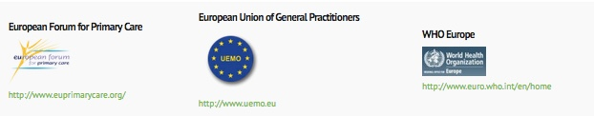
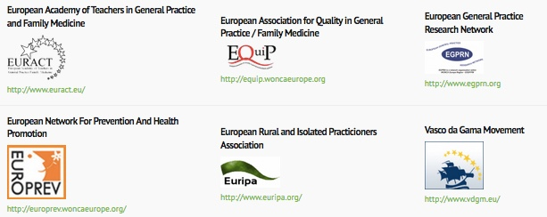
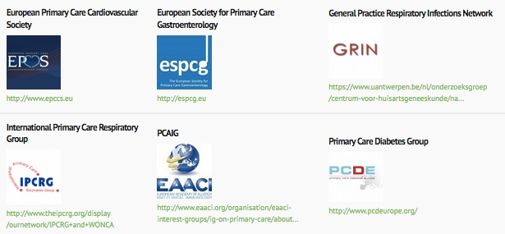


NETWORKS
Special Interest Groups

Slide 4
Why nutrition matters in primary care
Key to health across the life course
GPs see patients across all stages of life
Linked to frailty, multimorbidity, cancer, CVD
Under-recognized in many long-term conditions
Early action through prevention, screening, follow-up
Needs policy support, training, and system change

Slide 5
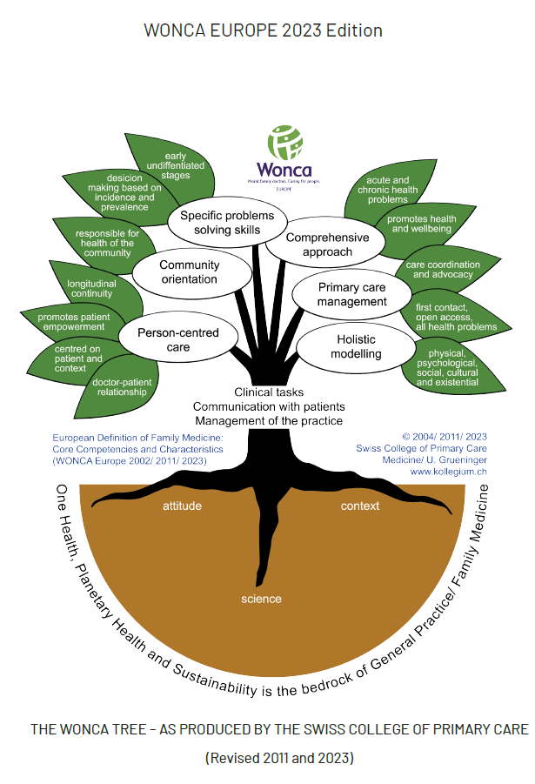
The role of the family physician
First point of contact and provider of continuous care
Early identification of nutrition-related problems
Monitoring and follow-up of dietary interventions
Management of nutrition-sensitive chronic conditions
Patient education and behavioral counseling
Referral and coordination with dietitians or other services

Slide 6
Nutrition day primary care pilot - what the data tells us
14% at risk of malnutrition
All age groups affected
Lack of screening widespread
Underdiagnosis is common
Need for structured screening
Supports case for policy change

Slide 7
Challenges and opportunities
Nutrition under-prioritized in primary care
Limited time during consultations
Gaps in clinical nutrition training
Lack of reimbursement or integration of dietetic services
Fragmentation in care pathways

Slide 8
Practical action already underway
WONCA Europe engagement
Collaboration with ESPEN on a Fast Sheet to boost teamwork in primary care nutrition
Joint webinar with EASO
Lifestyle medicine webinar on the Mediterranean diet
National training pilots in multiple countries
European best practices
GP-dietitian cooperation in Netherlands
Health checks including nutrition in Finland
Social prescribing of nutritional support in the UK

Slide 9
Key elements of a nutritional care pathway
Routine screening for malnutrition in primary care, including undernutrition and obesity, using simple validated tools
Brief interventions and lifestyle counseling integrated into chronic disease management plans
Referral pathways to dietitians and multidisciplinary teams, supported by clear protocols and feedback loops
Monitoring and follow-up as part of long-term care, especially in vulnerable groups
Training and CME for GPs in nutritional care, including motivational interviewing, basic assessment, and interdisciplinary collaboration

Slide 10
Strengthening nutritional care in PHC
Integrate nutritional care into routine primary care with simple, validated screening tools
Support local and regional collaboration among PHC teams, including dietitians
Provide relevant, ongoing training for family doctors at all stages
Leverage digital tools for shared care plans, referrals, and data exchange
Prioritise prevention, early intervention, and clear communication
Recognise PHC’s essential role with fair funding, indicators, and visibility

Slide 11
Enablers and policy for impactful implementation
Develop clear national guidelines and integrate screening into EHR systems
Ensure undergraduate and postgraduate training in nutrition for all PHC professionals
Align funding and public health policies with real-world PHC needs
Enable reimbursement for nutrition counselling to ensure equitable access
Promote partnerships for innovation, strategy development, and knowledge exchange

Slide 12
The role of WONCA Europe – our commitment
Supports research and policy development
Connects national primary care organisations
Advocates for better care
Empower member organizations
Promote education and research
Influence European health policy

Slide 13
Towards a shared agenda
Common goals like prevention and quality care give a clear sense of alignment
Shared platforms emphasize collaboration and joint action
Leverage strengths of each sector sets the stage for effective partnership

Slide 14
A vision for the future
From silos to systems: connected care for better nutrition
Empowered primary care + aligned policies = optimal outcomes
Nutrition embedded as routine primary care
Screening and monitoring led by family doctors
Patients supported and empowered to act
Strong partnerships with societies: ENHA, ESPEN, EFAD, EASO, EPHA, EASL & others

Slide 15
Call to action – why it matters
Improving nutritional care across Europe requires bold policy, strong leadership, and collaboration across disciplines
Primary care must be seen not as an optional partner, but as a foundational part of the nutritional care pathway

Slide 16
Call to action - WONCA Europe’s commitment
WONCA Europe reaffirms its commitment to:
Promoting nutrition-sensitive primary care
Strengthening professional education and training
Supporting collaborative, evidence-informed policy
Ensuring FDs’ voices are heard in European health policy forums
Through shared commitment, we can ensure that every patient receives appropriate nutritional care - starting where care begins - in the community

