Slide 1




Slide 2
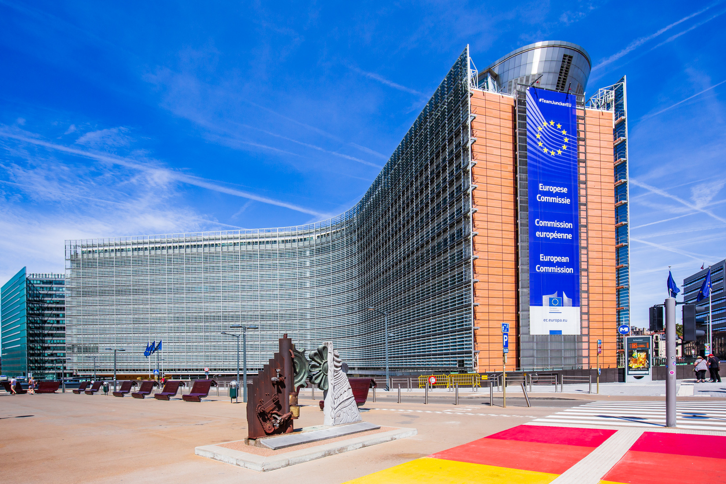
ONCA = IMPACT

Slide 3

EU agenda
National agenda

Slide 4
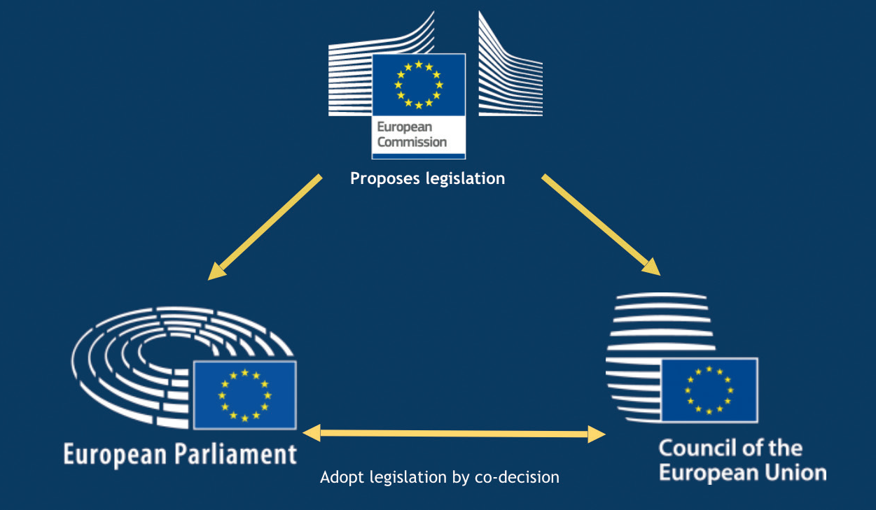

Slide 5



Slide 6
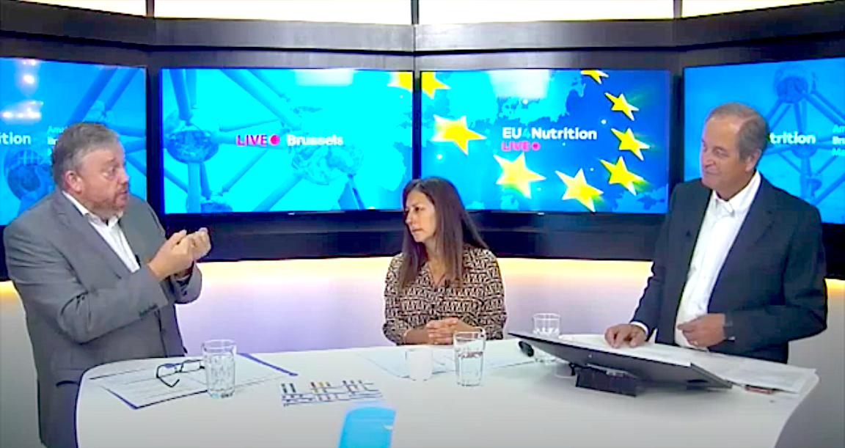
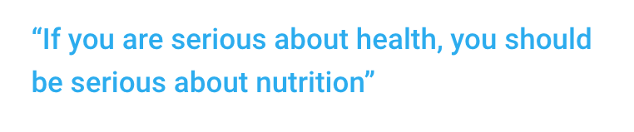

Slide 7



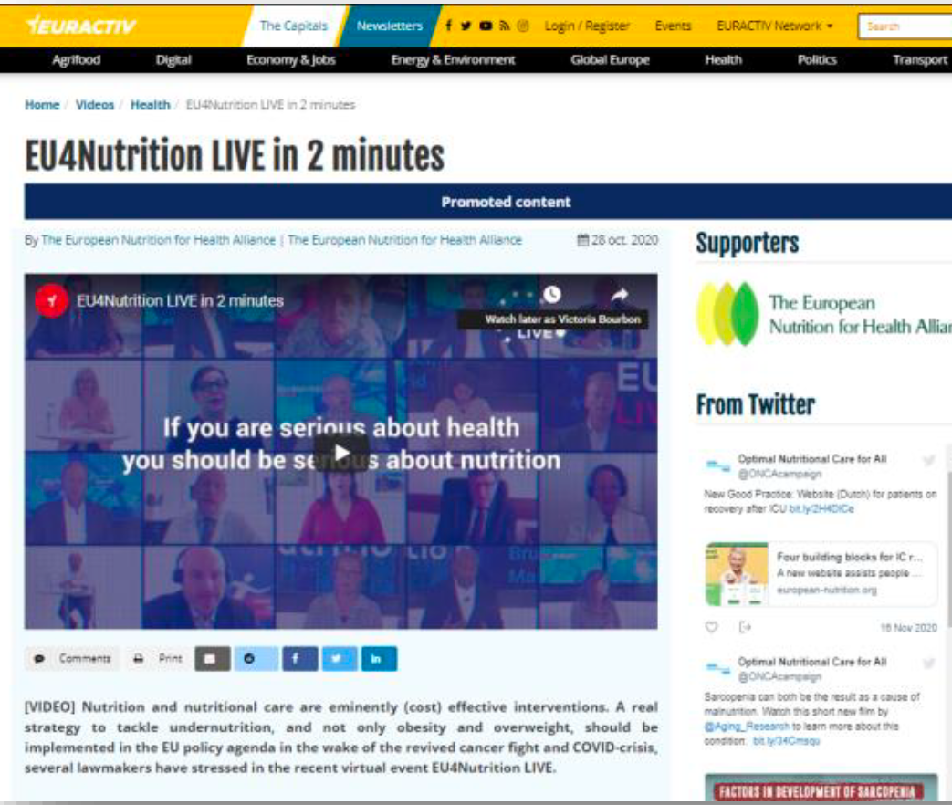
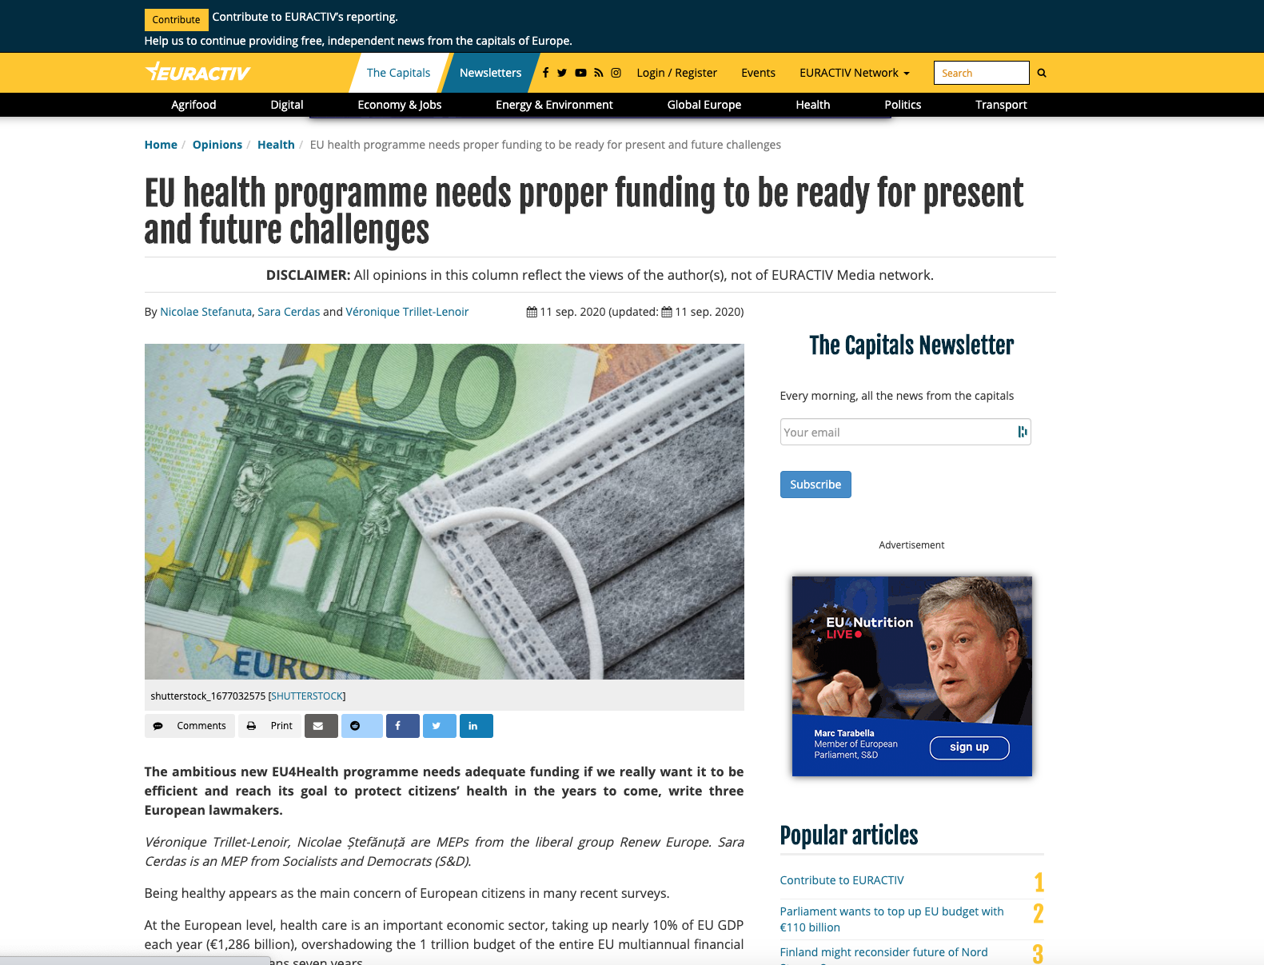
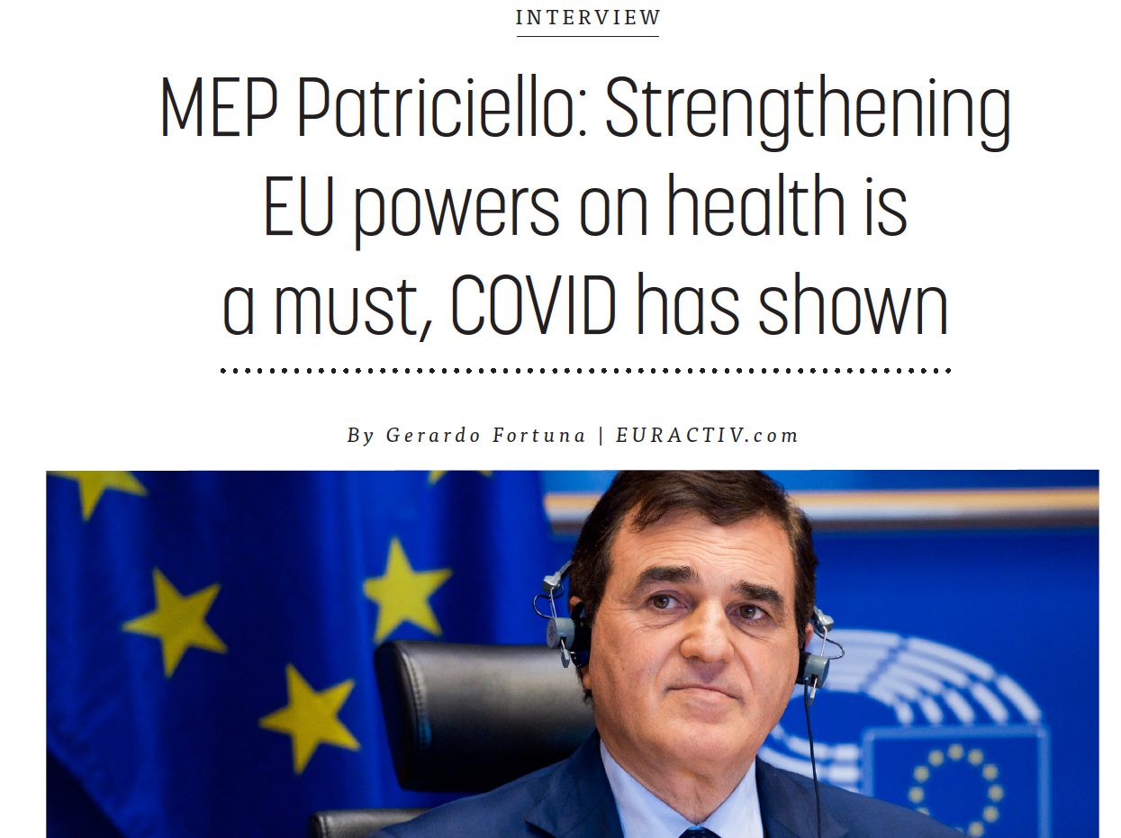


Slide 8

ONCA = IMPACT
EU MAW 2025
10-14 November

Slide 9


ONCA: Facilitating Activities at the European Level
Part of Coordination of activities towards the formulation of policy papers
Collecting data from diverse activities across countries.
Engaging with politicians at the European scale
Presenting key findings and initiatives to policymakers.
Synthesizing insights into comprehensive policy recommendations.
Collaborating with experts and policymakers to create impactful documents.
Advocating for policies that address malnutrition.
Leveraging the influence of ONCA countries in European policymaking.

Slide 10
ONCA: Facilitating ONCA Campaign Activities
Coordination of activities:
Facilitating communication between participating ONCA countries.
Ensuring the alignment of messaging and branding.
Sharing strategies for overcoming potential challenges:
ONCA Conference
Centralized platform for activities and resource sharing
Malnutrition Awareness Weeks
Three MAW Workshops (Sep – Feb – ONCA CON)

Slide 11




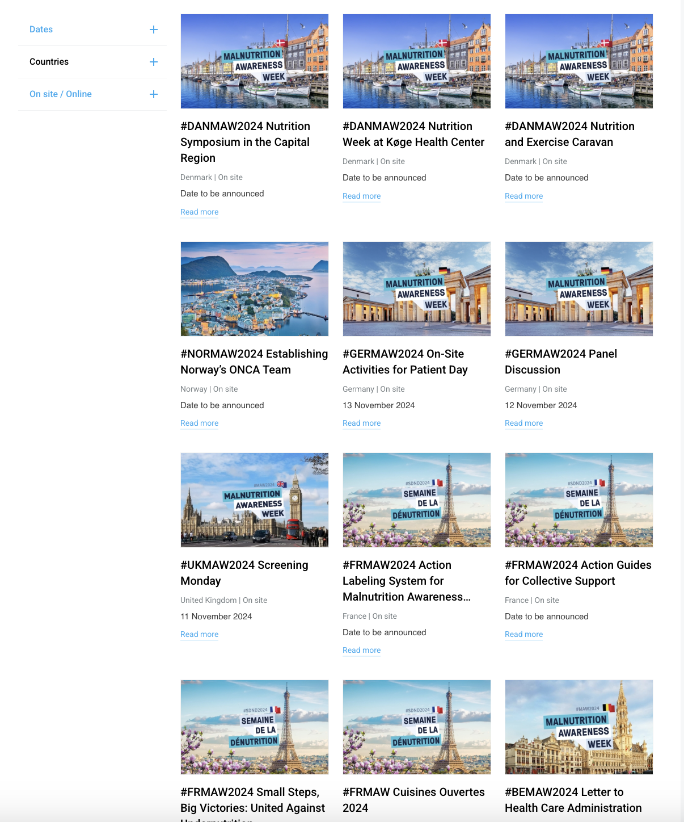
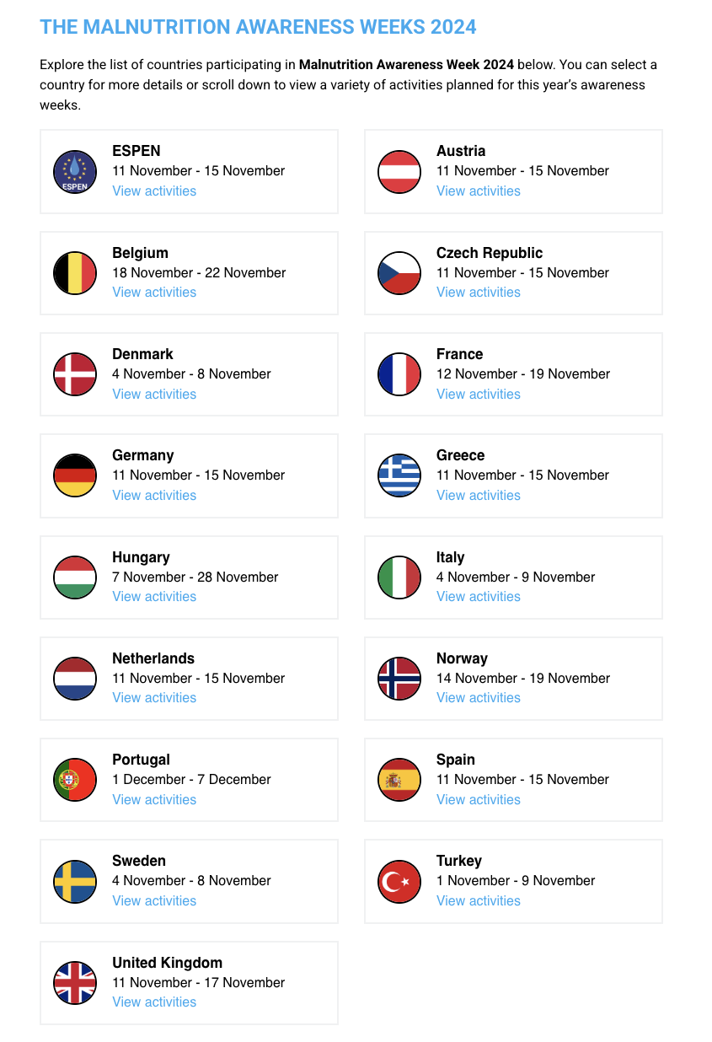
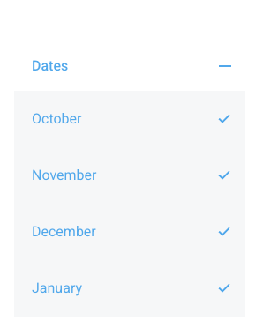
Introduction
Breaking down the numbers of #MAW2024..
4
81 MAW Activities
16 ONCA Countries
4 Months of Activities

Slide 12
Actions in the different countries
4
Let’s hear from…
  France
  Belgium
  Greece

Slide 13
Objectives Malnutrition Awareness Campaigns
Nutrition is essential to good health, well-being & sustainable healthcare.
Yet, 20 million EU citizens remain at risk of malnutrition, costing €120B annually.
ENHA calls on the next EU mandate (2024–2029) to:
1. Prioritize patient-centered care - Integrate nutrition into treatment plans.
2. Include nutrition in EU strategies – CVD, NCDs, and mental health pathways.
3. Guarantee early screening & treatment – Across all healthcare settings.
4. Invest in professional training – Mandatory, ongoing education on nutrition.
Ensure fair reimbursement policies – Make nutrition support accessible to all.
Engage multi-stakeholders – In policy design and evaluation.

Slide 14
How to plan your MAW Activities?
1. Set Clear Goals
2. Decide on Your Target Audience
3. Form a Core Team
4. Choose 2-3 Low-Cost Activities
5. Create Key Messages & Materials
6. Promote your Activities
7. Document & Share
8. Reflect & Follow-up
Define the purpose: awareness, education, action, or policy change.
Ensure goals are measurable (e.g. number of participants, media reach).
Who are you trying to reach? (e.g. healthcare professionals, patients, public)
Tailor messaging style and content to their needs and understanding.
Gather a small group of committed people with diverse skills.
Assign roles: coordination, communication, logistics, partnerships.
Focus on feasible events like webinars, local campaigns, posters.
Prioritize visibility and accessibility over complexity.
Develop a consistent, clear message around malnutrition.
Use logos, factsheets, videos, and templates from ONCA, ESPEN or other partners & adapt when necessary.
Use newsletters, social media, press releases, and networks.
Start promotion early and maintain engagement throughout the week.
Take photos, collect feedback, track media coverage.
Share highlights online and with stakeholders for visibility.
Evaluate what worked well and what didn’t.
Plan for next year or follow-up actions.
Did you reach your target audience?
Use common hashtags #MAW2025 or e.g. #UKMAW2025.

Slide 15
Promoting MAW Activities by Type
Activity Type | Examples of Activities | Target Audience | Promotion Channels | Key Messaging Tip
Clinical & Professional Workshops | HCP training sessions, malnutrition screening tool demos, case discussions | Healthcare professionals, educators | Relevant newsletters Professional bodies, Medical Sociaties Direct emails | Highlight clinical value and patient impact
Public Awareness Events | Free screenings, info booths, patient talks | General public, patients, caregivers | Local media Community centers Social media Partnerships with NGOs | Emphasize action, simplicity, and accessibility
Policy & Advocacy Activities | Roundtables, national briefings, stakeholder meetings | Policymakers, healthcare leaders, stakeholders | ONCA/member networks Press releases LinkedIn Stakeholder briefings | Stress urgency and system-level change
Digital Campaigns | Infographics, video explainers, webinars, social media challenges, awareness hashtags | Online audience, young people, professionals | ONCA website Twitter/X, Instagram, LinkedIn Partner toolkits | Use visual storytelling and concise facts (e.g. infographics)

Slide 16
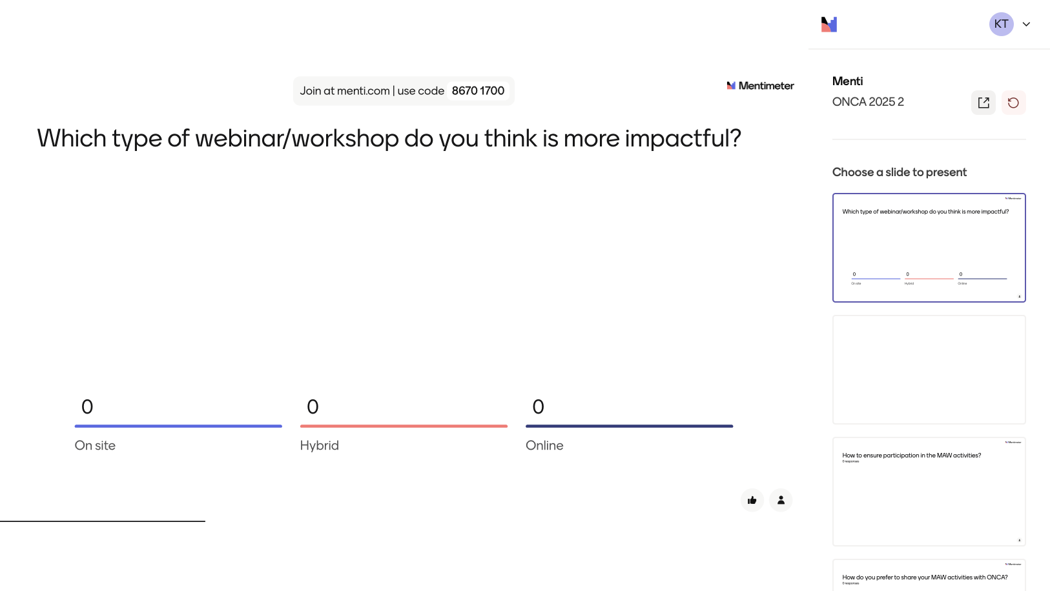

Slide 17
MAW:On-site vs. Hybrid vs. Online
What’s the best format for your country’s context?
Format | Pros ✅ | Cons ❌
On-site | Strong personal engagement & trust-building Better media visibility Great for screenings, workshops & community feel | Requires more resources & planning Limited reach (geography) Less inclusive for remote areas
Hybrid | Combines wide reach with in-person connection More inclusive Flexible & resilient to change | Requires tech support & coordination Risk of uneven experience between audiences
Online | Low-cost & scalable Easy to record & reuse content Accessible to remote participants | Weaker community bonding Digital divide (limited access for elderly or other groups) Harder to assess impact
Tip: Choose the format based on your goals, budget, and your audience’s digital access & preferences.

Slide 18
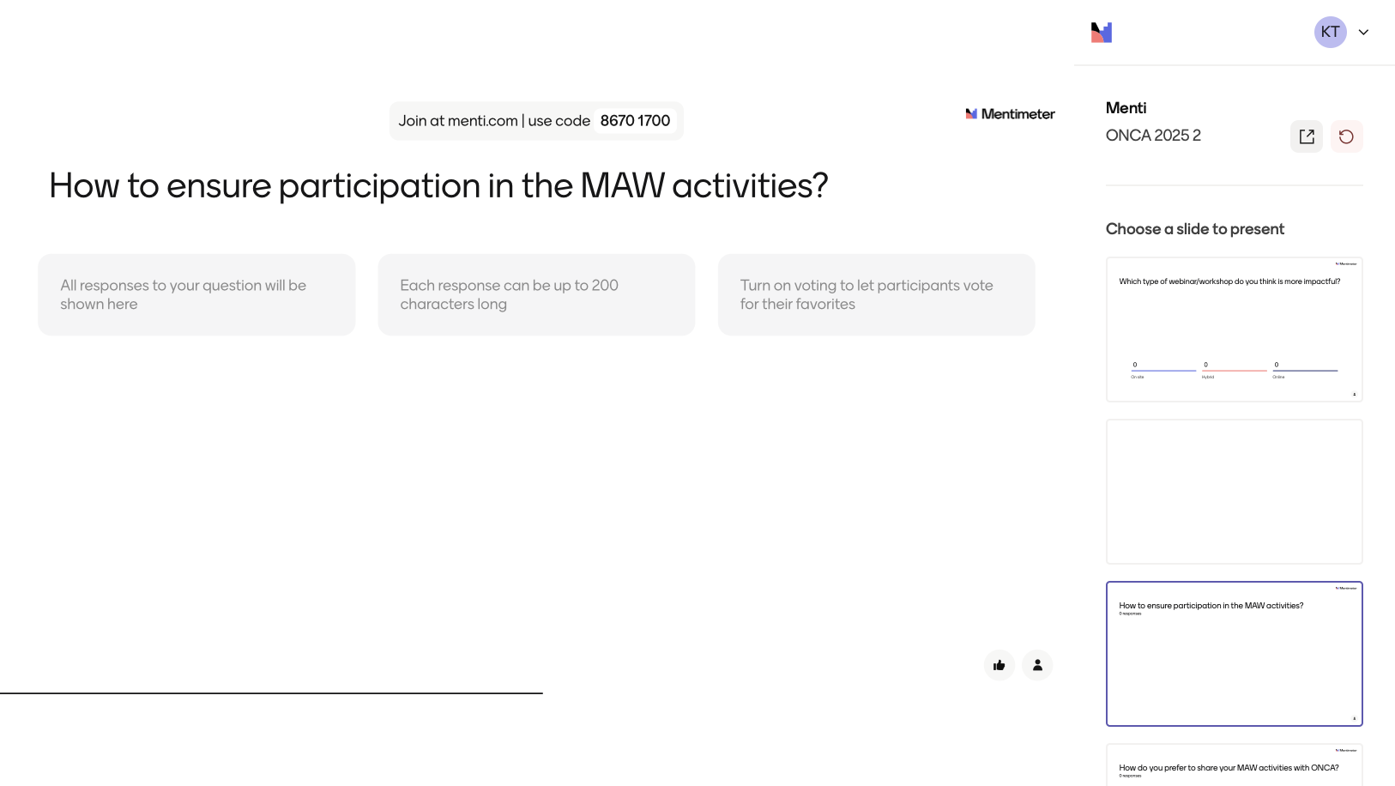

Slide 19
Ensuring Participation in MAW Activities
Public Events / Screenings
Offer free check-ups or small incentives (e.g. fruit packs)
Workshops / Educational Talks
Use relatable speakers (e.g. local dietitians)
Social Media Campaigns
Use local language & simple visuals
Choose high-traffic venues (markets, squares)
Keep sessions short & interactive
Provide printed materials to take home
Include personal stories
Use hashtags & tag local influencers
Online Webinars / Panels
Offer certificates of attendance
Keep timing suitable (e.g. lunch or early evening)
Send calendar invites/reminders
Record and share afterward
School/Youth Activities
Include fun elements (games, drawings, competitions)
Workplace Initiatives
Offer short lunchtime sessions
Printed Campaigns / Posters
Include QR codes linking to more info or event pages
Post consistently before and during MAW

Slide 20
How to assess the outcomes and impact of MAW actions?
Pre-Post Surveys
Ask participants short questions before and after an event or campaign.
Focus on changes in awareness, knowledge, or intentions.
Participation Numbers
Count how many people attended events, workshops, screenings, or trainings.
Track number of materials distributed or viewed.
Media and Social Media Reach
Track likes, shares, comments, views, and mentions.
Use simple analytics tools (e.g. Facebook Insights, Instagram Stats, or basic post counts).
Photos & Visual Documentation
Collect photos from events and social media as proof of engagement.
Add short captions to describe what happened.
Short Feedback Forms
After an event, ask 3–5 quick questions like:
What did you learn?
What was most useful?

Slide 21
How to enhance collaboration and alignment of MAW initiatives across ONCA countries?
Agree on a Shared Annual Theme
Propose and vote on one common slogan or focus area to use across all countries.
Use and Adapt Shared MAW Materials
Make use of ESPEN’s toolkit & MAW logos and translate/adapt them locally.
Share Your Plans Early
Upload your country’s MAW plan, timeline, and key messages in a shared folder so others can align or join in.
Join MAW Workshops
Actively participate in MAW Workshops to stay updated and offer input.
Exchange Social Media Content
Cross-share each other’s campaigns and tag fellow countries to show a united front.
Partners with a "Buddy Country"
Pair up with another country to co-organize an activity or share media, tools, or speakers.
Showcase National Highlights
After MAW, share photos, results, or stories that others can learn from or be inspired by.
Celebrate Each Other’s Work
Acknowledge and repost what other countries are doing during MAW — visibility builds unity!
Give Feedback to the ONCA Team
Suggest what support you need (e.g. earlier templates, joint PR, media partnerships).

Slide 22
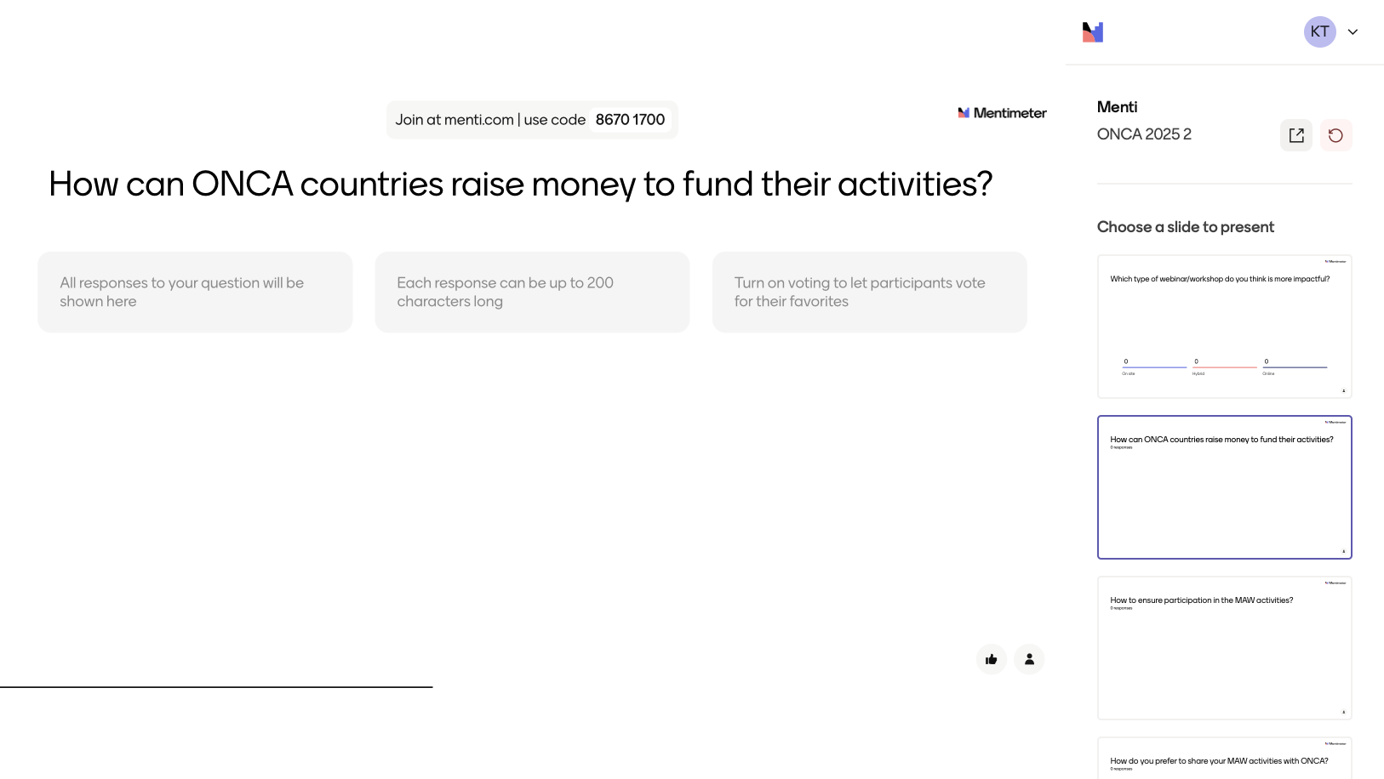

Slide 23
Fundraising & Funding
Map the Stakeholders Who Care | Build Strategic Partnerships (value-based) | Tell a Compelling Story | Start Small, Prove Impact | Use Existing Tools and Resources | Ask Openly and Repeatedly
Who benefits from reduced malnutrition? Hospitals and healthcare systems (less burden, fewer costs) Health insurance providers Food companies and retailers promoting healthy products Government agencies with public health mandates NGOs working on nutrition, or chronic disease These are potential funders, partners, or amplifiers. | Co-branded awareness campaigns Staff training on malnutrition screening Joint reports or events Policy roundtables | Use real stories of patients or caregivers (with consent) Show how malnutrition is often hidden, but treatable Link malnutrition to wider issues like frailty, hospital stays, healthcare costs, or even productivity loss | Launch pilot activities: A local awareness week A hospital screening initiative A short video campaign Then use the results — even if modest — to attract bigger funding | Many ONCA or ESPEN materials — toolkits, infographics, campaign visuals — already exist. Use them to: Save time and money Show funders you’re working within an established, evidence-based framework Make your initiative part of a European movement | A simple email to aligned organizations asking to support a specific action Hosting a breakfast briefing with potential sponsors Including a “Support Us” section on your website or flyer.

Slide 24

MAW 2025 – Kicking off the Campaigns
August 2025
Sharing MAW dates & theme
September 2025
MAW Launching Workshop
Present Planned Activities
Start Promotion
October –December 2025
Promote & Implement Activities
Social Media handles
February 2026
Share achievements, learnings, barriers in MAW Workshop
the sooner the better

Slide 25
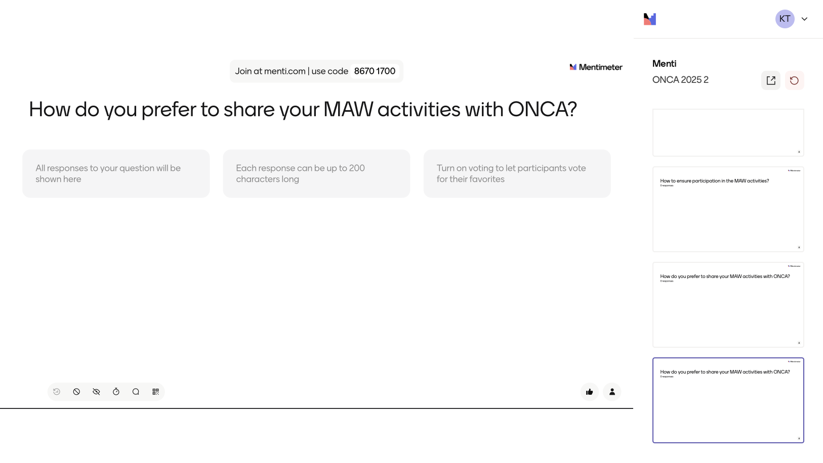

Slide 26
MAW 2025 – Kicking off the Campaigns
Coordination
Reporting process → Workshop in February to discuss the achievements, learnings, barriers etc.
We have circulated the MAW 2025 logos → confirm or request for adjustments
September MAW Workshop → Start the promotion of your activities & sharing them on ONCA's website.

Slide 27
A warm thank you for your active participation, commitment and dedication to the MAW initiative!

Slide 28
Laws Regarding Malnutrition Screening in Different Countries
Country | Screening Status
🇦🇹 Austria | ⚠️ No mandatory screening
🇧🇪 Belgium | ⚠️ Voluntary in care homes
🇭🇷 Croatia | ⚠️ No mandatory screening
🇨🇿 Czech Republic | ⚠️ No mandatory screening
🇩🇰 Denmark | ⚠️ No mandatory screening
🇫🇷 France | ⚠️ Guidelines exist, not mandatory
🇩🇪 Germany | ❌ No mandatory screening
🇬🇷 Greece | 🗣 Advocacy efforts
🇭🇺 Hungary | 🛠 In development
🇮🇱 Israel | ⚠️ No mandatory screening
🇮🇹 Italy | ⚠️ No mandatory screening
🇳🇱 Netherlands | ⚠️ No mandatory screening
🇳🇴 Norway | 🛠 In development
🇵🇹 Portugal | ✅ Mandatory in hospitals, primary care, and elderly care
🇮🇪 Ireland | ⚠️ No mandatory screening
🇸🇮 Slovenia | ⚠️ No mandatory screening
🇸🇪 Sweden | ⚠️ No mandatory screening
🇵🇱 Poland | ✅ Mandatory in hospitals
🇹🇷 Turkey | ⚠️ No mandatory screening
🇬🇧 United Kingdom | ⚠️ Strong NICE guidelines, no legal obligation
Please feel free to share any feedback here, as well as any updates or information you have regarding your country's current malnutrition screening status.

Slide 29
How to plan your MAW Activities?
STEP 6: PROMOTE YOUR ACTIVITIES
Type of Activity | Target Audience | Type of Activity
🇦🇹 Austria | ⚠️ No mandatory screening
🇧🇪 Belgium | ⚠️ Voluntary in care homes
🇭🇷 Croatia | ⚠️ No mandatory screening
🇨🇿 Czech Republic | ⚠️ No mandatory screening
🇩🇰 Denmark | ⚠️ No mandatory screening
🇫🇷 France | ⚠️ Guidelines exist, not mandatory
🇩🇪 Germany | ❌ No mandatory screening
🇬🇷 Greece | 🗣 Advocacy efforts
🇭🇺 Hungary | 🛠 In development
🇮🇱 Israel | ⚠️ No mandatory screening

Slide 30
How to plan your MAW Activities?
STEP 2: DECIDE ON YOUR TARGET AUDIENCE
                General public?
                Healthcare professionals?
                Policy stakeholders?
                Schools or older adults?
What are some other TARGET AUDIENCES you have had, or you want to plan for?

Slide 31
How to plan your MAW Activities?
STEP 3: FORM A CORE TEAM
Include people from your ONCA team, volunteers, local partners.
Assign clear roles (e.g., communication, logistics, materials, partnerships).
More ideas?

Slide 32
How to plan your MAW Activities?
STEP 4: CHOOSE 2-3 LOW-COST ACTIVITIES (quality > quantity)
Host a local awareness event or workshop.
Share daily tips on social media.
Offer free malnutrition screening in a clinic or senior center.
Distribute flyers in pharmacies, markets, or food banks.
Invite local leaders to post a message or speak about malnutrition.
More ideas?

Slide 33
How to plan your MAW Activities?
STEP 5: CREATE KEY MESSAGES & MATERIALS
What do you want people to remember?
Use existing ONCA or partner materials.
Adapt with local language, examples, and tone.
More ideas?
“Malnutrition is treatable”
“Screen. Intervene. Nourish.”

Slide 34
How to plan your MAW Activities?
STEP 6: PROMOTE YOUR ACTIVITIES
Use free channels: Social media, WhatsApp groups, posters in clinics, local press.
Contact your local radio, podcasts, community papers, or NGOs for free coverage.
Ask partners to help spread the word.
Based on the types of activities & your target audience → Examples.

Slide 35
How to plan your MAW Activities?
STEP 7: DOCUMENT & SHARE
Take photos, collect quotes, and write down outcomes.
Share your activities with the ONCA secretariat and on social media using common hashtags #MAW2025 or #UKMAW2025.
Impact will start building → more participation every year.

Slide 36
How to plan your MAW Activities?
STEP 8: REFLECT & FOLLOW-UP
What worked well? What could be improved?
Did you reach your target audience?
Can you build long-term partnerships from this?
Any ideas or input on that?

Slide 37
How to plan your MAW Activities?
STEP 6: PROMOTE YOUR ACTIVITIES
6.1 Educational Events (Workshops, Webinars, School Sessions)
Target: General public, students, caregivers, professionals
Local Schools & Universities: Partner with teachers or student unions to co-host or promote events.
Posters & Flyers: Place them in schools, libraries, clinics, and community centers.
Email Newsletters: Share through local school/NGO mailing lists.
WhatsApp Groups: Teachers, parents, and caregivers often share information via group chats.

Slide 38
How to plan your MAW Activities?
STEP 6: PROMOTE YOUR ACTIVITIES
6.2 Health Screenings / Community Days
Target: Older adults, vulnerable populations, caregivers
Local Clinics & Pharmacies: Ask them to display posters and inform their clients.
Faith Groups & Community Leaders: Use their influence to invite people.
Neighborhood Associations: Promote events through their Facebook groups or bulletin boards.
Local Media: Free announcements in local radio stations or community newsletters.

Slide 39
How to plan your MAW Activities?
STEP 6: PROMOTE YOUR ACTIVITIES
6.3 Social Media Campaigns
Target: Youth, general public, online communities
Hashtag Challenge: Encourage people to share a healthy meal or tip using a custom hashtag – #MAW2025 or #UKMAW2025.
Short Videos: Share personal stories or expert tips (even filmed on a smartphone).
Collaborate with Local Influencers: Even micro-influencers with a local audience can help (pro pono or with low cost).
Scheduled Countdown: Build excitement with daily facts, myths, or calls to action.

Slide 40
How to plan your MAW Activities?
STEP 6: PROMOTE YOUR ACTIVITIES
6.4 Policy / Professional Roundtables
Target: Healthcare professionals, policymakers, academics
Leverage Professional Networks: LinkedIn, medical/nutritional societies, hospital mailing lists.
Direct Invitations: Personalized emails to targeted stakeholders.
Event Listings: Post your session on event calendars of universities or professional associations.

Slide 41
How to plan your MAW Activities?
STEP 6: PROMOTE YOUR ACTIVITIES
6.5 Printed Materials & Visuals
Target: Elderly, low-literacy populations, general public
Infographics & Posters: Display in clinics, hospitals, elderly care homes, and grocery stores.
Bus Stops & Community Boards: Use low-cost printing and pin them in public spaces.
Simple Take-Home Cards: With 3–5 clear nutrition messages and contact info for follow-up.

Slide 42
How to plan your MAW Activities?
STEP 6: PROMOTE YOUR ACTIVITIES
6.6 Engaging the Mainstream Media
Target: Wider public reach
Local Press Releases: Share stories & the importance of early screening.
Radio Interviews: Reach people in rural areas or with less access to social media.
Invite Journalists: To attend a key event or workshop for coverage.

Slide 43
How to plan your MAW Activities?
STEP 6: PROMOTE YOUR ACTIVITIES
6.7 Partner Amplification
Target: Multiplied audiences via networks
Partner with NGOs, schools, hospitals, food banks: Ask them to share your materials.
ONCA Coordination: Cross-promote with other ONCA countries or aligned campaigns.
Include MAW in Other Events: Add a MAW theme to events that are already happening.

