Slide 1




Slide 2


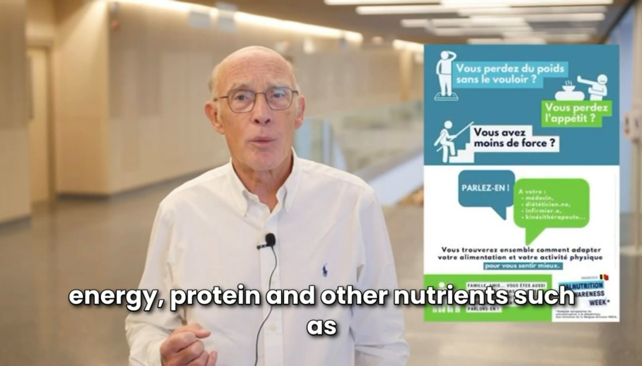
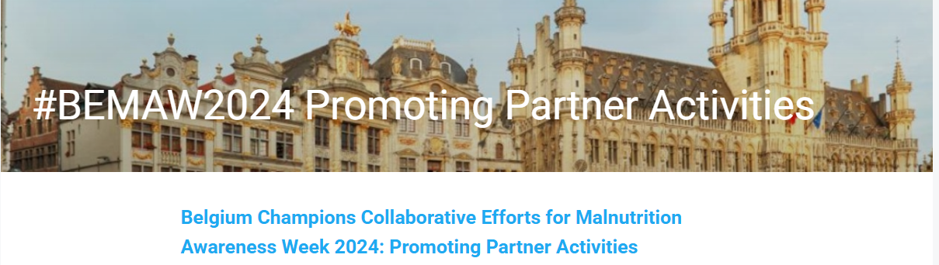
Malnutrition Awareness Week 2024
BA ONCA
Creation of a ‘ MAW Tool box’ with posters, slides presentation, articles for professionals, ESPEN Fact sheet, video on YouTube,… provided by Belgian Alliance ONCA (in Dutch and French).
See MAW 2024 ToolKit - Belgium – Dropbox

Slide 3
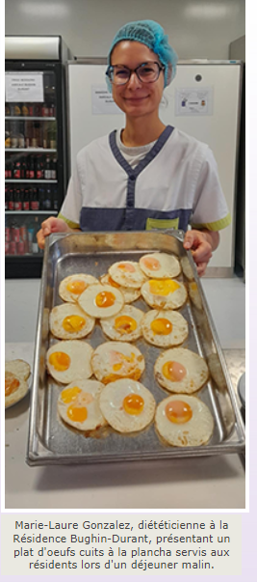

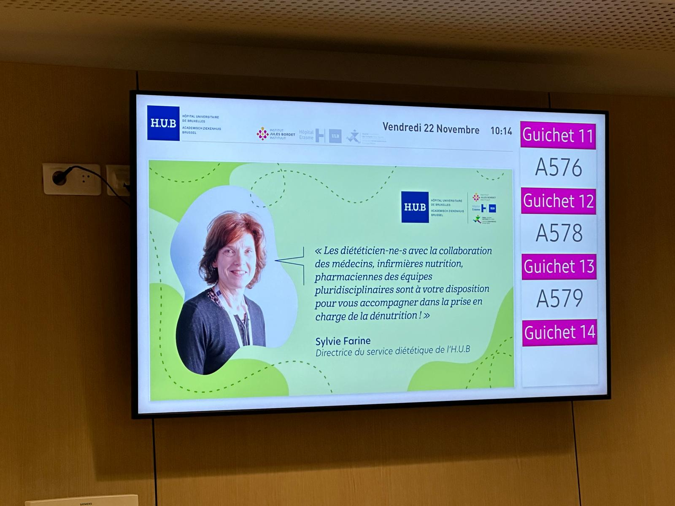
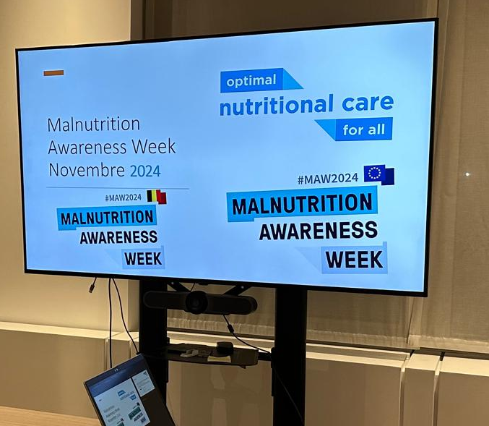
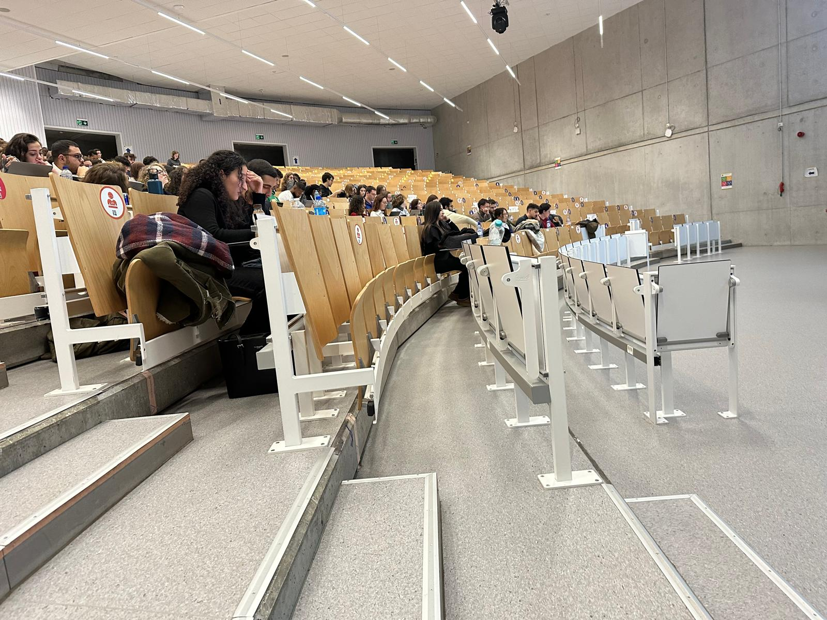
Malnutrition Awareness Week 2024 BA ONCA
Creation of a MAW 2024 ToolKit - Belgium – Dropbox
Various actions from our 40 stakeholders in hospitals, home care, dietetic institutes, scientific institutes, a few patient associations, … with support of the Ministry of Health

Slide 4

Malnutrition Awareness Week 2024 BA ONCA
Creation of a MAW 2024 ToolKit - Belgium – Dropbox
Various actions from our 40 stakeholders in hospitals, home care, dietetic institutes, scientific institutes, a few patient associations, … with support of the Ministry of Health
  Action: distribution of materials – newsletter & social media
    Target group: health professionals including dieticians, exercise coaches, higher education teachers, etc.
    CAT: image link to the ONCA website
  Action: distribution of materials – mailing
    Target group: dieticians, trained as process supervisors in residential care centres & local service centres
    CAT: link to toolbox

Slide 5
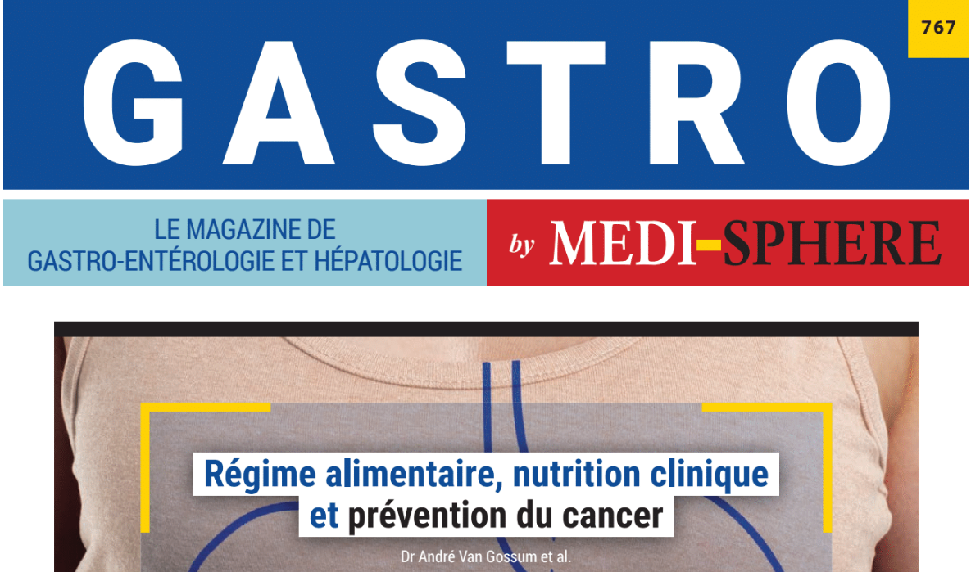
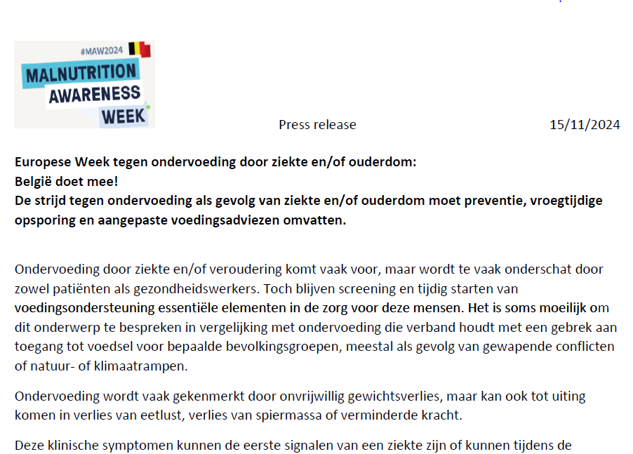


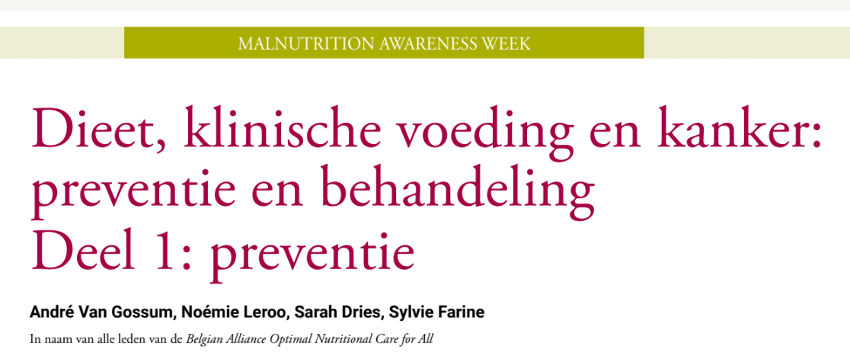
Malnutrition Awareness Week 2024 BA ONCA
Creation of a MAW 2024 ToolKit - Belgium – Dropbox
Various actions from our 40 stakeholders
Informative letter send to politicians, articles in trade journals and Press realease to general media (low impact)

Slide 6
Malnutrition Awareness Week 2024 BA ONCA
Creation of a MAW 2024 ToolKit - Belgium – Dropbox
Various actions from our 40 stakeholders
Informative letter, articles and Press realease
Our objective of raising public awareness is difficult to achieve

