Slide 1
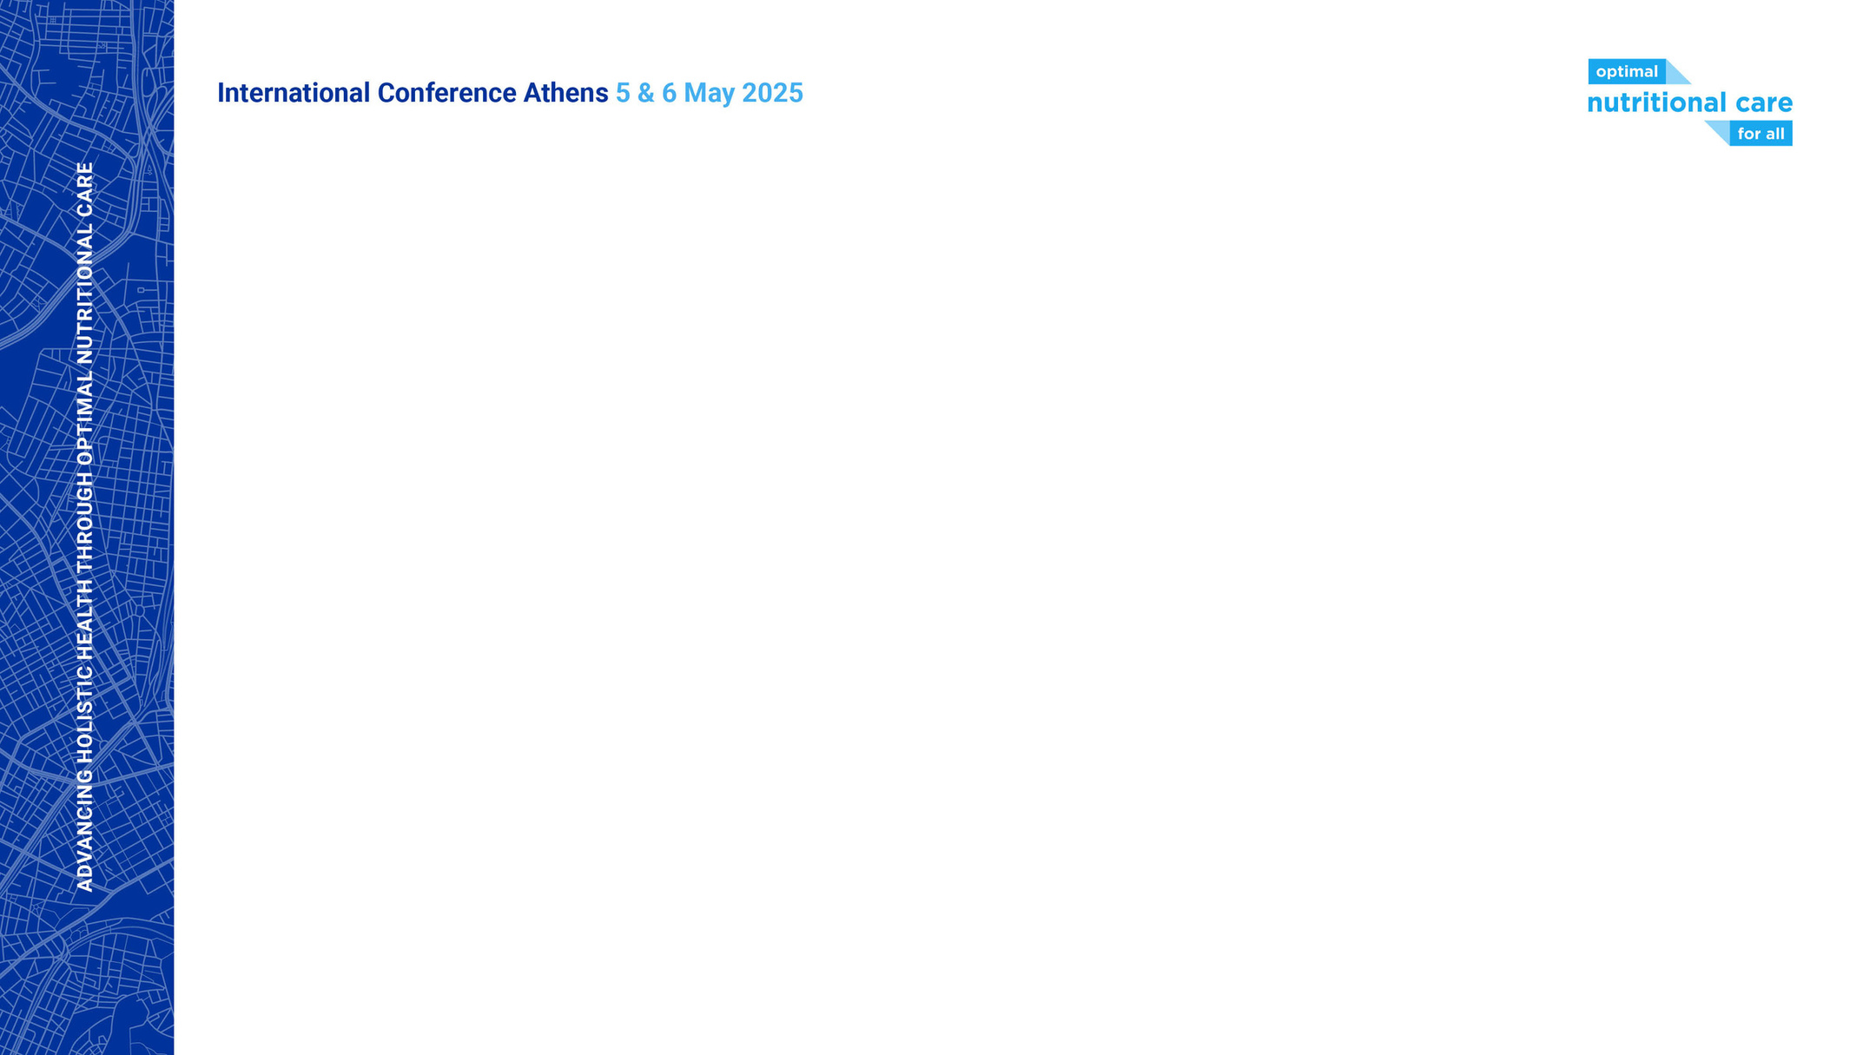
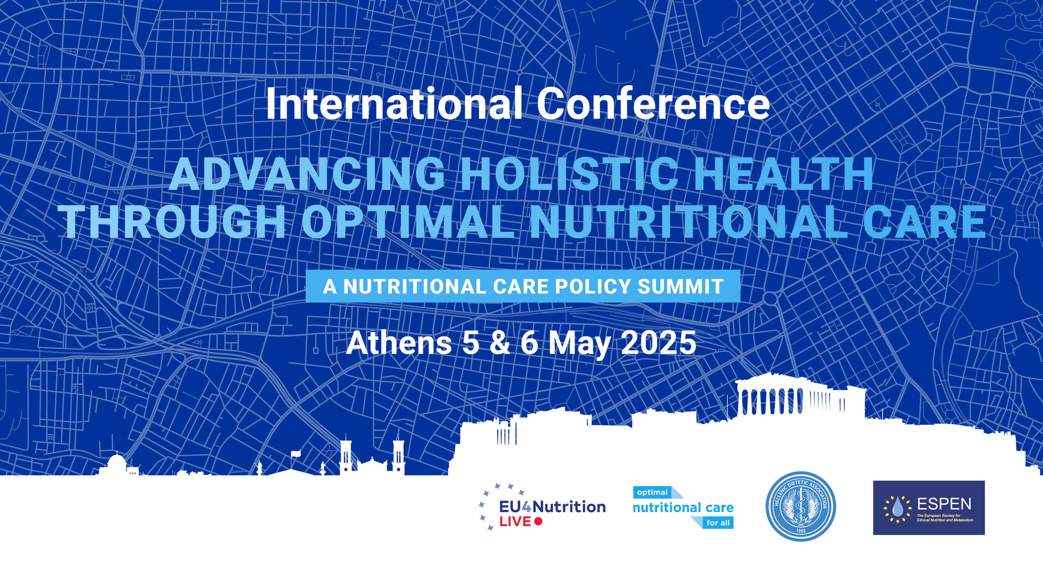



Slide 2
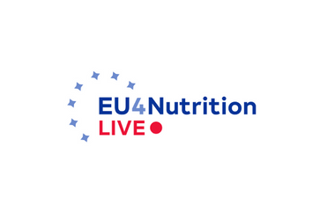


Hellenic Dietetic Association
Notable MAW campaign achievements from Greece
Dr. Theodora E. (Dorina) Sialvera, MSc, PhD, Post-Doc
Clinical Dietitian – Nutritionist, Head of the Department of Dietetics and Nutrition,
General Hospital for Chest Diseases of Athens “Sotiria”
Former President of the Hellenic Dietitians and Nutritionists Association (HDA)
ONCA delegate HDA

Slide 3
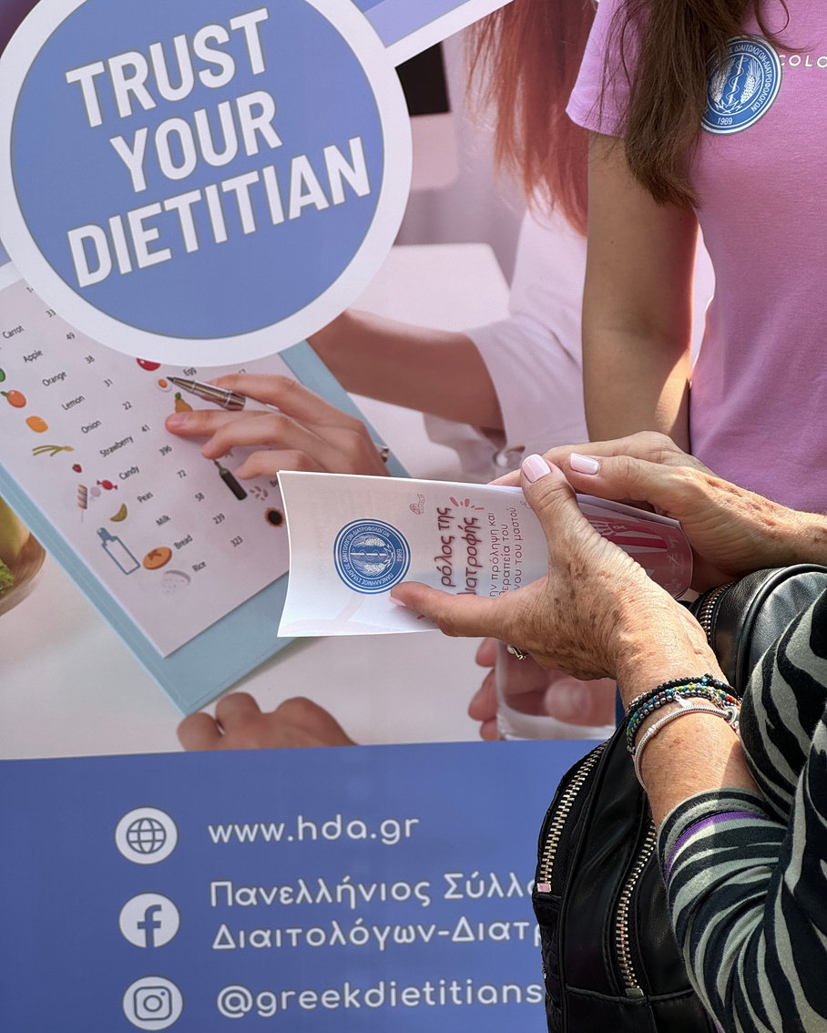

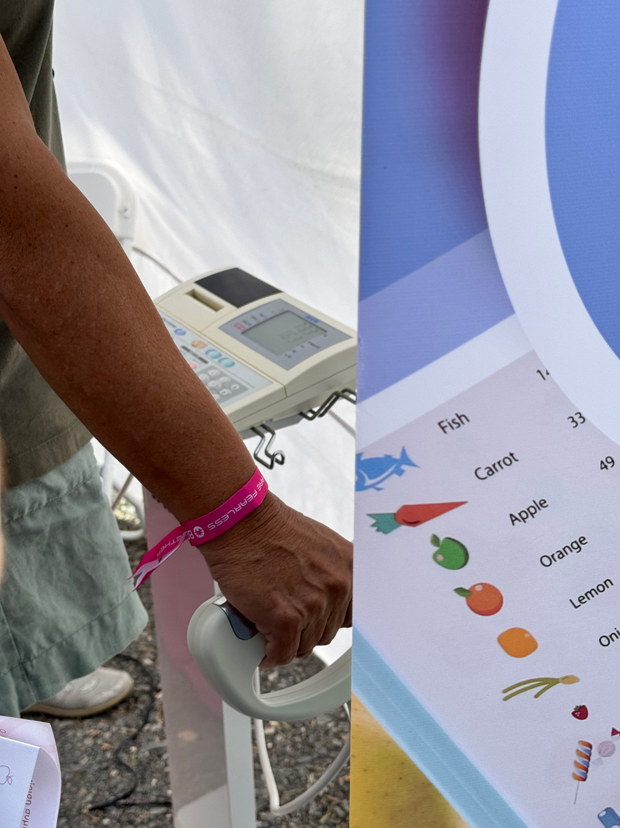
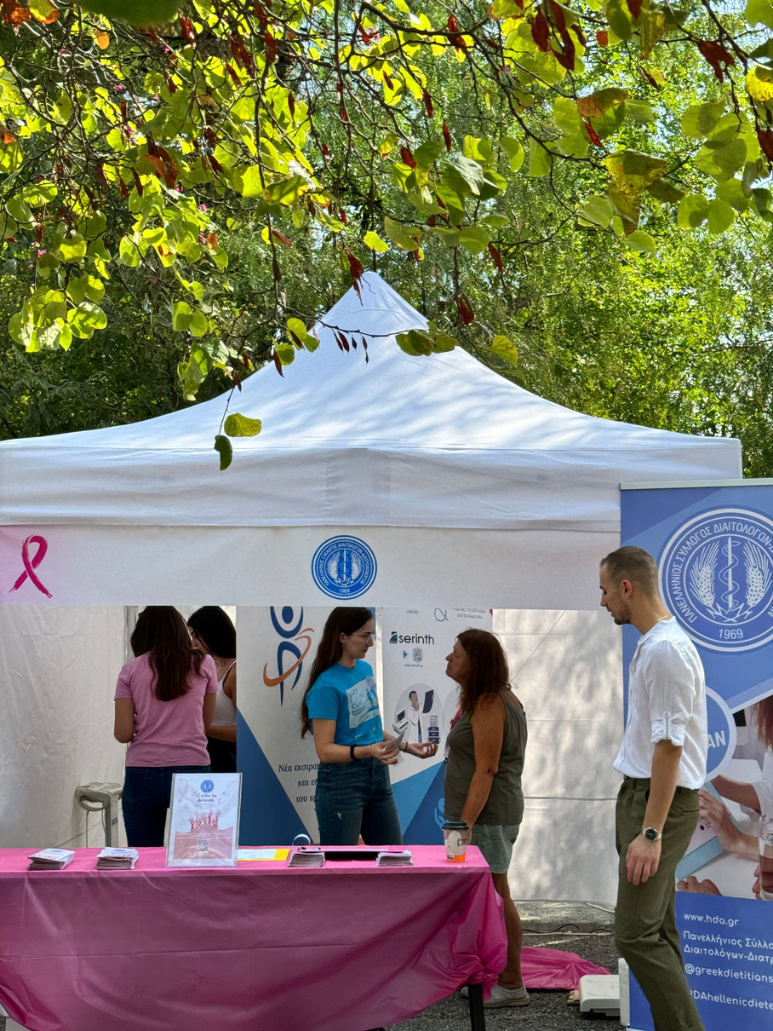
Hellenic Dietetic Association
Greece Race For The Cure
“The role of nutrition in breast cancer treatment”
  For the second consecutive year, the Hellenic Dietetic Association (HDA) participated in the Health Village of Race for the Cure, held on September 28–29.
  At the HDA booth, visitors received body composition analyses and personalized dietary counseling, emphasizing the critical role of nutrition in preventing and managing malnutrition in the context of breast cancer.
  The volunteer team of dietitians provided evidence-based guidance on how to address malnutrition risks during cancer treatment and recovery, supporting better outcomes and improved quality of life for breast cancer survivors.

Slide 4
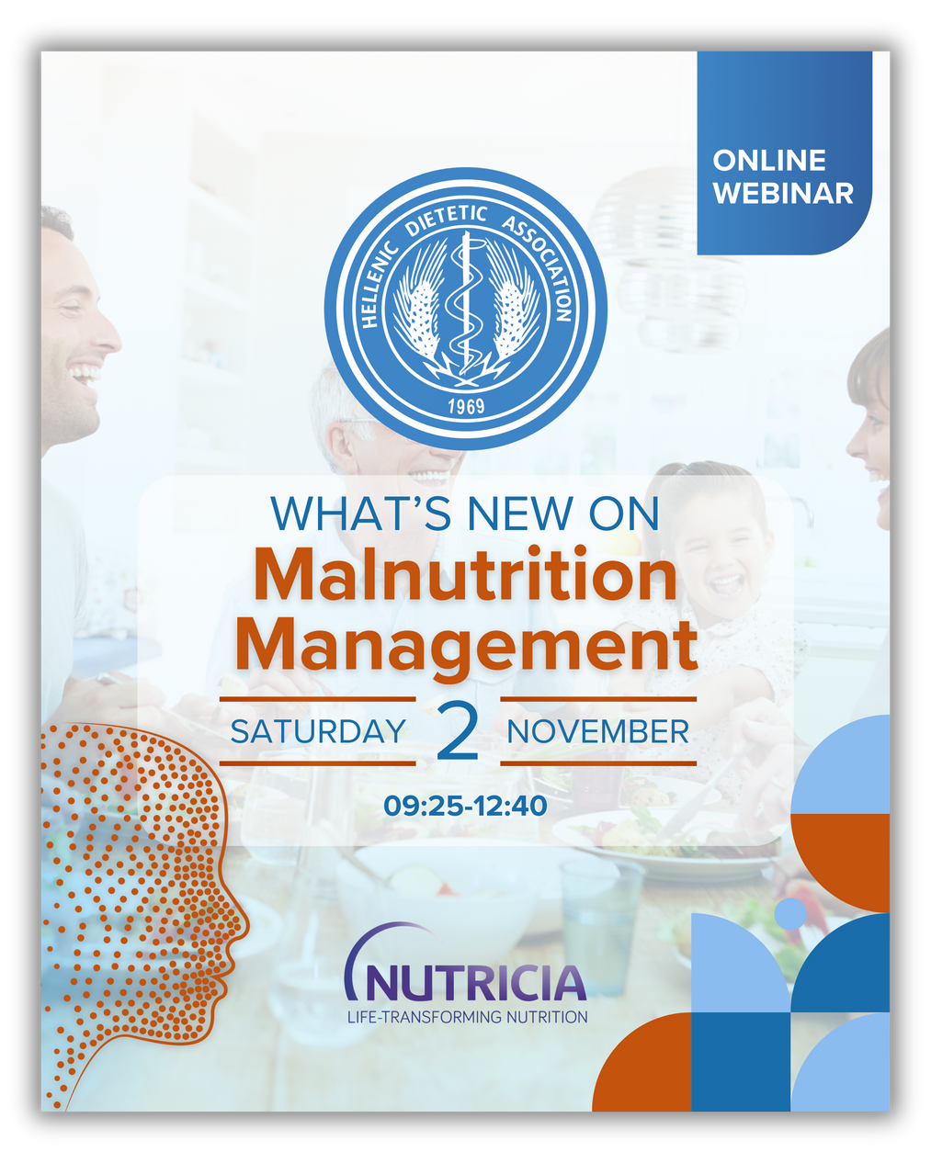
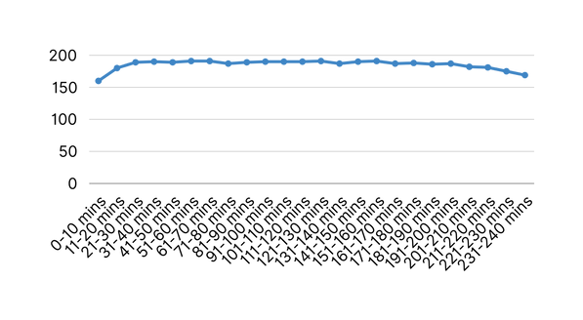
Hellenic Dietetic Association
HDA Webinar on Malnutrition
As part of Malnutrition Awareness Week, the Hellenic Dietetic Association (HDA) organized a three-hour webinar titled:
“What’s Malnutrition Management” on November 2, 2024
Program Highlights:
  Nutritional assessment in children and adolescents
  Updated recommendations for older adults
  New tools for malnutrition screening and assessment
  Special nutritional needs in older adults: anorexia, metabolic syndrome, frailty
  The role of supplements and weight management interventions
  Dysphagia: clinical cases, use of IDDSI protocol, and the importance of interdisciplinary approaches
  Case study: transition from hospital to home care and nutritional follow-up
Total registrations: 219
Live Concurrency

Slide 5

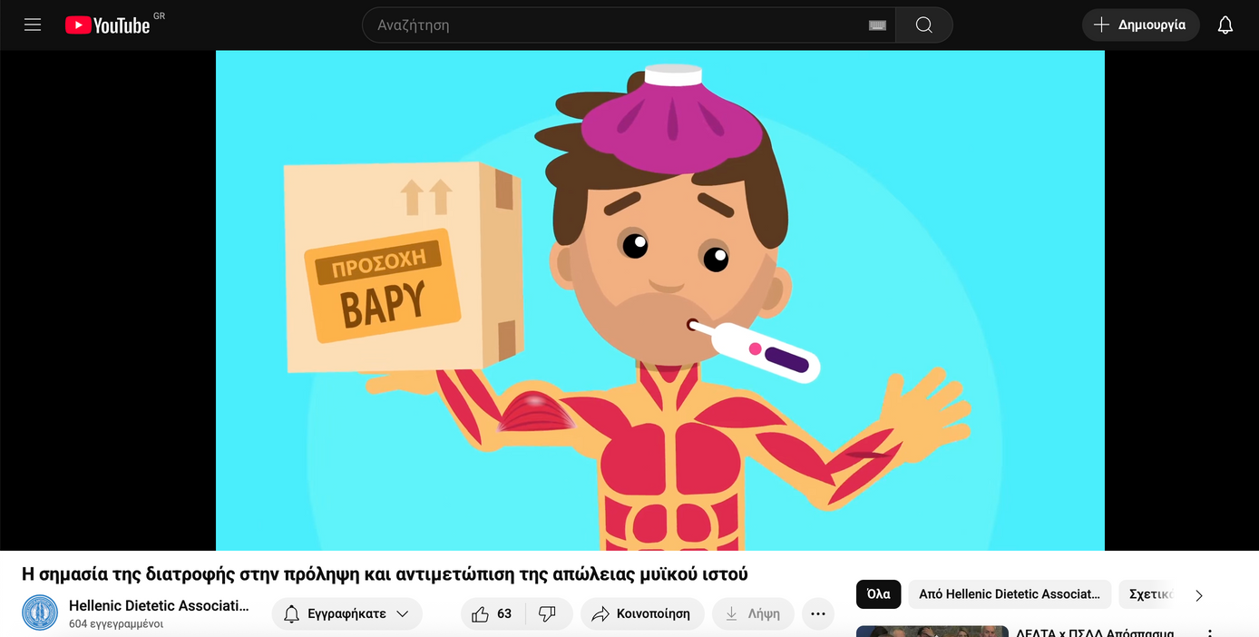


Hellenic Dietetic Association
  The Hellenic Dietetic Association (HDA) and its Clinical Nutrition Special Interest Group launched an awareness video on the importance of nutrition in preventing and addressing muscle mass loss.
  The video aims to sensitize both health professionals and the general public in Greece about the critical role of preserving muscle mass for overall health and during disease.
  Core message: “Nutrition plays a key role in supporting muscle mass and should never be neglected!”
  Special thanks to Professor Dr. Carla Prado (University of Alberta, Canada) for her contribution and to all sponsors supporting this initiative.
  This campaign strengthens national efforts to combat malnutrition and highlights the importance of early nutritional intervention to prevent muscle wasting and associated health complications.
  36.9k Views
  445 Likes
  106 Shares
  3270 Views

Slide 6
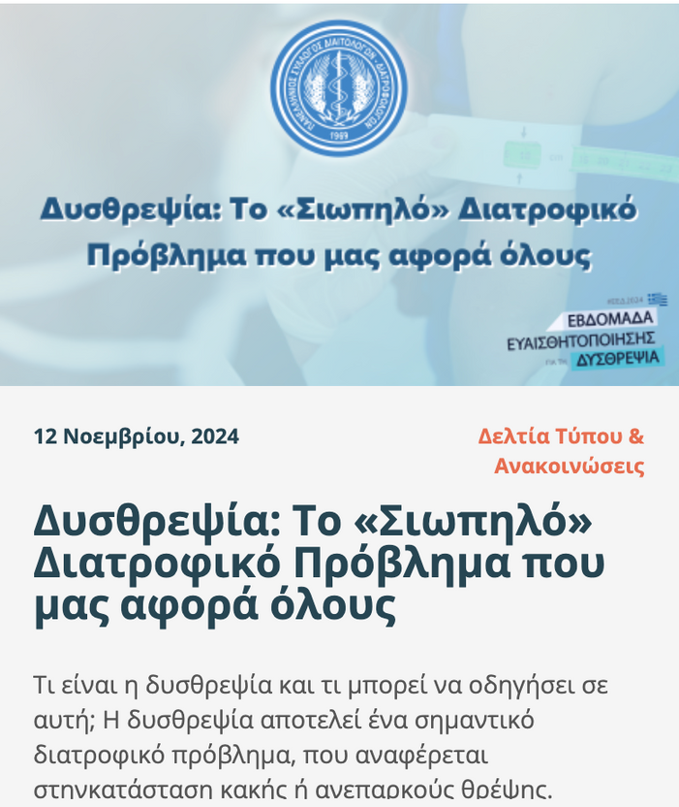

Hellenic Dietetic Association
Public Awareness Article on Malnutrition
The Hellenic Dietetic Association (HDA), together with its Clinical Nutrition Working Group, published an informative article in national online media to raise public awareness on malnutrition.
The article explains:
  What malnutrition is and the medical, social, and economic factors that contribute to it.
  Its impacts on muscle mass, immune function, mobility, mental health, and quality of life.
  The significant healthcare burden due to increased hospital admissions, complications, and costs.
  It emphasizes the importance of screening, early diagnosis, and timely nutritional intervention, including referrals to dietitians for detailed nutritional assessments and tailored care plans.
  A key message is that malnutrition affects all age and weight groups, including overweight and obese individuals who may experience unnoticed weight and muscle loss.
The article was widely published across multiple online news outlets and websites, reaching the general public throughout Greece.

Slide 7
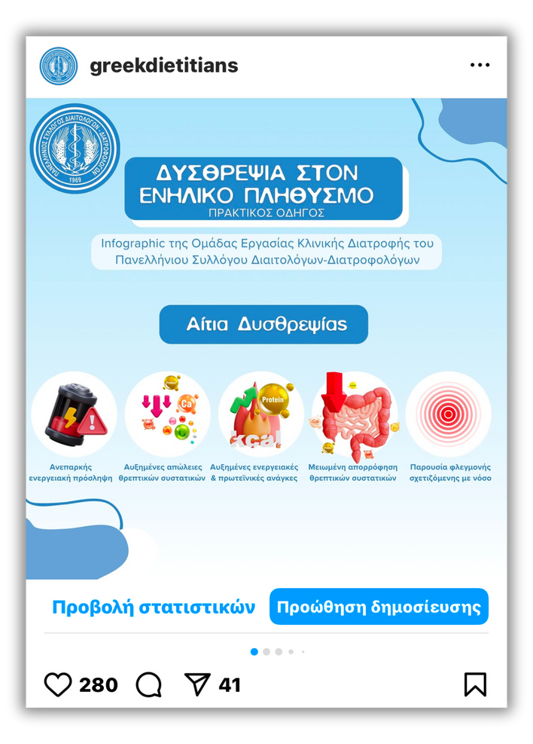
Hellenic Dietetic Association
Infographic
“Malnutrition in the Adult Population”
The infographic included clear, practical sections on:
  Recognizing malnutrition — key signs, symptoms, and risk factors.
  Treatment algorithm — step-by-step clinical guidance for managing malnutrition.
  Dietary recommendations — evidence-based nutritional strategies to support patient recovery and prevent further decline.
This resource was created to enhance awareness and support the daily clinical practice of healthcare professionals working to address malnutrition in adult populations.

Slide 8


Hellenic Dietetic Association
The Hellenic Dietetic Association (HDA) is preparing an upcoming seminar on Nutrition in Kidney Disease, focusing on the specialized nutritional care required for patients with chronic kidney disease (CKD).
  The event will feature expert presentations on nutritional support strategies, aiming to prevent and manage malnutrition in this particularly vulnerable group.
  Key topics will include nutritional assessment, dietary approaches, and personalized interventions to maintain muscle mass, prevent malnutrition, and improve health outcomes.
  This upcoming initiative further strengthens HDA’s commitment to raising awareness and improving practices related to disease-related malnutrition in Greece.
Seminar about Nutrition in Kidney Disease

Slide 9
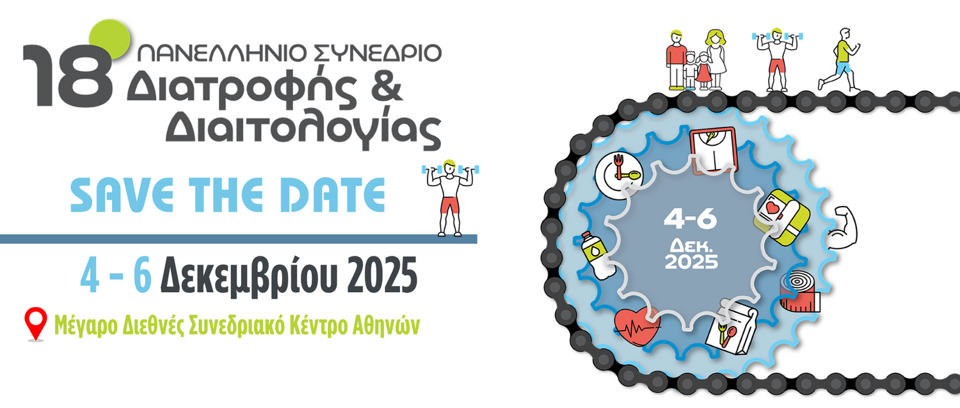
Hellenic Dietetic Association
18th Hellenic Congress on Nutrition and Dietetics
  The upcoming 18th Hellenic Congress on Nutrition and Dietetics will include presentations and workshops on malnutrition, covering topics such as nutritional assessment, intervention strategies, and practical clinical approaches.
  This congress provides an important opportunity to update professional knowledge and promote best practices in the prevention and management of malnutrition within the broader context of nutrition and dietetics.

Slide 10




Hellenic Dietetic Association
Notable MAW campaign achievements from Greece
@greekdietitians
Πανελλήνιος Σύλλογος Διαιτολόγων - Διατροφολόγων
info@hda.gr
www.hda.gr

