Slide 1


Opportunities and Challenges: Nutrition care policy action
Dr.Nicole Erickson

Slide 2


Working with ENHA to create a HPP and policy PAper

Slide 3
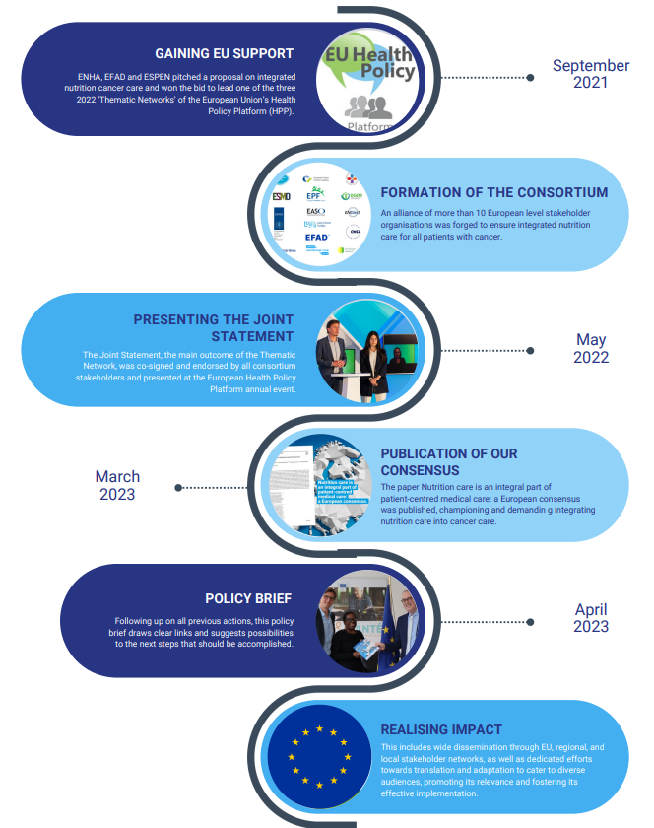

Slide 4

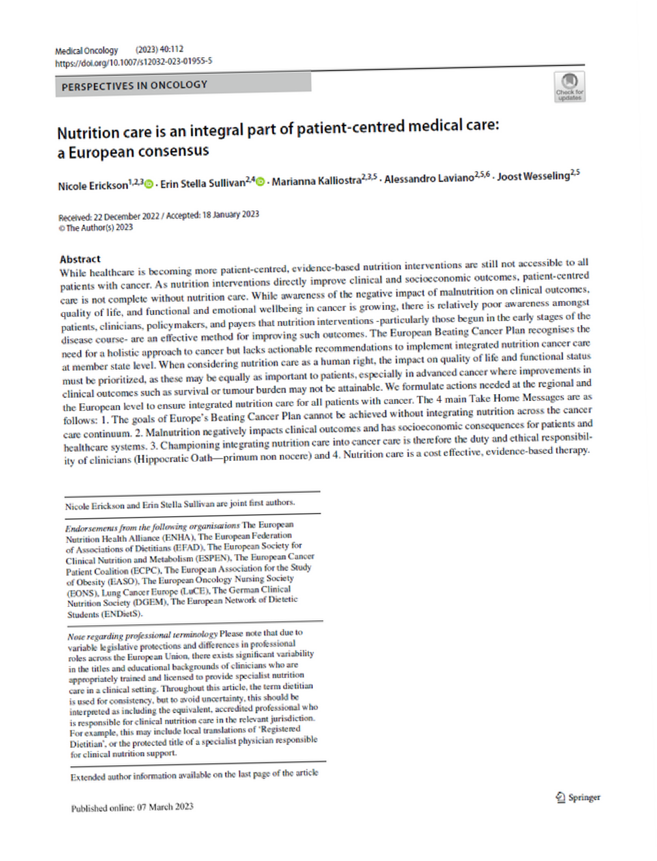




Nutrition care is an integral part of patient-centred medical care: A European consensus
Published in Medical Oncology, March 2023
Nicole Erickson, Erin Stella Sullivan, Marianna Kalliostra, Alessandro Laviano, Joost Wesseling
Peer Review Article &
EU Policy Brief
This policy brief originated in the thematic network ‘Integrated Nutrition Cancer Care’ of the European Commission’s Health Policy Platform.

Slide 5
Germany takes Action

Slide 6
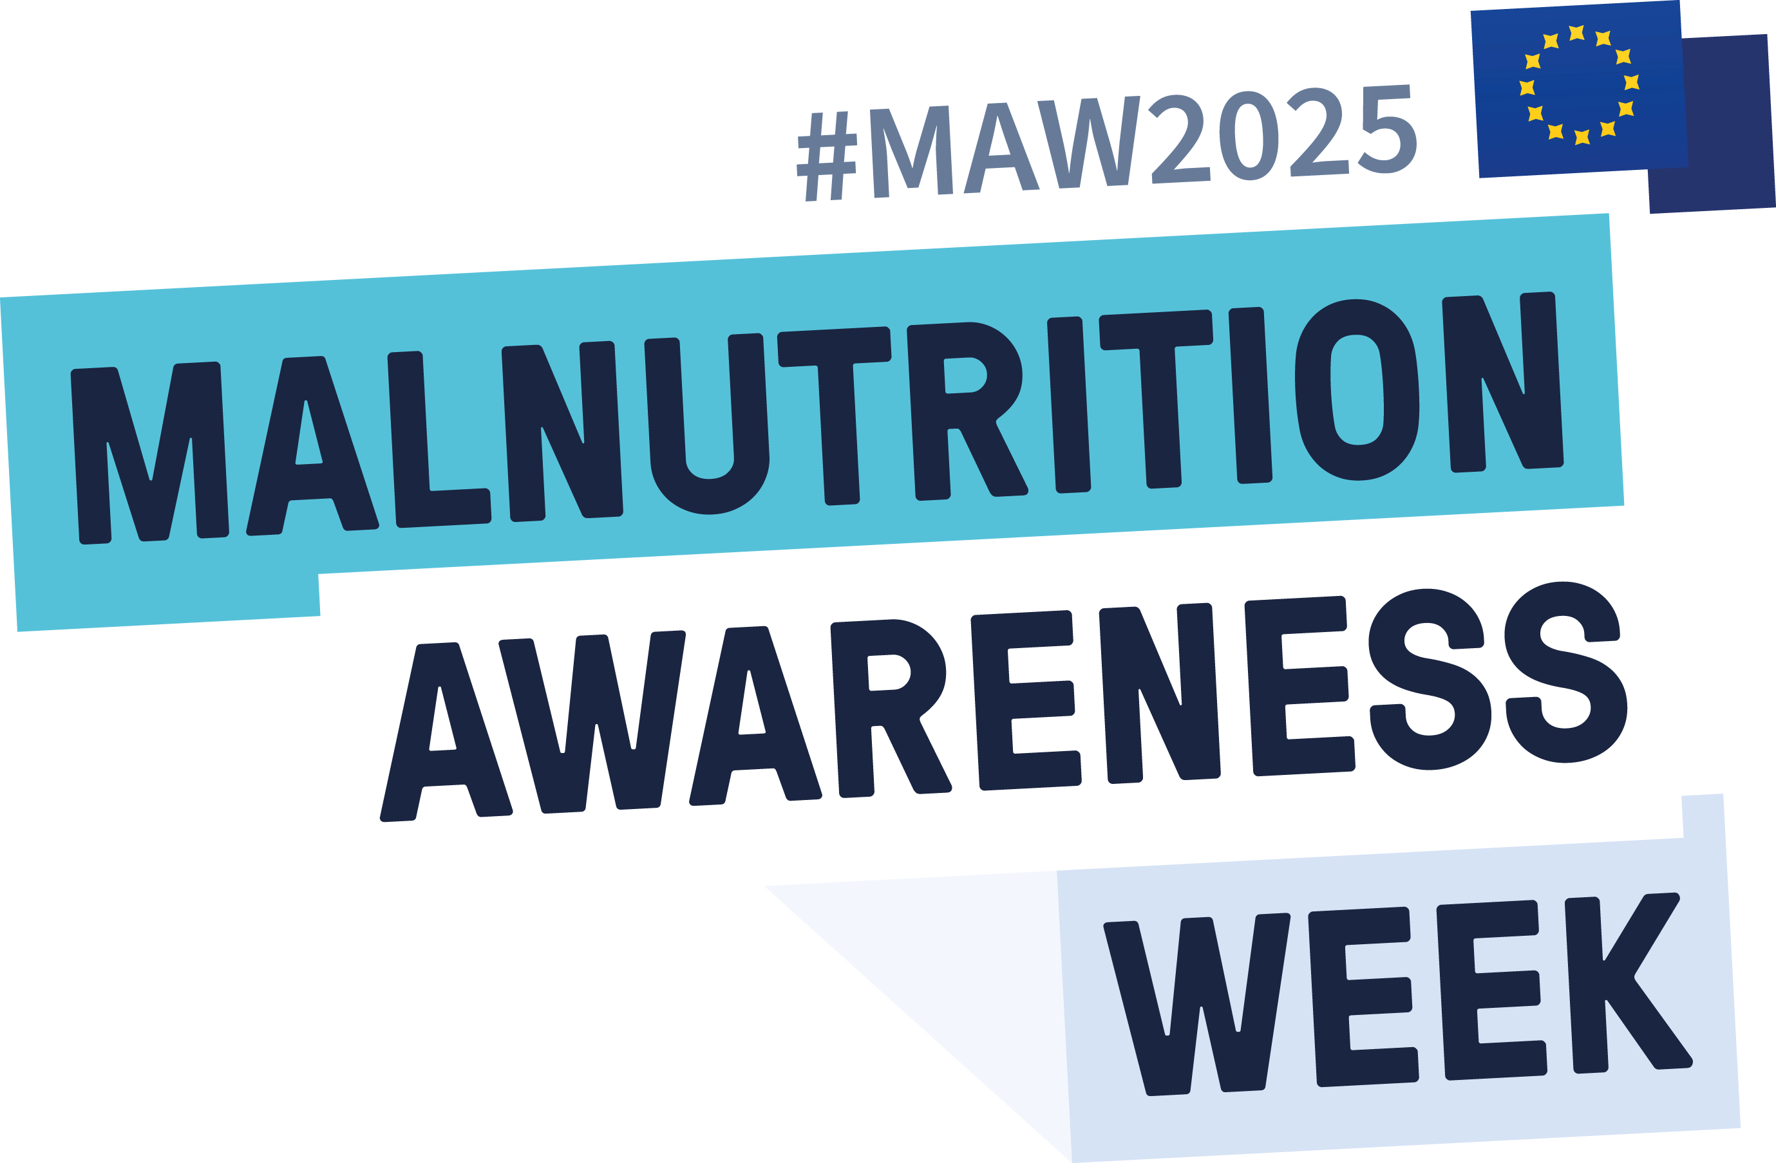
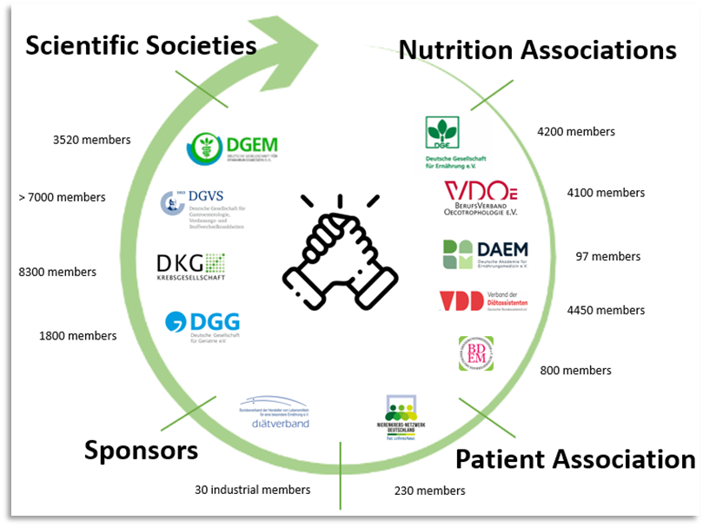
MAW in Germany starting 2023
Large network is the key
Professional appearance, simple messages & numbers attract multipliers
Main challenges: addressing the target group of patients; get politics involved
Everything depends on the right (political) timing.
→ German government collapsed one week prior MAW. Nutrition strategy was no longer an issue.
10 partners; representing > 34.5000 members

Slide 7
MAW in Germany starting 2023
Our Main Goal: “Full reimbursement of outpatient nutritional counseling”
Large network is the key
Professional appearance, simple messages & numbers attract multipliers
Main challenges: addressing the target group of patients; get politics involved
Everything depends on the right (political) timing.
→ German government collapsed one week prior MAW. Nutrition strategy was no longer an issue.
10 partners; representing > 34.5000 members
In 2024 Jost Wesseling contributed to MAW with a presentation on
“How to convince the keyplayers”

Slide 8



Activities for MAW 2024
11th Nov.
12th Nov.
13th Nov.
14th Nov.
15th Nov.
Main audience: | Professionals | Politicians & stakeholders | Patients | Professionals | Students
Activities: | Webinar “Disease-associated malnutrition - an interdisciplinary challenge” Focus: Intra- and interdisciplinary communication | Panel discussion “Nutrients are active substances for vulnerable groups. What can the government's nutrition strategy achieve?” Press conference | Hospital events Information materials High caloric snacks Weight measurement Cookinar Live cooking class | NutritionDay | Webinar “Malnutrition in different appearances - prevention in vulnerable groups”

Slide 9
Brainstorm Where are you on the road?
And where Can ENHA be helpful?
Accurate and consistent nutrition care messaging is central to patient confidence and supporting them in decision-making
Policy makers need to better understand how the key health care systems building blocks need to interlock to effectively integrate and scale up nutrition services
Health care systems should be required to improve effective and efficiency of integration of nutrition into cancer care
All national authorities should establish a National Nutrition Steering Group linked to comprehensive cancer centers
Financial barriers should be minimized or eliminated
All patients should have timely assess to dietetic care, information and resources
Minimal standards for the cancer care team should include dietitians, nurses, physician and other care specialists
Pérez-Escamilla R, Engmann C. Integrating nutrition services into health care systems platforms: Where are we and where do we go from here. Matern Child Nutr. 2019 Jan;15 Suppl 1(Suppl 1):e12743. doi: 10.1111/mcn.12743. PMID: 30748115; PMCID: PMC7198949
Kozeniecki M, Pitts H, Patel JJ. Barriers and Solutions to Delivery of Intensive Care Unit Nutrition Therapy. Nutr Clin Pract. 2018 Feb;33(1):8-15. doi: 10.1002/ncp.10051. Epub 2018 Jan 11. PMID: 29323759.
Thorne JL, Moore JB, Corfe BM. Nutrition and cancer: evidence gaps and opportunities for improving knowledge. Proc Nutr Soc. 2020 Aug;79(3):367-372. doi: 10.1017/S0029665120000099. Epub 2020 Mar 18. PMID: 32183926

