Slide 1




Slide 2

EU Session: Opportunities for Member State Actions on Nutritional Care
Creating evidence to support clinical practice
Alessandro Laviano
Sapienza University, Rome, Italy
alessandro.laviano@uniroma1.it

Slide 3
My disclosures
Honoraria for independent lectures at industry-sponsored events.
Board of Directors, Danone Nutricia Campus.
Consultant for medical nutrition industries.

Slide 4

Is nutrition the only «ugly duckling»?

Slide 5

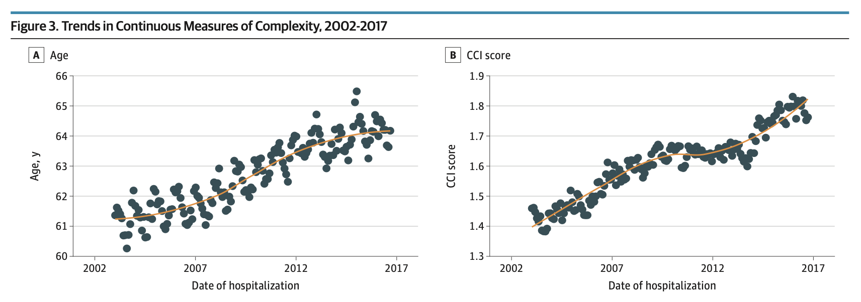

Slide 6
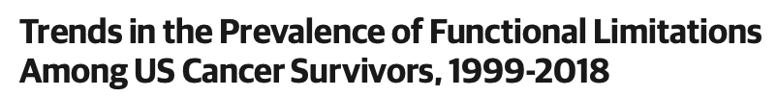

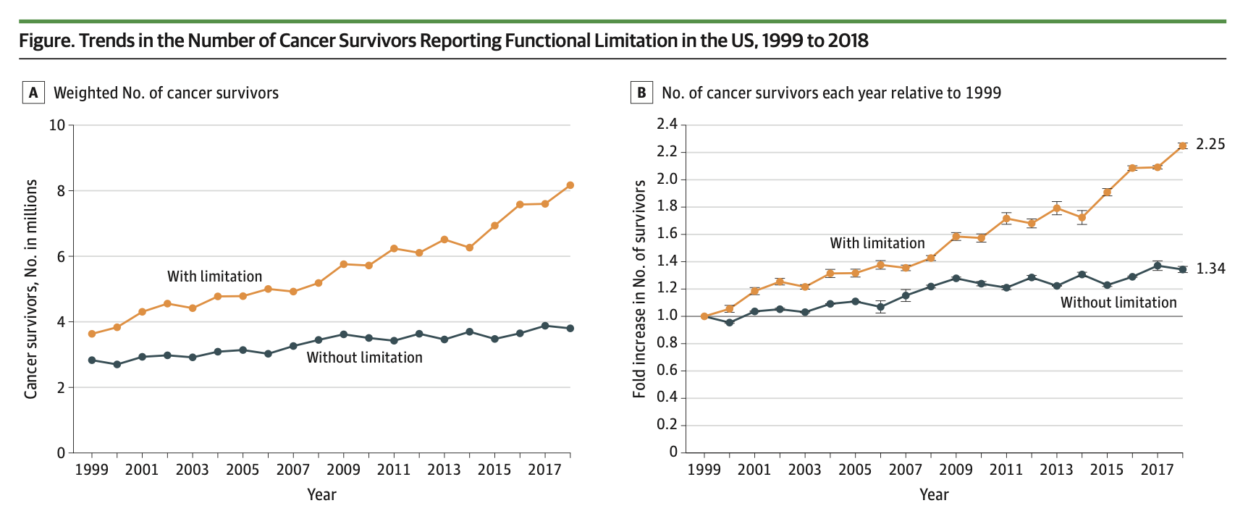

Slide 7
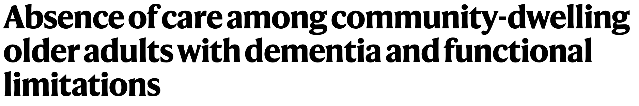
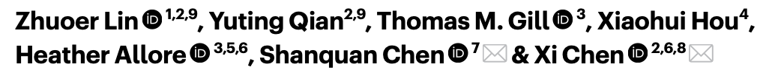
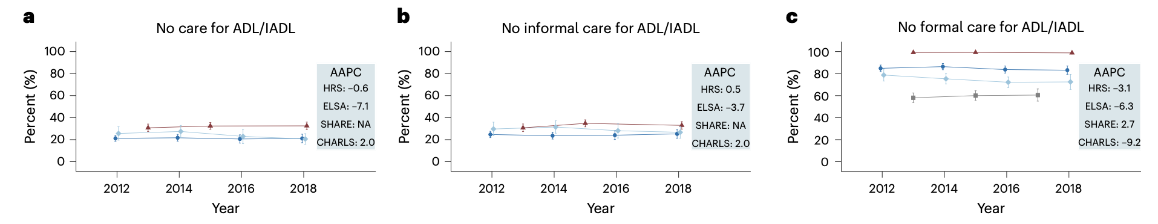

Slide 8
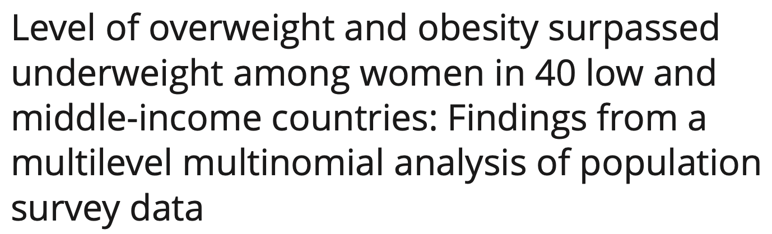

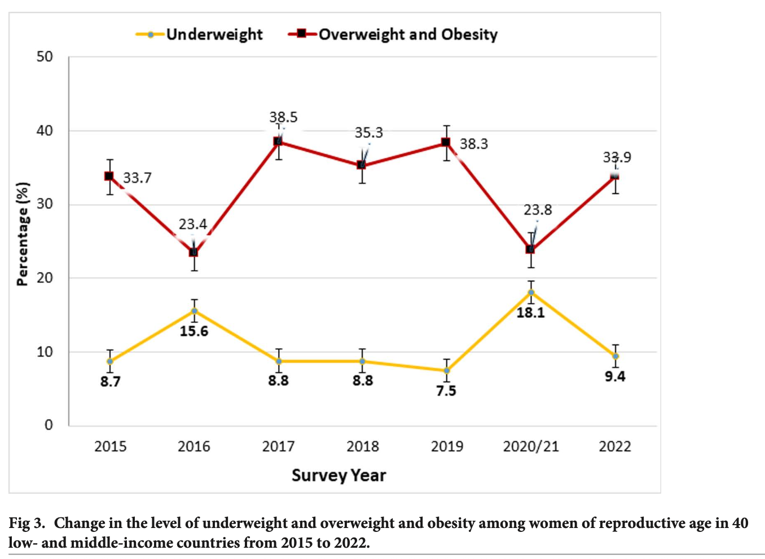

Slide 9
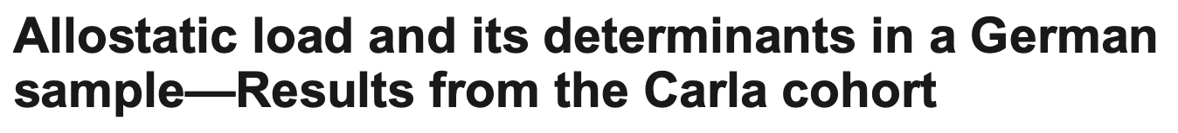
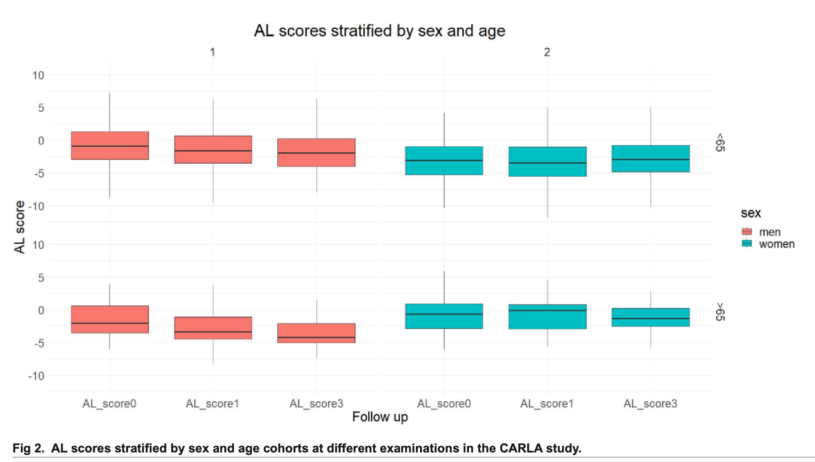

Slide 10

Are we selling the needed product?

Slide 11
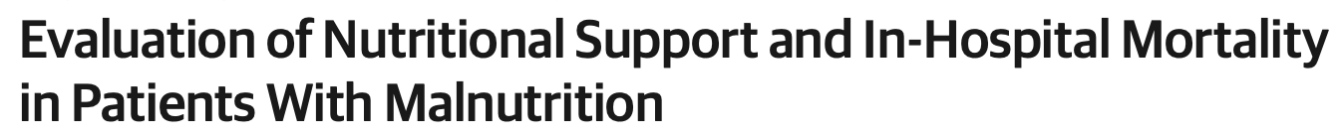

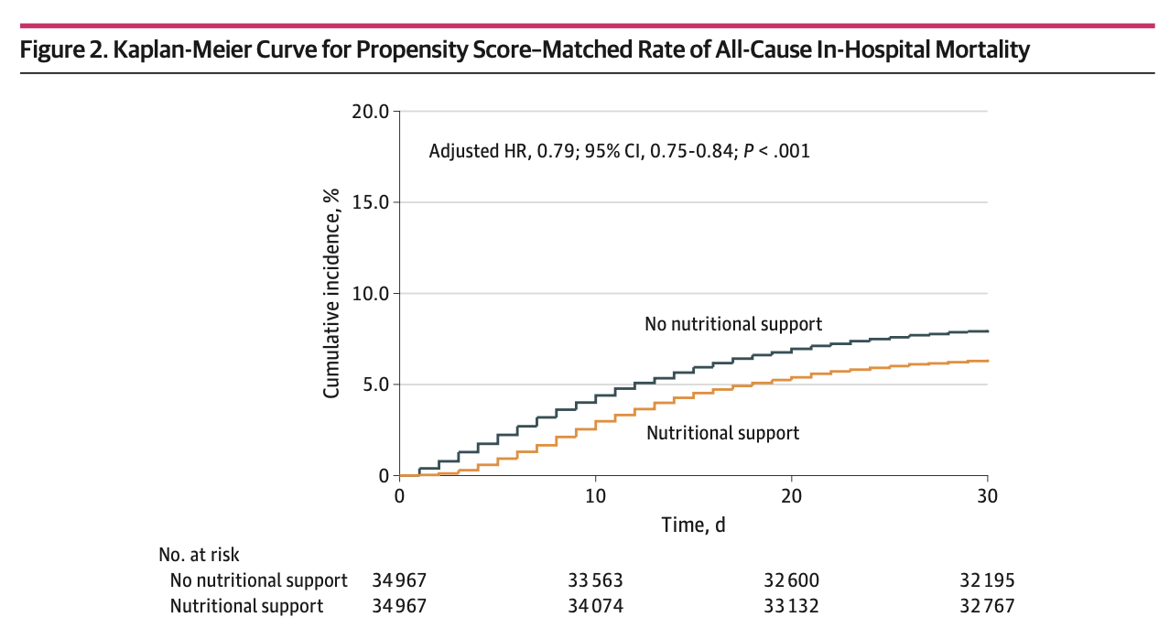

Slide 12
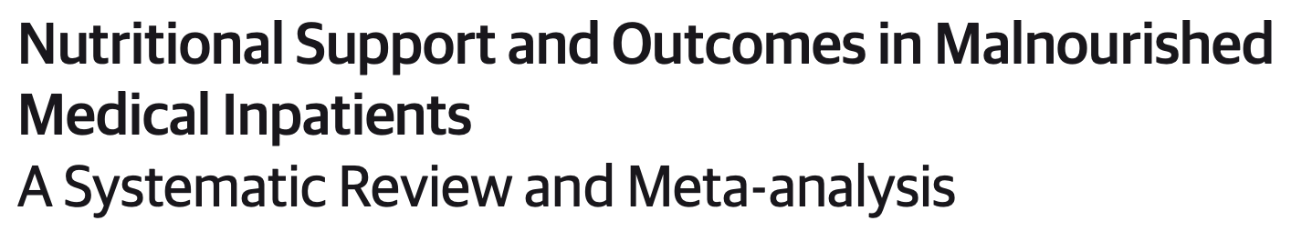
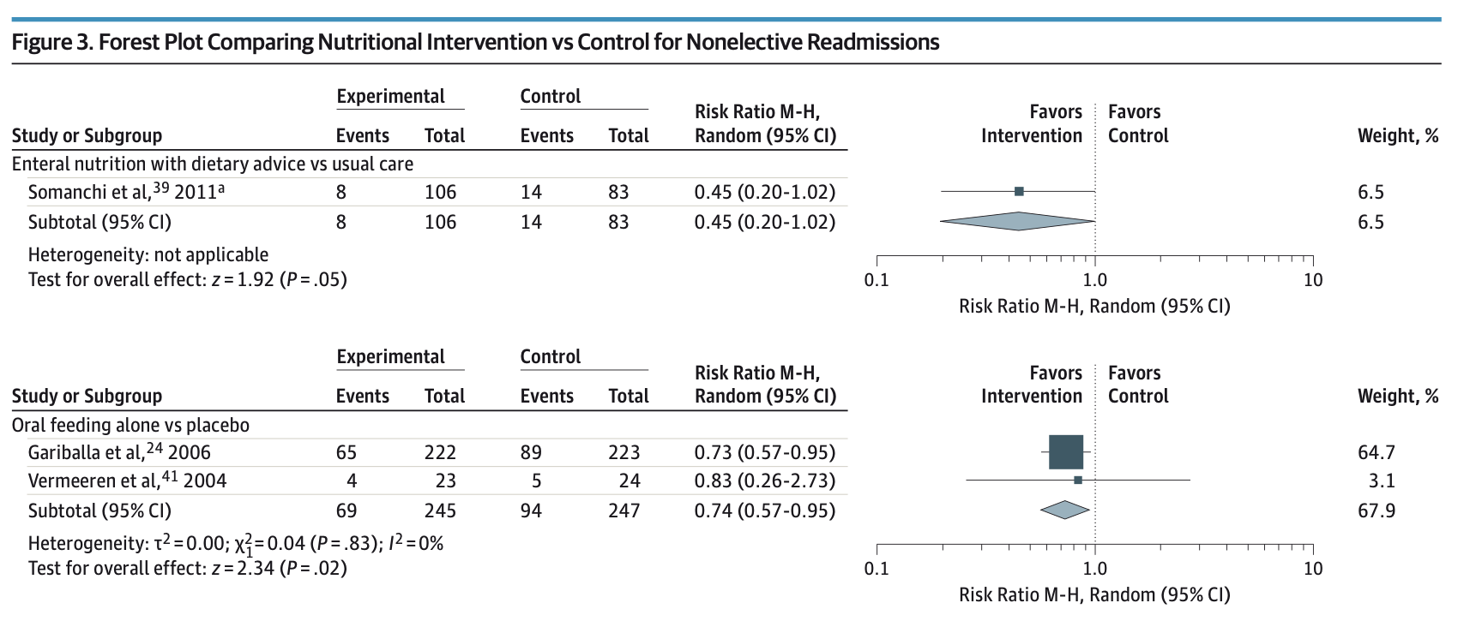

Slide 13
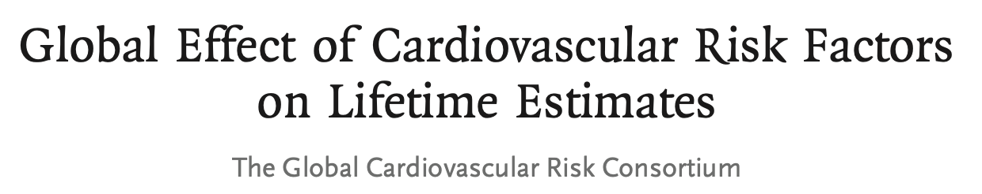

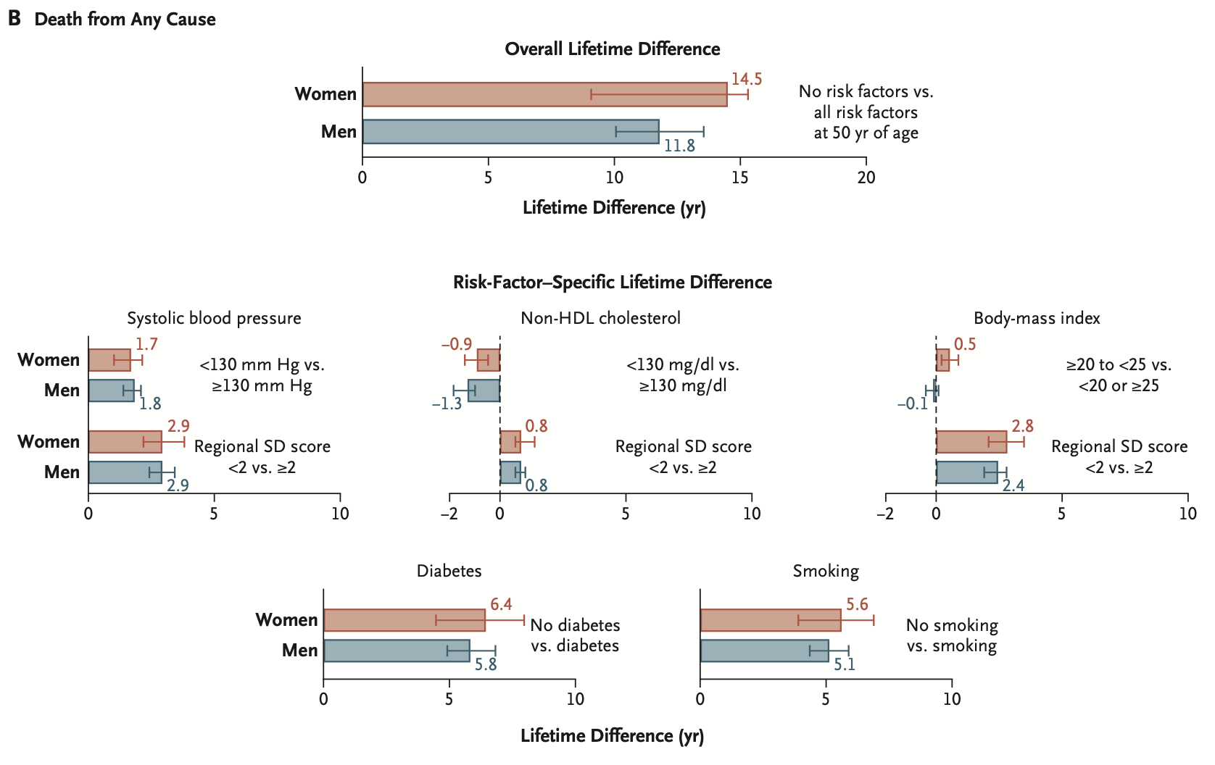
B

Slide 14
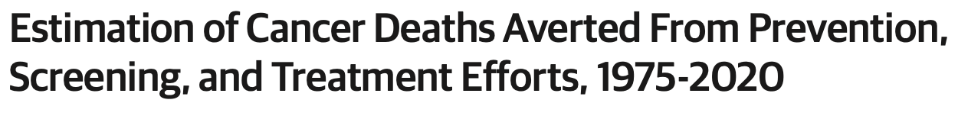

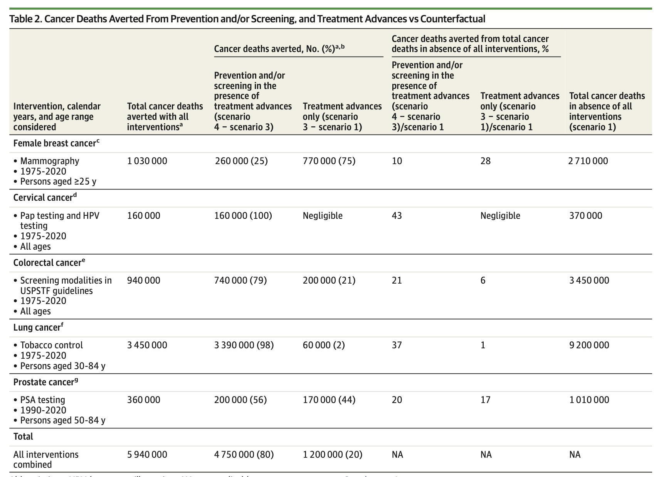

Slide 15

Opportunities

Slide 16
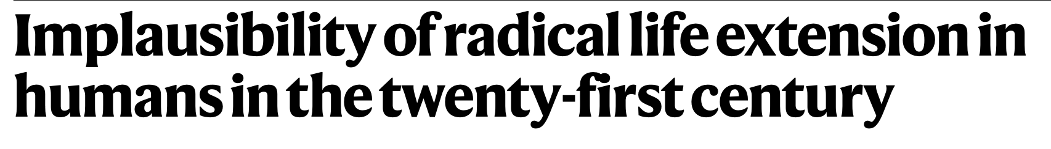
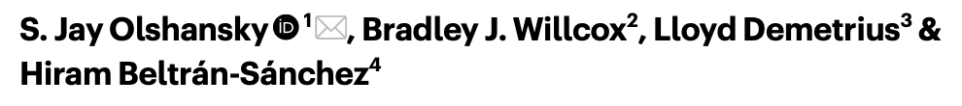

Slide 17
Integrate national/european data with nutritional information.
Reach out patients and lay people.
Define more appealing outcome measures.
Pilot studies assessing the long term efficacy of nutritional care on hospitalization and chronoc disease progression.

Slide 18
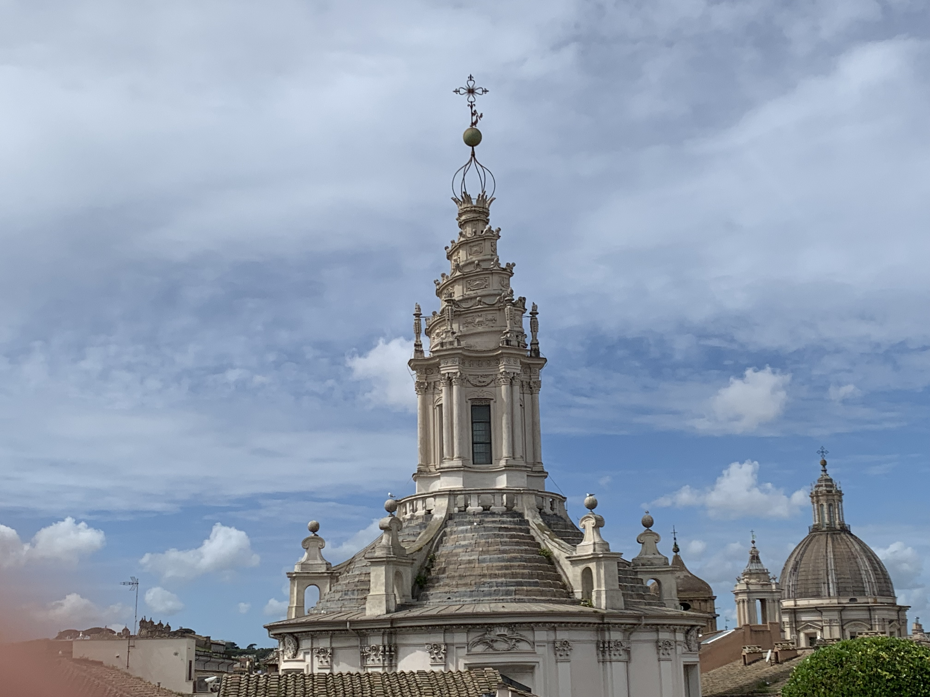
Thank you
Francesco Borromini (1599-1667)
Sant’Ivo alla Sapienza

