Slide 1




Slide 2



Health Economics:
Identifying the True Policy Drivers
Portugal
Aníbal Marinho
President of Portuguese PEN Society
ONCA Coordinator Portugal
anibalmarinho@gmail.com

Slide 3

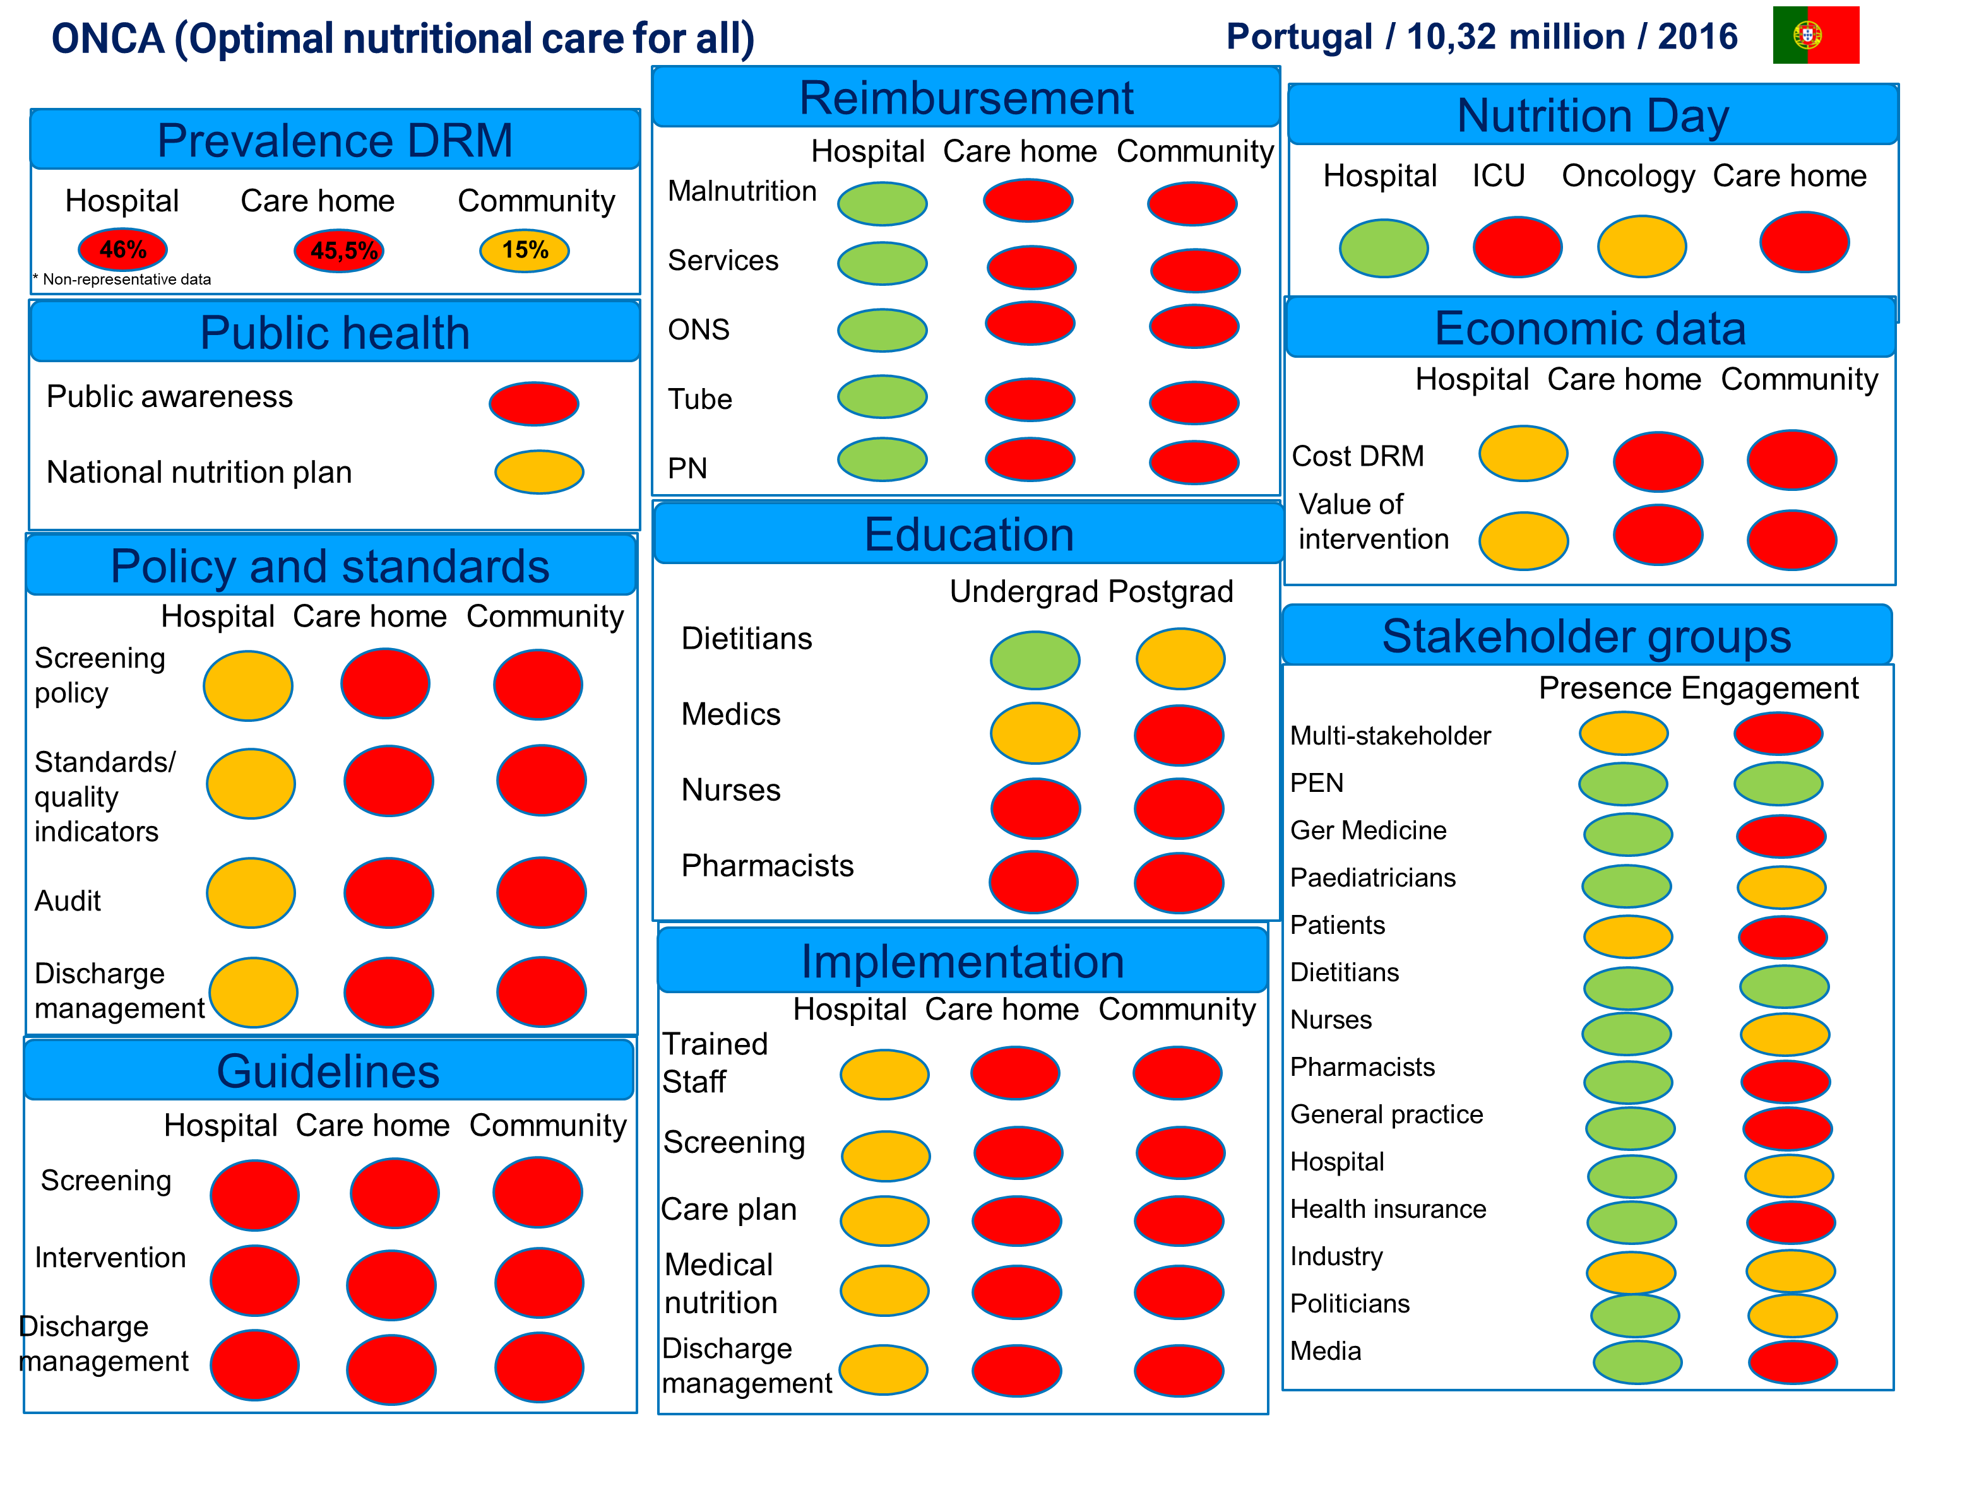
2016
Lack of legislation regarding nutritional screening
0% outpatient reimbursement for EN & PN

Slide 4
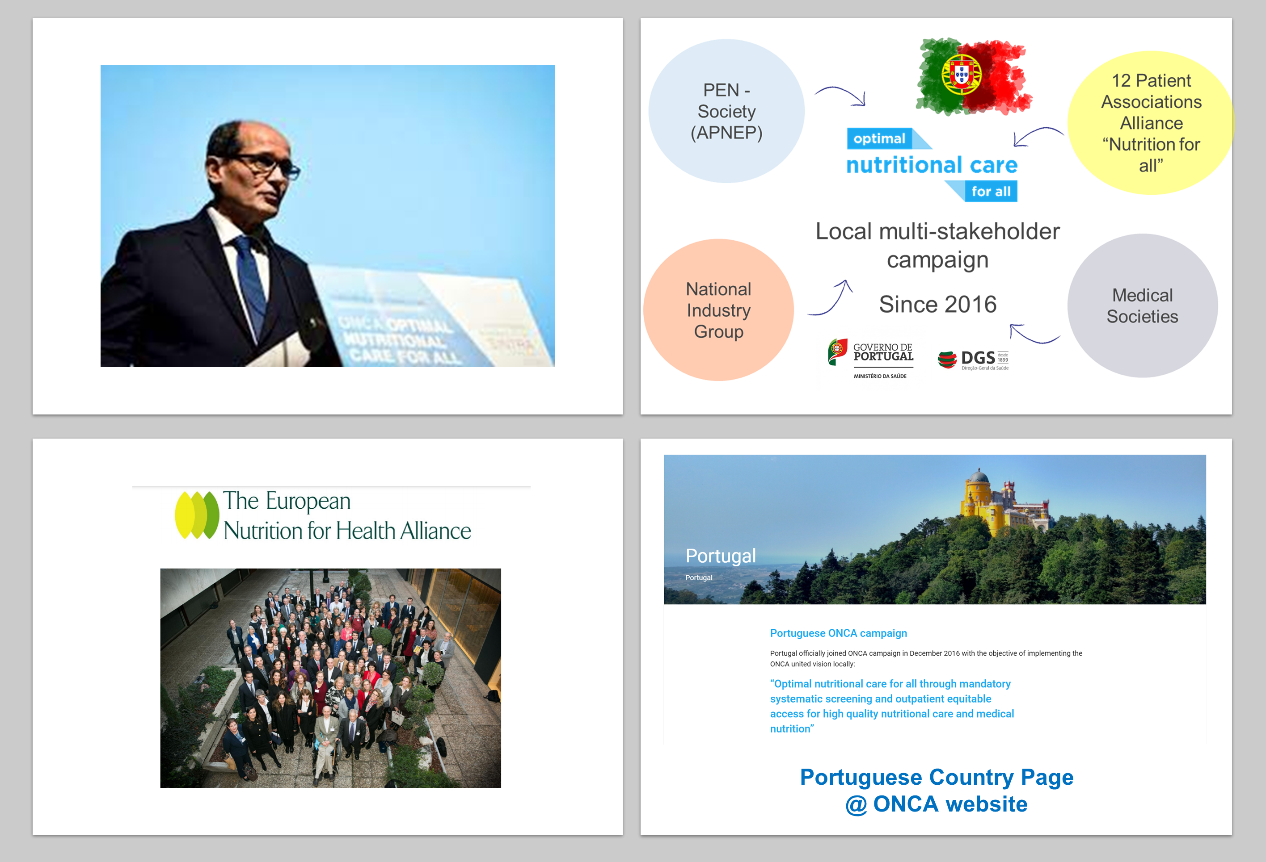
Strong multi-stakeholders' strategy

Slide 5
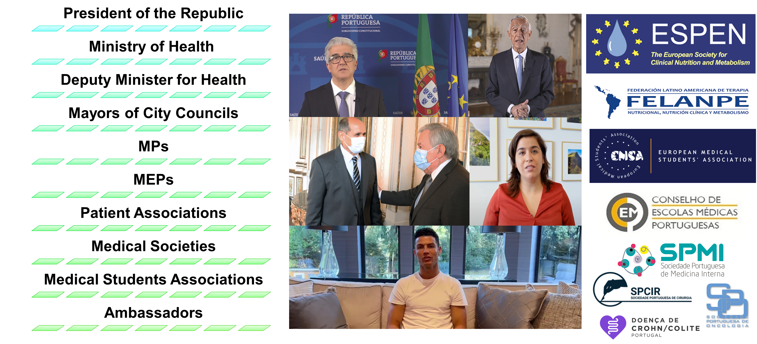
Policy Drivers Strategy

Slide 6
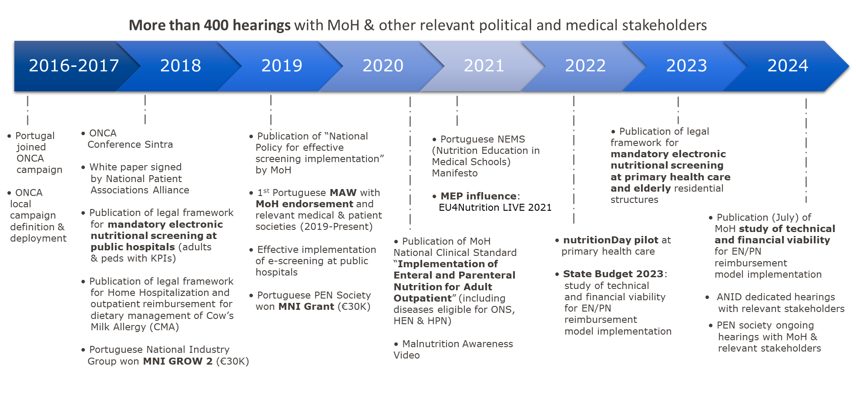

Slide 7

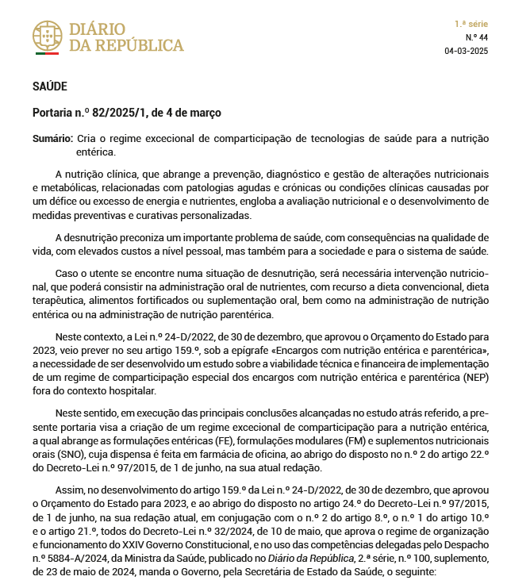
Order nº 82/2025/1
Published on 4th March 2025
This administrative decree creates the exceptional reimbursement scheme for enteral nutrition.
Reimbursement model implementation:
    Tube feeding:
      37% reimbursement level for 2025
      69% reimbursement level from 1st January 2026
      90% reimbursement level from 1st January 2027
    Modular ONS (other ONS are not included)
      37% reimbursement level for 2025
      69% reimbursement level from 1st January 2026
      90% reimbursement level from 1st January 2027
Prescription: Only by public hospital physicians within 5 specialties (Oncology, Internal Medicine, Endocrinology, Gastroenterology and Pediatrics)
Dispensing: Retail pharmacies
It produces effects from 1st August of 2025 – in 90 days INFARMED/SPMS/ACSS should publish the technical specifications for the prescription and dispensing for this exceptional reimbursement scheme.

Slide 8

Key highlights from ONCA Portugal 2016-2025
Legislation for mandatory Nutritional Screening at Hospitals published since 2018
Legislation for mandatory Nutritional Screening at Primary Health Care and elderly residential structures since 2023
6 editions of Portuguese Malnutrition Awareness Week with the endorsement of Portuguese Ministry of Health and several medical societies & patient associations
Outpatient reimbursement for Tube feeding & Modular ONS starting in 2025
Competence College of Clinical Nutrition by the Order of Physicians
Specialty College of Clinical Nutrition by the Order of Dietitians
Disease-related malnutrition at political and social agenda by:
    ▪ Political commitment
    ▪ Media coverage
    ▪ Involvement of patient associations

Slide 9

Next steps ONCA Portugal
Promote the publication of national prevalence of malnutrition (from hospital & community nutritional screening data)
Ensure fair and equitable access to medical nutrition:
  Extend outpatient reimbursement to all ONS formulas and Parenteral Nutrition
  Include all eligible diseases for EN & PN outpatient reimbursement (already defined and published at National Clinical Standard “Implementation of Enteral and Parenteral Nutrition for Adult Outpatient” in 2020)
Continuously reinforce our policy driver's strategy
  Identify new key stakeholders and keep the strong relationship with the current ones
  National elections in May: start working closely with new MoH as soon as they take office

Slide 10
Thank you for your attention!
Aníbal Marinho
President of Portuguese PEN Society
ONCA Coordinator Portugal
anibalmarinho@gmail.com

