Slide 1




Slide 2


Leading Intestinal Failure Equality (LIFE) Initiative
Stéphane Schneider, Chair & Marek Lichota, Co-Chair
ONCA Conference - Athens, 06. May 2025

Slide 3

THE STEERING COMMITTEE
Professor PALLE BEKKER JEPPESEN - Copenhagen University Hospital, Denmark
Professor FRANCISCA JOLY - Hospital Beaujon AP-HP, Paris, France
VALERIE JOUBERT - President, La Vie par un Fil, Paris, France
Professor SIMON LAL - Salford Royal NHS Foundation Trust, Salford, UK
NATHALIE LAUWERS - Clinical Nurse Specialist IF, UZ Leuven, Belgium
MAREK LICHOTA - Chair, Appetite for Life and IF patient, Krakow, Poland
Professor ANIBAL MARINHO - Hospital Geral de Santo Antonio, Porto, Portugal
Doctor NADA ROTOVNIK KOZJEK - Faculty of Medicine, University of Ljubljana
Professor STÉPHANE SCHNEIDER - Archet Hospital, Nice, France
Professor TIM VANUYTSEL - UZ Leuven, Belgium
ROB WALTON - Independent policy expert, Farnham, UK
JOOST WESSELING - Executive Director, ENHA, Amsterdam, The Netherlands
CAROLYN WHEATLEY - Chair, PINNT and IF patient, Christchurch, UK

Slide 4



REVIEW AND CONSENSUS ON TERMS OF REFERENCE
Roles and responsibilities
Steering Committee
Members
Chair
Patient Co-Chair
  Provide expertise and guidance on IF awareness and care.
  Actively participate in face-to-face meetings twice a year, review materials and provide input and feedback to aid completion of the proposed activities.
  Collaborate with key stakeholders to shape and implement policies.
  Leads the strategic direction of the Steering Committee, focusing on long-term objectives and facilitation of the decision-making process among members.
  Acts as central point of communication and represents the group in front of external stakeholders.
  Leads meetings and ensures inclusivity of members, providing support and guidance where needed.
  Shares leadership responsibilities with Chair, ensuring patient-centricity in decision making.
  Provides insights based on lived experience, helping to bridge communication between the Committee and the wider patient community.
  Co-facilitates face-to-face meetings (as required).

Slide 5


REVIEW AND CONSENSUS ON TERMS OF REFERENCE
Roles and responsibilities
Industry partners
HCPs and patient advocates
  Provide financial support through an annual (educational) grant.
  Engage with key opinion leaders and support campaign activities.
  Participate in meetings and events to share insights and promote best practices.
  Contribute to research and data collection.
  Share patient stories and experiences to highlight the impact of IF.
  Advocate for improved care and support services.

Slide 6
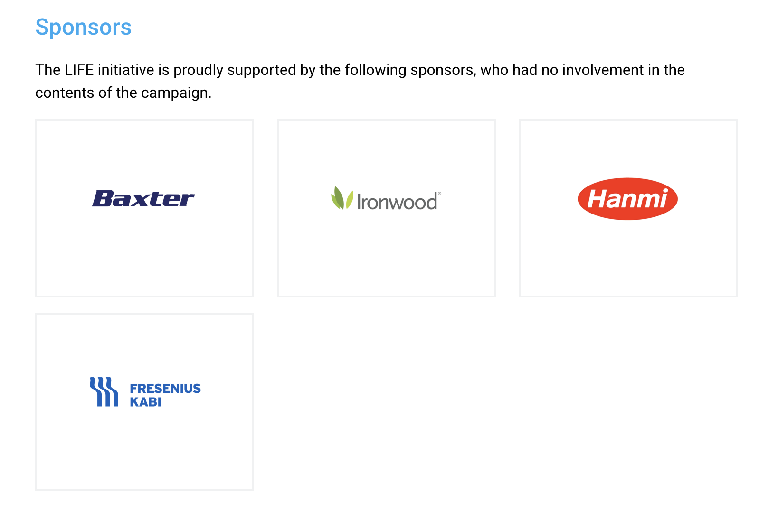
LIFE SPONSORS

Slide 7
LIFE 2025 TIMELINE
Q1 2025
Steering group
on-line meeting
Run IF survey
1F Day pilotage
Q2 2025
Steering group meeting ONCA Conference Athens
Survey results
Publish Policy toolkit for local and EU policymakers
Strenghten relationship with EURODIS & ERNica
Q3 2025
Steering group meeting ESPEN Congress
Publish results e.g.
IF Journal
Clinical Nutrition
Q4 2025
Malnutrition Awareness Weeks
Launch campaign brand and website IF Journal
1F Day Ambassadors on-line workshop
Policy brief

Slide 8
LIFE long–term AGENDA
RESEARCH ON PREVALENCE OF IF:
Conduct studies to understand how common Intestinal Failure (IF) is, identify causes, and assess its impact on patients.
EXPAND CAMPAIGN TO OTHER COUNTRIES AND EXPAND PROFESSIONAL NETWORKS:
Extend the current awareness and advocacy campaign to 7-10 more countries, adapting into local contexts and collaborating with local centres and organizations. Strengthen and expand networks of healthcare professionals and researchers both within and across countries to share knowledge and best practices.
CONNECT TO LOCAL AND EU POLICYMAKERS AND ADDITIONAL PATIENT ORGANISATIONS TO FURTHER STRENGTHEN NETWORK AND ADVOCACY:
Link more patient organizations to create a stronger support network and enhance joint advocacy efforts toward policymakers.
DEVELOP STRATEGY FOR IMPLEMENTING QUALITY STANDARDS:
E.g. Create and implement guidelines to ensure high-quality care for IF patients, such as training for healthcare providers and quality assessments.

Slide 9

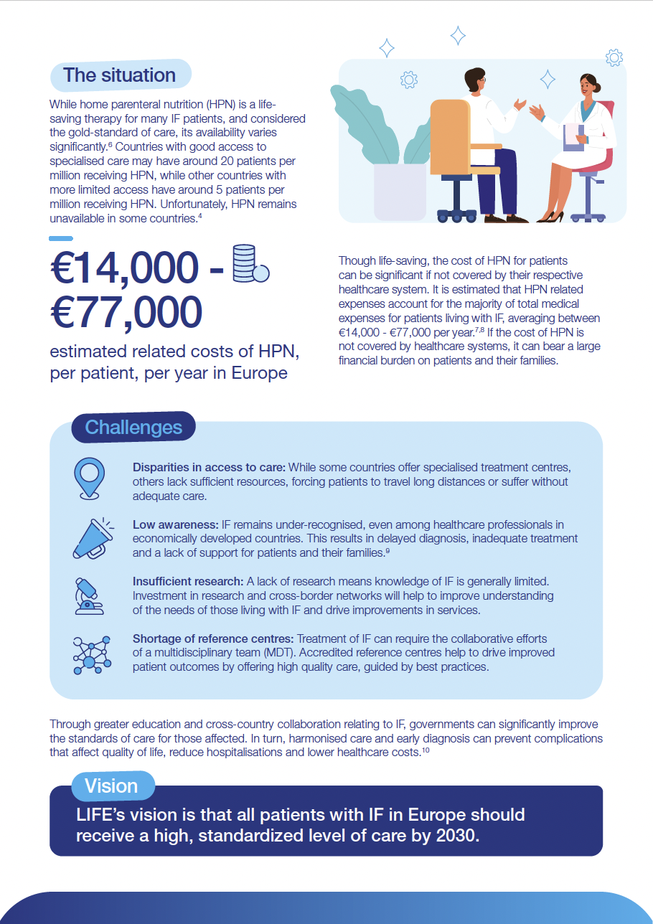
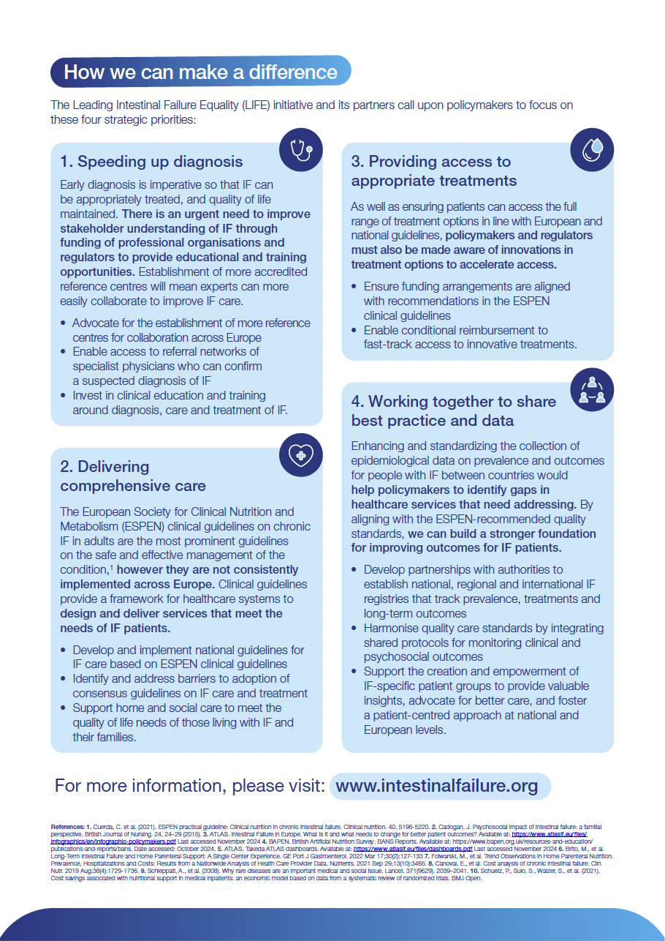
UPDATE ON MANIFESTO
Process
Overview of Manifesto content
Manifesto Objectives

Slide 10
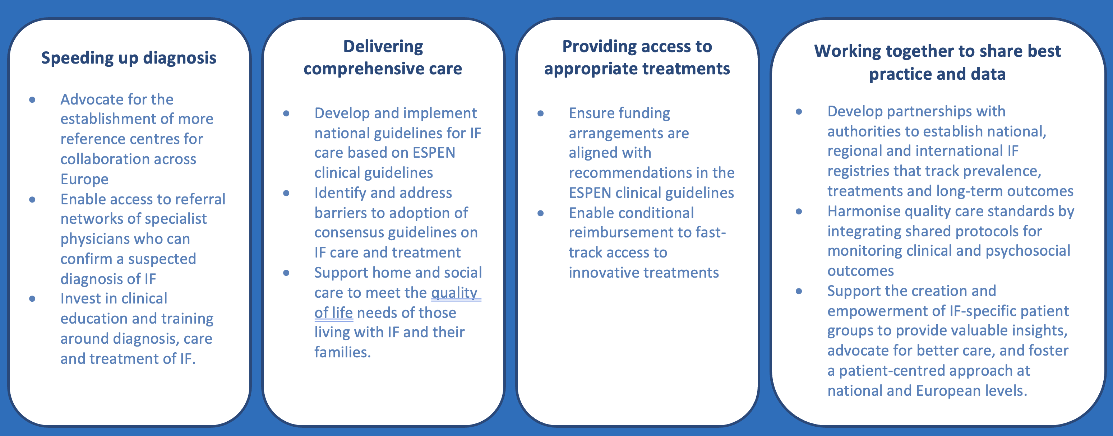
MANIFESTO RECOMMENDATIONS

Slide 11
FEEDBACK, BRAINSTORM
AND DISCUSSION

Slide 12
FEEDBACK, BRAINSTORM
AND DISCUSSION

Slide 13
FEEDBACK, BRAINSTORM
AND DISCUSSION

Slide 14
FEEDBACK, BRAINSTORM
AND DISCUSSION

Slide 15

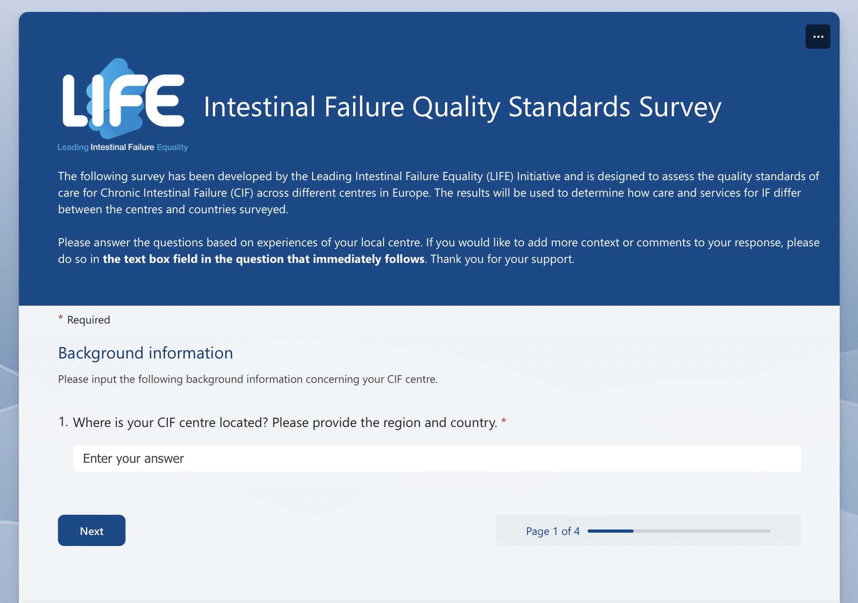
UPDATE ON SURVEY
Survey populated in Q1 2025
Analysis of results

Slide 16
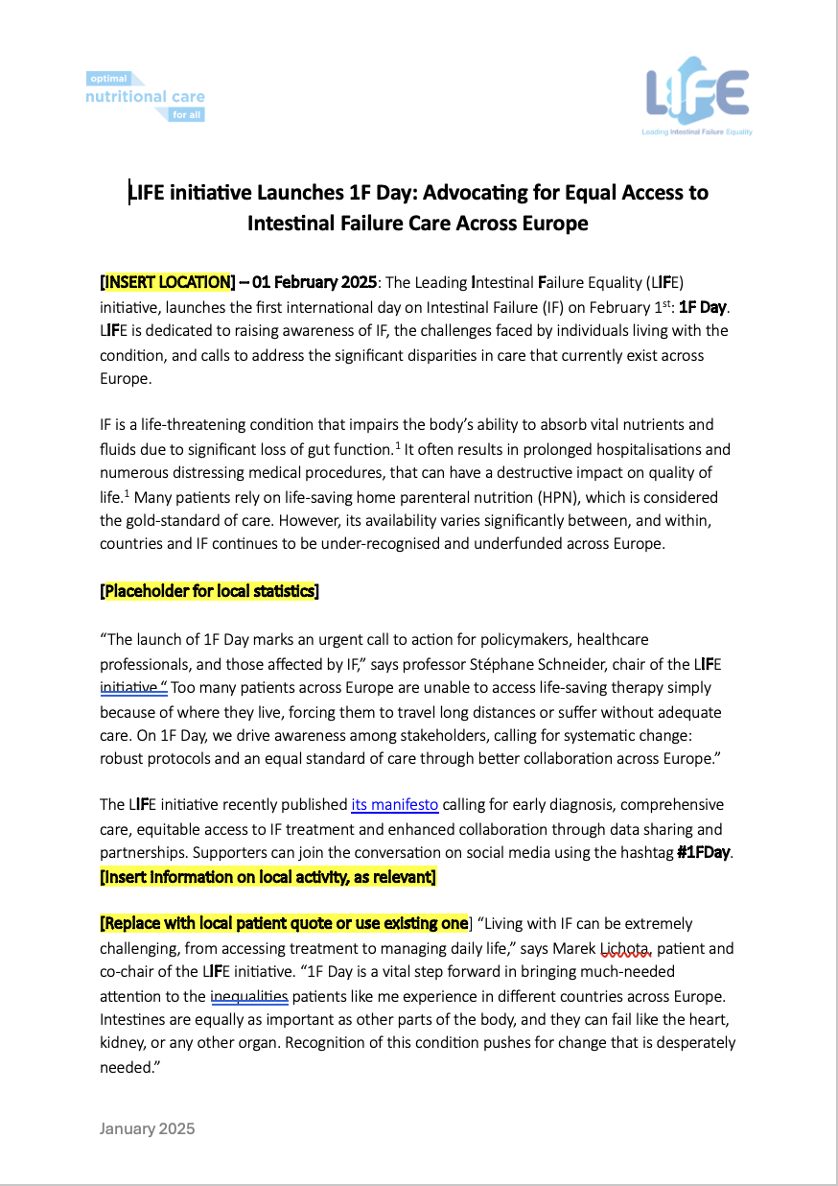




Poster
Press release
LIFE & 1F DAY
COMMUNICATION ACTIVITES
FOR 1F DAY 2025
Brand
Core messaging document
Webpage
Poster
Press release
Social media posts
Guidance document and email
LIFE landing page
Social post assets

Slide 18
LIFE & 1F DAY PLANS FOR 1F DAY 2026
LIFE 1F Day Ambassadors group
reference centres, gather feedback, coordinate activities, share best practices, keep momentum, on-line workshop September/October 2025 (mailing, WhatsApp, FB Group)
LIFE newsletter (Q2, Q3, Q4 2025 + Q1 2026 update & provide ideas, keep the fire burning :)
1F DAY 2026
Patients’ STORIES (reaching out to the reference centres, patients' organizations, reflect different needs and situation)
1F Day Communication (activities first week of January 2026,
press release social media posts, guidance document and email
Evaluation (gather impact and summary from country/local events, activities, create best practices document, make video/photo compilation)

Slide 19

FEEDBACK, BRAINSTORM AND DISCUSSION

Slide 20
Thank you

Slide 21
2024-2025 PLANNING (LONG TERM GOALS)

