Slide 1


Workshop:
Leveraging One Health to Drive Nutritional Care Policies for Patients
Flora Tiniakos
Nutrition Strategy Consultant
ASETA
Mary Yannakoulia
Professor of Nutrition and Eating Behavior
Harokopio University Athens Greece

Slide 2

Programme of the Workshop
Introduction
One Health
Discussion on how the principles of One Health could be integrated into the Nutrition care Policies and Processes
Our proposal
Discussion on the potential actions
EAT-Lancet Commission proposed actions
Discussion on the barriers and how to overcome the barriers in hospitals & community
Successful cases - Conclusions

Slide 3

Let’s introduce ourselves!

Slide 4
One Health

Slide 5
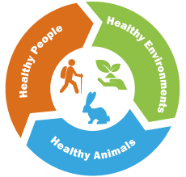
ONE HEALTH definition
One Health is an integrated, unifying approach that aims to
sustainably balance and optimize the health of humans, animals, plants and ecosystems. It recognizes the health of humans, domestic and wild animals, plants and the wider environment (including ecosystems) are closely linked and interdependent.
The approach mobilizes multiple sectors, disciplines and
communities at varying levels of society to work together to foster well-being and tackle threats to health and ecosystems, while addressing the collective need for clean water, energy and air, safe and nutritious food, taking action on climate change, and contributing to sustainable development.
One Health Joint Plan of Action 2022-2026. FAO, UN, WHO, WOAH

Slide 6
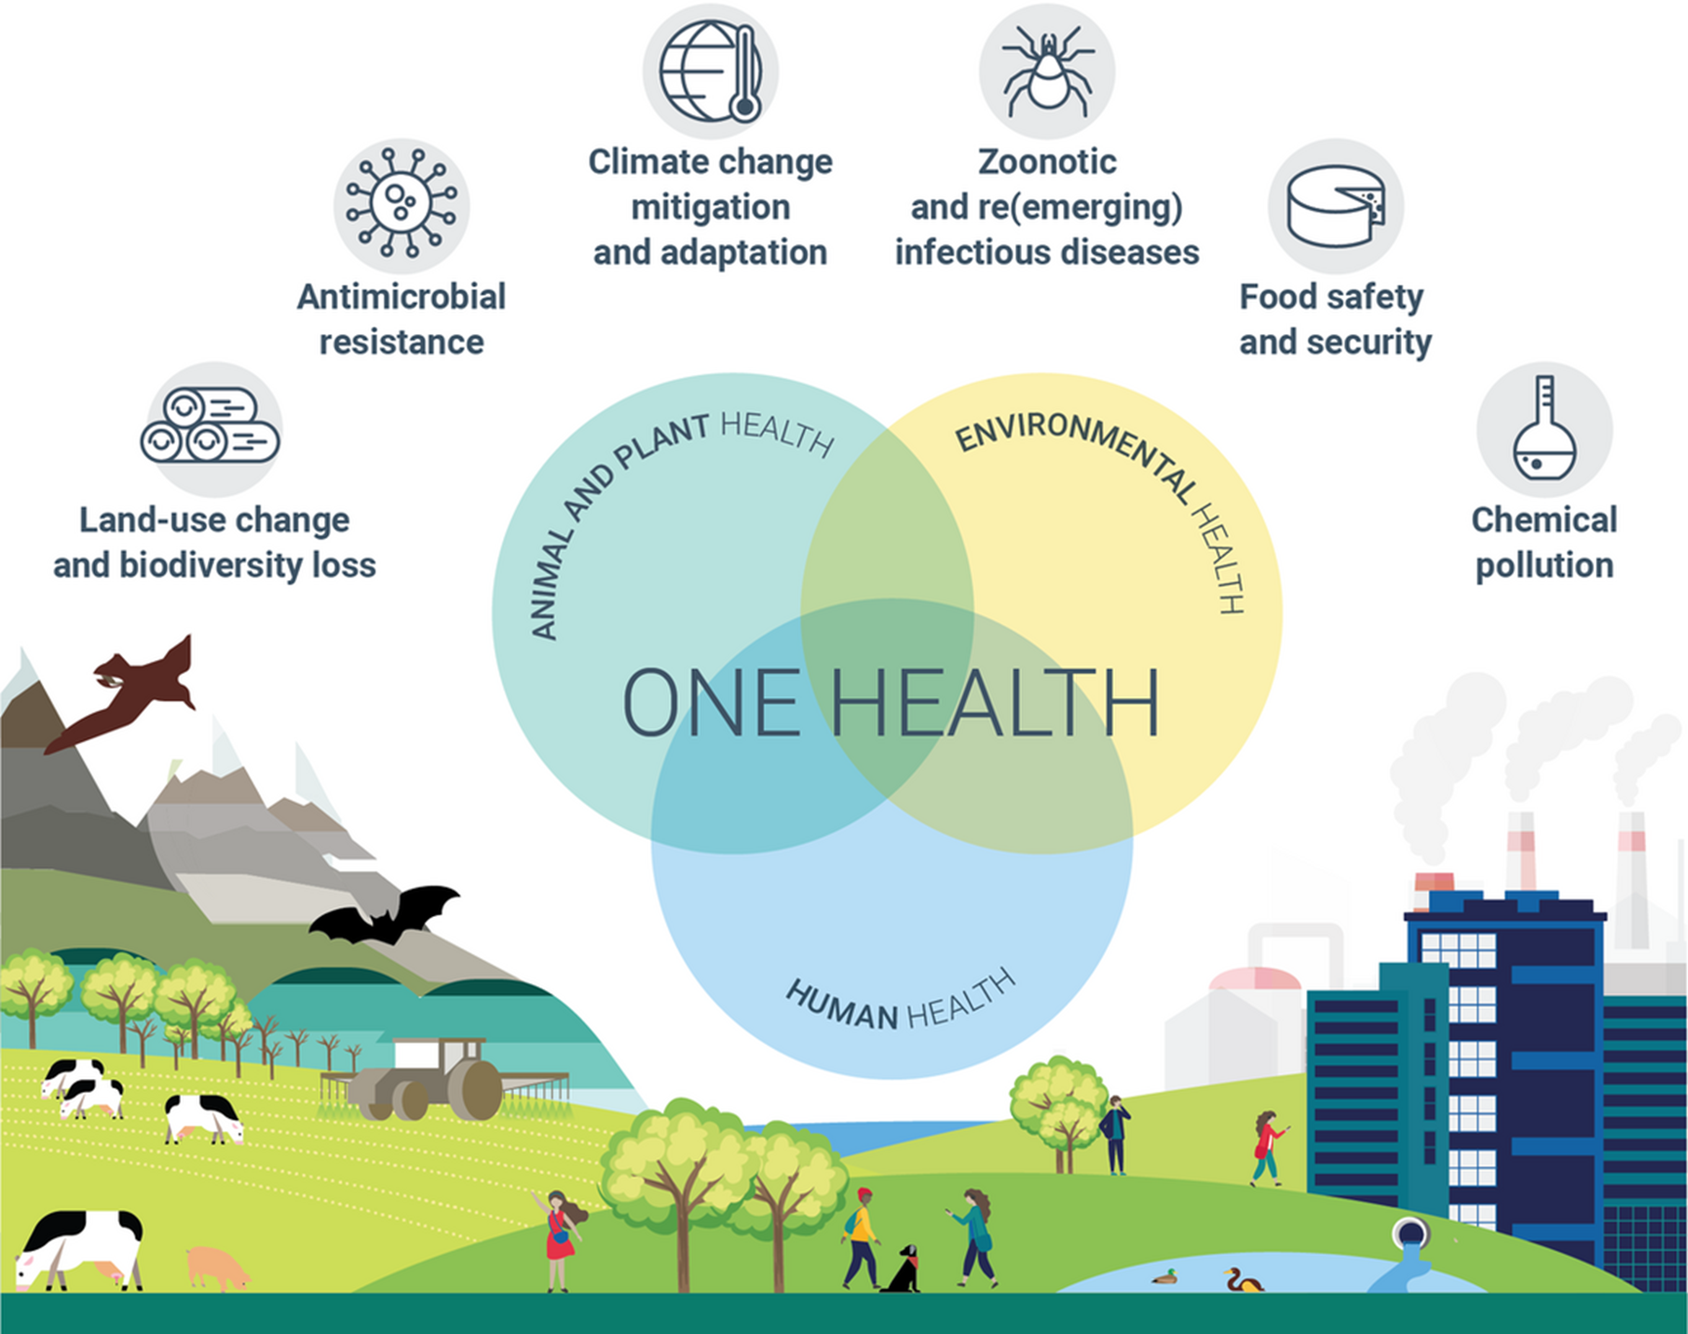
Applying the One Health approach
Serious health and environmental issues can be addressed and managed with the One Health approach
https://www.ecdc.europa.eu/en/one-health

Slide 7
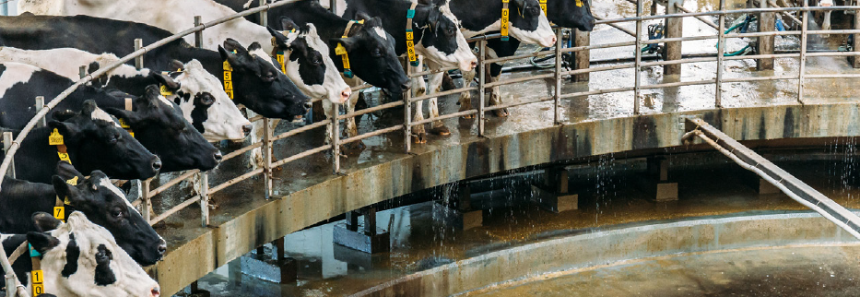
The Food system and its impact on One Health

Slide 8
Food production largely impacts the environment
Tackling what we eat, and how we produce our food, plays a key role in:
tackling climate change
reducing water stress and pollution
restoring lands back to forests or grasslands
protecting the world’s wildlife

Slide 9
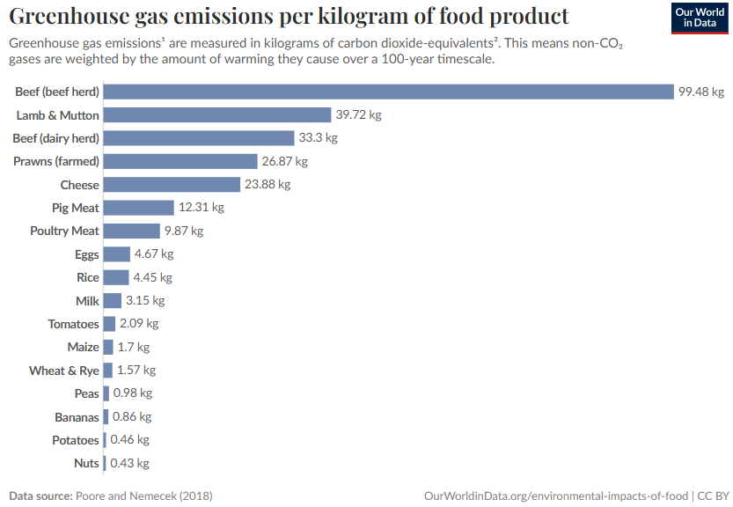
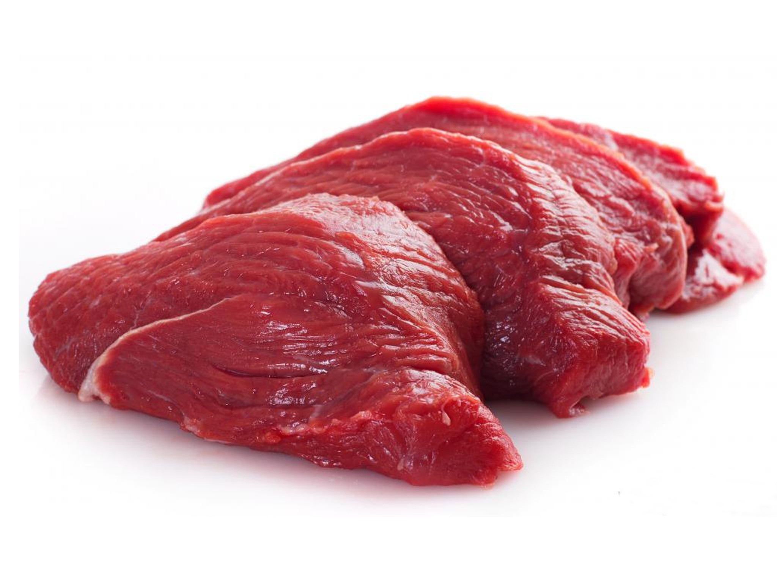
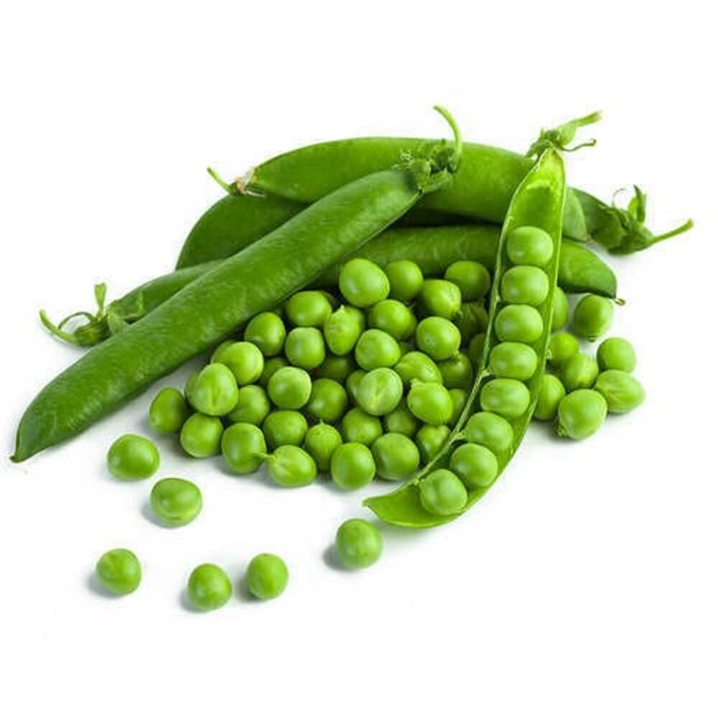
Meat & dairy tend to have a higher carbon footprint
x100 times more GHG emissions

Slide 10
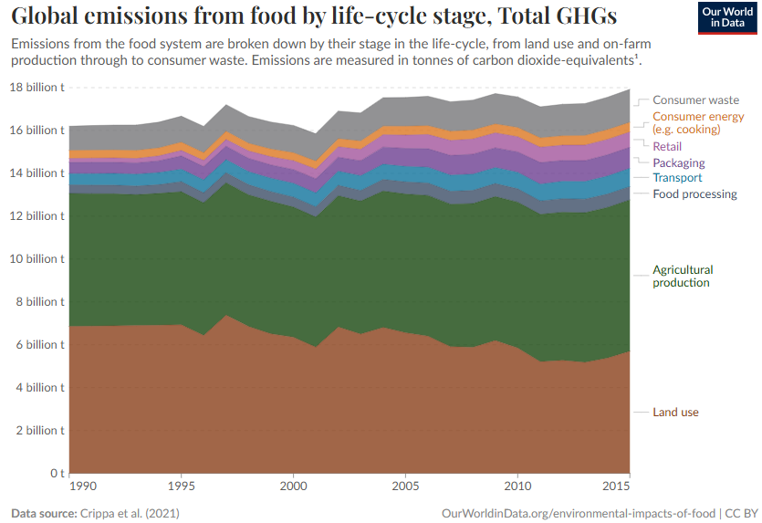
Production & land use impacts
Agricultural production and land use are the big drivers of food GHG emissions

Slide 11
Land use efficiency for global nutrition
80% of agricultural land is used for livestock pasture & feed production. This provides only 17% of global calories and 38% of global protein

Slide 12

The Food system needs to change for planet and human health, for ONE HEALTH

Slide 13
Let’s brainstorm on how the principles of One Health could be integrated into the Nutrition care Policies and Processes

Slide 14
How can we leverage One Health to Drive Nutritional Care Policies for Patients?

Slide 15
EAT-Lancet Commission
Brought together 19 Commissioners and 18 co-authors from 16 countries in various fields including human health, agriculture, political science and environmental sustainability
Aim:
to develop global scientific targets for healthy diets and sustainable food production that apply to all people and the planet and link diets with human health and environmental sustainability.

Slide 16

Lancet 2019; 393: 447–929
https://eatforum.org/about/

Slide 17
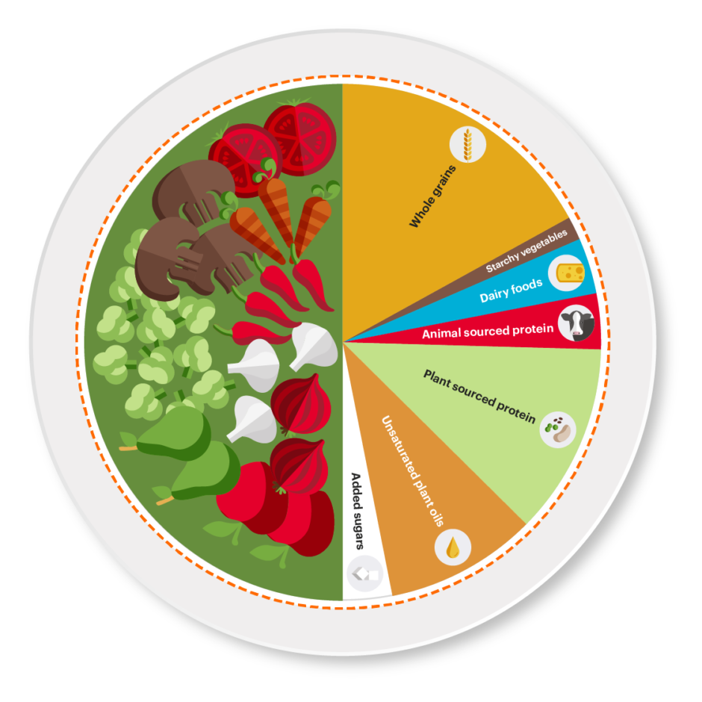

A Planetary health plate
Notes:
A planetary health plate should consist by volume of approximately half a plate of vegetables and fruits; the other half, displayed by contribution to calories, should consist of primarily whole grains, plant protein sources, unsaturated plant oils,
and (optionally) modest amounts of animal sources of protein.

Slide 18
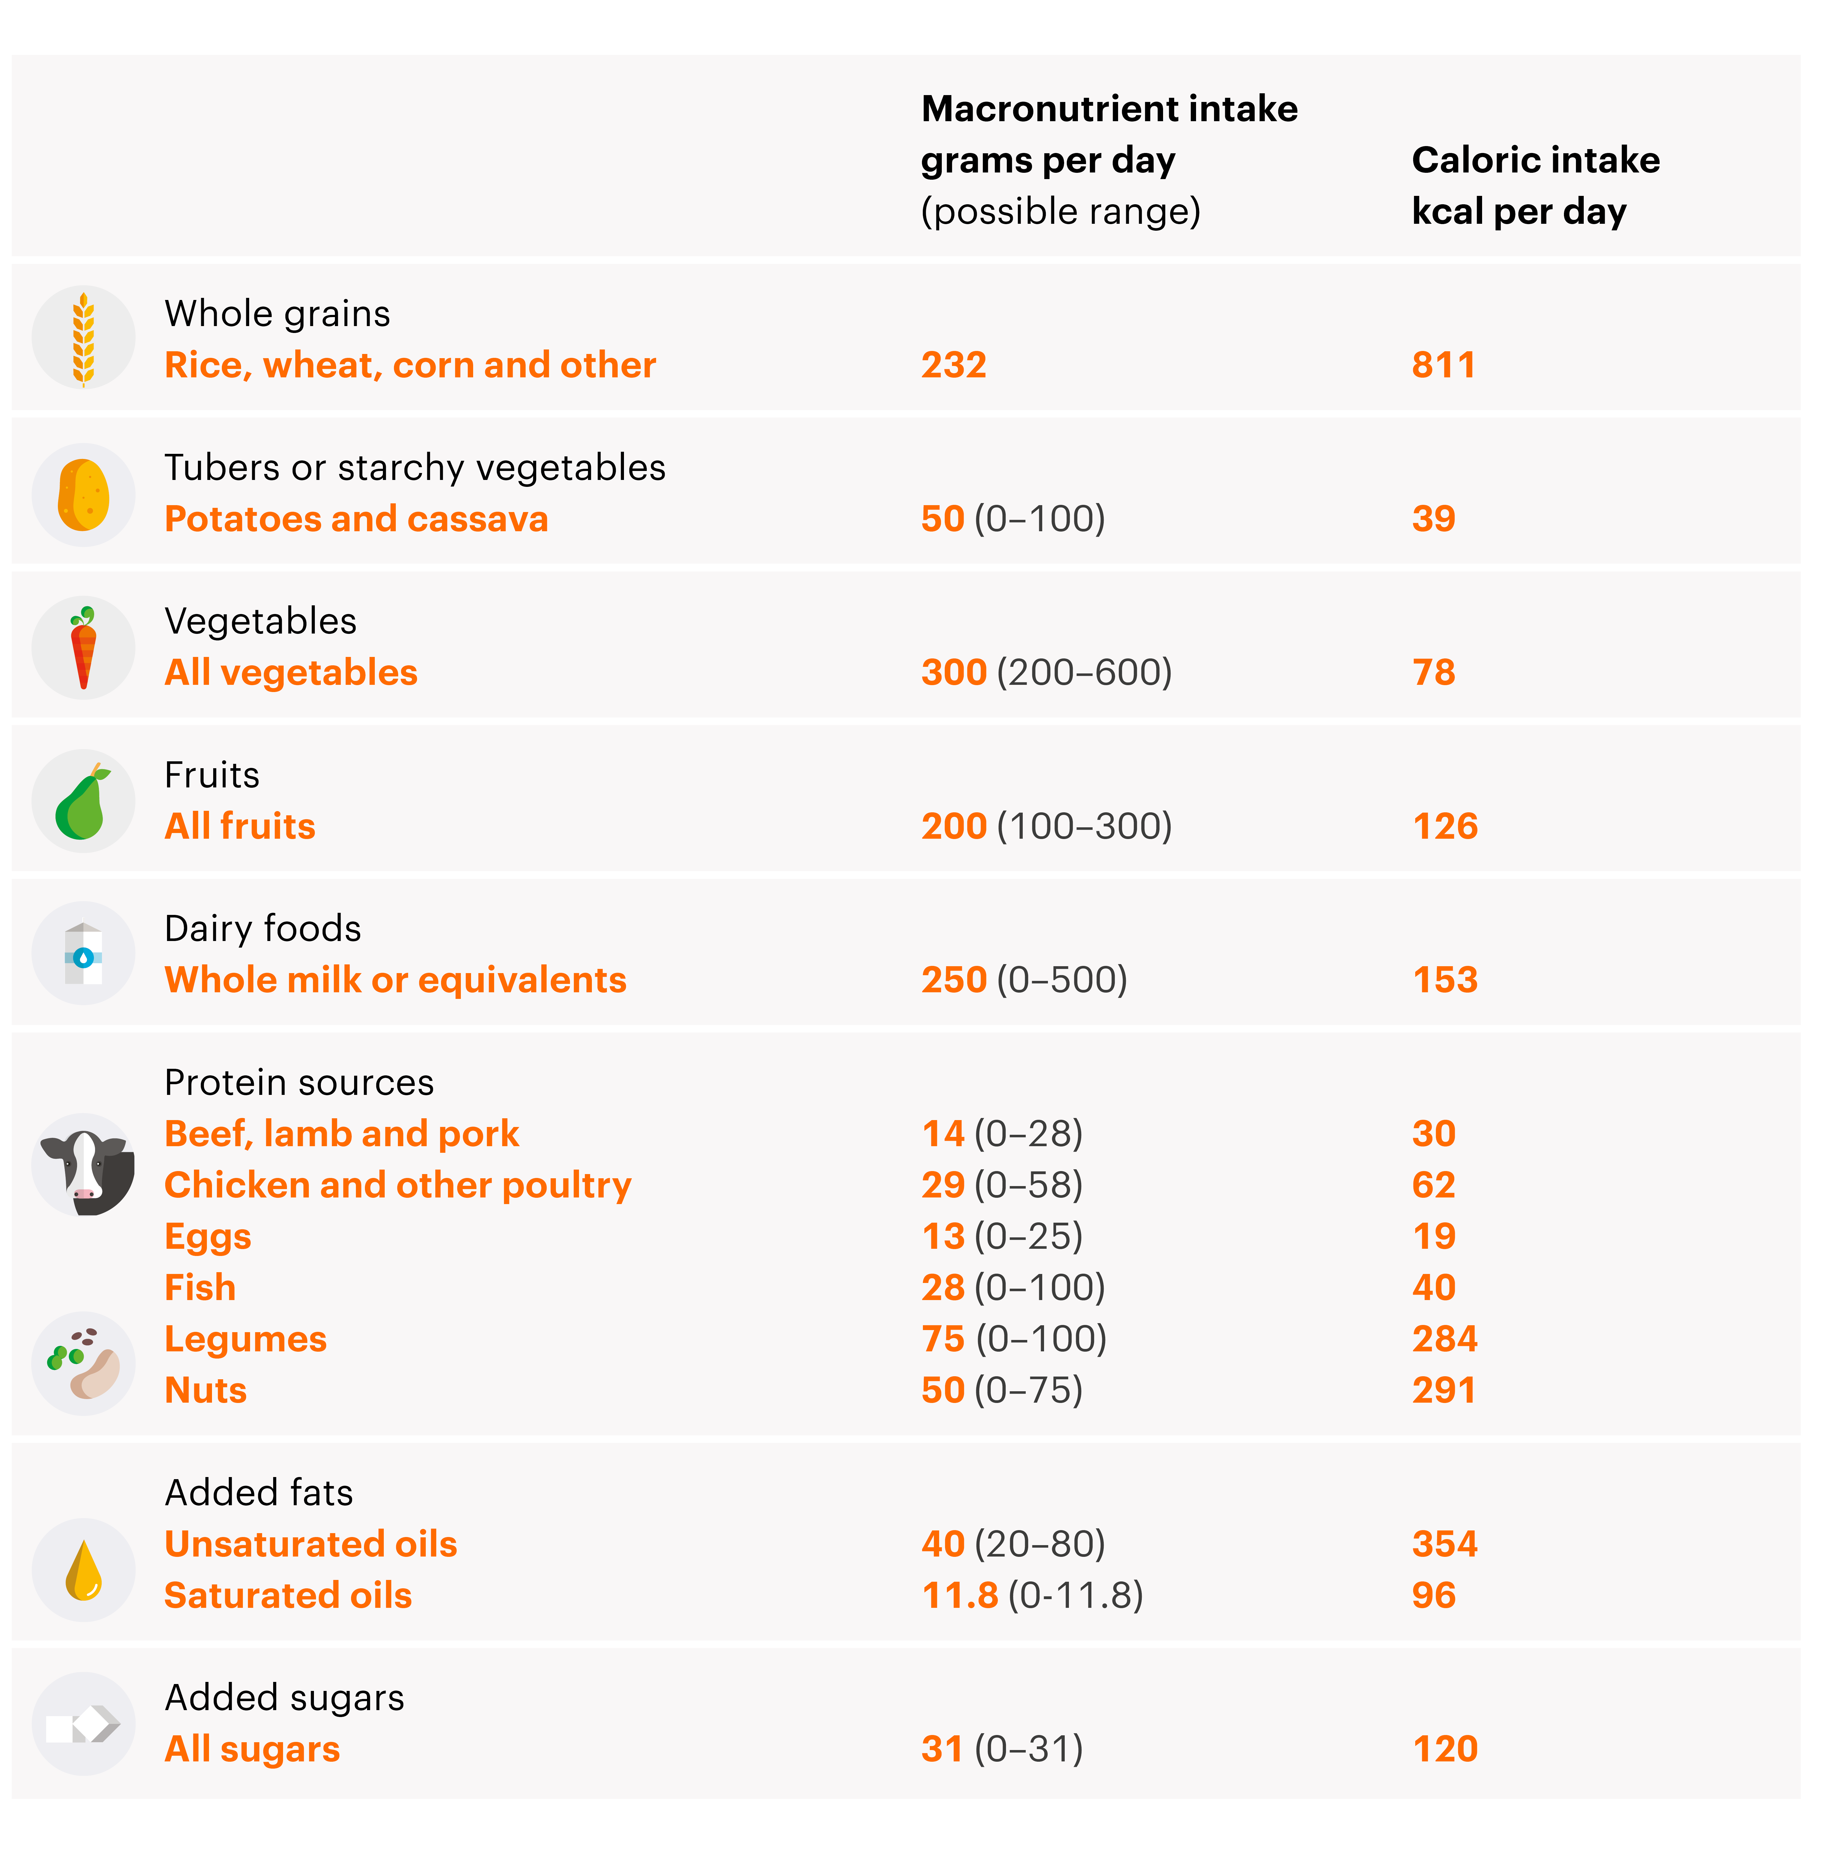
A Planetary diet
[scientific targets with possible ranges, for an intake of 2500 kcal/day]

Slide 19






Vegetarian diets
Vegan
Lacto-vegetarian
Ovo vegetarian
Lacto-ovo-vegetarian
Pescatarian
Flexitarian

Slide 20
The Mediterranean diet
A plant – based diet
Cereals (wholegrain), vegetables, legumes, fruits
Olive oil: the main dietary fat
Olives, nuts and seeds
Moderate amounts of dairy products (mainly cheese, then yogurt)
Low-moderate amounts of fish and poultry
Red meat in low amounts
Wine, consumed modestly, normally with meals

Slide 21
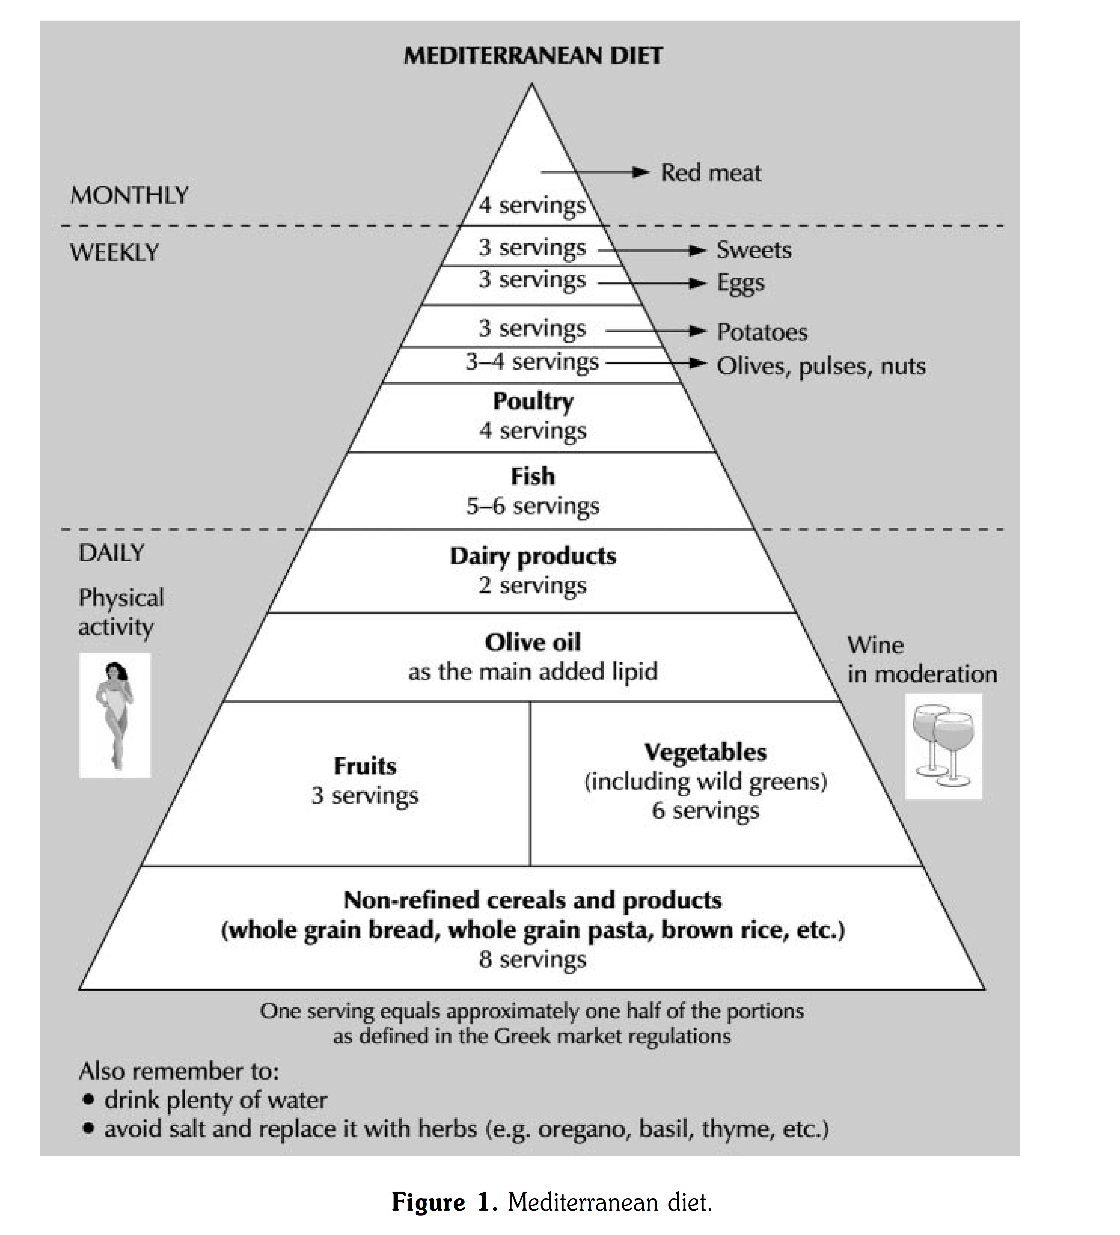
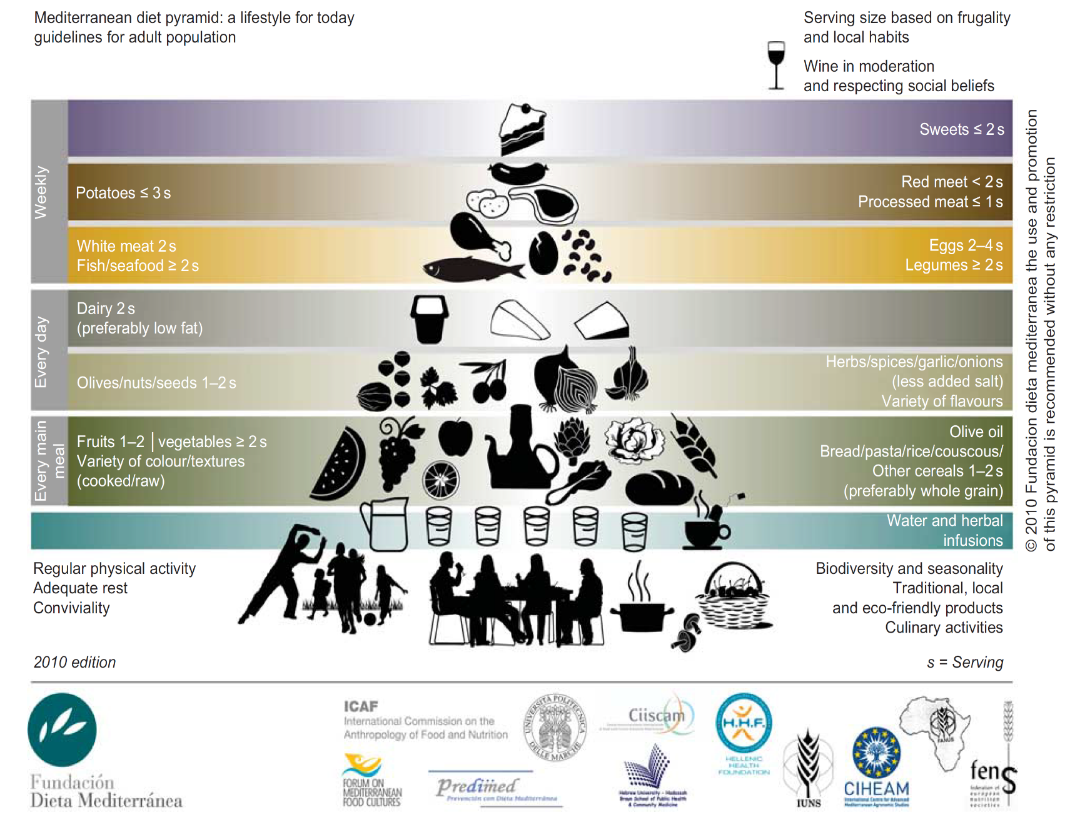
Supreme Scientific Health Council, Archives of Hellenic Medicine 1999

Slide 22
What actions should be undertaken?

Slide 23
EAT-Lancet Commission specific actions for
Health Professionals
Conduct dietary assessments by:
  Assessing individual diets as a standard clinical evaluation to address specific nutritional needs according to age, sex, comorbidities and physical activity levels, and with an added sensitivity toward the needs of vulnerable groups.
  Monitoring changes in individual diet quality over time continuously alongside their nutritional requirements.
Provide professional counsel by:
  Giving individuals and vulnerable groups dietary guidance and by encouraging breastfeeding and providing information on nutritional requirements for maternal and child healthcare.
  Promoting the planetary health diet while also giving special considerations to vulnerable groups such as expecting mothers, children and adolescents, and individuals suffering from chronic diseases.

Slide 24
Support education and training by:
  Actively partaking in education campaigns in schools and other public services to promote the planetary health diet.
  Including nutrition and food systems in the medical curricula.
Change food procurement practices by:
  Focusing on sustainably grown food to provide healthy foods and beverages from sustainable food systems to a high standard.
  Ensuring that food procurement and provision activities also minimize food waste and food loss in healthcare facilities.
Drive advocacy efforts by:
  Promoting this agenda in advocacy surrounding the medical profession and in medical communities including medical associations, unions and colleges.
  Setting up guidelines based on the planetary health diet that are applicable to local communities and ensuring the implementation of such guidelines.
  Encouraging and supporting increased collaboration between healthcare professionals such as physicians and dieticians and between actors across different sectors including food, agriculture, environment and health.

Slide 25
EAT-Lancet Commission specific actions for
Policy Makers
Embrace what works and innovate where more action is needed by:
  Recognizing that there is no silver bullet solution to current food system challenges - multi-faceted interventions
  Developing guidelines based on the planetary health diet and supporting the implementation of these guidelines through regulatory efforts
  Enabling access to planetary health diets by increasing the affordability of healthy and sustainably produced foods and by reviewing policies
  Ensuring that vulnerable groups have the economic resources to remain food secure.
  Renewing national efforts to restrict advertising and marketing of unhealthy and unsustainable foods targeted towards children, youth and other vulnerable groups, and by supporting a positive reinforcement of planetary health diets.
  Applying effective food labeling laws and regulations to inform consumers
  Engineering agricultural policies toward a greater emphasis on nutritious foods and sustainable food production practices
  Designing public policies and innovations that will contribute toward achieving at least an overall 50% reduction in food loss and food waste by 2030
Provide leadership and commitment by:
  Demonstrating political leadership in setting national food system strategies and initiatives with attainable targets accordingly and by implementing monitoring and reporting mechanisms to measure progress.
  Addressing the different socioeconomic and political drivers of food through the full range of policy levers from “soft” (e.g. voluntary commitments) to “hard” (e.g. legislation) to advance the planetary health diet.
  Using the range of ministerial and departmental portfolios to ensure coherent food system actions.

Slide 26
Create novel governance arrangements by:
  Adopting a multi-sectoral approach -- all levels of governance and a broad range of actors
  Empowering departments to recognize synergies in their mandates and enabling cross-departmental collaboration
  Working to establish international land use and ocean governance and management mechanisms
Enable cost-effective financing by:
  Implementing fiscal policies -- taxation and food subsidies
  Establishing financial incentives to help reduce food waste and food loss.
  Designing or strengthening social protection systems to protect vulnerable population groups
  Engaging with donors alongside multilateral organizations to create dedicated funding streams and programs that will support sustainable food system transformation
Champion advocacy and education efforts by:
  Complementing other policy measures with public education campaigns
  Embedding healthy and sustainable food education into national school curricula.
  Ensuring that all certified health professionals have a demonstrable level of competence surrounding planetary health diets.
  Training and equipping food producers with both the knowledge and skills to deliver healthy and sustainable food options and by creating “win-win” interventions through building novel collaborative relationships.

Slide 27
EAT-Lancet Commission specific actions for Food Service Professionals
Change culture by changing menus
Emphasize the benefits of dietary shifts
Explore new foods and mix up menus
Lead with messaging around flavor
Work with suppliers and consumers
Focus on both quality and quality
Waste not, want not
Let plants take center stage
Embrace cultural food influences
Bring biodiversity to the table
Share the farmer’s story

Slide 28
What are the barriers?

Slide 29
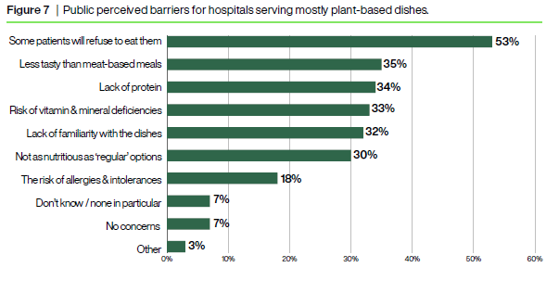
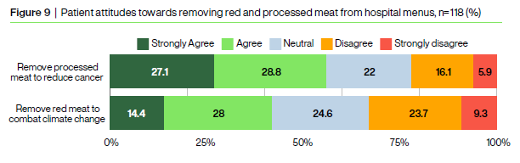
Attitudes towards plant-based diets in hospitals
OnePoll consumer survey of 2000 UK adults, 2024
Attitudes of hospital patients regarding removal of processed and unprocessed red meats from menus to support sustainable healthcare targets: A single-centre survey. M. Truman et al. Lifestyle Medicine. 2023

Slide 30
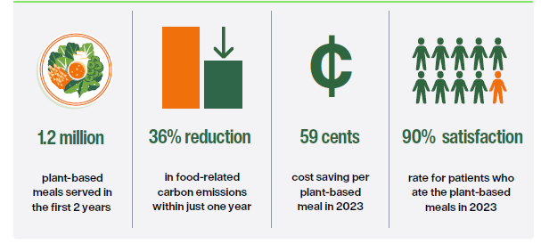

Successful implementation of plant-based nutrition in Hospitals
Successful implementation of plant-based menus as
the default option in all 11 public hospitals NYC Health + Hospitals.
Patients still have the choice to request a meat-based option.
An Innovative Program for Hospital Nutrition. S. Morgenstern et al. American Journal of Lifestyle Medicine. 2024

Slide 31
Conclusions

Slide 32


